Slide 1
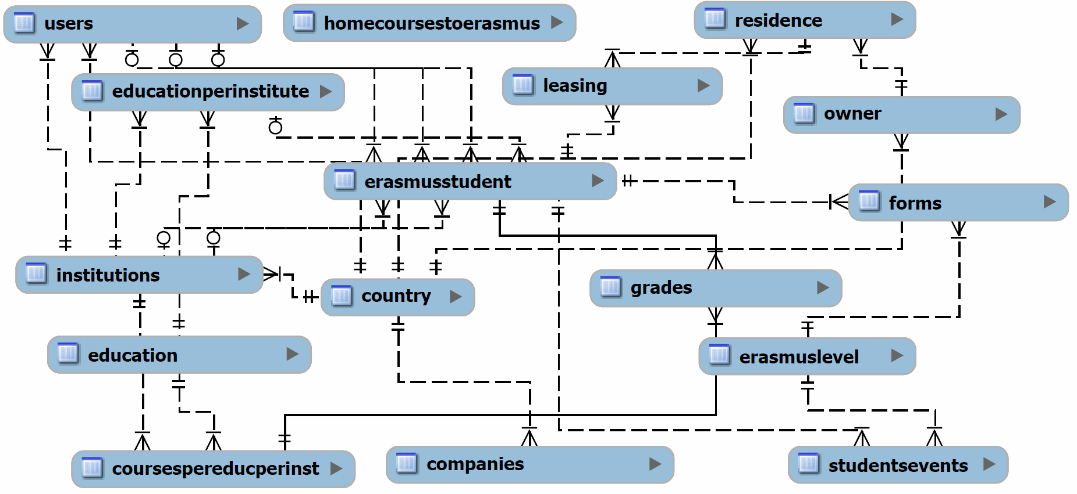
P1 – Config (Data Management)
MySQL Database and UTF8 Charset
Data is stored in 16 tables
Table 'erasmusstudent' coordinates whole workflow
Table 'studentsevents' coordinate erasmus process
Notes:
Kurzer überblick über Datenbank MySQL und Aufbau
Erklärung des Bildes
Studentsevents in combination with erasmuslevels

Slide 2
P1 – Config (User Management)
All information stored in table 'users'
Six different roles give access to different parts of the application
Public mask for easy registration

Slide 3
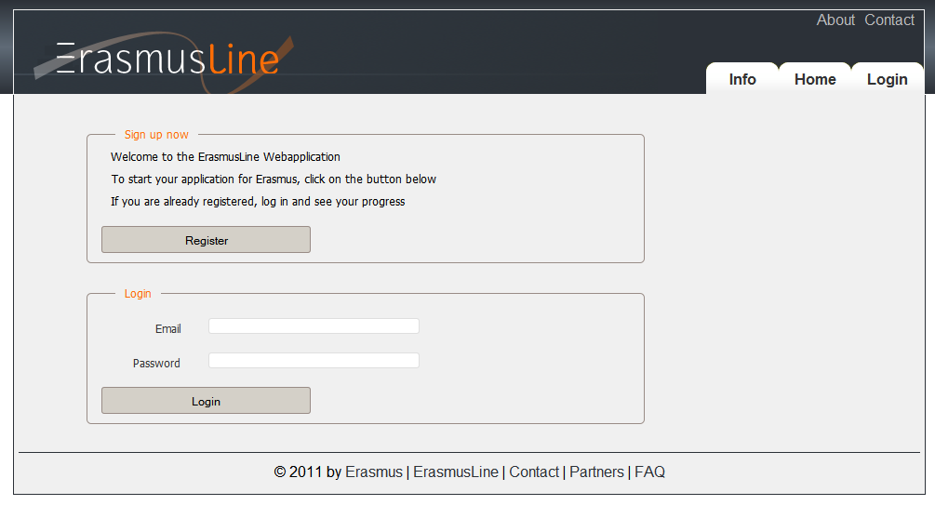
P1 – Config (Page Layout)
Using Plonk as PHP Framework
Created two page layouts to vote for
Decision came to the more discreet layout
Notes:
Plonk is created by the belgium coordinator
Page is 980 pixel wide

