Slide 1
ErasmusLine
Presentation
Orange Team
MUTW final meeting
Crete, 2011

Slide 2
Agenda
Presentation of all developed modules:
  P1-CONFIG (Germany)
  P2-INFOX (Germany)
  P3-ALERT (Bulgaria)
  P4-OUT (Belgium)
  P5-IN (Greece)
  P6-EXAM (Bulgaria)
  P7-MATCH (Iceland)
  P8-STATS (Portugal)
Demonstration of the ErasmusLine Application
Discussion

Slide 3
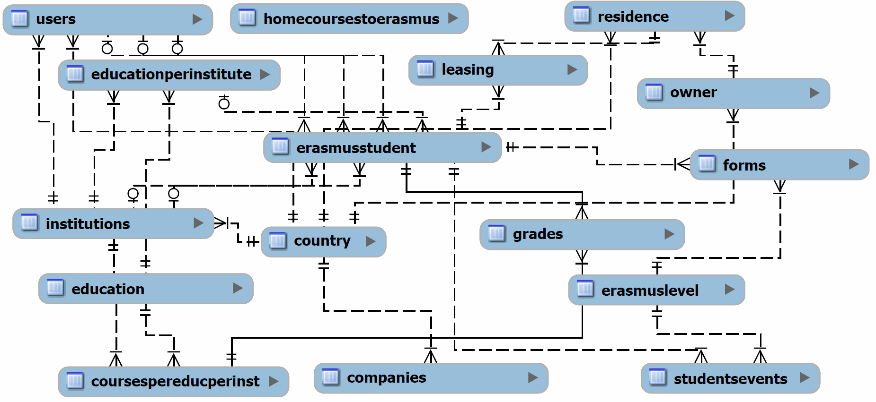
P1 – Config (Data Management)
MySQL Database and UTF8 Charset
Data is stored in 16 tables
Table 'erasmusstudent' coordinates whole workflow
Table 'studentsevents' coordinate erasmus process
Notes:
Kurzer überblick über Datenbank MySQL und Aufbau
Erklärung des Bildes
Studentsevents in combination with erasmuslevels

Slide 4
P1 – Config (User Management)
All information stored in table 'users'
Six different roles give access to different parts of the application
Public mask for easy registration

Slide 5
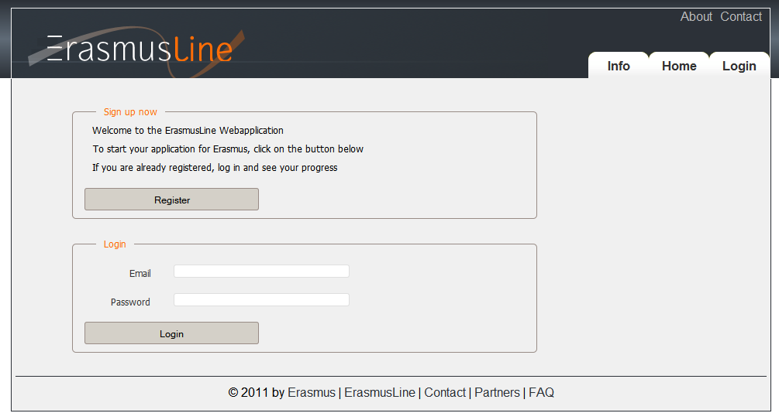
P1 – Config (Page Layout)
Using Plonk as PHP Framework
Created two page layouts to vote for
Decision came to the more discreet layout
Notes:
Plonk is created by the belgium coordinator
Page is 980 pixel wide

Slide 6
P2 – INFOX (Data Transfer)
Goal:
  Transferring information and files between institutions
  Keeping it simple and easy to use
  Deploying an interface for other modules
Used technologies:
  PHP
  cURL library
  JSON

Slide 7
P2 – INFOX (Security)
Goal:
  Encryption of all transferred data
  Secure transfer between institution
  Restricted to authorized users only
Used technologies:
  3DES encryption standard
  Server sided SSL encryption with HTTPS

Slide 8
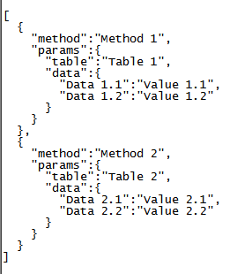
P2 – INFOX (Example)
Data transfer expects three arrays for creating the JSON string

Slide 9
Alerts module: P3 - ALERTS
  Problem solved:
    module, which checks death lines and sends emails acording the control.
  Used technologies:
    Programming language – PHP
    Database managment system – MySQL.

Slide 10
MODULE LOGIC
Once started deamon checks death lines.
Daemon reads information for deathlines from the database.
If there is detected expiration, the daemon sends emails.
Daemon is running once a day every day.

Slide 11

Outgoing Students: P4-OUT
Research
  Form Validation
    Client-side (JavaScript / jQuery)
    Server-side (PHP)
  Automatic form completion
    jQuery → PHP
  Database
    erasmusLevel
    forms
    studentEvents
Notes:
The P4-OUT module: Before we could start implementing the different forms regarding our modules, we needed to deside which library’s we were going to use.
We needed 2 form validation librarys, one for the client side, so JavaScript/jQuery and one for the server side, so PHP. Also, we thought that it would be usefull to search for a jQuery plugin/library, which made it possible to complete parts of the form. For example, if a student searches for his name, his email and so on are automaticaly filled in in the form. For the flow between the different forms, we mostly used the erasmusLevel, forms and studentEvents tables of the database.

Slide 12

Implementation
Form validation
  jQuery (jQuery validation engine)
  PHP (Benjamin Keen validation engine)
Notes:
Now for the implementation of the forms. For the client side form validation, so Javascript/jQuery, we used the jQuery validation Engine. This engine uses instant formchecking, there where most of the other libraries we examined only validate the form when it’s sent. So the user is direcly informed about a bad input. Also is it not so difficult to use this engine, as you can see here. This is the input field for a required emailfield. You just have to give right attributes to the class of the input field. Also, it is very easy to extend the library with your own rules.
For the server side form validation, we used the Benjamin Keen validation Engine, The reason we chose this library is that is not only has a good form validation, but also form persistence. For example, if a user inserts a bad value and the info is sent to the server, the user returns to the form, but he has to refill all the input fields engine. When using this library, all the fields are automaticaly field in again, which is very user friendly.

Slide 13
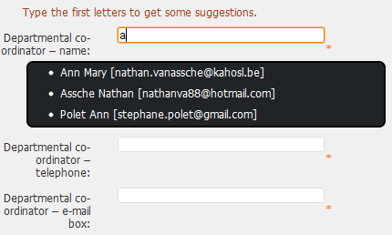
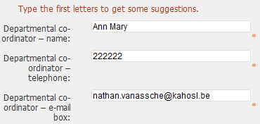
Implementation
Automatic form completion
Notes:
Another important part of the application was to make it possible to fill in the forms more quickly. This could be done by autofilling the forms. There are 2 ways of doing this. The first done while loading a certain form and then data is automatically loaded in the fields.
Or by typing the first letters in an inputfield (for example for a user). Based on that input suggestions are given and when you select one, the associated info (for example telephone number) is being automatically filled in.

Slide 14
Flow
erasmusLevel:
  Precandidate → Student Application &
  Learning Agreement → …
action:
  0 : Denied – 1 : Approved - 2 : Pending
forms:
  Most forms saved as JSON in forms table
  Most important values saved in database
studentsEvents
Notes:
To go through the erasmus proces it’s necessary to have a certain flow in the administration proces. To do this, it was necessay to set up

Slide 15
InComing Students:P5-IN
Forms to be filled
Learning Agreement Changes, Accomodation Registration(students) - Certificates of stay/arrival/departure, Transcript of Records(coordinators)
Programming Language
HTML,Javascript, jQuery, PHP, MySQL

Slide 16
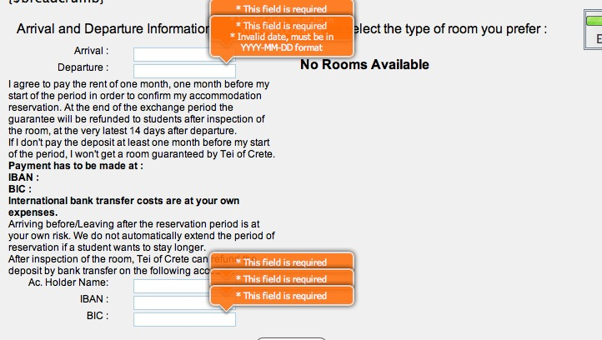
P5-IN
Validation
jQuery , PHP

Slide 17
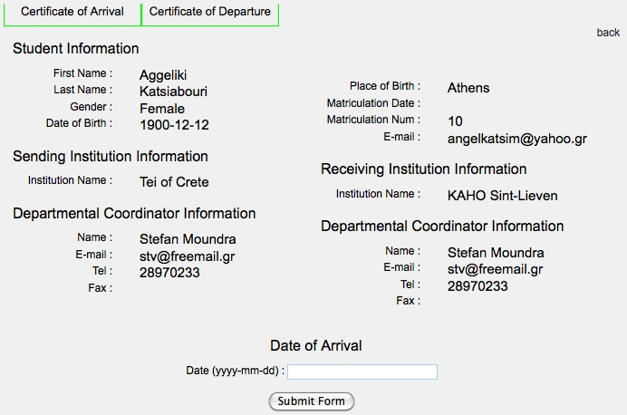
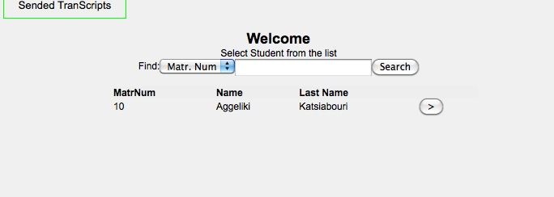
P5-IN
Store - Pull Data
pull from tables(Database)

Slide 18
Exams module: P6-EXAMS
  Problems solved:
    implementation of the module for students;
    implementation of the module for coordinators to use it;
  Used technologies:
    Programming language – PHP
    Database managment system – MySQL
    Library – Plonk.
  User interface - easy to use.

Slide 19
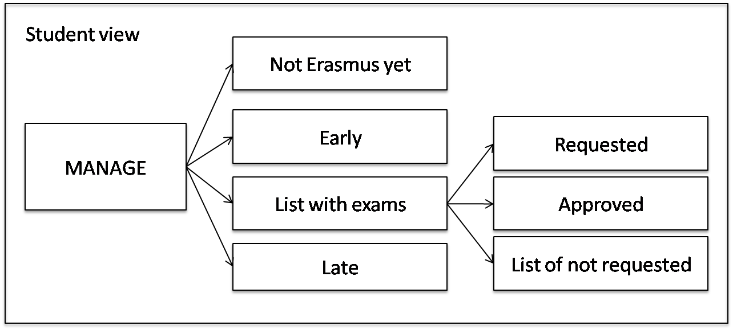
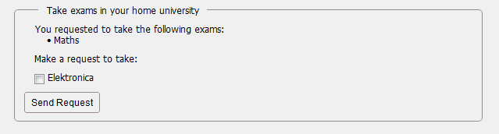
Student view

Slide 20
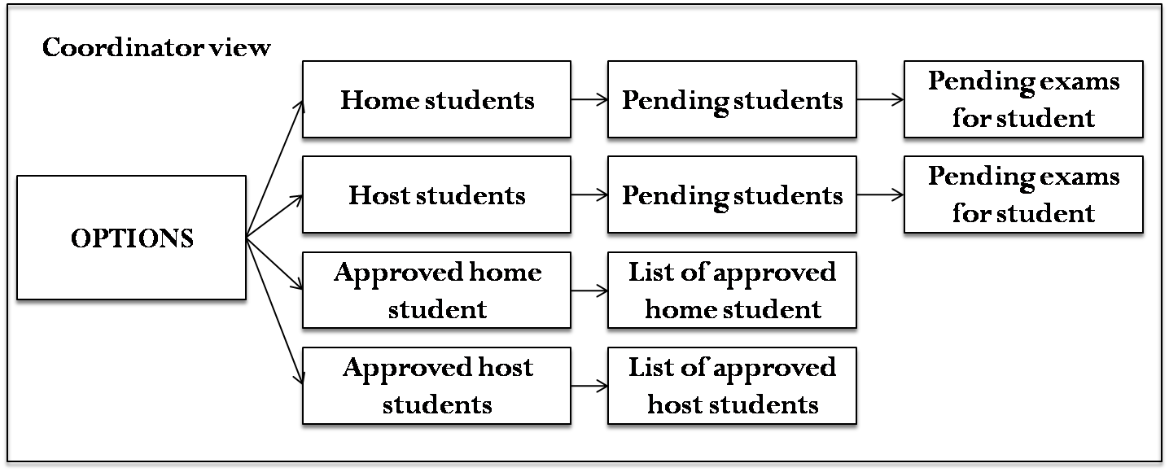
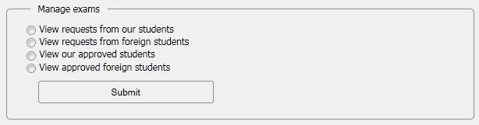
Home/host coordinator view

Slide 21
P7-MATCH
Integration to the application missing
Responsible students didn't appear at the final meeting

Slide 22
Statistical Core: P8-STATS
Decision Support visual tools
Measure Key Performance Indicators for Efficiency, Efficacy
Extract business information from the Erasmus process workflow
Decisions:
  Parallel processing – Availability
  Easy to use Interface w/ Client-Side App
  Separate Data Marts / Servers – Load Balance
  *nix systems – Performance / Open Source
  One file defines KPI / Dimensions / Measures

Slide 23
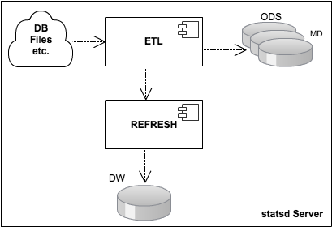
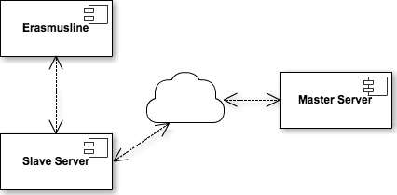
Implementation - Deployment
Server scheduled refreshment
Slaves send data to Master's Task queue, b.g. execution
Aggregated data is joined to DW, no locking
JSON-RPC Communication
Efficacy data is requested from the Master Server
Local or remote communication via configuration file

Slide 24
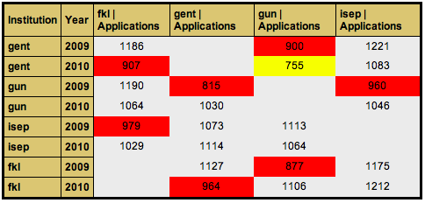
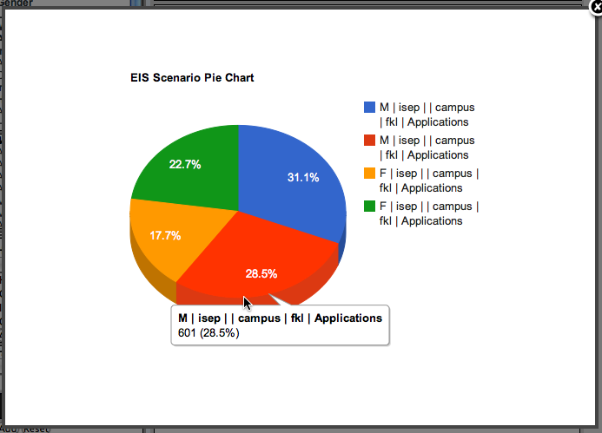
EIS User Interface
Select KPI, add Dimensions / Measures to columns <-> rows
Drill-Down / Roll-Up flexibility
Filter results by list of values
Highlight, Save, Export, Print...
Pivot Tables
Pie Charts
Bar Charts
Line Charts

Slide 25
Conclusion
We developed a good prototype which is very flexible to modify and improve
Communicating in three different timezones is sometimes hard to manage
Putting together all our knowledge enabled us to achieve most of the project goals and was a great experience in multicultural teamwork

Slide 26
ErasmusLine
Demonstration

