Slide 1
Statistical Core: P8-STATS
Decision Support visual tools
Measure Key Performance Indicators for Efficiency, Efficacy
Extract business information from the Erasmus process workflow
Decisions:
  Parallel processing – Availability
  Easy to use Interface w/ Client-Side App
  Separate Data Marts / Servers – Load Balance
  *nix systems – Performance / Open Source
  One file defines KPI / Dimensions / Measures

Slide 2
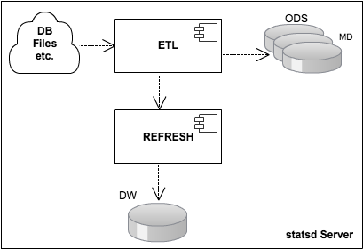
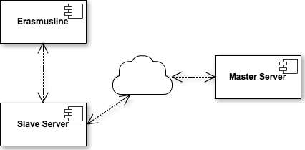
Implementation - Deployment
Server scheduled refreshment
Slaves send data to Master's Task queue, b.g. execution
Aggregated data is joined to DW, no locking
JSON-RPC Communication
Efficacy data is requested from the Master Server
Local or remote communication via configuration file

Slide 3
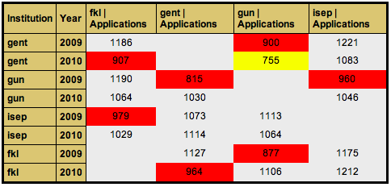
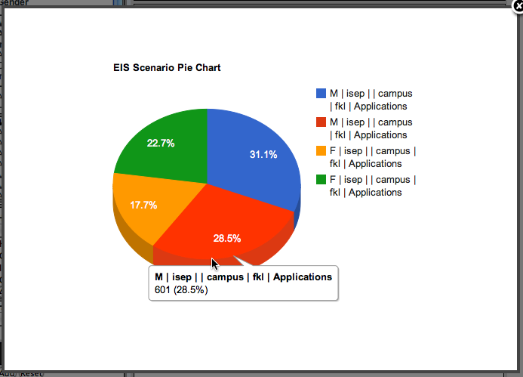
EIS User Interface
Select KPI, add Dimensions / Measures to columns <-> rows
Drill-Down / Roll-Up flexibility
Filter results by list of values
Highlight, Save, Export, Print...
Pivot Tables
Pie Charts
Bar Charts
Line Charts

