Slide 1
P2 – INFOX (Data Transfer)
Goal:
  Transferring information and files between institutions
  Keeping it simple and easy to use
  Deploying an interface for other modules
Used technologies:
  PHP
  cURL library
  JSON

Slide 2
P2 – INFOX (Security)
Goal:
  Encryption of all transferred data
  Secure transfer between institution
  Restricted to authorized users only
Used technologies:
  3DES encryption standard
  Server sided SSL encryption with HTTPS

Slide 3
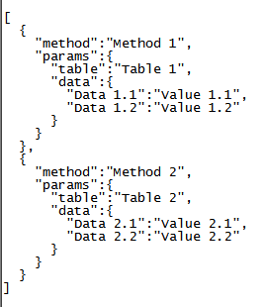
P2 – INFOX (Example)
Data transfer expects three arrays for creating the JSON string

