Slide 1

Outgoing Students: P4-OUT
Research
  Form Validation
    Client-side (JavaScript / jQuery)
    Server-side (PHP)
  Automatic form completion
    jQuery → PHP
  Database
    erasmusLevel
    forms
    studentEvents
Notes:
The P4-OUT module: Before we could start implementing the different forms regarding our modules, we needed to deside which library’s we were going to use.
We needed 2 form validation librarys, one for the client side, so JavaScript/jQuery and one for the server side, so PHP. Also, we thought that it would be usefull to search for a jQuery plugin/library, which made it possible to complete parts of the form. For example, if a student searches for his name, his email and so on are automaticaly filled in in the form. For the flow between the different forms, we mostly used the erasmusLevel, forms and studentEvents tables of the database.

Slide 2

Implementation
Form validation
  jQuery (jQuery validation engine)
  PHP (Benjamin Keen validation engine)
Notes:
Now for the implementation of the forms. For the client side form validation, so Javascript/jQuery, we used the jQuery validation Engine. This engine uses instant formchecking, there where most of the other libraries we examined only validate the form when it’s sent. So the user is direcly informed about a bad input. Also is it not so difficult to use this engine, as you can see here. This is the input field for a required emailfield. You just have to give right attributes to the class of the input field. Also, it is very easy to extend the library with your own rules.
For the server side form validation, we used the Benjamin Keen validation Engine, The reason we chose this library is that is not only has a good form validation, but also form persistence. For example, if a user inserts a bad value and the info is sent to the server, the user returns to the form, but he has to refill all the input fields engine. When using this library, all the fields are automaticaly field in again, which is very user friendly.

Slide 3
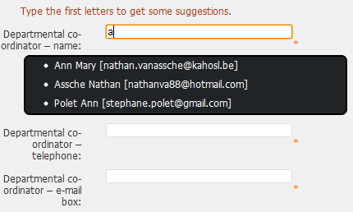
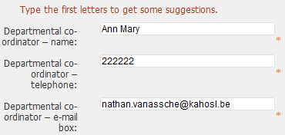
Implementation
Automatic form completion
Notes:
Another important part of the application was to make it possible to fill in the forms more quickly. This could be done by autofilling the forms. There are 2 ways of doing this. The first done while loading a certain form and then data is automatically loaded in the fields.
Or by typing the first letters in an inputfield (for example for a user). Based on that input suggestions are given and when you select one, the associated info (for example telephone number) is being automatically filled in.

Slide 4
Flow
erasmusLevel:
  Precandidate → Student Application &
  Learning Agreement → …
action:
  0 : Denied – 1 : Approved - 2 : Pending
forms:
  Most forms saved as JSON in forms table
  Most important values saved in database
studentsEvents
Notes:
To go through the erasmus proces it’s necessary to have a certain flow in the administration proces. To do this, it was necessay to set up

