Slide 1
InComing Students:P5-IN
Forms to be filled
Learning Agreement Changes, Accomodation Registration(students) - Certificates of stay/arrival/departure, Transcript of Records(coordinators)
Programming Language
HTML,Javascript, jQuery, PHP, MySQL

Slide 2
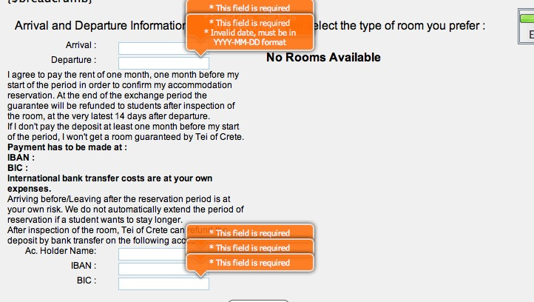
P5-IN
Validation
jQuery , PHP

Slide 3
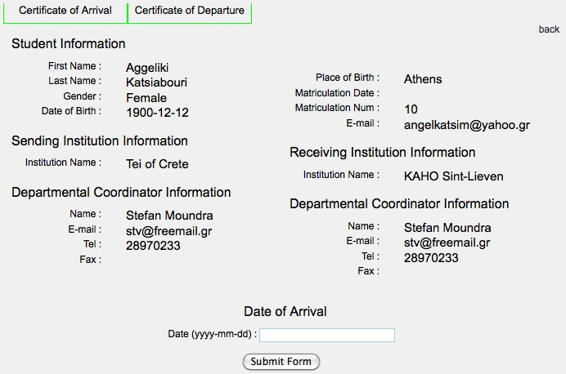
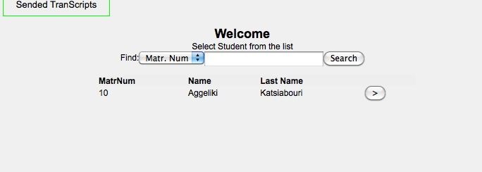
P5-IN
Store - Pull Data
pull from tables(Database)

