Slide 1
Exams module: P6-EXAMS
  Problems solved:
    implementation of the module for students;
    implementation of the module for coordinators to use it;
  Used technologies:
    Programming language – PHP
    Database managment system – MySQL
    Library – Plonk.
  User interface - easy to use.

Slide 2
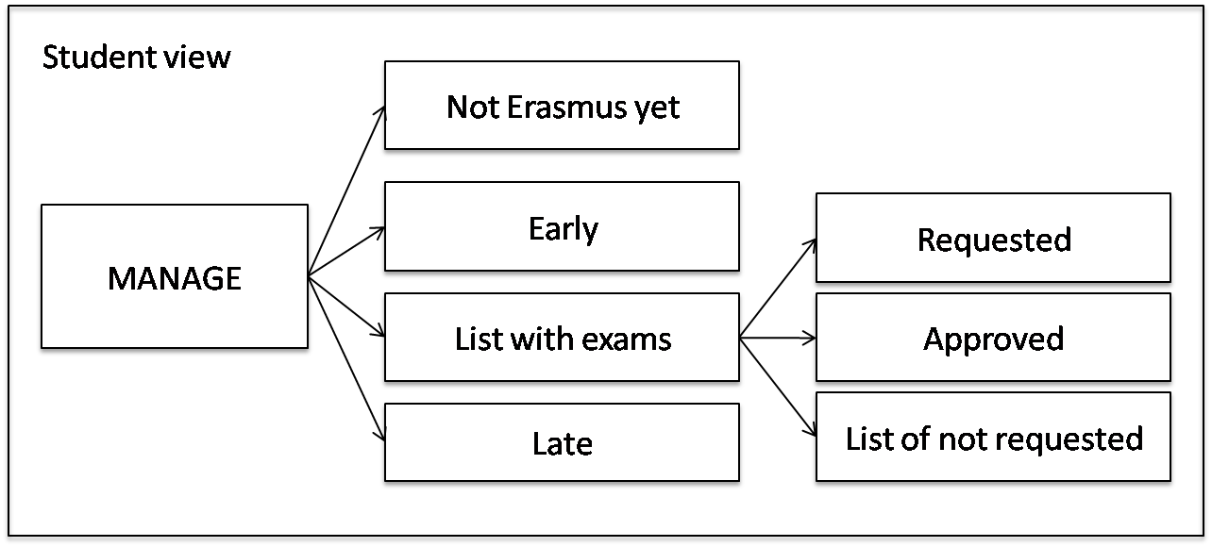
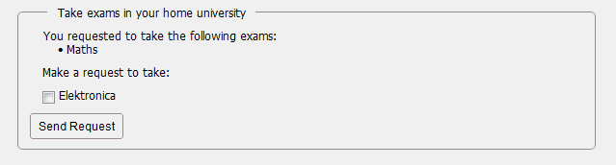
Student view

Slide 3
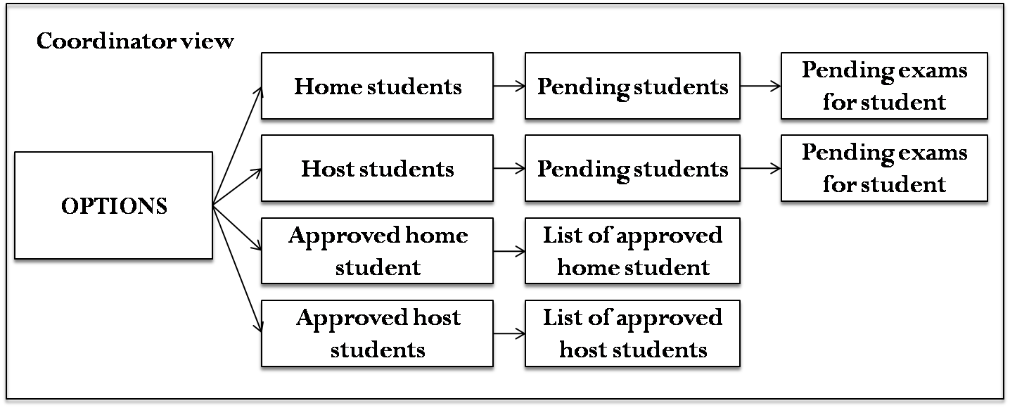
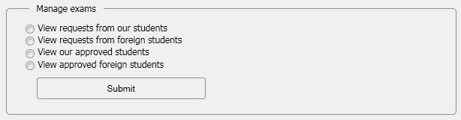
Home/host coordinator view

