Slide 1
Application of Machine Learning Methods to Predict the Level of Building Damage in the Nepal Earthquake
UE24CS352A - Machine Learning | Mini-Project
[VINODKUMAR L- PES1UG25AM817] | [HARSHITH K K - PES1UG24AM370] | Section [G]

Slide 2
Problem statement
• April 2015 Gorkha earthquake: hundreds of thousands of buildings damaged
• Engineering analysis per building is slow - we need fast triage for rescue & reconstruction
• Task: predict damage grade from building attributes (3-class classification)
• Grade 1 = low damage | 2 = medium | 3 = near-complete destruction
• Metric: micro-averaged F1 (DrivenData: Richter's Predictor)
Notes:
Motivate: triage after a disaster needs speed.

Slide 3
Dataset
train_values.csv
train_labels.csv
test_values.csv
260,601 buildings
38 features
keyed by building_id
damage_grade 1 / 2 / 3
imbalanced: grade 2 is the majority
86,868 buildings
labels hidden (DrivenData)
• Features: geo-level IDs, floors, age, area/height %, 8 categorical attributes, 11 superstructure flags, 11 secondary-use flags, ownership, families

Slide 4
Approach & evaluation protocol
• Stratified 80 / 20 split of the labelled data - 20% holdout is touched only for final scoring
• All model selection on the 80% part only (grid search CV, NN restarts on inner validation)
• Preprocessing inside sklearn Pipelines -> no leakage
• KNN & NN: one-hot + StandardScaler | Random Forest: ordinal encoding, no scaling
• Best model refit on all labelled data -> DrivenData submission.csv

Slide 5
Three models
K-Nearest Neighbours
Neural network
Random Forest
Euclidean distance, k = 7
SelectKBest(f_classif) -> top 20 features
Simple, non-parametric
Lazy: cost paid at prediction time
From scratch in NumPy
sigmoid hidden, softmax output
L2 reg, mini-batch 1000
hidden = sqrt(n_in * n_out)
lr lowered until loss stabilised
Bagged decision trees, Gini splits
GridSearchCV (3-fold):
min_samples_leaf, n_estimators
No scaling needed
Robust on mixed tabular data

Slide 6
Implementation
repo/
src/data.py loading + preprocessing
src/neural_net.py NumPy 2-layer NN
src/models.py model factories
src/train.py train, evaluate, plots
docs/ write-up + slide generators
run_all.py one-command pipeline
results/ metrics, figures, submission
• Python 3, scikit-learn, NumPy, pandas, matplotlib
• Reproducible: fixed seeds, requirements.txt
• Live demo: python run_all.py --fast

Slide 7
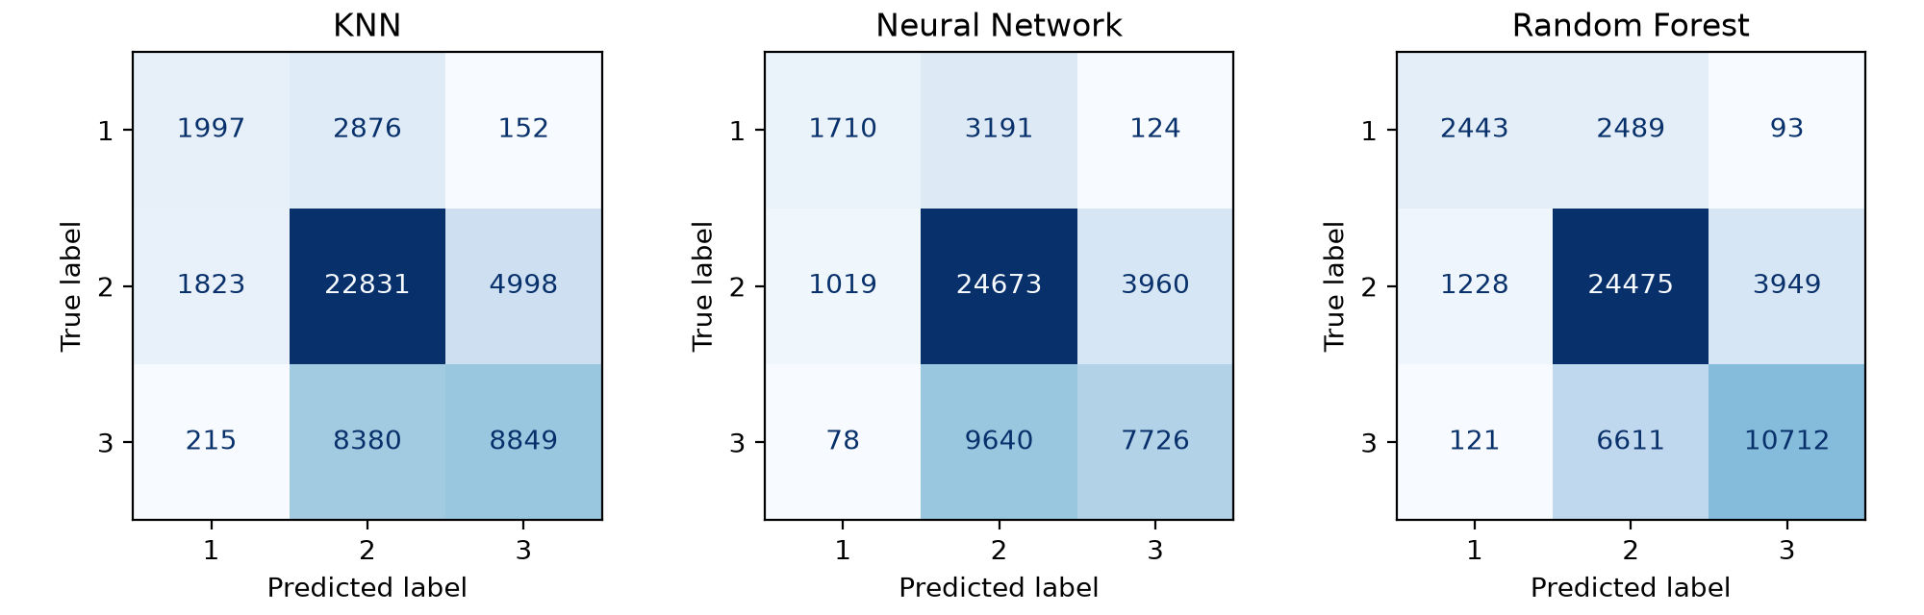
Results
Model | Train F1 | Holdout F1 | Macro F1 | Fit time (s)
KNN | 0.6709 | 0.6461 | 0.5734 | 1
Neural Network | 0.6508 | 0.6544 | 0.5666 | 99
Random Forest | 0.9867 | 0.7220 | 0.6646 | 102
Holdout: 52,121 buildings | micro-F1 = accuracy for single-label problems

Slide 8
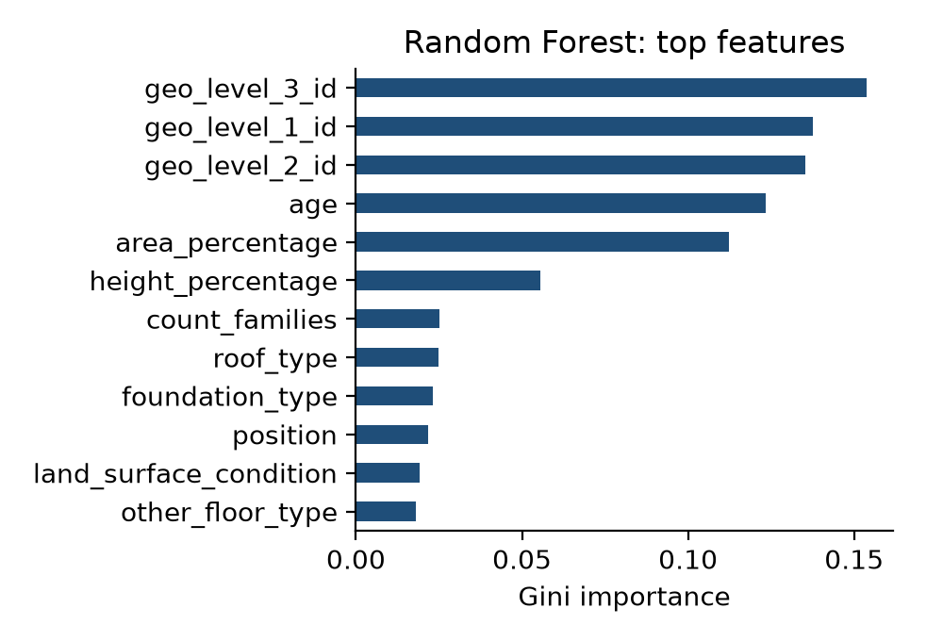
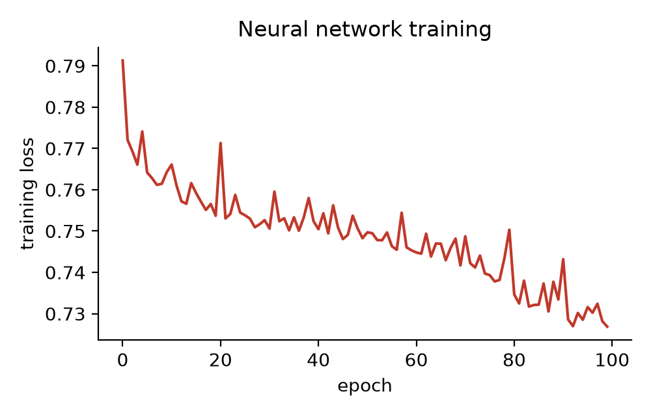
Analysis
Left: which features the Random Forest relies on. Right: NN training loss per epoch.
The Random Forest shows a train-holdout gap of 0.265 (0.9867 vs 0.7220), indicating overfitting; limiting depth or raising min_samples_leaf would help.

Slide 9
Conclusions & future work
• Random Forest achieved the best holdout micro-F1 (0.7220); KNN was lowest (0.6461). Fastest to train: KNN (1s).
• The Random Forest shows a train-holdout gap of 0.265 (0.9867 vs 0.7220), indicating overfitting; limiting depth or raising min_samples_leaf would help.
• Per-grade recall of the best model: grade 1 = 0.49, grade 2 = 0.83, grade 3 = 0.61.
• Future work: gradient boosting (LightGBM/XGBoost), one-hot geo-level IDs, class weights, stronger regularisation for the forest

Slide 10
Thank you - Q&A / live demo
GitHub: https://github.com/djkfjdkdj/ML-Project--Team-24
python run_all.py --data_dir data

