Slide 1
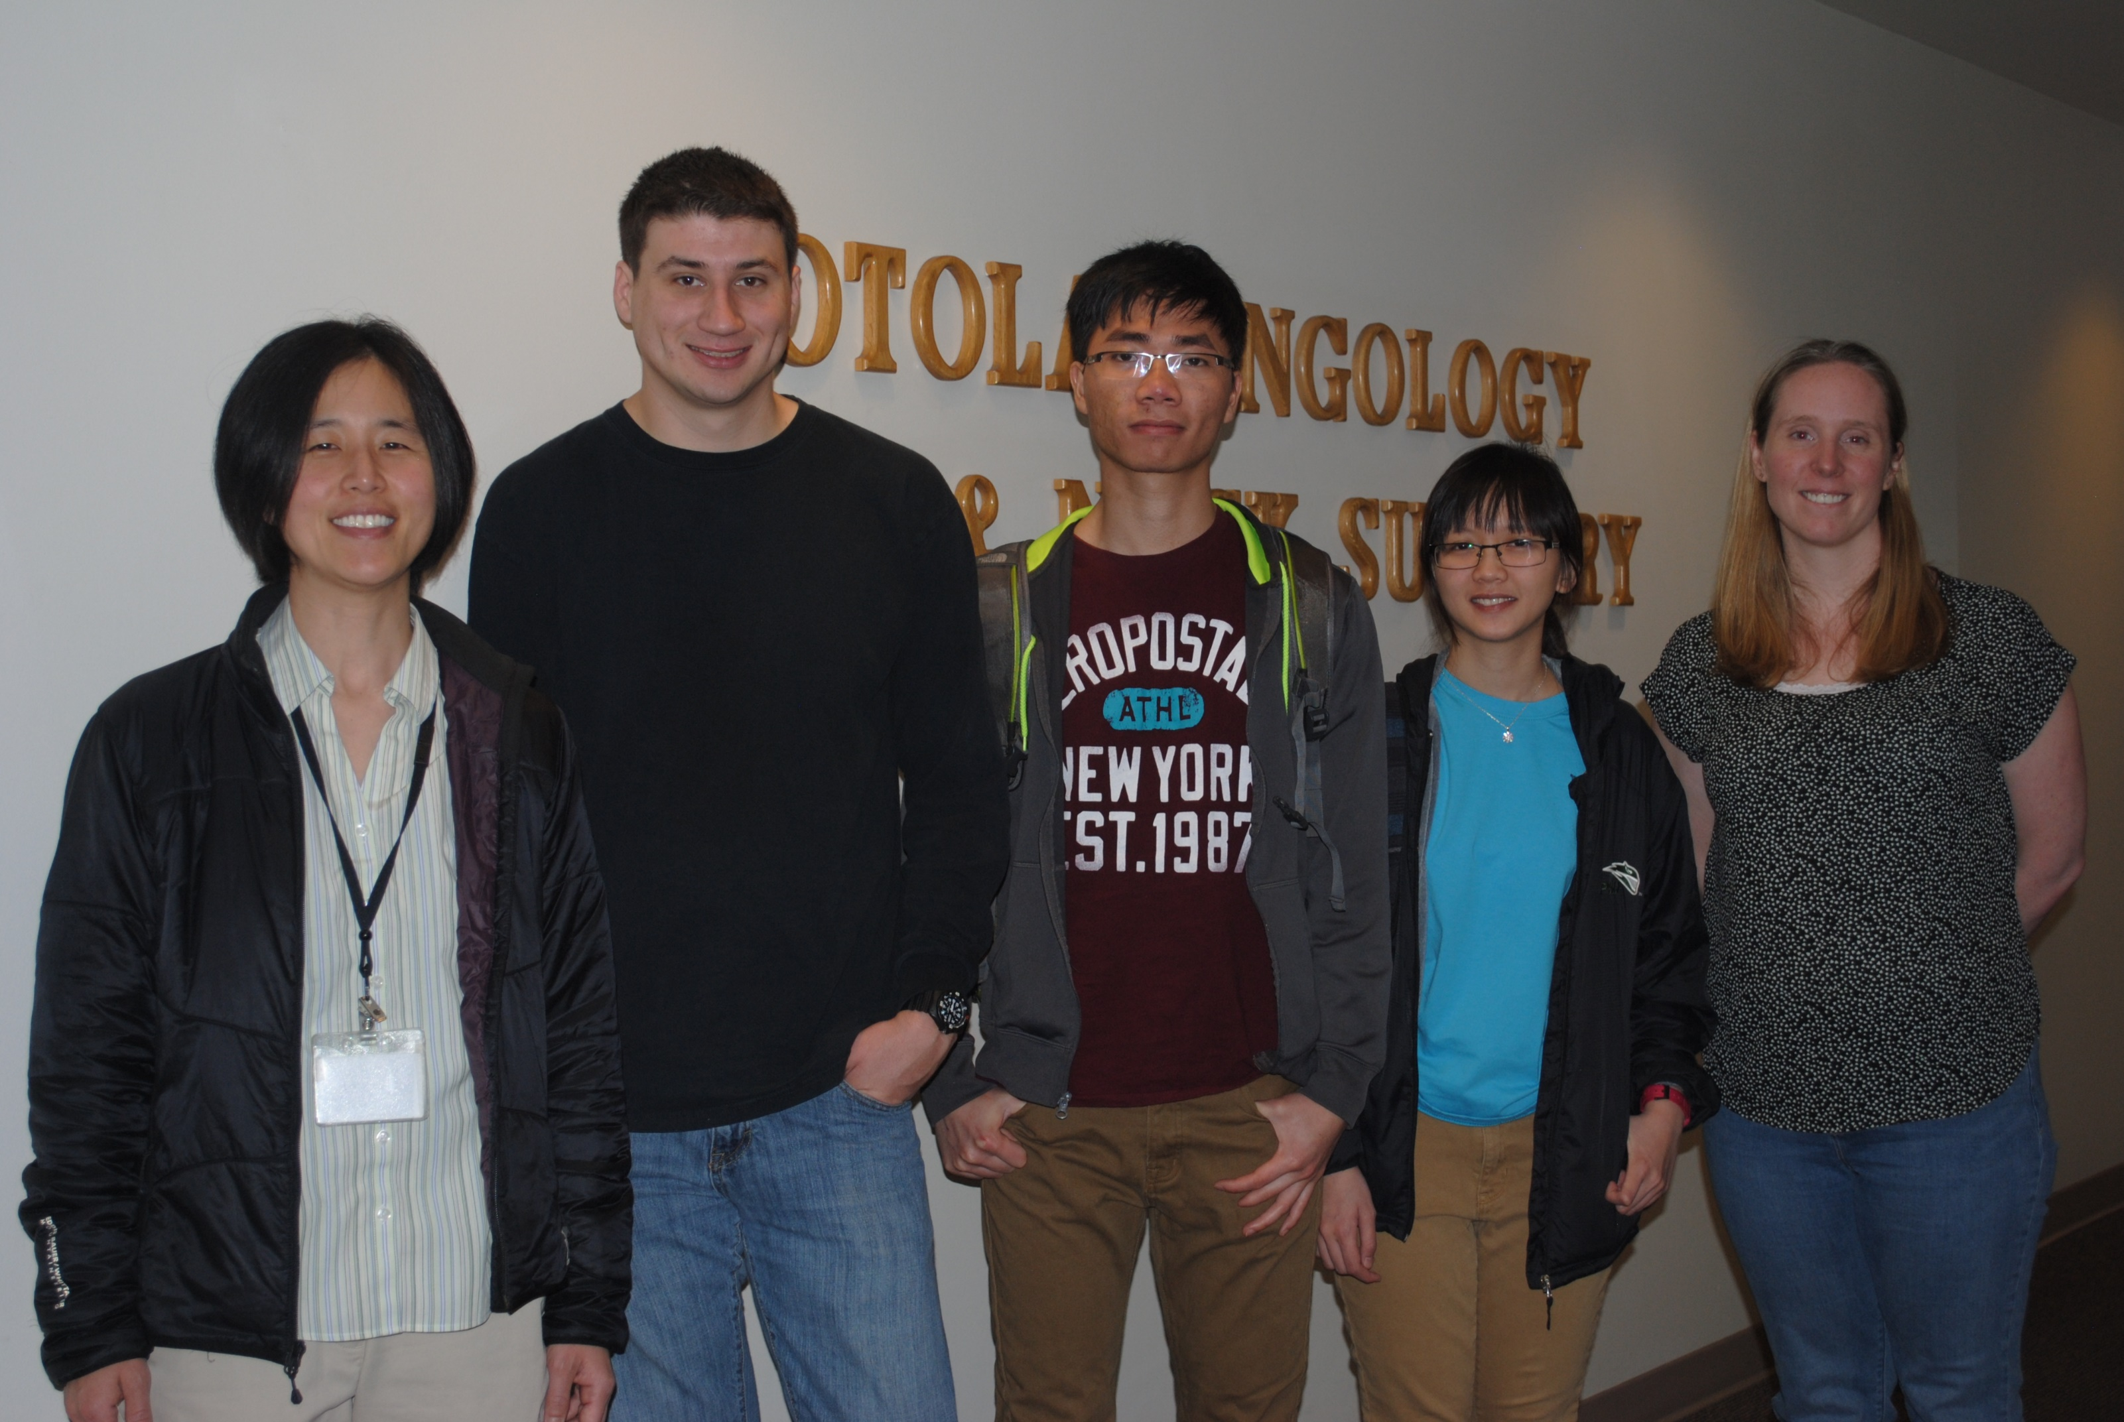
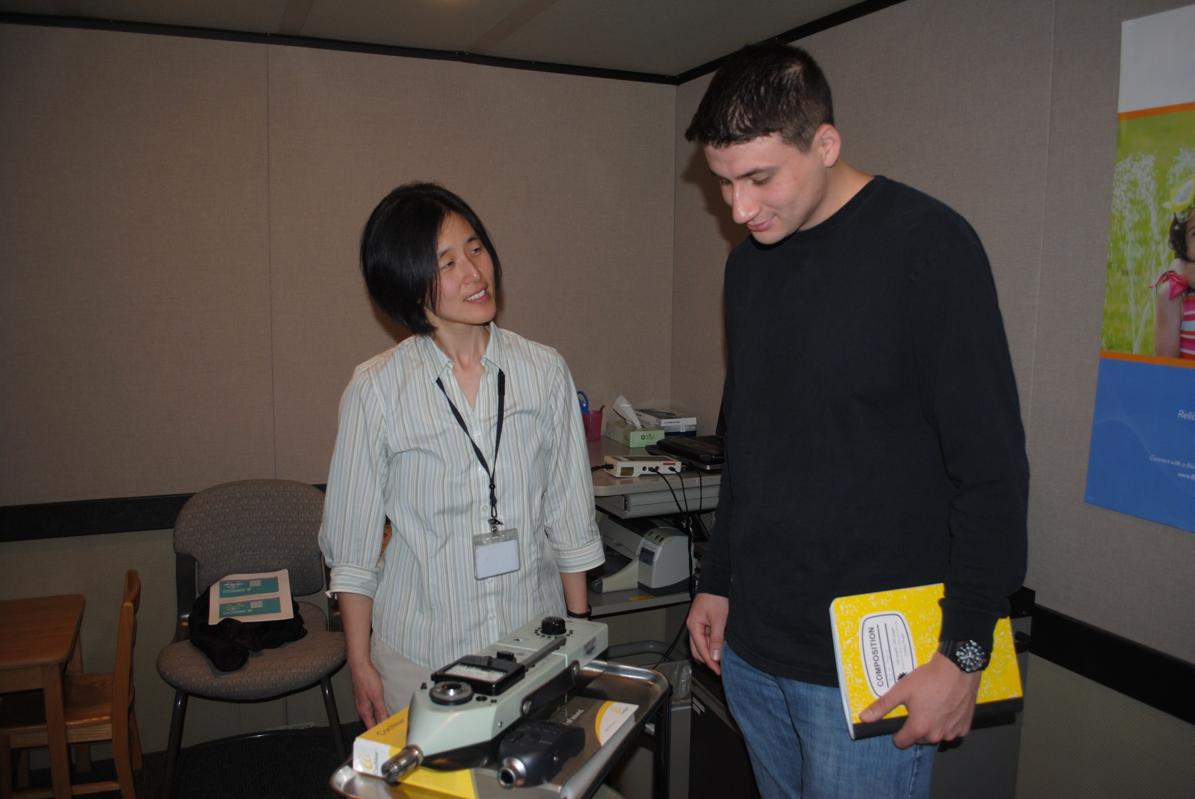
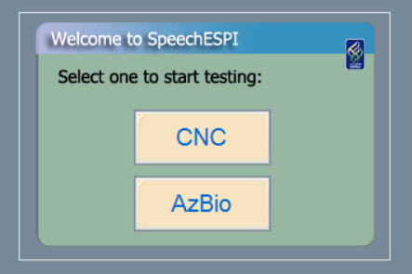
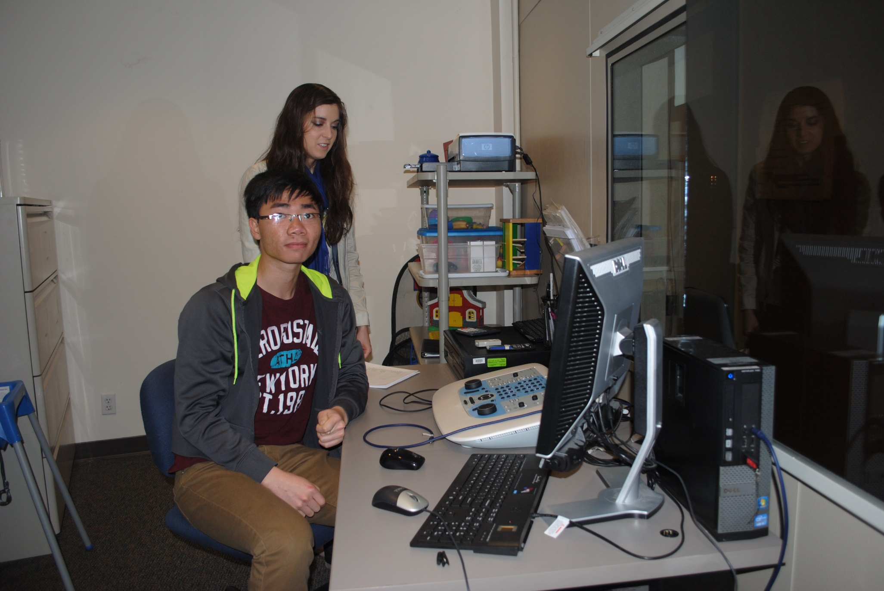

Capstone SpeechESPI
Solution:
Software that does this
Lite version
Extra talk
Description of the project to atomate a hand system, eliminate human error
Talk about sensitivity of db
Flow chart will go here
Department of Electrical and Computer Engineering

