Slide 1

TestBuilders
Electronic speech testing system for audiology
Leslie Eide
Nauvin Ghorashian
Chris Klupenger
han le
Ngan Nguyen

Slide 2
Motivation/background
This is a project initiated by Dr. Reiss to streamline the testing process that is currently conducted by hand with audio files at the OHSU audiology department
Some Matlab code previously existed for concept but not a long term solution
There are various data analyses that would benefit from having this data recorded in a database format

Slide 3
Requirements
There will be a login for each user
Enter patients name and various information for the purpose of testing
Specify the type of speech test, which lists of words/sentences to be used as well as additional testing parameters
Using provided audio files associated with a list to start the word/sentence and pause so that a technician can record a response via buttons on the screen
Calculation of the final score with ability to modify before completion of the test
Various graphical analysis based on test and input
Entry of existing records
Search criteria for analysis of records
Completion of this project will result in a computer program that is self contained

Slide 4
Constraints
Time, as scope of project could carry beyond deadline
Desktop platform so that it can interface with the audiometer
Work on Windows XP, 7 or 8
Placement of the database on a server
Epic constraints with interface
There are a few constraints on the project

Slide 5
Deliverables
Self contained software package
Simple user interface
Will have users
Will have groups
Will have patient record
Will conduct a CNC test with entered parameters
Will conduct a AzBio test with entered parameters
Will record the response entered by the technician
Will save the response entered by the technician for historical data
Will generate various reports based on the entered criteria
It is desired that we will deliver an all encompassing software with the room for expansion beyond what was created that we will not provide.

Slide 6
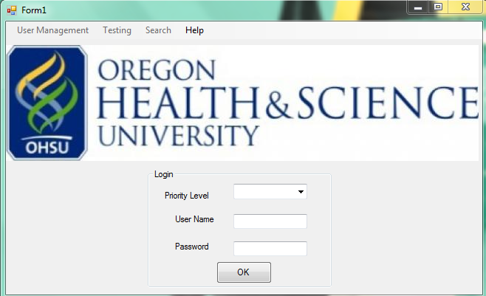
Solution
Our solution is a software that is created in C#. This will replace the process of using CD’s, pen and paper for performing and recording data used in both the CNC and AzBio tests.

Slide 7
Timeline
Individual components of the project to be completed by the first of April
Robust testing to commence in April
Final project requirements to be fulfilled by end of May
Presentation of software first of June

Slide 8
Criteria for success
Successful software program installed on the computer in the Department of Otolaryngology at OHSU
The ability to add a user
The ability to add a patient
The ability to run a CNC test
The ability to run an AzBio test
The ability to search on database for additional graphical analysis
Oral Presentation
Final Project report
Success will be measured for this capstone based on the criteria outlined in the deliverables as well as the deliverables required by Portland State.

Slide 9
Flow chart

Slide 10
Flow chart

Slide 11
Demonstration

Slide 12
Questions?

