Slide 1
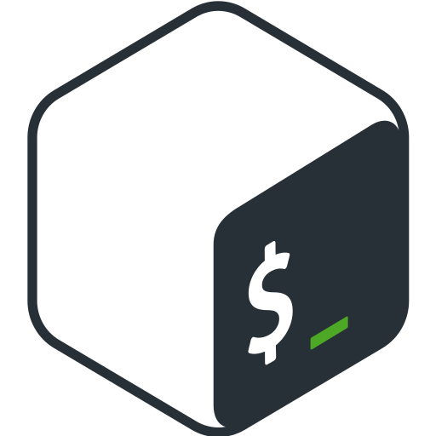
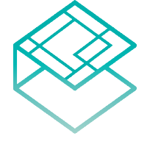
AKS ON Azure with BASH CNI
https://github.com/djkormo/k8s-cni-bash-plugin
Kubernetes CNI in BASH .
Krzysztof Pudłowski
+
Łódź 2023

Slide 2

About me
Long-time corporate employee. Currently, he works in the telecommunications sector.
Physicist by profession, education completed with a doctorate from the University of Łódź.
Practical knowledge of enterprise software development. Administrator, developer, team leader, IT expert.
He holds professional certificates: MCP, MCSA: SQL Server 2012/2014, MCSE: Data Management and Analytics, MCSA: Cloud Platform, MCSE: Cloud Platform and Infrastructure , MPP Data Science , Microsoft Certified: Azure Administrator Associate , Microsoft Certified: Azure Data Scientist Associate, Google Associate Cloud Engineer, Certified Kubernetes Administrator
Blogger at wchmurze.cloud

Slide 3
Intro
When I started to learn/teach kubernetes it was very diffcult to understand internals of Kubernetes networking. The best way to get the knowledge is to create own k8s network implementation.
At the beginning I will discuss the kubernetes network model and how cni plug-ins fit into it.
Then, I’ll try to write a simple cni plug-in in bash responsible for implementing a kubernetes overlay network, as well as for allocating and configuring network interfaces in pods.
I will also deploy an simple aks cluster and configure it to use our bash cni plug-in.
Next I try to install simple applications on Kubernetes and check theirs behavouir.

Slide 4
Creating K8s on Azure
 | Do it yourself | Aks-engine | Azure Kubernetes Service
Description | Create VMs, create infrastructure on Azure and install k8s using your lovely tools | Aks-engine generates templates to deploy k8s | Managed k8s
Possibility of modifiying the cluster | Highest | High | Medium
You pay for | Control Plane + Worker VMs | Control Plane + Worker VMs | Only Worker VMs
Support for internal clusters (only private Ips) | Yes | Yes | Yes (master VMs with public IPs today
Three Ways to do iT!
Note!
AKS ENGINE is deprecated
This project is deprecated for Azure public cloud customers. Please consider using Azure Kubernetes Service (AKS) for managed Kubernetes or Cluster API Provider Azure for self-managed Kubernetes. There are no new features planned; this project will only be updated for CVEs & similar, with Kubernetes 1.24 as the final version to receive updates
https://github.com/kubernetes-sigs/cluster-api-provider-azure

Slide 5
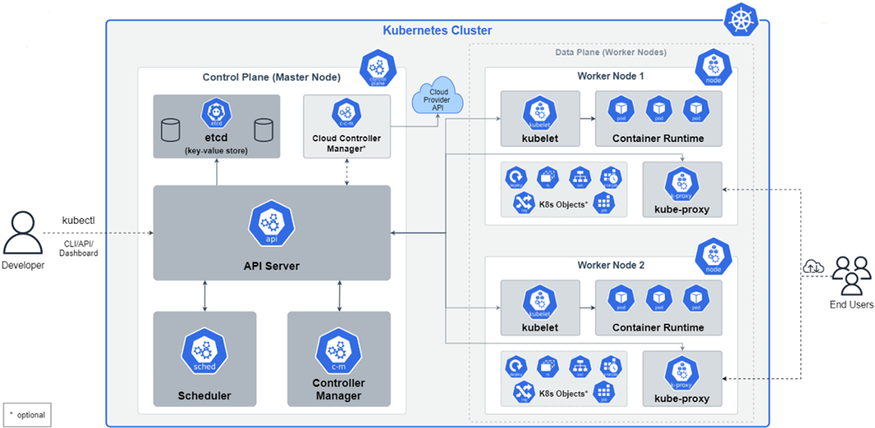
Kubernetes architecture

Slide 6
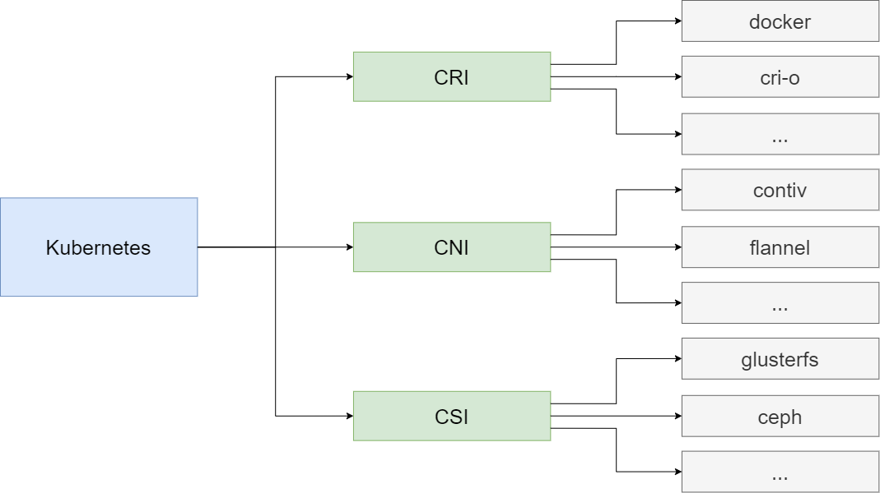
Kubernetes modular plugins

Slide 7
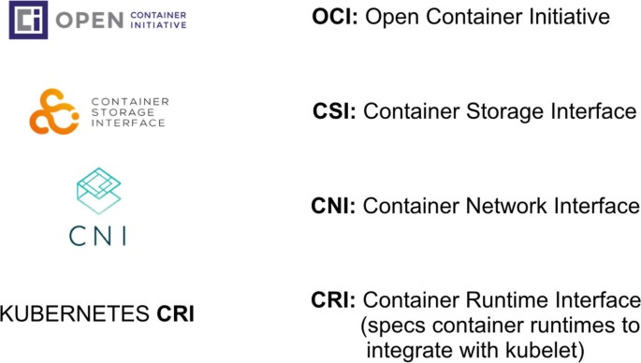
Kubernetes Plugins

Slide 8
AKS Host VM operating system
AKS clusters are deployed on host VMs, which run a security-optimized
OS used for containers running on AKS
Host OS is based on an Ubuntu 18.04.5 LTS image with security hardening and
optimizations applied.
By default there is no access to nodes, however:
• You can set SSH Key (but only one)
• You can run a debugger pod to node (but it’s privileged one)

Slide 9
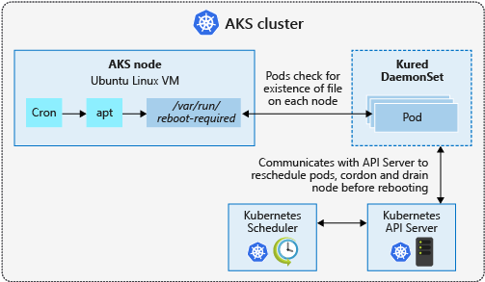
AKS node update
Some security updates, such as kernel updates, require a node reboot to finalize the process. A Linux node that requires a reboot creates a file named /var/run/reboot-required. This reboot process doesn't happen automatically.
https://learn.microsoft.com/en-us/azure/aks/node-updates-kured

Slide 10
Container NetworK (CNI)
The Kubernetes Network Model:
Every Pod gets its own IP address: There should be no need to create links between Pods and no need to map container ports to host ports.
NAT is not required: Pods on a node should be able to communicate with all Pods on all nodes without NAT.
Agents get all-access passes: Agents on a node (system daemons, Kubelet) can communicate with all the Pods in that node.
Shared namespaces: Containers within a Pod share a network namespace (IP and MAC address), so they can communicate with each other using the loopback address.
There are Many CNI Plugins for kubernetes
Flannel, Canal, Weave, Calico, Cilium,…
https://opensource.com/article/22/6/kubernetes-networking-fundamentals

Slide 11
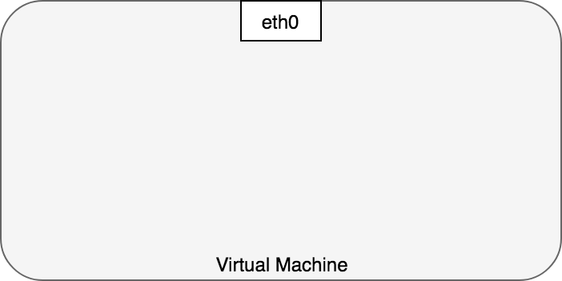
Container-to-Container Networking
Typically, we view network communication in a virtual machine as interacting directly with an Ethernet device
https://sookocheff.com/post/kubernetes/understanding-kubernetes-networking-model/

Slide 12
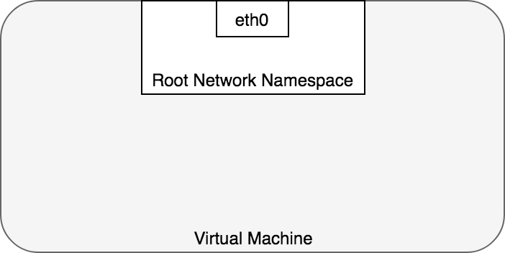
Container-to-Container Networking
In linux, each running process communicates within a network namespace that provides a logical networking stack with its own routes, firewall rules, and network devices. In essence, a network namespace provides a brand new network stack for all the processes within the namespace.
By default, linux assigns every process to the root network namespace to provide access to the external world

Slide 13
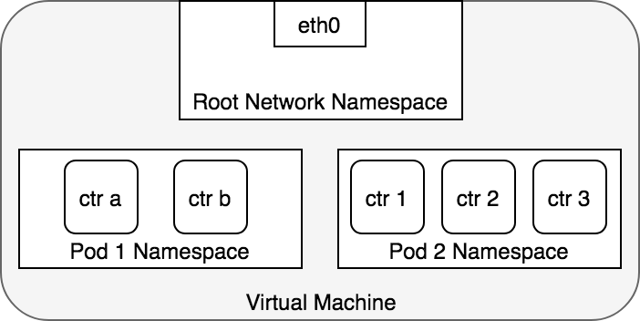
Container-to-Container Networking
Pod is modelled as a group of containers that share a network namespace. Containers within a Pod all have the same IP address and port space assigned through the network namespace assigned to the Pod
Applications within a Pod also have access to shared volumes, which are defined as part of a Pod and are made available to be mounted into each application’s filesystem.

Slide 14
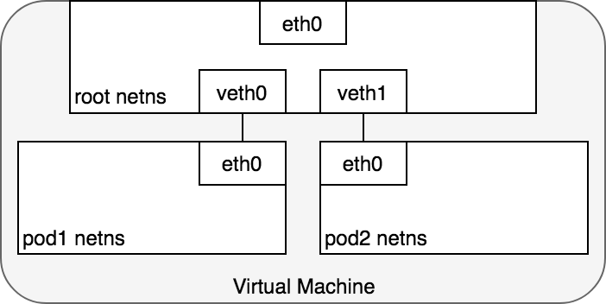
Pod-to-Pod Networking
In Kubernetes, every Pod has a real IP address and each Pod communicates with other Pods using that IP address
To connect Pod namespaces, we can assign one side of the veth pair to the root network namespace
and
the other side to the Pod’s network namespace.
Each veth pair works like a patch cable, connecting the two sides and allowing traffic.
Pod exists in its own Ethernet namespace that needs to communicate with other namespaces on the same Node. Namespaces can be connected using a Linux Virtual Ethernet Device or veth pair consisting of two virtual interfaces that can be spread over multiple namespaces.

Slide 15
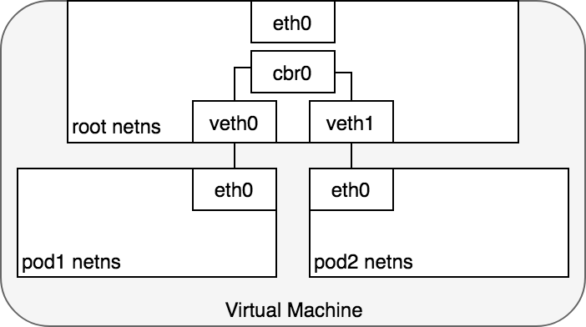
Pod-to-Pod Networking
Now, we want the Pods to talk to each other through the root namespace,
and for this we use a network bridge.
A Linux Ethernet bridge is a virtual Layer 2 networking device used to unite two or more network segments, working transparently to connect two networks together. The bridge operates by maintaining a forwarding table between sources and destinations.
Bridges implement the ARP protocol to discover the link-layer MAC address associated with a given IP address.

Slide 16
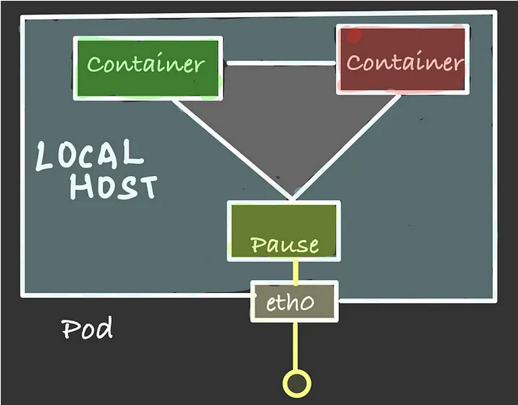
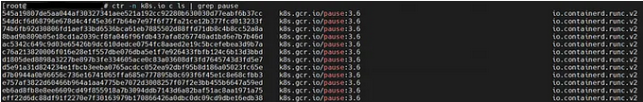
WHAT ARE PAUSE CONTAINERS ?
When creating a pod, the kubelet process first calls the CRI interface RuntimeService.Runpodsandbox to create a sandbox environment and set up the basic operating environment such as the network.
Once the pod sandbox is established, the kubelet can create user containers in it. When it comes time to delete a pod, the kubelet will first remove the pod sandbox and then stop all containers inside.
The pause container is a container that exists in each pod, it’s like a template or a parent containers from which all the new containers in the pod inherit the namespaces. The pause container starts, then goes to “sleep”.
https://blog.devgenius.io/k8s-pause-container-f7abd1e9b488

Slide 17
Life of a packet: Pod-to-Pod, same Node

Slide 18
Life of a packet: Pod-to-Pod, across Nodes
Generally, every Node in your cluster is assigned a CIDR block specifying the IP addresses available to Pods running on that Node. Once traffic destined for the CIDR block reaches the Node it is the Node’s responsibility to forward traffic to the correct Pod

Slide 19
How to create you own CNI Plugin
Assumptions
Using only prepared images for Kubernetes (AKS) nodes.
Not using any additional packages on NODES.
Installing only via kubernetes objects.

Slide 20
AKS ApProach
By default, AKS clusters use kubenet, and a virtual network and subnet are created for you. With kubenet, nodes get an IP address from a virtual network subnet. Network address translation (NAT) is then configured on the nodes, and pods receive an IP address "hidden" behind the node IP. This approach reduces the number of IP addresses that you need to reserve in your network space for pods to use.
With Azure Container Networking Interface (CNI), every pod gets an IP address from the subnet and can be accessed directly. These IP addresses must be unique across your network space, and must be planned in advance. Each node has a configuration parameter for the maximum number of pods that it supports. The equivalent number of IP addresses per node are then reserved up front for that node. This approach requires more planning, and often leads to IP address exhaustion or the need to rebuild clusters in a larger subnet as your application demands grow.
https://learn.microsoft.com/en-us/azure/aks/use-byo-cni

Slide 21
AKS ApProach Bring your own CNI
Kubernetes does not provide a network interface system by default; this functionality is provided by network plugins. Azure Kubernetes Service provides several supported CNI plugins. Documentation for supported plugins can be found from the networking concepts page.
While the supported plugins meet most networking needs in Kubernetes, advanced users of AKS may desire to utilize the same CNI plugin used in on-premises Kubernetes environments or to make use of specific advanced functionality available in other CNI plugins.
https://pixelrobots.co.uk/2022/04/bring-your-own-container-network-interface-cni-plugin-with-azure-kubernetes-service-aks-preview/

Slide 22
What is CNI
CNI (container network interface), a cloud native computing foundation project, consists of a specification and libraries for writing plugins to configure network interfaces in linux containers, along with a number of supported plugins. CNI concerns itself only with network connectivity of containers and removing allocated resources when the container is deleted. Because of this focus, CNI has a wide range of support and the specification is simple to implement.

Slide 23
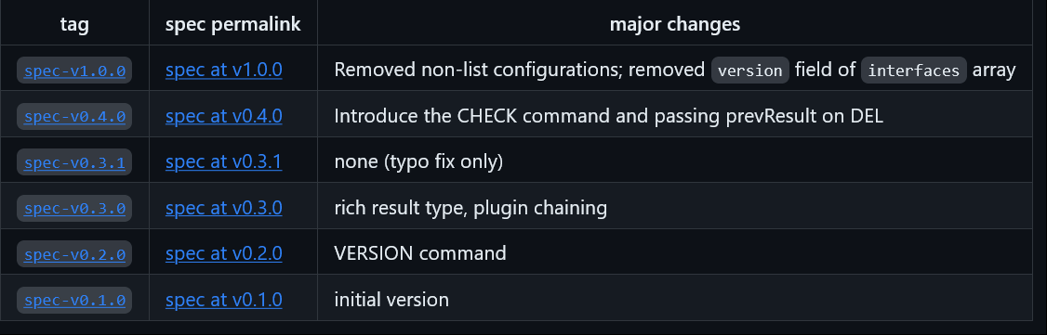
CNI Versions
https://github.com/containernetworking/cni/blob/main/SPEC.md#released-versions

Slide 24
How CNI plugin works (in k8s)
A CNI binary Handles connectivity - configures the network interface of the pod
A daemon Handles reachability - manages routings across the cluster

Slide 25
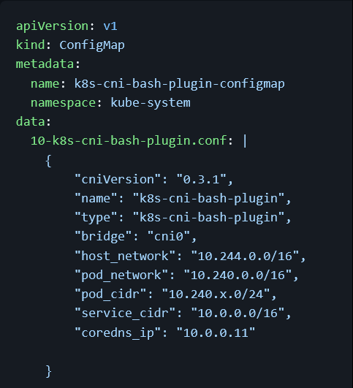
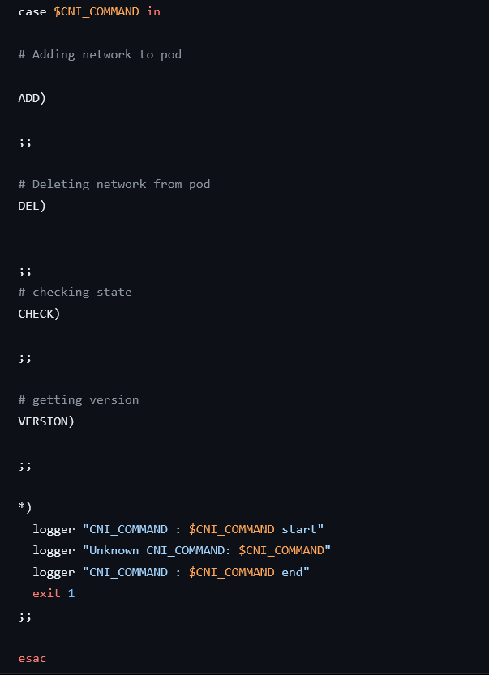
What a CNI plugin is made of?
Configuration
Logic

Slide 26
CNI Operations
CNI plug-in supports four commands
ADD
DEL
CHECK
VERSION
The caller of a CNI plug-in (kubelet in our case)
must initialize the CNI_COMMAND environment variable,
which contains the desired command.
The most important command is ADD,
it is executed each time after a container is created,
and it is responsible for allocating a network interface to the container.

Slide 27
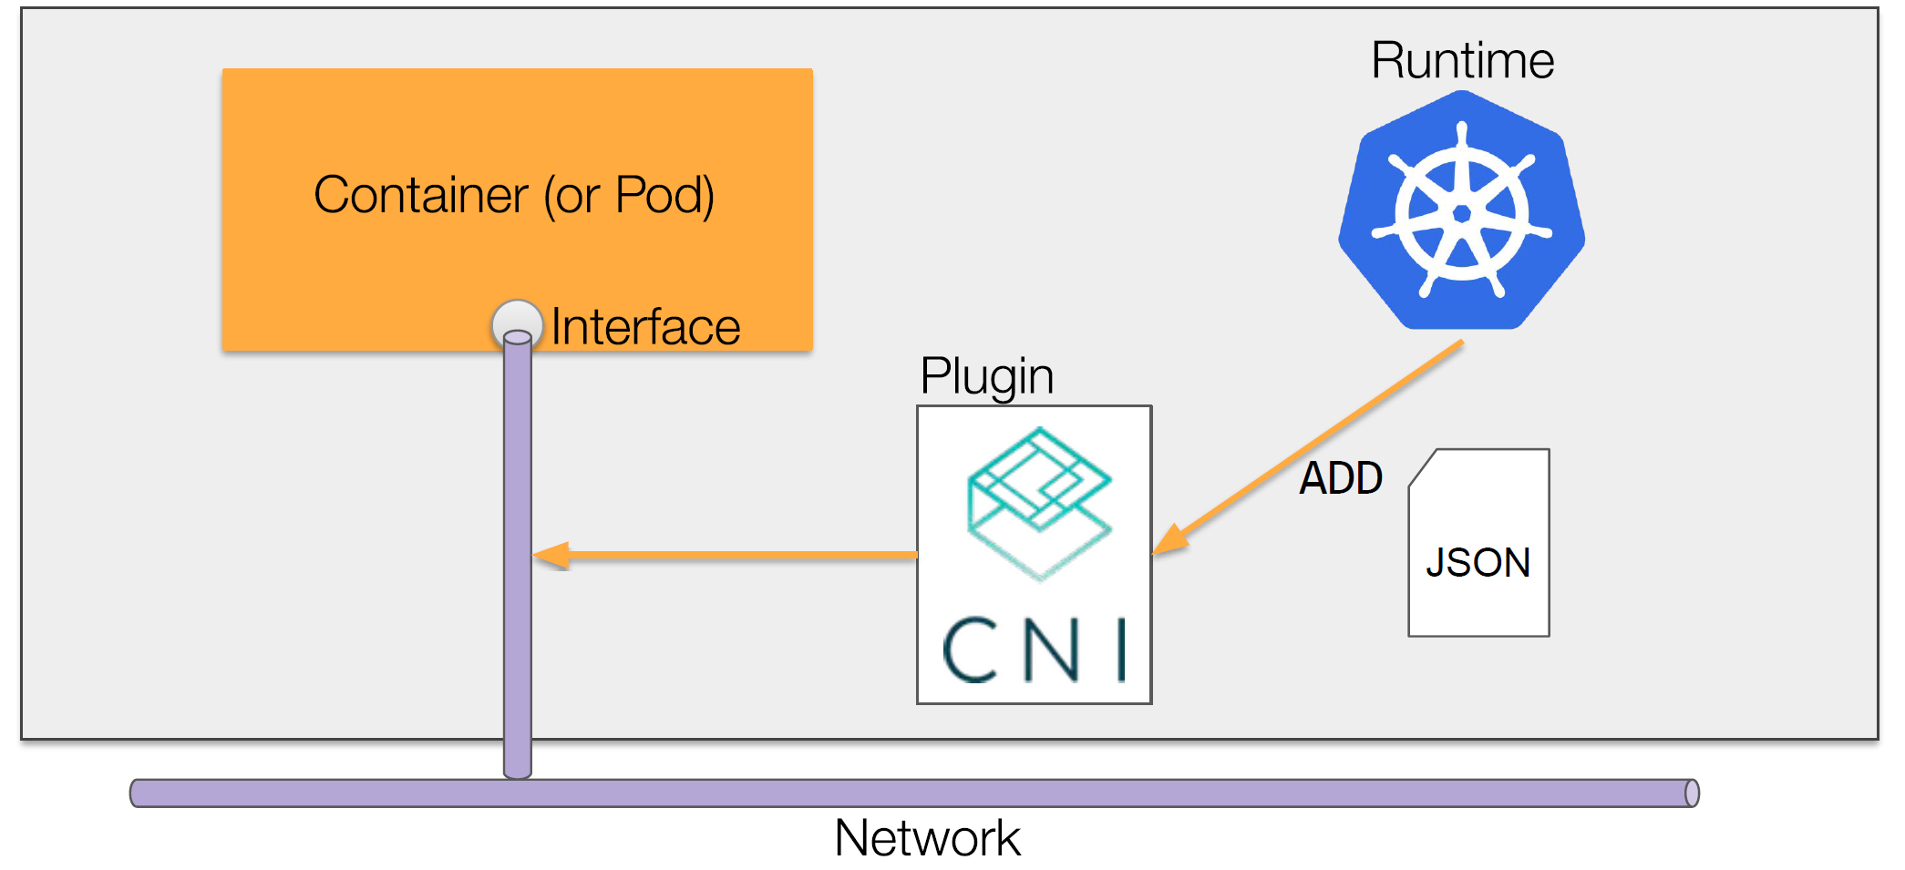
HOW CNI FITS IN

Slide 28
CNI interaction
Basic commands: ADD, DEL, CHECK and VERSION
Plugins are executables
Spawned by the runtime when network operations are desired
Fed JSON configuration via stdin
Also fed container-specific data via stdin
Report structured result via stdout

Slide 29
CNI Configuration
cniVersion (string): semantic version 2.0 of CNI specification to which this configuration conforms.
name (string): network name. This should be unique across all containers on the host (or other administrative domain).
type (string): refers to the filename of the cni plugin executable.
args (dictionary, optional): additional arguments provided by the container runtime. For example a dictionary of labels could be passed to CNI plugins by adding them to a labels field under args.
ipam (dictionary, optional): dictionary with ipam specific values

Slide 30
CNI BASH LOOP
Incoming VARIABLES
CNI_COMMAND
CNI_CONTAINERID
CNI_NETNS
CNI_IFNAME

Slide 31
CNI Specification
ADD: Add container to network
A CNI plugin, upon receiving an ADD command
should create the interface defined by CNI_IFNAME
inside the container at CNI_NETNS
Required environment parameters:
CNI_COMMAND
CNI_CONTAINERID
CNI_NETNS
CNI_IFNAME
https://www.cni.dev/docs/spec/#parameters

Slide 32
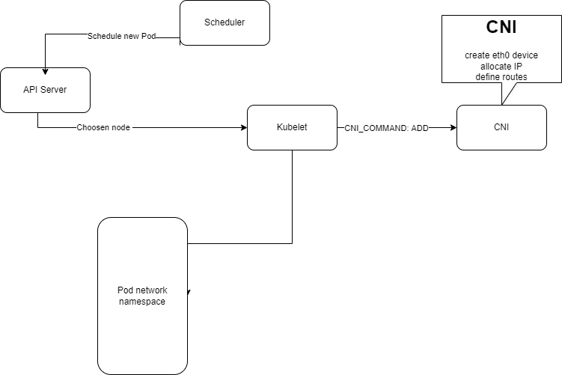
CNI WORKFLOW

Slide 33
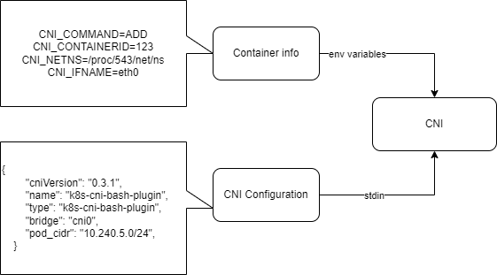
CNI WORKFLOW

Slide 34
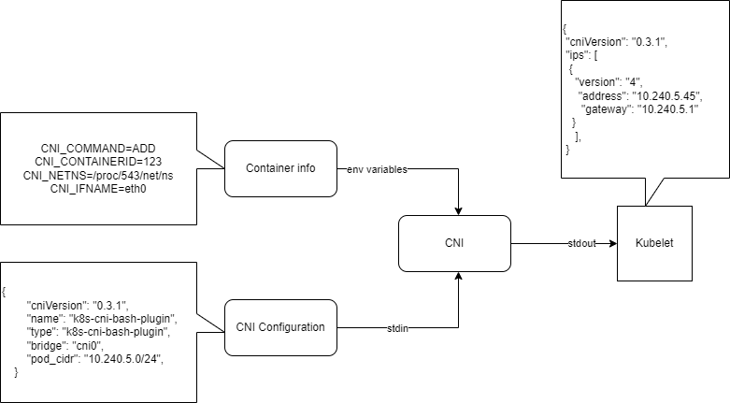
CNI WORKFLOW

Slide 35
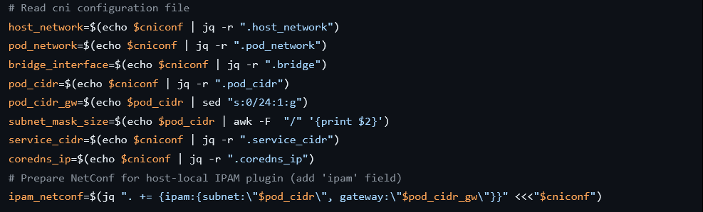
CNI BASH CONFIGURATION
https://www.cni.dev/plugins/current/ipam/host-local/

Slide 36
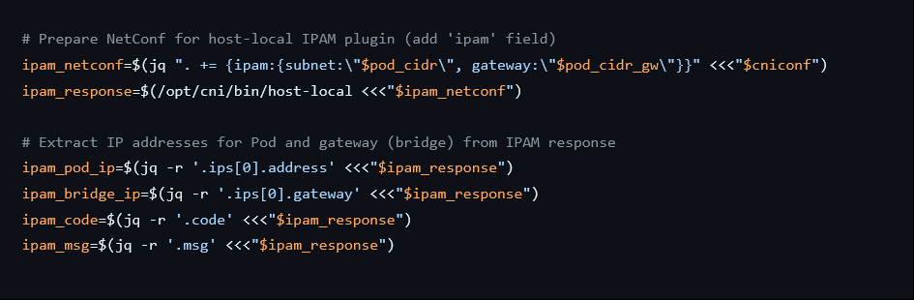
Obtaining IP for POD
https://www.cni.dev/plugins/current/ipam/host-local/

Slide 37
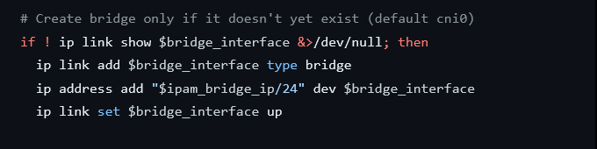
Create Network Bridge

Slide 38
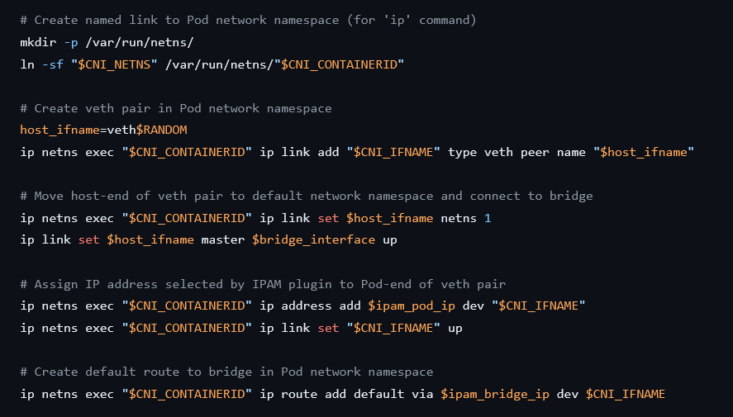
Create VETH PAIR

Slide 39
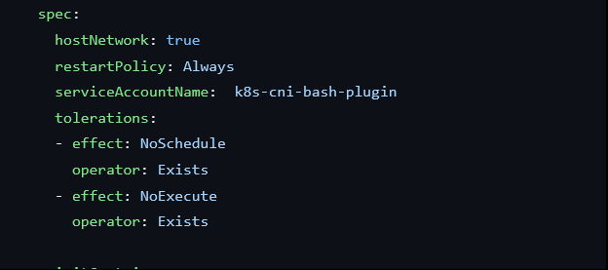

How to install CNI ON AKS
Using deamonset
Host network
Tolerations for not ready nodes
https://github.com/djkormo/k8s-cni-bash plugin/blob/main/kubernetes/manifests/daemonset.yaml

Slide 40
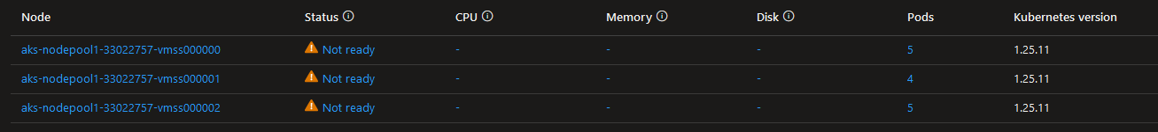
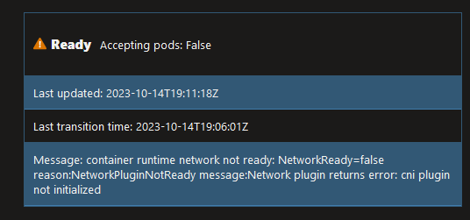
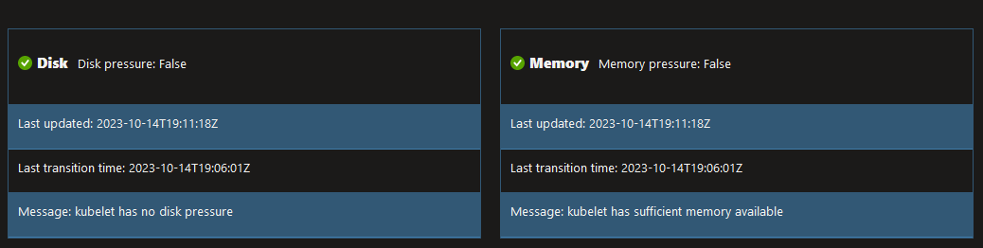
DAY 0 afTER installation

Slide 41
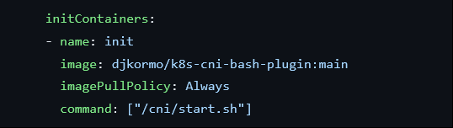
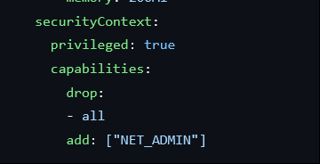
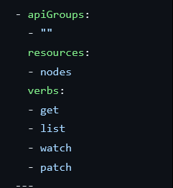
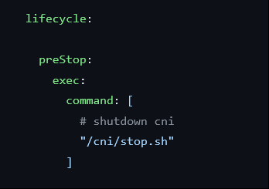
How to install CNI on AKS
Start
STOP
NETWORK ADMIN
RBAC

Slide 42
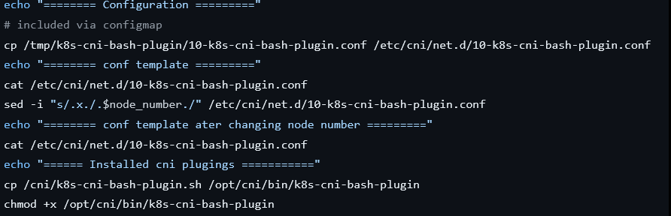
CNI START
start.sh

Slide 43
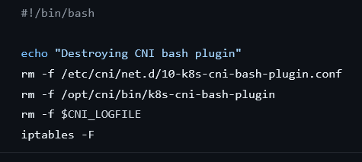
CNI STOP
stop.sh

Slide 44
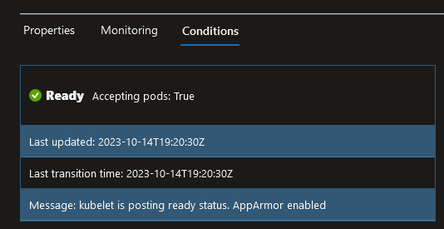
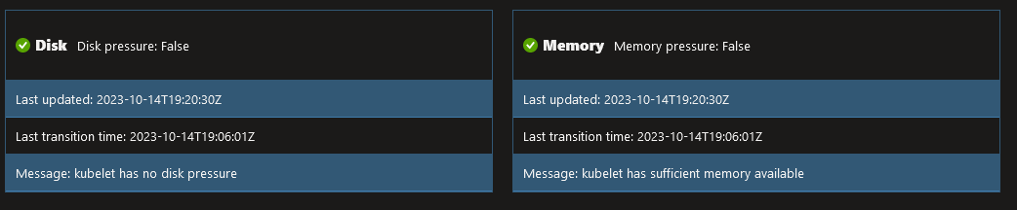
Day 1 after installation

Slide 45
Demo
Demo

Slide 46
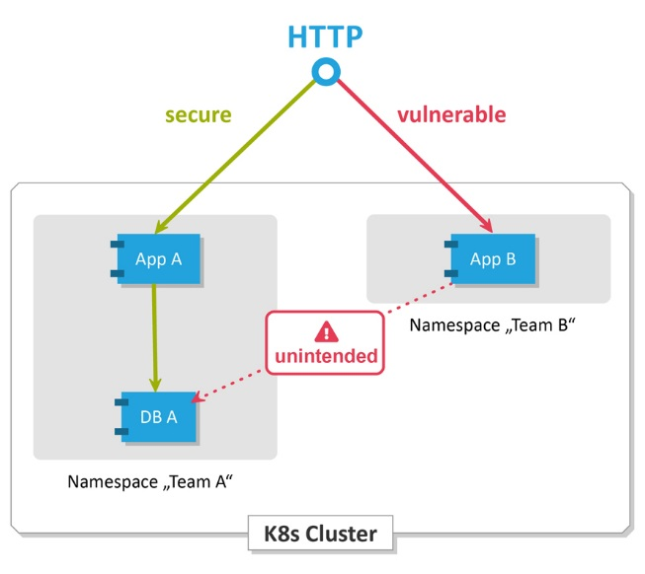
Next Steps
Kubernetes offers the network policy resource that can be used to restrict network connections. The rules for incoming and outgoing traffic are declared in a network policy for ISO/OSI layers 3 and 4 (IP addresses and ports), and these rules are assigned to a group of pods using labels.
Change BASH to Golang code
Implement NETWORK POLICIES
Create in GOLANG simple ingress controller

