Slide 1
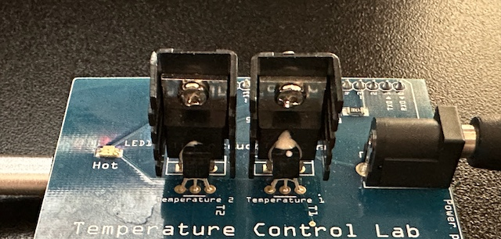










data
model
2
1
model
data
$$T_{H2}$$
Fin
Fin
$$T_{H1}$$
$${\overline{u}}_{2}$$
$$u_{2}$$
Heater
Heater
$$u_{1}$$
$${\overline{u}}_{1}$$
$${\overline{T}}_{S2}$$
$$T_{S2}$$
Sensor
Sensor
$$T_{S1}$$
$${\overline{T}}_{S1}$$
Thermal Paste

