Slide 1
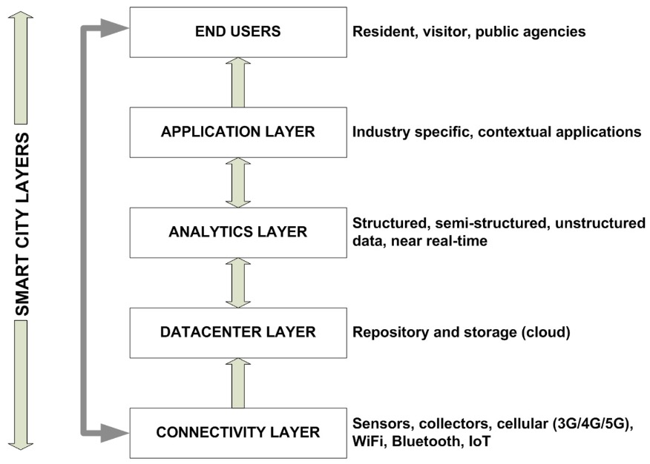
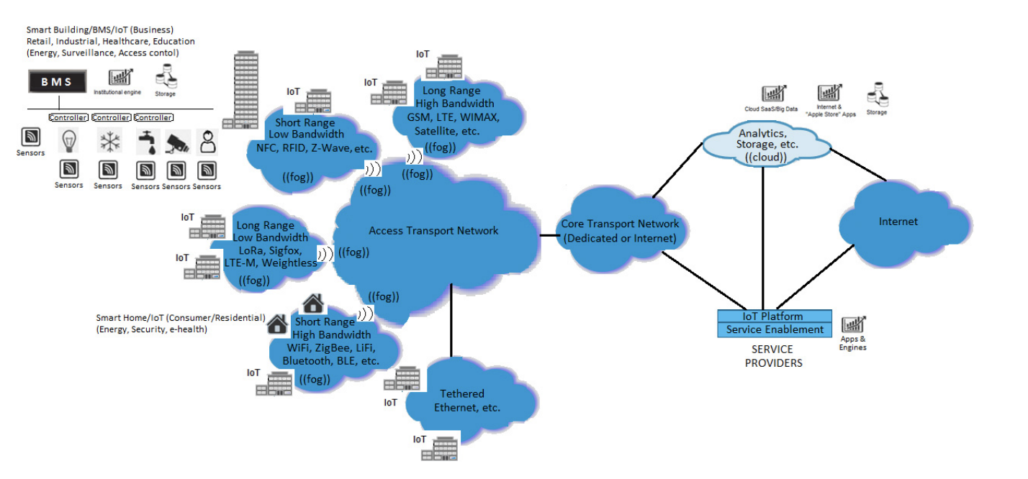
Jiaming Deng - 22302794
IoT Considerations, Requirements, and Architectures for Smart Buildings—Energy Optimization and Next-Generation Building Management Systems
Big Sensor Data Systems for Smart Cities
1. introduce some of the IoT applications for smart building such as energy managerment, lighting control
2. classify building blocks of building management system including sensors, controllers, output devices, communication media, data analytics and databoard
3. conclude some of the technical challenges faced by the IoT in the smart building.
1. define big sensor data systems
2. show the progress in the development and applications of big sensor data
3. classify smart city layers
4. show future applications of big sensor data systems
Notes:
The BMS is a comprehensive platform for improving efficiency and reducing waste by interacting with the control hardware in various mechanical and electrical systems and regulating the energy they use.
PoE technology enables the transmission of DC currents over data conductors and it consists of IoT component-powered devices and point-receiving devices.

