Slide 1
MAAD: Week 3 Self Supervised Models
July 25th, 2026
Notes:
This week we are going to be covering self supervised representation learning for speech.

Slide 2
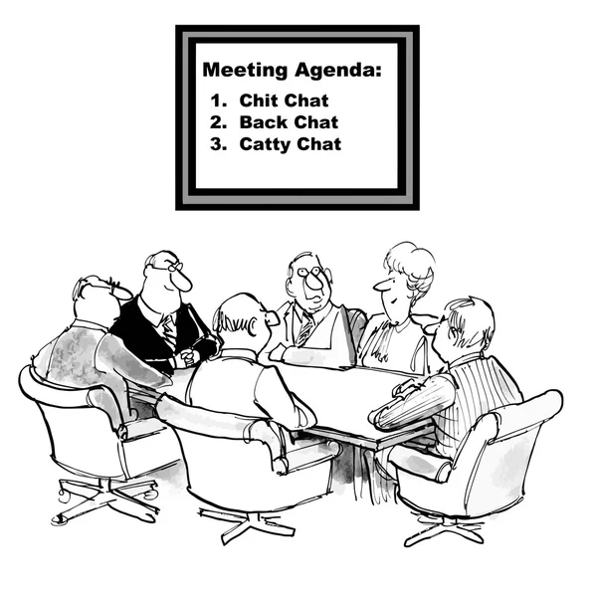
Agenda
Generative
WaveNet
Self Supervised
Wav2Vec
VQ-Wav2Vec
Wav2Vec 2.0
Hubert
WavLM
Audio Language Models
Whisper
Qwen2-Audio
Qwen-Audio-VAE
https://www.everypixel.com/image-419543868743882478
Notes:
First, we will cover wavenet, which is not actually representation learning and more of a vocoder, but will provide some useful blocks that the next models will use.
Then we will cover wav2vec, vq-wav2vec, wav2vec 2.0, hubert and wavlm.
CLICK
We won’t be covering audio language models due to time, but I will still leave them in here if you are interested.

Slide 3
What are we going to talk about?
We are here to learn about how these models work.
No time is spent on the specific datasets or results.
All of these models build on each other.
Understanding one helps you understand the rest.
After WaveNet, the tasks remain the same: learn a representation that helps on downstream tasks.
After Wav2Vec, the results improve for each iteration.
Notes:
Read off slides and click.

Slide 4
What are we going to talk about?
This is just one of those things that are good for you.
Notes:
Read of slides.

Slide 5
Timeline
2016
Google DeepMind published WaveNet.
2019
Facebook AI published Wav2Vec.
2020
Facebook AI published VQ-Wav2Vec.
2020
Facebook AI published Wav2Vec 2.0.
2021
QWEN published Qwen-Audio-VAE.
2022
Microsoft published WavLM.
2022
OpenAI published Whisper.
2024
QWEN published Qwen2-Audio.
2026
Facebook AI published HuBERT.
Notes:
So just a quick timeline for these works.
Read from slides.
CLICK
Again, we will not be going over the audio language models.

Slide 6
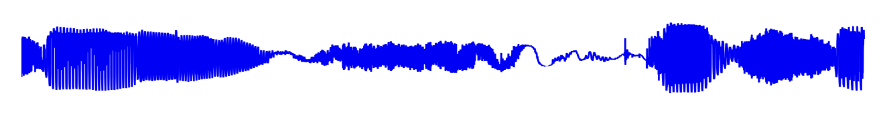
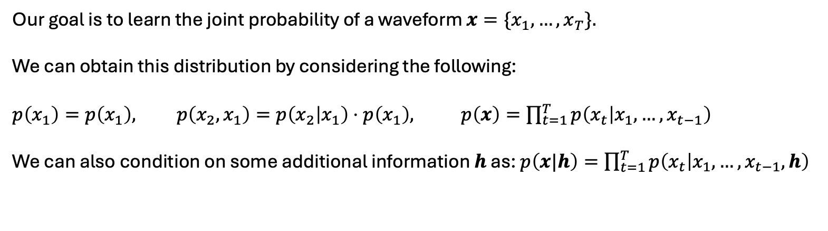
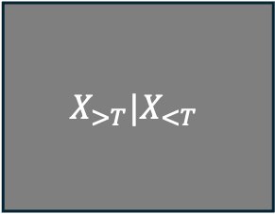
WaveNet
$$X_{>T}|X_{<T}$$
Our goal is to learn the joint probability of a waveform $x=\{x_{1},…,x_{T}\}.$
We can obtain this distribution by considering the following:
$p\left(x_{1}\right)=p\left(x_{1}\right), p\left(x_{2},x_{1}\right)=p\left(x_{2} | x_{1}\right)⋅p\left(x_{1}\right),$ $p\left(x\right)=\prod_{t=1}^{T}{p\left(x_{t} | x_{1},…,x_{t−1}\right)}$
We can also condition on some additional information $h$ as: $p\left(x|h\right)=\prod_{t=1}^{T}{p\left(x_{t} | x_{1},…,x_{t−1}, h\right)}$
Notes:
WaveNet is a generative model based on the PixelCNN for audio data. CLICK
Our goal is autoregressive generation. CLICK
We achieve this goal by learning the joint probability distribution for the waveform.
We can obtain this distribution by considering the joint probability distribution as the product of conditional distributions.
We can use the model as a vocoder by considering the conditional extension, where h is some related context.

Slide 7
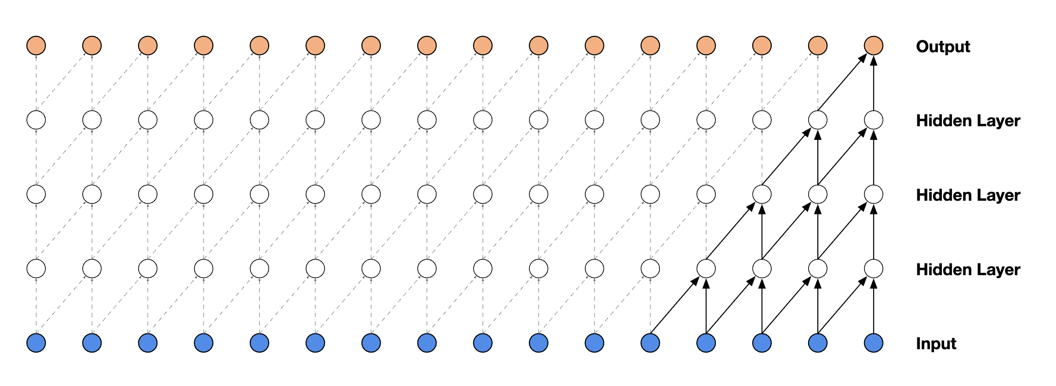
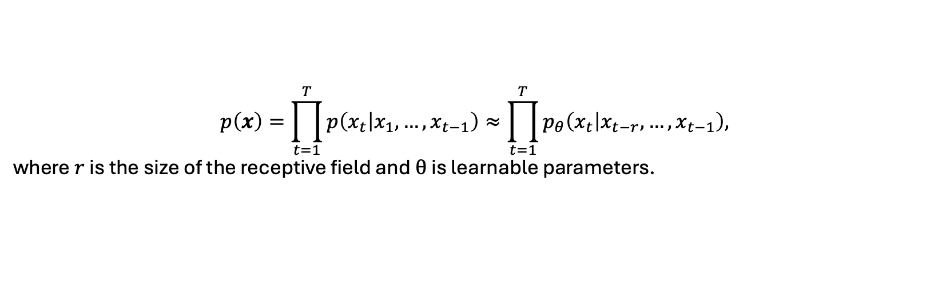
WaveNet
The first ingredient is the causal convolution.
With any convolution block, we will have a fixed receptive field. Therefore, we will approximate the joint distribution as such:
$$p\left(x\right)=\prod_{t=1}^{T}{p\left(x_{t} | x_{1},…,x_{t−1}\right)}≈\prod_{t=1}^{T}{p_{θ}\left(x_{t} | x_{t−r},…,x_{t−1}\right),}$$
where $r$ is the size of the receptive field and $θ$ is learnable parameters.
Notes:
The first ingredient is the causal convolution.
This type convolution only depends on past data.
CLICK
With any convolution block, we will have a fixed receptive field. Therefore, we will approximate the joint distribution as such, where r is the size of the receptive field.

Slide 8
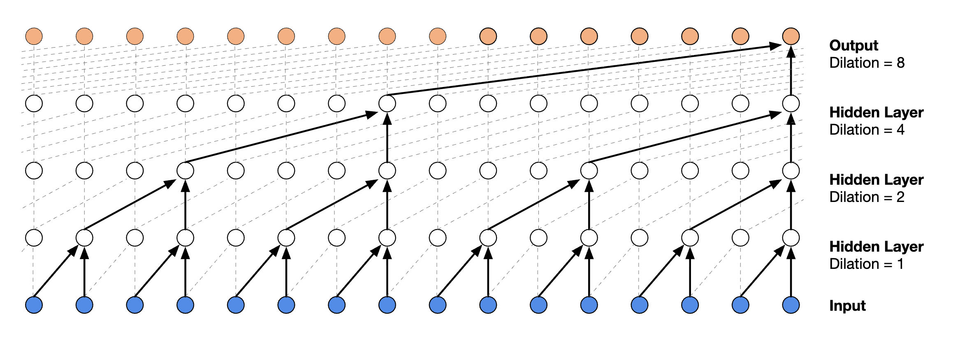
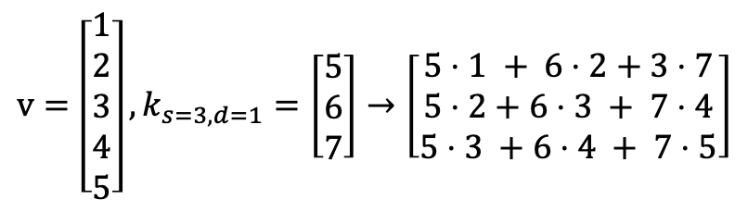
WaveNet
The next ingredient is the dilated causal convolution.
Dilation is conceptually adding zeros in between kernel components.
$$v=\left[\begin{aligned}1 \\ 2 \\ 3 \\ 4 \\ 5\end{aligned}\right],k_{s=3,d=1}=\left[\begin{aligned}5 \\ 6 \\ 7\end{aligned}\right]→\left[\begin{aligned}5⋅1 + 6⋅2+3⋅7 \\ 5⋅2+6⋅3 + 7⋅4 \\ 5⋅3 +6⋅4 + 7⋅5\end{aligned}\right]$$
No Dilation
Notes:
For audio sequences with a high sample rate we would ideally want to have receptive field that is larger than a millisecond.
We can increase the field by either having a larger stride, which requires a larger filter, or a larger sparser filter.
The latter is a dilated convolution.
CLICK
It is the concept of adding zeros to a filter, or in terms of a convolution, using a filter with instances a multiple of d apart.
Notice for the no dilation, our receptive field is currently 3, so the output vector has length 3 with no padding on the input.

Slide 9
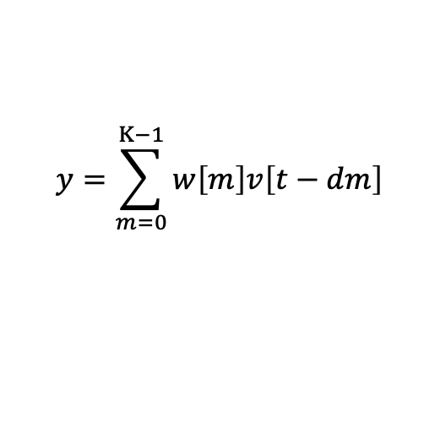
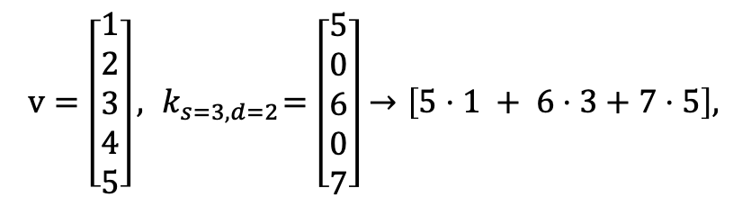
WaveNet
The next ingredient is the dilated causal convolution.
Dilation is conceptually adding zeros in between kernel components.
$v=\left[\begin{aligned}1 \\ 2 \\ 3 \\ 4 \\ 5\end{aligned}\right],{ k}_{s=3,d=2}=\left[\begin{aligned}5 \\ 0 \\ 6 \\ 0 \\ 7\end{aligned}\right]→\left[5⋅1 + 6⋅3+7⋅5\right],$
$$y=\sum_{m=0}^{K−1}{w\left[m\right]v\left[t−dm\right]}$$
Dilation
Notes:
Now notice that with dilation we add zeros in between the filter values. Now our output has size 1 with a much larger field. Although we lost some information in this example.
Typically, we use a strided convolution followed by dilated convolution to ensure less information is lost.
CLICK
As mentioned, the convolution has filter components that are multiples of the dilation.

Slide 10
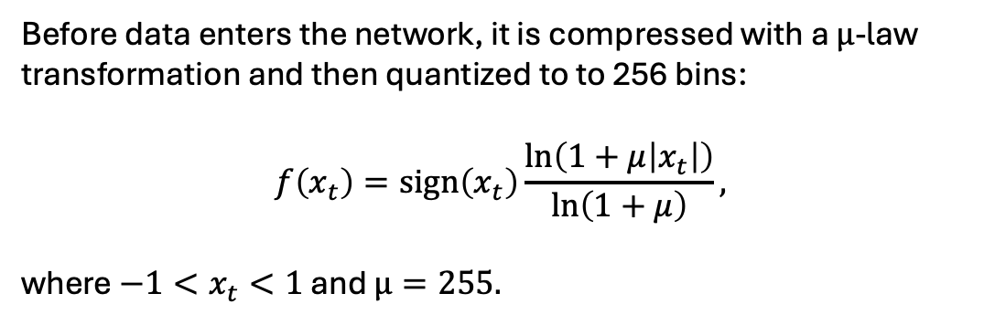

WaveNet
Before data enters the network, it is compressed with a $μ$-law transformation and then quantized to to 256 bins:
$$f\left(x_{t}\right)=\text{sign}\left(x_{t}\right)\frac{\ln\left(1+μ\left|x_{t}\right|\right)}{\ln\left(1+μ\right)},$$
where $−1<x_{t}<1$ and $μ=255.$
$$h_{256}$$
Notes:
The next ingredient is their compression method.
They use something called mu-law, which is typically used to save bandwidth over a network. With 256 bins this is the 8-bit format.
That means every value of the waveform x_t is scaled by this. We must also normalize the waveform using max absolute value before computation.
CLICK
Now that we know that the input is a one hot vector of size 256, that means out prediction is a vector of probabilities for each class/bin.

Slide 11
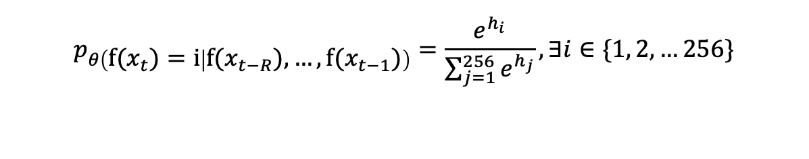

WaveNet
$$h_{256}$$
We can now define our conditional distribution as:
$$p_{θ\left({f(x}_{t})=i | {f(x}_{t−R}),…,{f(x}_{t−1})\right)}=\frac{e^{h_{i}}}{\sum_{j=1}^{256}{e^{h_{j}}}}, ∃i∈\{1, 2, …256\}$$
Notes:
We can now define conditional distributions as such. This is the softmax distribution with target i.
As a side note, make sure to get comfortable seeing this equation because it is used everywhere.

Slide 12
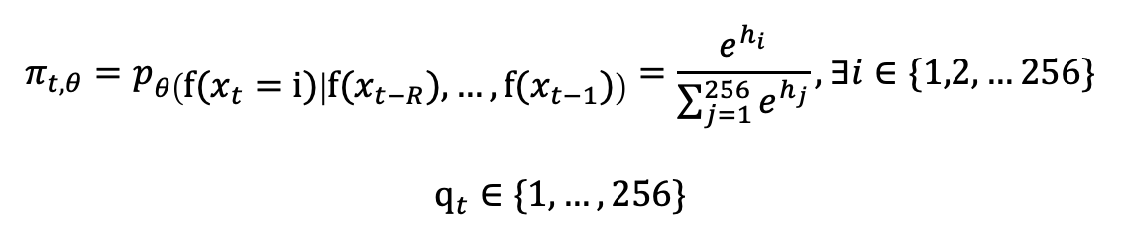
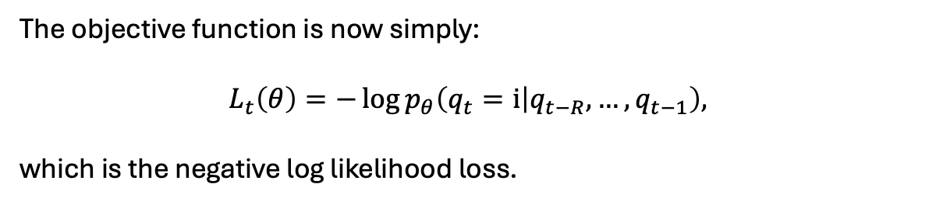
WaveNet
We can now define our conditional distribution as:
$${π_{t,θ}=p}_{θ\left(f(x_{t}=i) | f(x_{t−R}),…,f(x_{t−1})\right)}=\frac{e^{h_{i}}}{\sum_{j=1}^{256}{e^{h_{j}}}},∃i∈\{1,2,…256\}$$
$$q_{t}∈\{1,…,256\}$$
The objective function is now simply:
$$L_{t}\left(θ\right)=−\log{p_{θ}\left(q_{t}=i | q_{t−R},…, q_{t−1}\right),}$$
which is the negative log likelihood loss.
Notes:
We also can define the ground truth as single one hot vector that is indexed q_t.
CLICK
Therefore, our objective is now the negative log likelihood loss.
When fully written, the loss it is just that softmax computation inside the -log with the ground truth logit on top, and the sum of all logits including the ground truth on the bottom

Slide 13
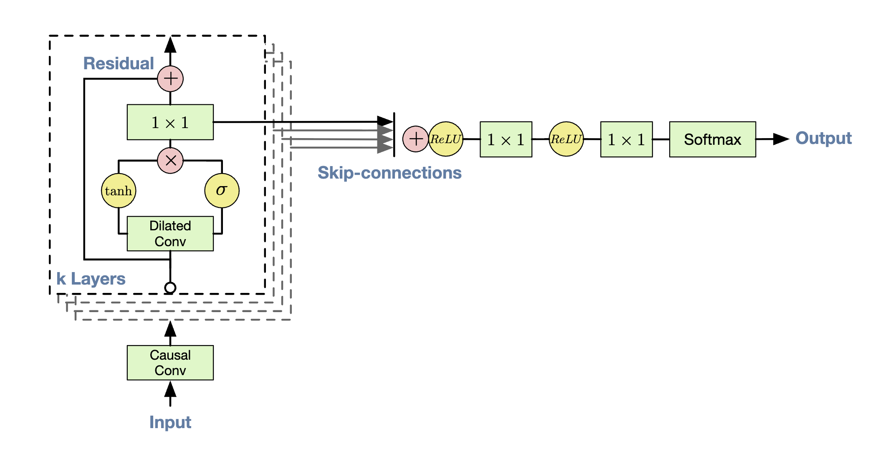
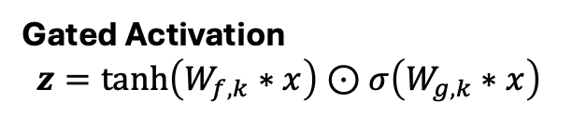
WaveNet
Feature Values
Feature Weights
Gated Activation
$$z=\text{tanh}\left(W_{f,k}∗x\right)⊙σ\left(W_{g,k}∗x\right)$$
Notes:
Finally, the architecture starts with a strided causal convolution. Then a few repeated layers.
These layers start with a dilated convolution, CLICK, then use a gated activation. CLICK
The first block encodes feature values whilst the second encodes feature weights. The gating effect comes from the weights which allow the model to block/downweight the importances of certain features.
CLICK
Now looking at the forward passes, we pass in, we get out, we append. Then we repeat.

Slide 14
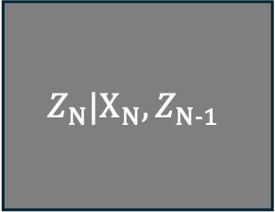
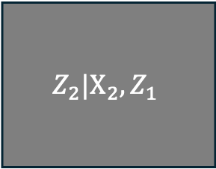
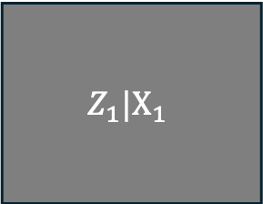
Wav2Vec
$$Z_{1}|X_{1}$$
$$Z_{2}|X_{2},Z_{1}$$
$$Z_{N}|X_{N},Z_{N−1}$$
. . .
Our goal is to learn a latent representation of the waveform, $z$, that encodes information
governing overall speech structure such as linguistics, phonetics, and identity.
Notes:
Now let's move to the first representation learning model, Wav2Vec.
Going forward, each of these will have a bit of abuse of notation, but the idea to setup how the learned representation encodes some information.
Our goal is to learn a latent representation of the waveform, $z$, that encodes information governing overall speech structure such as linguistics, phonetics, and identity.

Slide 15
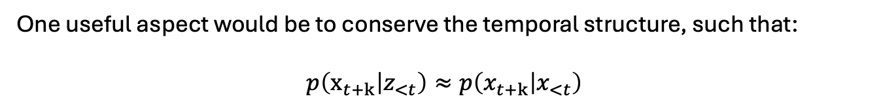
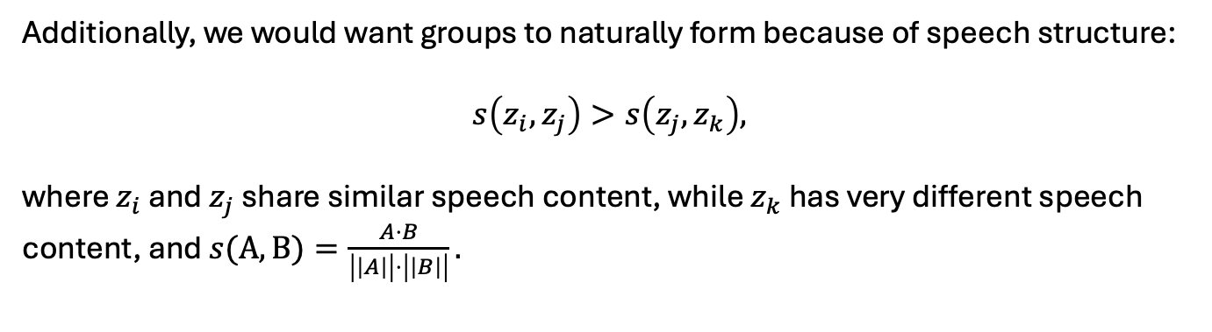
Wav2Vec
Before we jump into what they do, lets think about what a useful embedding space might look like.
One useful aspect would be to conserve the temporal structure, such that:
$$p\left(x_{t+k} | z_{<t}\right)≈p\left(x_{t+k} | x_{<t}\right)$$
Additionally, we would want groups to naturally form because of speech structure:
$$s\left(z_{i},z_{j}\right)>s\left(z_{j},z_{k}\right),$$
where $z_{i}$ and $z_{j}$ share similar speech content, while $z_{k}$ has very different speech content, and $s(A,B)=\frac{A⋅B}{\left|\left|A\right|\right|⋅\left|\left|B\right|\right|}.$
Notes:
Before we jump into what they do, lets think about what a useful embedding space might look like.
CLICK
One useful aspect would be to conserve the temporal structure, such that we can predict the next waveform sample from the prior latents just as well at the actual prior waveform samples.
CLICK
Additionally, we would want groups to naturally form because of speech structure. For example, two latents representations that share similar speech content should be better align than two components that are not.

Slide 16
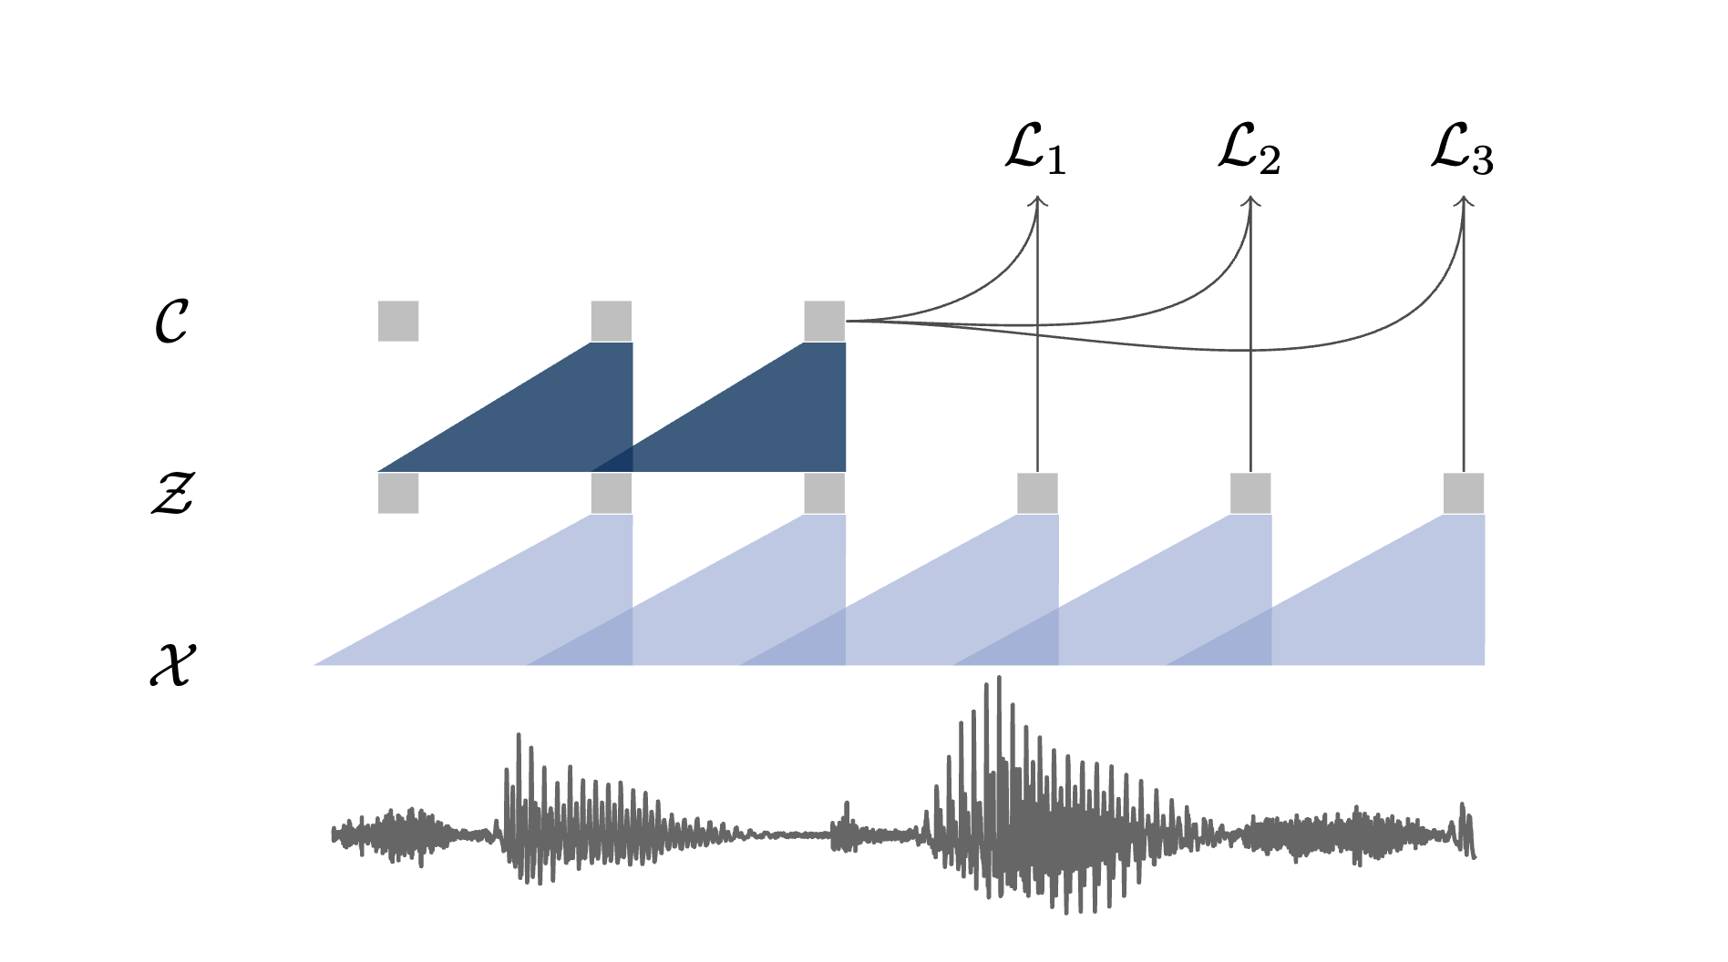
Wav2Vec
The raw waveform after normalization is fed into model. No quantization!
Notes:
Let's start building the method.
First, we have the waveform, with no quantization.

Slide 17
Wav2Vec
The encoder maps the audio signal $X$ into a latent space $Z$, such that $f : X→Z$. It also uses causal convolutions.
Encoder
Notes:
We add an encoder that maps the waveform to a latent space. This encoder block uses the same strided plus dilated causal convolutions.

Slide 18
Wav2Vec
The context network maps the latent $Z$ to an an aggregate representation C, such that $g : Z →C$.
Context Network
Notes:
Now lets add a context network that aggregates latent representations together, again using causal convolutions.
This plot doesn’t do it just for how many latents it aggregates.
To put in perspective, the context network aggregates around 210 ms of input and the encoders only encode around 10 ms each. So, for only 21 latents, we don’t need dilation.

Slide 19
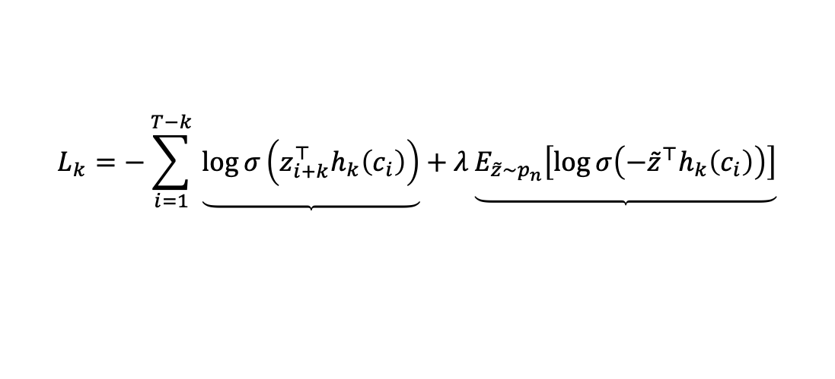
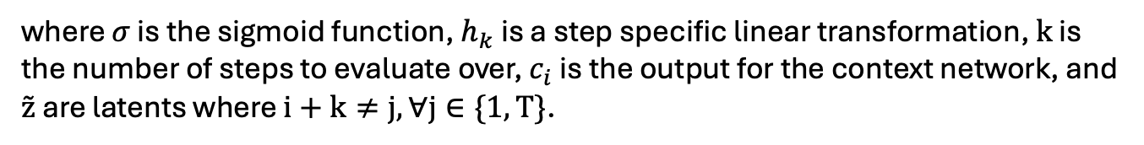
Wav2Vec
Thinking back to how we wanted to organize the latent space, we wanted temporal prediction and speech structure. We can now define the loss as such:
$$L_{k}=−\sum_{i=1}^{T−k}{​}\underbrace{\log{σ\left(z_{i+k}^{⊤}h_{k}\left(c_{i}\right)\right)}}+λ\underbrace{E_{\tilde{z}∼p_{n}}\left[\log{σ\left(−{\tilde{z}}^{⊤}h_{k}\left(c_{i}\right)\right)}\right]}$$
Prediction
Discrimination
where $σ$ is the sigmoid function, $h_{k}$ is a step specific linear transformation, $k$ is the number of steps to evaluate over, $c_{i}$ is the output for the context network, and $z̃$ are latents where $i+k≠j, ∀j∈\{1,T\}$.
This objective stems from Contrastive Predictive Coding where the goal is to maximize the mutual information between historical context and future representations.
Notes:
Thinking back to how we wanted to organize the latent space, we wanted temporal prediction and speech structure. We can now define the loss as this equation.
CLICK
The first term is a temporal prediction term.
CLICK
The second term is discrimination term
CLICK
This objective stems from Contrastive Predictive Coding where the goal is to maximize the mutual information between historical context and future representations.

Slide 20

Wav2Vec
Ground Truth
Prediction
$$−log{σ\left(z_{i+k}^{⊤}{h_{k}\left(c_{i}\right)}\right)}$$
The prediction term is the positive class binary log-likelihood between the prediction for timestep $k$, $h_{k}\left(c_{i}\right),$ and the encoded future timestep $k$, $z_{i+k}$.
$σ$ is a sigmoid function. Therefore, maximizing the function means a large inner product between the two vectors.
Notes:
The prediction term is the inner product between our CLICK prediction for the next term, and the CLICK encoded ground truth.
Specifically, this is positive class for a binary log-likihood loss.
CLICK
Since sigma is a sigmoid function, to maximize this term we want a large inner produce between the two vector (i.e. constructive interference).

Slide 21
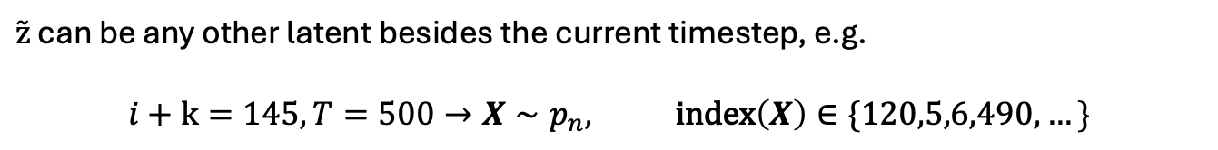
Wav2Vec
$$−E_{\tilde{z}∼p_{n}}\left[\log{σ\left(−{\tilde{z}}^{⊤}h_{k}\left(c_{i}\right)\right)}\right]$$
The discriminator term is the negative class binary log-likelihood between the prediction for timestep $k$, $h_{k}\left(c_{i}\right),$ and latents sampled from the distractor set $p_{n}$, $z̃$.
In practice, 10 latents are sampled to estimate the expectation.
$z̃$ can be any other latent besides the current timestep, e.g.
$$i+k=145,T=500→X∼p_{n}, \text{index}\left(X\right)∈\{120,5,6,490,…\}$$
Again, $σ$ is a sigmoid function. Since we compute the negative inner product, we want to make the inner product as small as possible.
Notes:
Now the discriminator term is the negative class of the binary log-likelihood.
For this term we do not have a temporal prediction. Here we sample ground truth latent instances from the distractor set.
CLICK
In practice, 10 latents are sampled to estimate the expectation.
CLICK
This set is all instances future and past that are not equal to the prior prediction step. Not that these instances are the encoded ground truth, not the waveform but the latents.
CLICK
Since sigma is a sigmoid function and we have a negative inside, we want to make the inner product as small as possible (i.e. destructive interference).

Slide 22
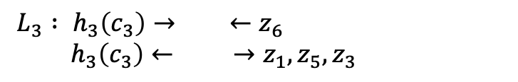
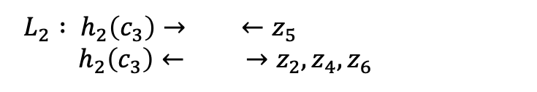
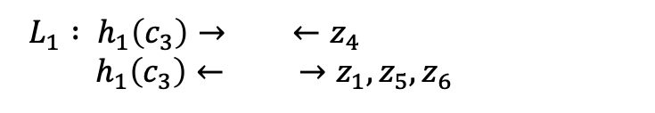
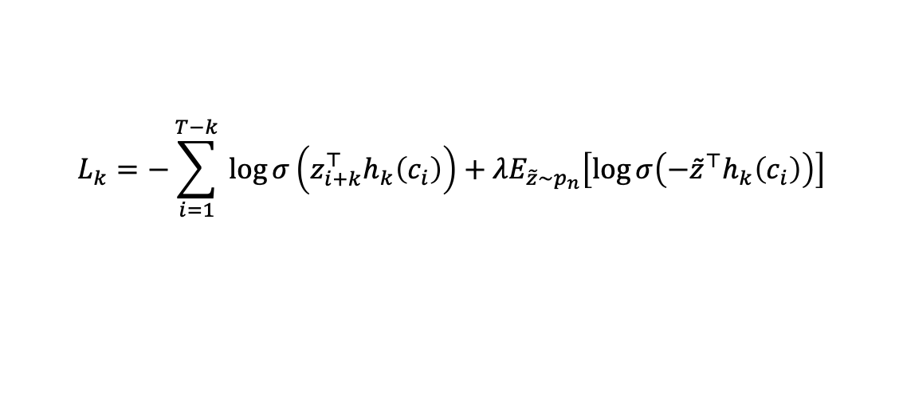
Wav2Vec
$$L_{k}=−\sum_{i=1}^{T−k}{​}\log{σ\left(z_{i+k}^{⊤}h_{k}\left(c_{i}\right)\right)}+λE_{\tilde{z}∼p_{n}}\left[\log{σ\left(−{\tilde{z}}^{⊤}h_{k}\left(c_{i}\right)\right)}\right]$$
$L_{1} : h_{1}\left(c_{3}\right)→ ←z_{4}$
$h_{1}\left(c_{3}\right)← →z_{1},z_{5},z_{6}$
$L_{2} : h_{2}\left(c_{3}\right)→ ←z_{5}$
$h_{2}\left(c_{3}\right)← →z_{2},z_{4},z_{6}$
$L_{3} : h_{3}\left(c_{3}\right)→ ←z_{6}$
$h_{3}\left(c_{3}\right)← →z_{1},z_{5},z_{3}$
Notes:
So together, the first term aligns representations temporally, while the second pushes representations as far away as possible.
Training wise, structure naturally forms due to the give and take of the two competing terms.
Note the scalar to slightly downweight the second term.
Now let's look at L_1, L_2 and L_3.
The first term pushes the context past terms to the encoded furture term, while the second term pushes it away from z_1 (which it actually has context of) and two future terms.
CLICK
We get the same thing for the L_2, just with different latents.
CLICK
And again, with L_3.

Slide 23
Wav2Vec
NOTE:
The inner products determine which representations are pulled together or pushed apart, while the binary log-loss converts those scores into a stable classification objective with diminishing gradients for already-correct pairs.
Notes:
Finally, to clear up any more confusion regarding why the binary classification loss.
The inner products determine which representations are pulled together or pushed apart, while the binary log-loss converts those scores into a stable classification objective with diminishing gradients for already-correct pairs.
We could use something like soft/hard clipping, but the binary classification version of the loss is the statistically reasonable and stable approach.

Slide 24
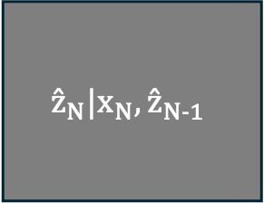
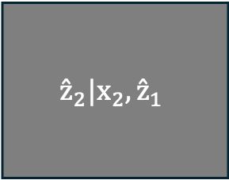
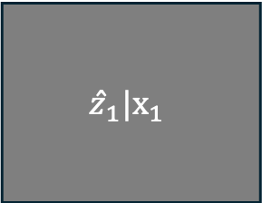
VQ-Wav2Vec
$$ẑ_{1}|x_{1}$$
$${ẑ}_{2}|x_{2},{ẑ}_{1}$$
$${ẑ}_{N}|x_{N},{ẑ}_{N−1}$$
. . .
The goal of VQ-Wav2Vec is the same, learning a representation that contains sufficient temporal information for prediction, and various components of speech.
Surprisingly, it is the same method as Wav2Vec but with discretized latents $Ẑ$.
Notes:
Now onto VQ-Wav2Vec.
CLICK
The goal again remains the same.
CLICK
The only new part is the quantization module added after the encoder.

Slide 25
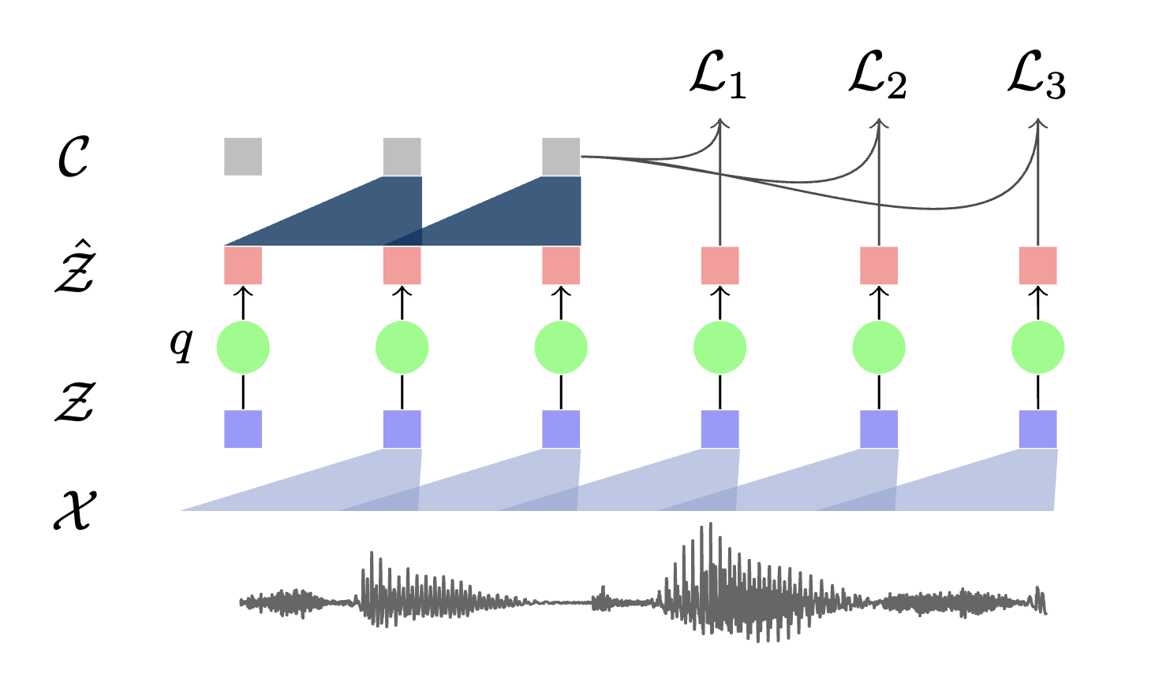
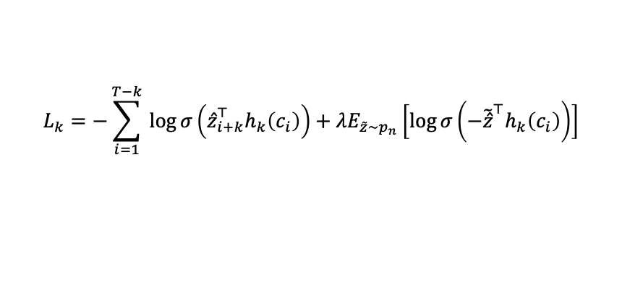
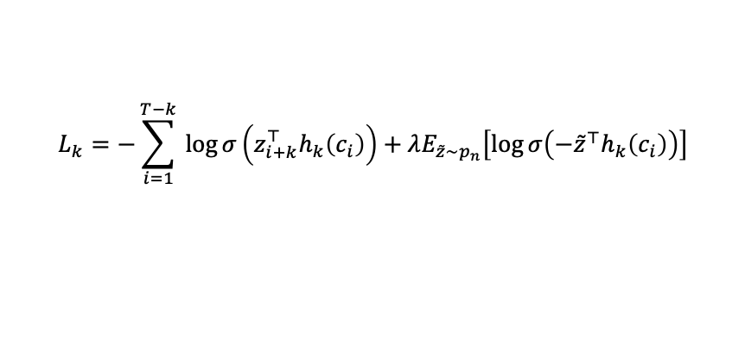
VQ-Wav2Vec
Wav2Vec
VQ-Wav2Vec
Architectures
$$L_{k}=−\sum_{i=1}^{T−k}{​}\log{σ\left(z_{i+k}^{⊤}h_{k}\left(c_{i}\right)\right)}+λE_{\tilde{z}∼p_{n}}\left[\log{σ\left(−{\tilde{z}}^{⊤}h_{k}\left(c_{i}\right)\right)}\right]$$
$$L_{k}=−\sum_{i=1}^{T−k}{​}\log{σ\left({ẑ}_{i+k}^{⊤}h_{k}\left(c_{i}\right)\right)}+λE_{\tilde{z}∼p_{n}}\left[\log{σ\left(−{\tilde{ẑ}}^{⊤}h_{k}\left(c_{i}\right)\right)}\right]$$
Objectives
Notes:
Looking at the architectures and objectives, they are pretty much the same.
CLICK
The only difference in architectures is this quantization module.
CLICK
And the only difference in objectives is we now use z hat, which is the quantized latent

Slide 26
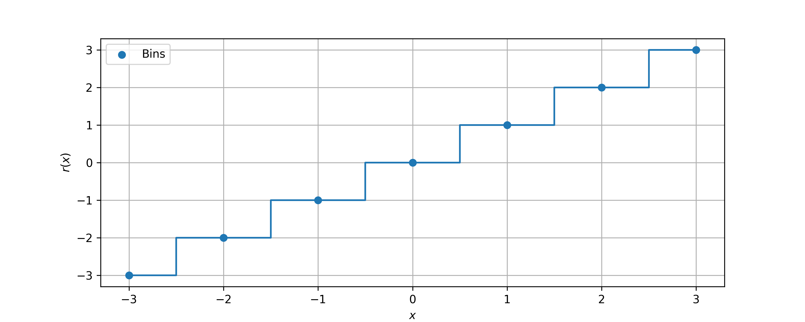
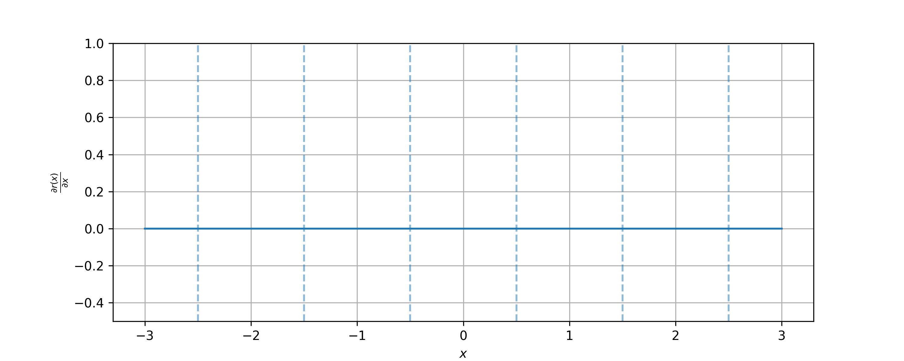

VQ-Wav2Vec
The key to VQ-Wav2Vec is the discretization module. Two quantization modules are introduced,
but we will discuss “hard” Gumbel-Softmax.
First, lets detail a problem that occurs with quantization in models trained with gradient descent.
Let's consider what happens with a simple quantizer such as the round function, $r\left(x\right)=\text{round}\left(x\right)$.
Plotting $r(x)$ and $\frac{∂r\left(x\right)}{∂x}$ we see:
Notes:
The key to VQ-Wav2Vec is the discretization module. Two quantization modules are introduced, but we will discuss “hard” Gumbel-Softmax.
CLICK
First, lets detail a problem that occurs with quantization in models trained with gradient descent.
CLICK
Let's consider a simple quantizer such as the round function.
CLICK
Plotting them we see a step function corresponding to the function, and a constant with discontinuous corresponding to the first derivative.

Slide 27
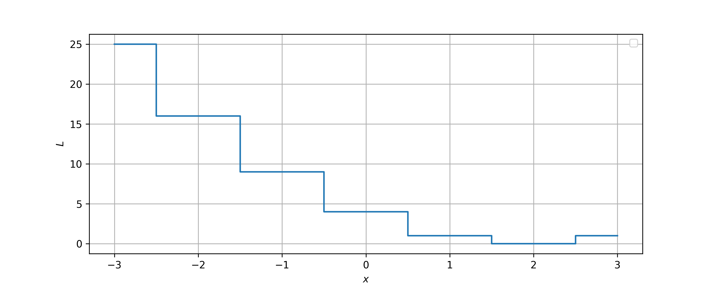


VQ-Wav2Vec
The function $r\left(x\right)$ is defined everywhere.
Let's compute the forward pass of this module. Our objective function will be $L={\left(r\left(x\right)−2\right)}^{2}$.
For the following values of $x:$
$$x_{1}=−1.5→r\left(−1.5\right)=−1→L_{1}={\left(−1−2\right)}^{2}=9$$
$$x_{2}=0.7→r\left(0.7\right)=1→L_{2}={\left(1−2\right)}^{2}=1$$
$$x_{3}=3→r\left(3\right)=3→L_{3}={\left(3−2\right)}^{2}=1$$
Notes:
Now let's compute the forward pass with a squared error objective. We target is the value 2.
CLICK
Now let's test some values.
CLICK
With x = -1.5 we get a loss of 9.
CLICK
With x = 0.7 we get a loss of 1.
CLICK
And with x = 3, we get a loss of 1.

Slide 28
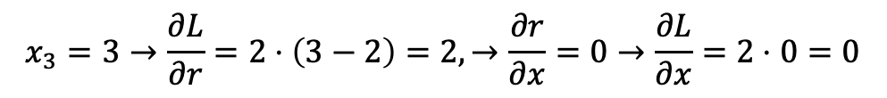
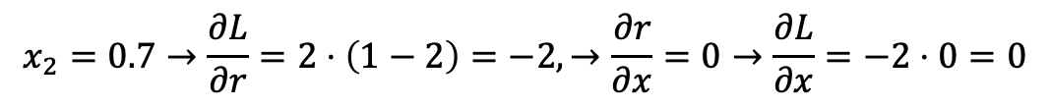
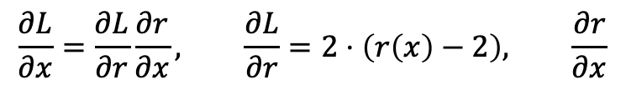
VQ-Wav2Vec
That looked okay, we have loss values at least. Now let's compute the backward pass.
$$\frac{∂L}{∂x}=\frac{∂L}{∂r}\frac{∂r}{∂x}, \frac{∂L}{∂r}=2⋅\left(r\left(x\right)−2\right), \frac{∂r}{∂x}$$
And finally looking at some values:
$$x_{1}=−1.5→\frac{∂L}{∂r}=2⋅\left(−1−2\right)=−6,→\frac{∂r}{∂x}=\text{UNDEFINED}→\frac{∂L}{∂x}=−6⋅\text{UNDEFINED}=\text{UNDEFINED}$$
$$x_{2}=0.7→\frac{∂L}{∂r}=2⋅\left(1−2\right)=−2,→\frac{∂r}{∂x}=0→\frac{∂L}{∂x}=−2⋅0=0$$
$$x_{3}=3→\frac{∂L}{∂r}=2⋅\left(3−2\right)=2,→\frac{∂r}{∂x}=0→\frac{∂L}{∂x}=2⋅0=0$$
Notes:
That looked fine. Now let's compute the backward pass.
CLICK
First let's write out some useful functions.
CLICK
Now let's look at some values
CLICK
With x = -1.5 the derivative of r w.r.t x is undefined due to discontinuity, so our gradient is undefined under the chain rule.
CLICK
Now let's try x = 0.7. The derivative of r w.r.t x is now 0, so our gradient is 0.
CLICK
Okay, now let’s try x=3. Again, our gradient is 0.

Slide 29
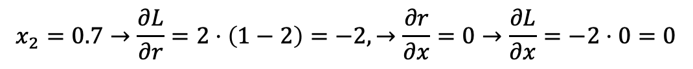
VQ-Wav2Vec
Forward
Backward
$$x_{3}=3→r\left(3\right)=3→L_{3}={\left(3−2\right)}^{2}=1$$
$$x_{2}=0.7→\frac{∂L}{∂r}=2⋅\left(1−2\right)=−2,→\frac{∂r}{∂x}=0→\frac{∂L}{∂x}=−2⋅0=0$$
As we have seen, with a quantization in a model that is updated via gradient descent, the forward pass works functionally the same but due to the quantization functions being constant everywhere except at discontinuities, the gradient is therefore 0, meaning we cannot update any parameters that occur BEFORE the quantization operation.
This is the discretization problem.
Notes:
This is discretization/quantization problem. We cannot have differentiable quantization modules.
As we have seen, with a quantization in a model that is updated via gradient descent, the forward pass fine but due to the quantization functions being constant everywhere except at discontinuities, the gradient is therefore 0. This means we cannot update any parameters that occur BEFORE the quantization operation, such as an encoder.
That means the context network would have its parameters updated, but the encoder parameters would never be updated.

Slide 30
VQ-Wav2Vec
Now let's see how ”hard” Gumbel Softmax aims to relax this problem.
Notes:
Now let's see how ”hard” Gumbel Softmax aims to relax this problem.

Slide 31
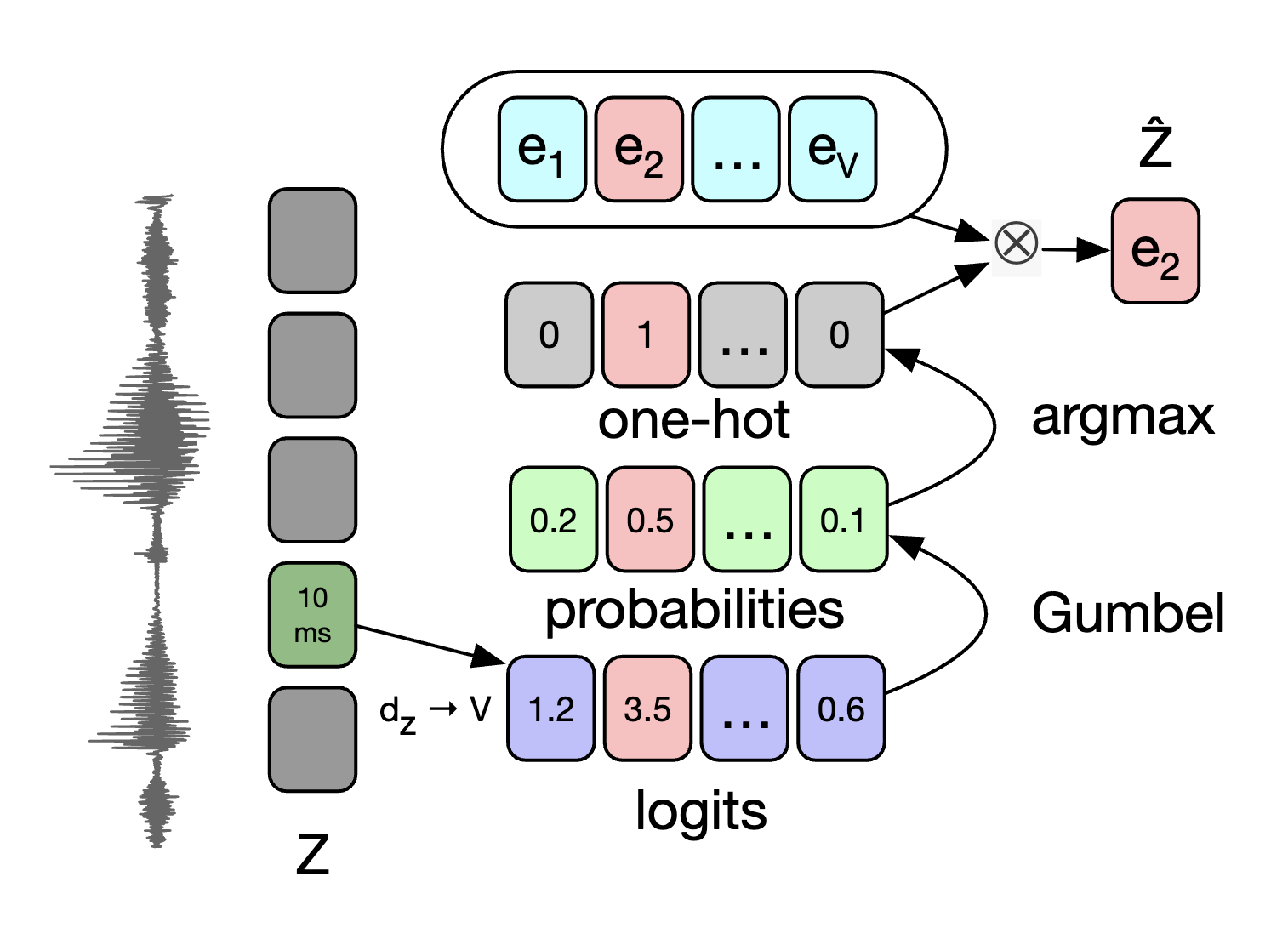
VQ-Wav2Vec
We first start from the continuous latent space.
Notes:
We first start from the continuous latent space, where the latent space is mapped to V logits.
Each logit corresponds to a different quantized unit called a codeword. We can also encode multiple vectors called groups.

Slide 32
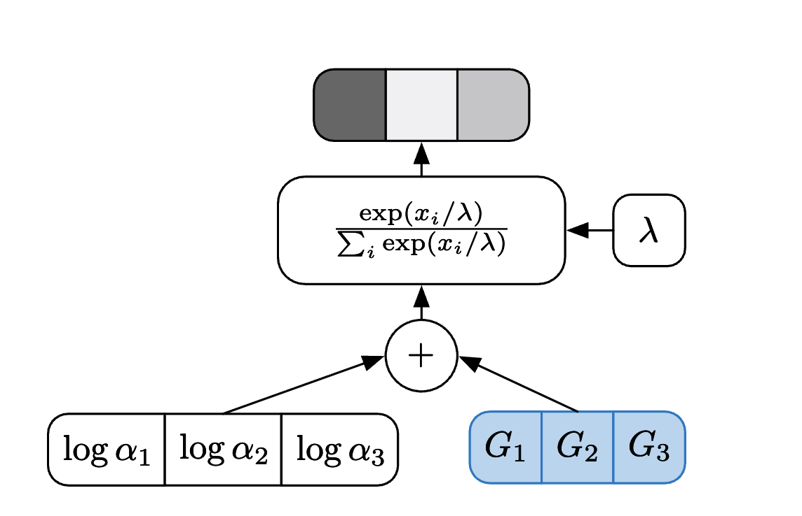
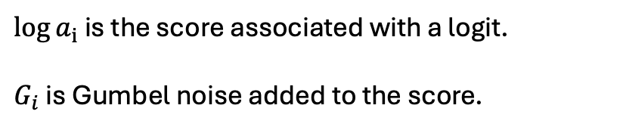
VQ-Wav2Vec
Next, we apply Gumbel-Softmax to the continuous vectors to get a probability distribution for each codeword.
$\log{a_{i}}$ is the score associated with a logit.
$G_{i}$ is Gumbel noise added to the score.
Notes:
Next, we compute the Gumbel distribution.
CLICK
This distribution follows a Concrete distribution which is a continuous, differentiable relaxation of a categorical distribution that approaches a discrete one-hot distribution as the temperature decreases. When temperature (lambda) goes to 0 we have a categorical distribution. In practice we do not actually compute the argmax like this, we just select the maximum argument.
It is similar to the reparameterization trick used in VAEs, where it allows us to sample from a categorical whilst staying differentiable.
This trick adds noise to the scores and computes the distribution given that.

Slide 33
VQ-Wav2Vec
Using ”hard” Gumbel-Softmax, we compute the argmax of the distribution (also achieved as $λ→0^{+}$).
Notes:
Now the “hard” in ”hard” Gumbel-Softmax means we do compute that armax.

Slide 34
VQ-Wav2Vec
Using the one-hot vector we compute the codeword using an embedding layer.
Notes:
Given the index of the one hot entry, we use that to select the codeword through a learnable embedding layer.

Slide 35
VQ-Wav2Vec
But wait, didn’t we show that the quantization (i.e., the argmax operation) is non-differentiable.
The solution to this problem is a straight through estimator.
def straight_through_estimator(self):
return y_hard - y_soft.detach() + y_soft
Notes:
What we have just shown is how to simulate an estimate a categorical distribution, so we can sample from the quantization module.
What we didn’t show was the solution to that non-differentiable argmax operation.
CLICK
The is a straight through estimator.
The code is easiest to understand, and its that simple.

Slide 36
VQ-Wav2Vec
But wait, didn’t we show that the quantization (i.e., the argmax operation) is non-differentiable.
The solution to this problem is a straight through estimator.
def straight_through_estimator(self):
return y_hard - y_soft.detach() + y_soft
During the forward pass, both the second and third terms cancel, so the argmax is computed correctly.
Notes:
During the forward pass, both the second and third terms cancel, so the argmax is computed correctly.

Slide 37
VQ-Wav2Vec
But wait, didn’t we show that the quantization (i.e., the argmax operation) is non-differentiable.
The solution to this problem is a straight through estimator.
def straight_through_estimator(self):
return y_hard - y_soft.detach() + y_soft
During the backward pass, both the first and second terms have gradients that are zero everywhere, but the third term has well defined gradients which correspond to the Gumbel-Softmax distribution of the encoded vectors.
Although the gradient signal can be a little noisy, given that the gradient is w.r.t the one-hot vector and not the dense representation, overtime it is fairly stable.
Notes:
During the backward pass, both the first and second terms have gradients that are zero everywhere, but the third term has well defined gradients which correspond to the Gumbel-Softmax distribution of the encoded vectors.
CLICK
Although the gradient signal can be a little noisy, given that the gradient is w.r.t the one-hot vector and not the dense representation, overtime it is fairly stable.

Slide 38
VQ-Wav2Vec
We now know, (1) how the Gumbel-Softmax method approximates categorical distributions and (2) how straight through estimators can enable quantization in gradient descent optimization.
The rest of VQ-Wav2Vec remains the exact same as Wav2Vec.
Notes:
We now know, (1) how the Gumbel-Softmax method approximates categorical distributions and (2) how straight through estimators can enable quantization in gradient descent optimization.
The rest of VQ-Wav2Vec remains the exact same as Wav2Vec.

Slide 39
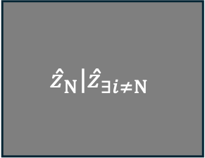
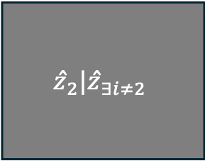
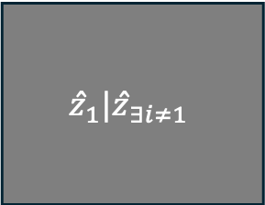
Wav2Vec 2.0
$$ẑ_{1}|ẑ_{∃i≠1}$$
$$ẑ_{2}|ẑ_{∃i≠2}$$
$$ẑ_{N}|ẑ_{∃i≠N}$$
. . .
The goal of Wav2Vec 2.0 is the same, learning a representation. We now aim to identify the latent quantized targets from the other latents.
Wav2Vec 2.0 builds upon VQ-Wav2Vec by (1) changing the objective, (2) changing the context network architecture, and (3) using masked prediction.
Notes:
Now let's move to Wav2Vec 2.0
CLICK
The goal is again the same, but as you may have noticed the text in the grey boxes have changed a bit.
CLICK
This is to reflect the new objective, which is masked prediction.

Slide 40
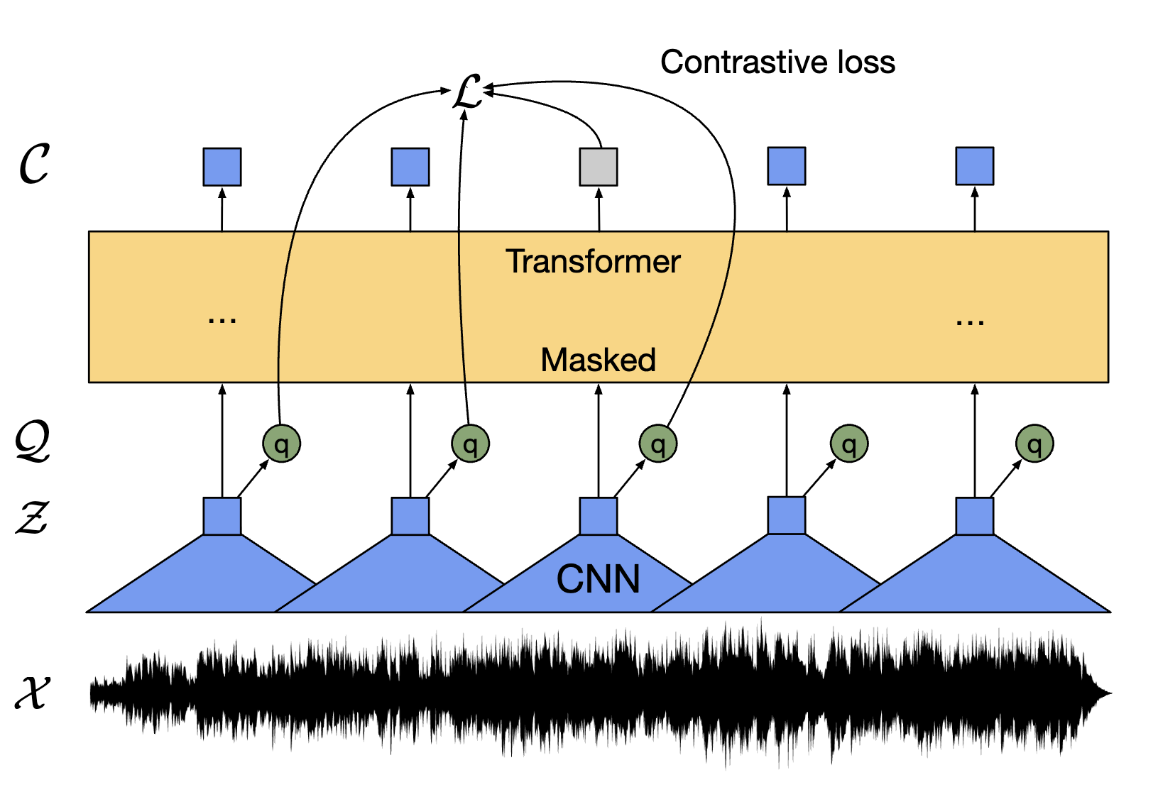
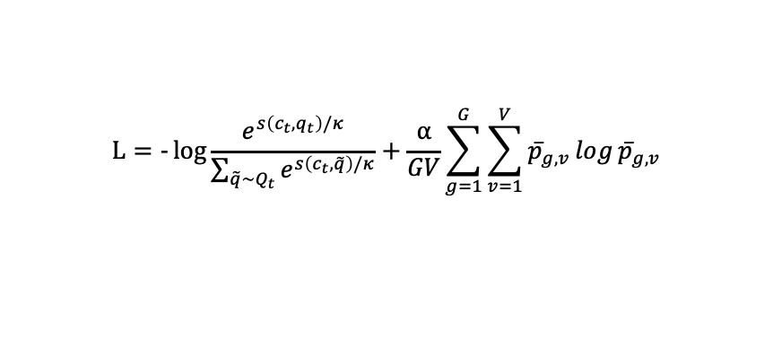

Wav2Vec 2.0
VQ-Wav2Vec
Wav2Vec 2.0
Architectures
$$L_{k}=−\sum_{i=1}^{T−k}{​}\log{σ\left({ẑ}_{i+k}^{⊤}h_{k}\left(c_{i}\right)\right)}+λE_{\tilde{z}∼p_{n}}\left[\log{σ\left(−{\tilde{ẑ}}^{⊤}h_{k}\left(c_{i}\right)\right)}\right]$$
$$L=−\log{\frac{e^{s\left(c_{t},q_{t}\right)/κ}}{\sum_{\tilde{q}∼Q_{t}}{e^{s\left(c_{t},\tilde{q}\right)/κ}}}}+\frac{α}{GV}\sum_{g=1}^{G}{\sum_{v=1}^{V}{p̅_{g,v}\log{p̅_{g,v}}}}$$
Objectives
Notes:
Comparing the architectures we see a new context network based on the transformer architecture, non causal encoders, and a new masked term.
Comparing the objectives, they look nothing alike.
Although the first term of Wav2Vec 2.0 is a multiclass classification contrastive loss while the full vq-wav2vec loss is a binary classification contrastive loss.
The second term of Wav2Vec 2.0 objective aims to maximize the usage of the codebook.

Slide 41
Wav2Vec 2.0
The first change is the architecture. We do not use causal convolution blocks in the context network anymore.
Notes:
The first change is the architecture. We do not use causal convolution blocks in the context network anymore.

Slide 42

Wav2Vec 2.0
We now use a Transformer.
Notes:
We now use a Transformer.
You maybe have heard of this before.
The transformer has two components, an encoder and a decoder.

Slide 43
Wav2Vec 2.0
First, throw away the decoder as this is a generative branch that we do not need/have use for.
Notes:
We don’t need the decoder. This is more of a generative branch, and it requires us to have a vocabulary, which we don’t have.

Slide 44
Wav2Vec 2.0
Now we are left with the encoder only, which was popularized by the method BERT.
The goal of this model is to take in a sequence of tokens and produce a sequence of embeddings.
In this scenario, our input is the continuous latent space $z$ (output of the encoder).
Notes:
Now we are left with the encoder only, which was popularized by the method BERT.
CLICK
The goal of this model is to take in a sequence of tokens and produce a sequence of embeddings.
CLICK
In this scenario, our input is the continuous latent space $z$ (output of the encoder).

Slide 45
Wav2Vec 2.0
Next, we need to detail masking.
The idea of masking is to use the context to fill in gaps.
Notes:
Next, let’s go over masking.
CLICK
The idea of masking is to use the context to fill in gaps.

Slide 46
Wav2Vec 2.0
Next, we need to detail masking.
The idea of masking is to use the context to fill in gaps.
How
was
your
[MASK]
at
[MASK]
?
What could these words be?
Notes:
Given this sentence with masks over the ground truth words,
CLICK
We could use the context of the surround words to fill in the gaps.
So, the sentence is:
How was you BLANK at BLANK ?
Note, we typically refer to input data as tokens given that they bits and pieces of words, not exactly like this setup.

Slide 47
Wav2Vec 2.0
Next, we need to detail masking.
The idea of masking is to use the context to fill in gaps.
How
was
your
[MASK]
at
[MASK]
?
day
ride
flight
work
NYC
Vegas
Notes:
Our guesses for the first token could be day, ride, or even flight.
CLICK
And maybe our guesses for the second token could be work, NYC, and vegas.

Slide 48
Wav2Vec 2.0
Next, we need to detail masking.
The idea of masking is to use the context to fill in gaps.
How
was
your
[MASK]
at
[MASK]
?
BERT (encoder only)
NOTE: Transformer models (such as BERT) have a fixed context length. The benefit of BERT is we get an embedding for all inputs in parallel.
Notes:
The encoder we use is a variant called BERT because it is a bidirectional encoder.
Its goal is to take in all those tokens, encode each token with context, and output an embedding for each token that encodes themselves and their context.
CLICK
Transformer models (such as BERT) have a fixed context length, which is the number of tokens that can take in at the same time. The benefit of this is we get an embedding for all inputs in parallel.

Slide 49







Wav2Vec 2.0
Next, we need to detail masking.
The idea of masking is to use the context to fill in gaps.
How
was
your
[MASK]
at
[MASK]
?
BERT (encoder only)
$$\left[\begin{aligned}1 \\ 5 \\ 3\end{aligned}\right]$$
$$\left[\begin{aligned}8 \\ 9 \\ 1\end{aligned}\right]$$
$$\left[\begin{aligned}0 \\ 0 \\ 1\end{aligned}\right]$$
$$\left[\begin{aligned}1 \\ 6 \\ 0\end{aligned}\right]$$
$$\left[\begin{aligned}1 \\ 4 \\ 5\end{aligned}\right]$$
$$\left[\begin{aligned}5 \\ 4 \\ 1\end{aligned}\right]$$
$$\left[\begin{aligned}9 \\ 9 \\ 0\end{aligned}\right]$$
Notes:
Now that we have passed the tokens into the model, we get some vectors.

Slide 50







Wav2Vec 2.0
The goal of these embeddings is to embed information from the context.
$$\left[\begin{aligned}1 \\ 5 \\ 3\end{aligned}\right]$$
$$\left[\begin{aligned}8 \\ 9 \\ 1\end{aligned}\right]$$
$$\left[\begin{aligned}0 \\ 0 \\ 1\end{aligned}\right]$$
$$\left[\begin{aligned}1 \\ 6 \\ 0\end{aligned}\right]$$
$$\left[\begin{aligned}1 \\ 4 \\ 5\end{aligned}\right]$$
$$\left[\begin{aligned}5 \\ 4 \\ 1\end{aligned}\right]$$
$$\left[\begin{aligned}9 \\ 9 \\ 0\end{aligned}\right]$$
Notes:
Again, the goal of these embeddings is to embed information from the context.
CLICK : such that all the surrounding information is encoded each vector.

Slide 51
Wav2Vec 2.0
The goal of these embeddings is to embed information from the context.
$$\left[\begin{aligned}1 \\ 5 \\ 3\end{aligned}\right]$$
$$\left[\begin{aligned}8 \\ 9 \\ 1\end{aligned}\right]$$
$$\left[\begin{aligned}0 \\ 0 \\ 1\end{aligned}\right]$$
$$\left[\begin{aligned}1 \\ 6 \\ 0\end{aligned}\right]$$
$$\left[\begin{aligned}1 \\ 4 \\ 5\end{aligned}\right]$$
$$\left[\begin{aligned}5 \\ 4 \\ 1\end{aligned}\right]$$
$$\left[\begin{aligned}9 \\ 9 \\ 0\end{aligned}\right]$$
today
work
We predict the masked tokens from the context.
Notes:
Now if we were to look at the ground truth for that sentence, our goal should be to predict the embedding that corresponds with ground truth token from the context alone.

Slide 52
Wav2Vec 2.0
We use the quantized target as the ground truth embedding.
Notes:
For our case, we do not have a fixed vocabularly,
CLICK
but we are learning it through the quantization module.
CLICK
Therefore, we want to predict the discrete class that was masked.

Slide 53

Wav2Vec 2.0
Note:
The masked vector is just a single learnable vector. It is not a function of the input. It could be fixed, such as $\vec{0}$ or $\vec{1}$, but this may not align with the range learned by the encoder, so it is more stable to use a learnable vector.
Notes:
Note this going forward, in our context, a mask is just a single learnable vector. It is not a function of the input. It could be fixed, such as $\vec{0}$ or $\vec{1}$, but this may not align with the range learned by the encoder, so it is more stable to use a learnable vector.

Slide 54

Wav2Vec 2.0
Finally, we can cover the objective.
The first component is the contrastive loss. Maximizing the probability of the target vector:
$$L_{m}=−\log{\frac{e^{s\left(c_{t},q_{t}\right)/κ}}{\sum_{\tilde{q}∼Q_{t}}{e^{s\left(c_{t},\tilde{q}\right)/κ}}}}$$
where $s\left(A,B\right)=\frac{A⋅B}{\left|\left|A\right|\right|⋅\left|\left|B\right|\right|}$, $c_{t}$ is the masked token context embedding, $q_{t}$ is the quantized target (premask) embedding, $q̃$ are randomly sampled quantized latents (including $q_{t}$ among distractors), and $κ$ is the temperature variable for Softmax distributions.
Minimizing this loss means (1) increasing the similarity with the quantized target and (2) decreasing the similarity with other quantized latents.
Notes:
Finally let's touch the objective.
CLICK
The first component is the contrastive loss.
This is again a Softmax distribution with a similar form to the wavenet loss.
The numerator compares the distance between the output of the masked embedding and the quantized latent (before masking). The denominator samples quantized distractors, similar to the prior versions, along with the quantized target, to bootstrap a multiclass classification term without having to sample all of codewords.
CLICK
Minimizing this loss means (1) increasing the similarity with the quantized target and (2) decreasing the similarity with other quantized latents.

Slide 55

Wav2Vec 2.0
Recap:
Maximize the probability of predicting the target vector from the masked context embedding, $p\left(q_{t} | c_{t}\right)$, whilst lowering the probability of predicting the other non-target vectors, $p\left(\tilde{q} | c_{t}\right)$.
Notes:
Get comfortable with this loss term, because you will see it over an over again.
To state it again: we maximize the probability of predicting the target vector from the masked context embedding, whilst lowering the probability of predicting the other non-target vectors.

Slide 56
Wav2Vec 2.0
Recap:
We do not sample all the codewords for the set of distractors.
Notes:
Stating it again, we do not sample all of the codewords, even though we could, we just sample a subset.

Slide 57

Wav2Vec 2.0
Next is the diversity loss.
$$L_{d}=\frac{1}{GV}\sum_{g=1}^{G}{\sum_{v=1}^{V}{p̅_{g,v}\log{p̅_{g,v}}}}$$
where $G$ is the number of codeword groups, $V$ is the number of codeword entries (for each group), $p̅_{g,v}$ is the average Softmax selection probability for entry $v$ in group $g$.
This equation is the negative entropy over each group. Therefore, minimizing this loss means maximizing entropy of the average codeword usage.
More entropy, more uniform.
Notes:
The final term is the diversity loss.
CLICK
This equation is the negative entropy over each group. Therefore, minimizing this loss means maximizing entropy of the average codeword usage.
More entropy, means more uniform. More uniform, means better quantization effectiveness.

Slide 58

Wav2Vec 2.0
Finally, our objective is:
$$L=L_{m}+αL_{d}=−\log{\frac{e^{s\left(c_{t},q_{t}\right)/κ}}{\sum_{\tilde{q}∼Q_{t}}{e^{s\left(c_{t},\tilde{q}\right)/κ}}}}+\frac{α}{GV}\sum_{g=1}^{G}{\sum_{v=1}^{V}{p̅_{g,v}\log{p̅_{g,v}}}}$$
Altogether, we want to (1) maximize the probability of predicting the quantized target from the masked content embedding and (2) ensure the quantization has high entropy with uniform probability usage for each codeword.
Notes:
And finally, our objective again.
Hopefully, it is less scary now.
We just have a term that does the push and pull of vectors using the masked vector, and a term that encourages a uniform quantization.
CLICK
Altogether, we want to (1) maximize the probability of predicting the quantized target from the masked content embedding and (2) ensure the quantization has high entropy with uniform usage for each codeword.

Slide 59
Wav2Vec 2.0
Note:
This objective changes things up a decent amount compared to Wav2Vec/VQ-Wav2Vec. This masked prediction objective has been shown to be correlated highly with learning structured latent spaces (which is our goal). To evaluate each of these representation learning method, these embeddings are typically used as input for downstream tasks: classification, automatic speech recognition, automatic speaker verification, phenome recognition, etc.
Wav2Vec 2.0 showed major empirical gains over prior methods. It is still used as a baseline/component of many modern methods.
Notes:
This masked prediction has been shown time and time again to be correlated with structured learning, in all domains, not just speech. There are these same mofels for vision, text, speech, pdes, etc.
CLICK
Wav2Vec 2.0 showed major empirical gains over prior methods. It is still used by many modern methods.

Slide 60
HuBERT
$$ẑ_{1}|ẑ_{∃i≠1}$$
$$ẑ_{2}|ẑ_{∃i≠2}$$
$$ẑ_{N}|ẑ_{∃i≠N}$$
. . .
This model model builds off BERT/Wav2Vec 2.0, utilizing the same masked prediction task.
Compared to Wav2Vec 2.0, HuBERT (1) removes the differentiable vector quantization module and (2) adopts a multi-stage clustering task as target embeddings.
Notes:
Now lets checkout HuBERT.
CLICK
Implied by the name, this model is heavily inspired by the original BERT paper.
CLICK
Compared to Wav2Vec 2.0, HuBERT (1) removes the differentiable vector quantization module and (2) adopts a multi-stage clustering task as target embeddings.

Slide 61

HuBERT
The architecture of HuBERT is nearly identical to Wav2Vec 2.0. The encoder is standard (non-causal) convolution blocks. The transformer block is again the BERT model. The mask is again a learnable vector.
Notes:
The architecture of HuBERT is nearly identical to Wav2Vec 2.0. The encoder is standard (non-causal) convolution blocks. The transformer block is again the BERT model. The mask is again a learnable vector.

Slide 62
HuBERT
However, notice there is no quantization block. That brings us to the next point...
Notes:
However, notice there is no quantization block. That brings us to the next point...

Slide 63
HuBERT
However, notice there is no quantization block. That brings us to the next point... offline clustering.
Notes:
offline clustering

Slide 64


HuBERT
Offline clustering operates in 2 stages.
Stage 1 occurs before any training has begun. The goal is to do K-means clustering on the speech components.
First, from each utterance, $x_{T}$, we compute the N Mel-Frequency Cepstral Coefficients, $m_{N,t}$, in frames of roughly 20-25ms. Along with this, we include the first and second order derivatives (computed via finite differences w.r.t time) of $m_{N,t}$, which is $Δm_{N,t}$ and $Δ^{2}m_{N,t}$ repspectively.
Next, we create the following feature vectors:
$$m_{K,t}=\left[\begin{aligned}m_{N,t} \\ Δm_{N,t} \\ Δ^{2}m_{N,t}\end{aligned}\right], ∀x∈X, ∀t∈T_{x}$$
where $K$ is the number of features, $X$ is the dataset of utterances, and $T$ is the frames per utterance.
Notes:
Offline clustering operates in 2 stages.
CLICK
The goal of stage 1 is to do K-means clustering on various speech components.
CLICK
We begin by taking each utterance (another word for instance when using a dataset of speech) and compute N Mel-Frequency Cepstral Coefficients. These are in frames of roughly 20-25ms.
Along with this we compute the first and second order derivatives.
CLICK
Then we stack these to create a feature vector. In the paper N=13, so the vector is of size 39.
We then compute these feature vectors for all utterances and for all frames.

Slide 65
HuBERT
The resulting feature vectors are now all the same size, $K$. Some utterances get more representation than others depending on total length of utterance.
Next, we do K-means clustering on this feature space with $K$ clusters (in this work they use $K=100$).
Notes:
The resulting feature vectors are now all the same size, $K$. Some utterances get more representation than others depending on total length of utterance.
CLICK
Next, we do K-means clustering on this feature space with $K$ clusters (in this work they use $K=100$).
And yes, there is a bit of abuse of notation.

Slide 66
HuBERT
Our objective has now become to predict the cluster for each masked frame. We now learn discrete embeddings FROM these clusters.
Notes:
Our objective has now become to predict the cluster for each masked frame. We now learn discrete embeddings FROM these clusters.

Slide 67


HuBERT
Written out, the objective function now becomes:
$$L=−\log{\frac{e^{s\left(e_{j},c_{t}\right)/κ}}{\sum_{k=1}^{K}{e^{s\left(e_{k},c_{t}\right)/κ}}}}$$
where $c_{t}$ the predicted embedding, $e_{j}$ is the ground truth embedding, $K$ is the number of classes/clusters, $κ$ is the temperature for a Softmax-distribution, and $s\left(A,B\right)=\frac{A⋅B}{\left|\left|A\right|\right|⋅\left|\left|B\right|\right|}$.
$e_{j}$ and $e_{k}$ are embeddings associated with the cluster labels, e.g.,
$x_{1}→z_{1}$ had a feature vector that was clustered into the 93rd class. We would create a learnable embedding, $e_{93}$, associated only with the 93rd class and that would be the target vector, $e_{j}$. We therefore want the predicted vector to be aligned with the learned embedding, $s\left(e_{j},c_{t}\right)↑$.
Notes:
Written out, the objective function now looks almost the same as the previous method's contrastive loss.
However, here we use all the classes since don’t have that many, and it is relatively easy to sample them.
CLICK
Here our c_t is the predicted embedding from the masked vector.
But now the embeddings are functions of the cluster labels. These embeddings are still learnable, but they are simply a single matrix vector product given a one hot vector of the cluster label, rather than being a function of the input itself.
Let's take for example, z_1 had a feature vector that was clustered into the 93rd class. We would create a learnable embedding, $e_{93}$, associated only with the 93rd class and that would be the target vector, $e_{j}$. We therefore want the predicted vector to be aligned with the learned embedding by having a high cosine similarity.

Slide 68

HuBERT
Note:
They also experiment with another term that predicts the non-masked token classes (the same loss but for every token not masked), i.e., $L=αL_{m}+\left(1−α\right)L_{u}$, where $L_{m}$ is the masked prediction and $L_{u}$ is non-masked prediction.
Notes:
They also experiment with another term that predicts the non-masked token classes (the same loss but for every token not masked), but we don’t need to worry about this because it was very good.

Slide 69

HuBERT
Stage 2 occurs after some training during stage 1 (in their work this is after 250k steps). The goal is to refine the cluster assignments.
$$\left[\begin{aligned}1 \\ 2 \\ 3\end{aligned}\right]$$
Notes:
After around 250k steps using those clusters and embeddings, we enter stage 2. Our goal is to refine the clusters.

Slide 70
HuBERT
To do so, all we do is extract an embedding from the transformer model $∀x∈X, ∀t∈T_{x}$. This is typically from a shallower layer (in their work they use layer 6).
$$\left[\begin{aligned}1 \\ 2 \\ 3\end{aligned}\right]$$
Notes:
To do so, all we do is extract an embedding from the shallow layers of the transformer model for all utterances and time frames.

Slide 71
HuBERT
These embeddings are now our new feature vectors with size $E$ (this size can get fairly large, i.e., $E∈\{384, 2048\}$).
Notes:
These embeddings are now our new feature vectors, and they can get fairly large even for the smallest models.

Slide 72
HuBERT
Given that the size of the features vectors nearly grow by $20×$ (in their work they had $K=39$ and $E=768$), we now only use $10\%$ of the total training dataset to do clustering.
We again do K-Means clustering on them with $K=500$ clusters.
Notes:
Because of this, we only extract embeddings 10% of the dataset.
CLICK
And we now do K-means clustering using these features. We also have 5 times the number of clusters than before.

Slide 73

HuBERT
Given that we (1) have more clusters than stage 1 and (2) likely have different semantic meaning, we also need to update the learnable embeddings for each class.
We simply instantiate a new embedding matrix for the learnable embeddings $e_{j}$ and $e_{k}$. Our prediction $c_{t}$ will also have to instantiate a new transformation to this embedding size as well.
Training begins for stage 2, the same as stage 1.
Notes:
Given that we now have more clusters than stage 1, we need to update the learnable embeddings for each class.
We to so, we simply instantiate a new embedding matrix for the learnable embeddings $e_{j}$ and $e_{k}$.
Our prediction $c_{t}$ will also have to instantiate a new transformation to a new embedding size as well.
CLICK
And now we carry on training.

Slide 74
WavLM
$$ẑ_{1}|ẑ_{∃i≠1}$$
$$ẑ_{2}|ẑ_{∃i≠2}$$
$$ẑ_{N}|ẑ_{∃i≠N}$$
. . .
This model is essentially HuBERT, but with some slight modifications that work well.
Compared to HuBERT, WavLM (1) mixes in other utterances/noise and (2) adds a gated relative position bias.
Notes:
And finally, we have reached WavLM.
CLICK
This model is essentially HuBERT, but with some slight modifications that work well.
CLICK
Compared to HuBERT, WavLM adds a denoising objective and a gated relative position bias.

Slide 75
WavLM
Note:
It also scales up data a ton, but we are just here to discuss methodology.
Notes:
It also scales up data a ton, but we are just here to discuss methodology.

Slide 76

WavLM
The first change is the gated relative position bias.
This operates as an offset for the weights $a_{i,j}$ based off the “key” and ”query” in the self-attention mechanism.
First, lets consider some latent space $h_{i}$.
We con compute the “key”, “query”, and “values” of the attention mechanism as such:
$$q_{i}=h_{i}W^{Q}, k_{i}=h_{i}W^{K}, v_{i}=h_{i}W^{V}$$
where $W$ is separate learnable matrices.
Notes:
The first change is the gated relative position bias.
CLICK
This operates as an offset for the self-attention weights based off the “key” and ”query” values.
CLICK
First, lets consider some latent space $h_{i}$.
CLICK
We con compute the “key”, “query”, and “values” as different transformation of this latent space.

Slide 77
WavLM
Note:
We use learned transformations for the queries, keys, and values so that the original hidden representation is not required to use a single geometry for both determining relevance and transmitting information.
Notes:
Also note, we use learned transformation for the queries, keys, and values so the original representation is not contrained to use a single geometry for both determining relevance and transmitting information.

Slide 78

WavLM
We can compute the self attention output as:
$$a_{i,j}∝e^{\frac{q_{i}⋅k_{j}}{\sqrt{d_{k}}}+r_{i−j}},$$
$$\overline{h_{i}}=\sum_{j=1}^{T}{a_{i,j}v_{j}}$$
where $q_{i}$ is the vector representing the current position, $k_{i}$ is a vector representing another position, $d_{k}$ is the dimension of the vectors (used for normalizing), and $v_{j}$ is a vector representing another position.
The idea of the summation is to encode the current sequence with a weighted sum of information of all other positions (including itself).
Notes:
Next, we compute the self attention with relative bias as follows.
CLICK
The idea of the summation is to encode the current sequence with a weighted sum of information of all other positions (including itself).

Slide 79
WavLM
We can compute the self attention output as:
$$a_{i,j}∝e^{\frac{q_{i}⋅k_{j}}{\sqrt{d_{k}}}+r_{i−j}},$$
$$\overline{h_{i}}=\sum_{j=1}^{T}{a_{i,j}v_{j}}$$
where $q_{i}$ is the vector representing the current position, $k_{i}$ is a vector representing another position, $d_{k}$ is the dimension of the vectors (used for normalizing), and $v_{j}$ is a vector representing another position.
This is the gated relative position bias.
Without it, the calculation would be the standard computation of the self-attention mechanism.
Notes:
This is the relative bias.
Without it, the calculation would be the standard computation of the self-attention mechanism.

Slide 80

WavLM
We can compute the gated relative position bias as follows:
$$g_{i}^{\text{update}}=σ\left(q_{i}⋅u\right), g_{i}^{\text{reset}}=σ\left(q_{i}⋅w\right)$$
$$r̅_{i−j}=ωg_{i}^{\text{reset}}d_{i−j}$$
$$r_{i−j}=d_{i−j}+g_{i}^{\text{update}}d_{i−j}+\left(1−g_{i}^{\text{update}}\right)r̅_{i−j}$$
where $σ$ is the sigmoid function, $q_{i}$ is again the query vector encoding the current sequence, $u$ and $w$ are learnable vectors with the same size as embeddings $d_{k}$, $d_{i−j}$ is a relative position bias, and $ω$ is a learnable scalar value.
The idea of all this math is similar to the older gated activation we saw.
Notes:
We can compute the gated relative position bias using these slightly confusing equations. The important thing is mainly d_{i-j}. This is the relative position bias. The rest of the math is the gates.
CLICK
Again, the idea of the gate is to block/downweight information flow, specifically this relative position bias.

Slide 81


WavLM
We can compute the gated relative position bias as follows:
$$g_{i}^{\text{update}}=σ\left(q_{i}⋅u\right), g_{i}^{\text{reset}}=σ\left(q_{i}⋅w\right)$$
$$r̅_{r−j}=ωg_{i}^{\text{reset}}d_{i−j}$$
$$r_{i−j}=d_{i−j}+g_{i}^{\text{update}}d_{i−j}+\left(1−g_{i}^{\text{update}}\right)r̅_{i−j}$$
where $σ$ is the sigmoid function, $q_{i}$ is again the query vector encoding the current sequence, $u$ and $w$ are learnable vectors with the same size as embeddings $d_{k}$, $d_{i−j}$ is a relative position bias, and $ω$ is a learnable scalar value.
The temporal bias $d_{i−j}$ allows the model to have information like “this vector is 50 positions away from the current”. The first gate, $g_{i}^{\text{update}}$, determines whether to to downweight, or upweight this bias ($d_{i−j}→2d_{i−j}$). The second gate, $g_{i}^{\text{reset}}$, has an alternative learnable weight that can downweight, or upweight, more strongly.
Notes:
This bias allows the model to have information like “this vector is 50 positions away from the current” (I won’t go into the actual computation of it here). The first gate, g^update determines the weight of another bias. Given that the gate has a range from 0 to 1, it can range from 0 to another $d_{i−j}$. The second gate, g^reset has a learnable weight that is unbounded so it can downweight or upweight the relative position bias as long as there is minimal contribution from the first gate.

Slide 82

WavLM
The rest of the model remain untouched.
Notes:
The rest of the model remain untouched.

Slide 83
WavLM
The objective is the same. The targets are from the same multi-stage offline clustering as in HuBERT.
Notes:
The objective is the same. The targets are from the same multi-stage offline clustering as in HuBERT.

Slide 84
WavLM
The final difference is the augmented training data.
Notes:
The final difference is the augmented training data.

Slide 85

WavLM
The algorithm is as follows:
(1) Sample a training utterance.
(2) Select a component to corrupt.
(3) Sample a corruption type.
(i) Noise.
(ii) Another training utterance.
(4) Crop it to be the same size as the component to corrupt.
Notes:
The algorithm is as follows:
CLICK
Sample a training utterance.
CLICK
(2) Select a component to corrupt.
CLICK
(3) Sample a corruption type.
CLICK
It can either be background noise, or another utterance
CLICK
(4) Crop it to be the same size as the component to corrupt.

Slide 86
WavLM
(5) Scale the energy of the source and corruption.
(6) Add the corruption to the source.
(7) Use this an input to the model. Ensure normalization AFTER the corruption.
Notes:
(5) Scale the energy of the source and corruption.
CLICK
(6) Add the corruption to the source.
CLICK
(7) Use this an input to the model. Ensure normalization AFTER the corruption.

Slide 87
WavLM
Note:
The offline clustering is computed on the non-corrupted data. The targets for the masked instances (if the masks happen to fall within the corrupted region) are the source utterance. If the mask happens to be over a token with corruption, the model must also be able to denoise.
Notes:
The offline clustering is computed on the non-corrupted data. The targets for the masked instances (if the masks happen to fall within the corrupted region) are the source utterance. If the mask happens to be over a token with corruption, the model must also be able to denoise.

Slide 88

WavLM
The only time we will include results. WavLM likely became so popular simply because of this plot.
Notes:
This is a little bit of a biased statement, but I believe this work got so popular because of these plots. I hadn’t seen it in work published around the same time.
It shows the weight analysis on a benchmark called SUPERB. The benchmark simply makes a learnable weighted vector out of all the vectors from the latent layers.
It then trains a model (which is just the weights of this weight sum) for each task. The rows sum to 1.
The larger the weight, the more correlation it has with that downstream task.

Slide 89
References
WaveNet: A Generative Model for Raw Audio - https://arxiv.org/abs/1609.03499
WAV2VEC: UNSUPERVISED PRE-TRAINING FORSPEECH RECOGNITION - https://arxiv.org/pdf/1904.05862
Representation Learning with Contrastive Predictive Coding - https://arxiv.org/pdf/1807.03748
VQ-WAV2VEC: SELF-SUPERVISED LEARNING OFDISCRETE SPEECH REPRESENTATIONS - https://arxiv.org/pdf/1910.05453
THE CONCRETE DISTRIBUTION: A CONTINUOUS RELAXATION OFDISCRETE RANDOM VARIABLES - https://arxiv.org/pdf/1611.00712
wav2vec 2.0: A Framework for Self-Supervised Learning of Speech Representations - https://arxiv.org/pdf/2006.11477
Attention Is All You Need - https://arxiv.org/pdf/1706.03762
BERT: Pre-training of Deep Bidirectional Transformers for Language Understanding - https://arxiv.org/pdf/1810.04805
HuBERT: Self-Supervised Speech Representation Learning by Masked Prediction of Hidden Units - https://arxiv.org/pdf/2106.07447
WavLM: Large-Scale Self-Supervised Pre-Training for Full Stack Speech Processing - https://arxiv.org/pdf/2110.13900
Notes:
That’s it.

