Slide 1
Lecture 9: Box Model, Styling Elements, and Media Queries
Dr. Jason Schanker

Slide 2
Line Spacing
The line-height property is used to specify vertical spacing between lines (known in publishing industry as leading, pronounced ledding); 1.6em means 1.6 times the height of the text.

Slide 3
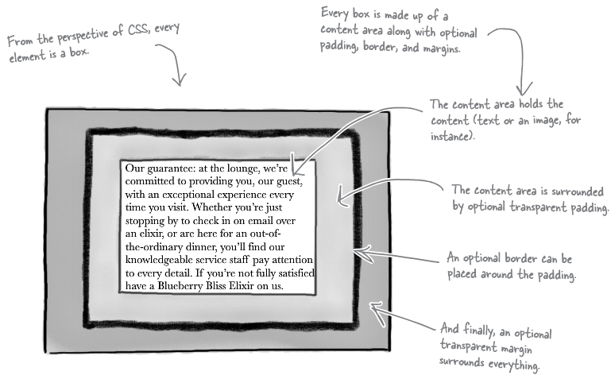
The Box Model

Slide 4
Box Model Dissected
Content area: Tight box surrounding content (e.g., text, image, etc.)
Padding: Blank spacing surrounding content area (inside border) that’s “internal” to the element in the sense that if the element has a background, it will show through the padding
Border: Surrounds the padding (and content area); divides padding and margin; encloses content and background of element
Margin: Blank space surrounding border; “External” to the element in the sense that it may merge with margins of other elements and element’s background will not extend behind margin
“Think of padding as part of the element, while the margin surrounds your element and buffers it from the things around it.”

Slide 5
Padding/Margin Properties
TOP
LEFT
RIGHT
BOTTOM
If four numbers are used, then they specify the top, right, bottom, and left paddings/margins in that order (like a clock starting from 12).
Example: margin: 5px 10px 15px 20px; gives a top margin of 5 pixels, a right one of 10, a bottom one of 15 and a left one of 20
If two numbers are used, then they specify the vertical (top/bottom) spacing and the horizontal (right/left) spacing.
Example: padding: 5px 10px; specifies 5 pixels of top/bottom padding and 10 pixels of right/left padding
If one number is used, then all spacing (top, right, left, and bottom) is the same:
Example: margin: 20px; specifies 20 pixels of margin space (top, right, bottom, and left).
The default padding and margins are 0 pixels and these properties are NOT inherited. You can specify top, right, bottom and left padding and margins individually by adding
Example: padding-top: 5px; sets the top-top, -right, -bottom, and -left. padding to 5 pixels; if unspecified, all other padding will still be 0.

Slide 6
Background Properties
The background-color is used to specify the background color of the content area, padding, and if it’s dashed, dotted, etc., between gaps in the border as well.
Example: background-color: #ff0000;
The background-image property can be used to specify the background when you want to use an image. Use a value of url(path to image); Note: The path does not need to be in quotes.
Example: background-image:url(images/background.gif);
The background-position property positions a background image. You can use combinations of top/bottom, and right/left.
Example: background-position: top left;
The background-repeat property can be used with repeat (which tiles the image and is the default), repeat-x and repeat-y (which tiles only horizontally and vertically, respectively), no-repeat (only once), or inherit (inherits the parent’s background-repeat value).
Example: background-repeat: no-repeat;

Slide 7
Border properties
The border-style property can have values of solid (default), double, dashed, dotted, groove, inset, outset, or ridge.
The border-width property can have values of thin, medium, or thick, or be specified with a number of pixels (e.g., 2px).
The border-color property can be specified with the same values as text and background colors.
You can also specify top, right, left, and bottom border properties for border-color, border-width and border-style by inserting -top, -right, -bottom, and –left after border:
Example: border-right-color: rgb(255, 0, 0);
The border-radius property can be used to create borders with rounded corners. The values can be expressed in pixels (px) or relative to text size with the em unit. You can also insert -top-left, -top-right, -bottom-right, or –bottom-left to specify corners individually.
Example: border-top-right-radius: 2em;

Slide 8
Using ids
You can use the id attribute with any element just as you can with the class attribute.
“You use a class when you might want to use a style with more than one element. And if what you need to style is unique and there’s only one on your page, then use an id. The id attribute is strictly for naming unique elements.”
You can use both the class an id attribute with the same element.
Example: You can have a unique logo on the page that’s one of the multiple drawings (as opposed to photos) that you display on your page. In that case, you may have a tag like this:
<img id = "logo" class = "drawing" src = "images/logo.gif">
To select the element with a specific id in a CSS rule for styling, use a # before the id (e.g., img#logo or simply #logo).
#logo {
border: 1px dashed;
}

Slide 9
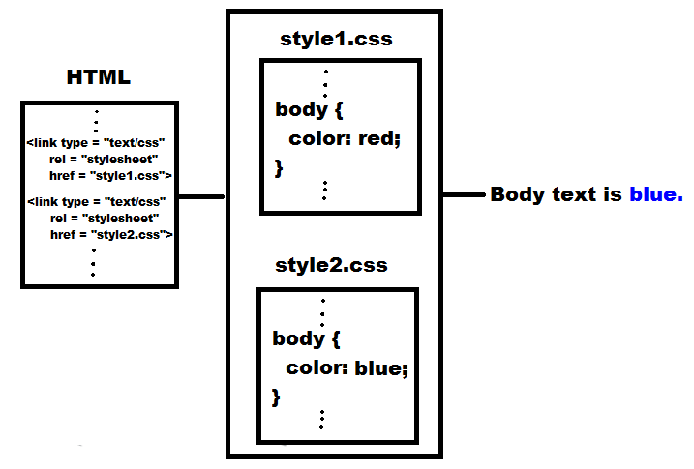
Multiple stylesheets
You can link to multiple stylesheets, in which case the browser treats the rules from the stylesheets as if they came from a single one, with the later linked sheets’ rules coming after the earlier linked sheets’ rules. This is important for determining “winners” in styling conflicts.
Beyond the code:
Why might you want to use multiple stylesheets?

Slide 10
Media Queries
You may want to use different stylesheets for different devices. For example, you may want a 3-column layout for a desktop user but a single-column layout to target a mobile device user.
Using HTML and/or CSS media queries, you can do exactly that.
HTML: Use the media attribute of the link element:
Example: <link href="lounge-mobile.css" rel="stylesheet"
media="screen and (max-device-width: 480px)">
Example: <link href="lounge-print.css" rel="stylesheet"
media="print">
CSS: Use the @media directive:
Example:
@media screen and (max-device-width: 480px) {
CSS Rules for browser windows <= 480 pixels run on screens go here
}
Example:
@media print {
CSS Rules for printing
}
All rules not surrounded by media directives are applied to all devices.
HTML link element media attribute is better to use for large number of device-specific rules.

Slide 11
Book Exercises
Create a lounge.css file. Set the default font size of the page’s text to small and a font face of Verdana; if Verdana’s not available, use Helvetica; then if Helvetica’s not available, use Arial; otherwise have the browser use its default sans-serif font. Also, set the line spacing to be 1.6 times the font size. Then set the colors of the h1 and h2 elements to have an aquamarine color (hex code #007e7e) “to match the glass in the logo”. Set the primary headings to 150% of the body text and the secondary headings to 130% of the body text.
Give the guarantee paragraph a unique id of guarantee in the HTML. Italicize its text and give it a font face of Georgia; if Georgia’s not available, use "Times New Roman"; then if "Times New Roman" is not available, use Times; otherwise have the browser use its default serif font. Also, set the line spacing to be 1.9 times the font size.
Set the padding to 25 pixels and the margin to 30 pixels. Then use a thin white dashed border to give the paragraph a “ragged” look.
Set the pargraph background color to aquamarine (hex code #007e7e), and its background-image property to url(images/background.gif). Make sure the image does not repeat and that its in the top left corner.

Slide 12
Slightly Modified Book Exercises (cont.)
Increase the padding on the left only to 80 pixels so that the text does not appear on the star. Then increase the right margin to 250 pixels.
Cut and paste the guarantee rule into two new CSS files: lounge-compact.css and lounge-medium.css. Make what you believe are appropriate changes to the guarantee rule for small browser windows in the lounge-compact.css file. Then add two link elements with media attribute above the existing link element in the HTML, in which one specifies use of the lounge-compact.css stylesheet for a browser window with width of at most 480 pixels (screen) and the other one which specifies use of the lounge-medium.css stylesheet for a browser window whose width is at least 481 pixels (screen). Finally, add one specifying lounge-print.css for print media. Test these all by resizing the browser window and viewing the page in Print Preview mode.

Slide 13
Notes
This is primarily a summary of Chapter 9 of Head First HTML and CSS, 2nd Edition by Elisabeth Robson and Eric Freeman, 2012. It contains images, exercises, and code from the book.

