Slide 1
Lecture 7: Introduction to Cascading Style Sheets (CSS)
Dr. Jason Schanker

Slide 2
Introducing CSS
CSS, which stands for Cascading Styling Sheets is used for styling your page.
You tell how elements on your page should be styled via rules with selectors selecting the element(s) to style and property-value pair(s) which specify how the properties of the selected element(s) should be styled:
Example (Style all paragraph elements with a red background and a 1 pixel solid gray border):
p
{
background-color: red;
border: 5px solid gray;
}
Note the form of the rule: selector first (p in this case) followed by a { followed by a series of property-value pairs in the form property:value , each terminated by a semicolon concluded with a closing }
CSS rules can be specified inline in the HTML between <style> and </style> tags or placed in a separate .css file, which can then be linked in via the link element.
Check out the beautiful lounge page with this styling (Remove /* and */ in the CSS, which is a comment that’s ignored by the browser when rendering the CSS): http://codepen.io/anon/pen/GjmxyG

Slide 3
CSS Exercise 1 for the Head First Lounge
As an example, see: http://codepen.io/anon/pen/kkyEEr
Open the lounge.html file and add <style> and </style> tags in between the <head> and </head> tags. Then insert CSS rules in between the <style> and </style> tags to perform the following styling:
The paragraph text color should be maroon. You can specify the text color (foreground color) with the color property.
The heading elements (h1 and h2) should have a sans-serif value for the font-family property and a gray (text) color.
Note: If you have multiple elements for which the same styling applies, you can list all of the selectors separated by commas in a single rule.

Slide 4
CSS Exercise # 2
Make the border-bottom property of the h1 elements have a value of 1px solid black. The difference between setting an underline style and a bottom border is that a bottom border can extend past the text it’s below.
Note: You can have multiple CSS rules in which an h1 element is selected; it is good to do so when an h1 element shares some property values with one or more elements but not all of them. In this case you “factor out” the shared properties in a separate rule so if you ever want to change the common properties, you can do so in one place.
Example: Only h1 elements should have a bottom border, but both h1 and h2 elements should have a sans-serif value for the font-family property and a gray (text) color

Slide 5
Resizable Images with Transition
See: http://codepen.io/anon/pen/EgmEOW
CSS width and height overrides width and height specified for image in HTML.
auto for height means the height will scale in proportion with the width.
:hover is an example of a pseudo-class; by appending it to the img selector, the rule will be applied whenever an image is being hovered over.
CSS3 transition: By giving a time interval for the transition property in the img:hover rule, the height and width of the image will adjust gradually instead of immediately when the image is hovered over. Similarly, by providing a transition property in the img rule, the image will gradually return to its initial size when removing the mouse cursor.

Slide 6
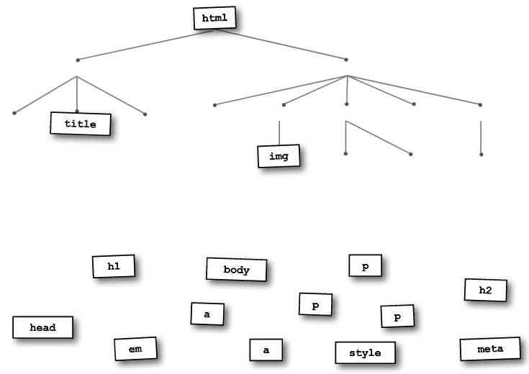
Exercise: Fill in the HTML element tree for the lounge page

Slide 7
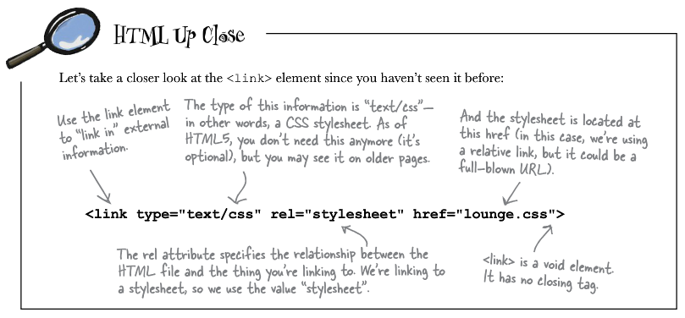
Linking style sheets
We often want consistent styling among the many web pages that can make up our site. Inserting the common CSS across the pages is a bad idea because if we ever wanted to change this style, we’d be modifying every page.
Can create an external .css file (stylesheet) and then insert a link element in the head element of the HTML in each page to tell the browser that we want to use this common style. Use this element instead of the style element.

Slide 8
Exercise: External style sheet
Cut all of the CSS from between the <style> and </style> tags and paste it in a new file, lounge.css. Then remove the style element and replace it with the link element from the previous page. Finally, link to the external stylesheet from the elixir.html and directions.html files.

Slide 9
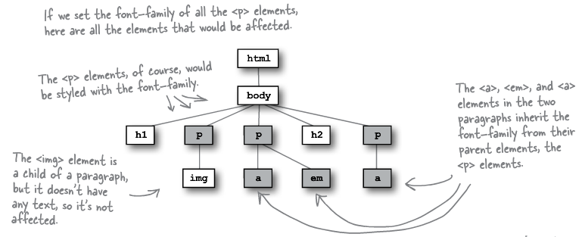
CSS Inheritance
If the value for an element’s property is not specified directly, then it may be inherited from its “most immediate” parent (parents are more immediate than grandparents who are more immediate than great grandparents, etc.) for which this styling information is specified.

Slide 10
Inheritance Exercises
Modify the stylesheet so that all of the text uses the sans-serif font-family. Be sure to remove any unnecessary property-value pairs.
To override inheritance, simply specify the new value you want that element’s property to assume in a selector for that element. Now make em elements have a font-family of serif instead by overriding its sans-serif inheritance.

Slide 11
Classes
In cases where you don’t want to style elements exclusively by type (e.g., all paragraphs, all primary headings, etc.), you can form your own collections of elements to style as a group by assigning the same value to each of their class attributes.
Each class name should be one word.
You may list multiple classes for elements by separating the names by spaces (e.g., blue and description classes: Use <p class = "description blue"> or
<p class = "blue description">
In the CSS, you specify classes with dot and the class name (e.g., .blue selector to specify all types of elements belonging to the blue class) or if you only want to style classes for certain types of elements, precede the . with the element type (e.g., p.blue to only select paragraphs belonging to the blue class).

Slide 12
Exercise on classes
Modify the HTML by adding appropriately valued class attributes. Then create CSS rules with class selectors so that all of the gains get styled with green text and losses with red text. If the gain or loss is very large (greater than 1000 or less than -1000), make it bold.
<!doctype html>
<html>
<head>
<title>List of Gains/Losses</title>
<meta charset = "utf-8">
<link type = "text/css" rel = "stylesheet" href = "stocks.css">
</head>
<body>
<h1>Stocks</h1>
<ul>
<li>Apple: -$2534.86</li>
<li>Google: $145.87</li>
<li>Red Hat: $2734.45</li>
<li>IBM: -$41.15</li>
<li>Microsoft: $324.59</li>
</ul>
</body>
</html>
Possible Interview Question (Going beyond the code): Why might this not be such a great idea for styling losses and gains?

Slide 13
Book Exercise
Assign each of the first 3 drink paragraphs on the elixir.html page to its own class using a name to match the drink that it describes (i.e., greentea, raspberry, and blueberry classes) and then add appropriate rules in lounge.css so that each paragraph text color matches the color of the drink it describes (i.e., green, blue, and purple). Note the cranberry paragraph is already the correct text color by the CSS rule:
p {
color:maroon;
}
Question on conflicting rules: The green tea paragraph is still a paragraph so how does the browser decide between the above rule and the newly added rule specifying different text colors?

Slide 14
Specificity: More details later
When rules conflict, the “most specific” one is used.
If no CSS rules exist for an element, we use the rule applying to the element’s most immediate parent (if any such rules exist).
Given a rule which selects the element’s class and one which selects the element’s type (e.g., .greentea vs. p), we use the class rule (.greentea).
Given a rule which selects the element’s class and type and one that selects the element’s class alone (e.g., p.greentea vs. .greentea), we use the one that selects the class and the type (p.greentea)
Exercises (for thought):
Suppose we were to replace raspberry by <em>raspberry</em> in the description of the raspberry drink, what would its text color be? Why? What would be the text color if we were to then add a rule with an em selector specifying a color of maroon? What if the rule instead only selected em.raspberry elements?

Slide 15
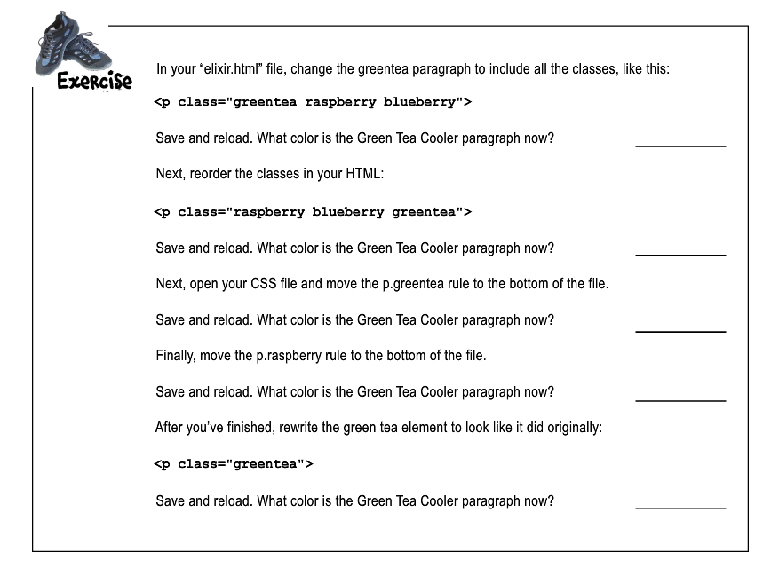
Book exercise on specificity: Tiebreakers
Based on your tests, does the order that you specify the classes matter? What about the order that you specify the CSS rules? How do each of these orderings matter or does it not matter?

Slide 16
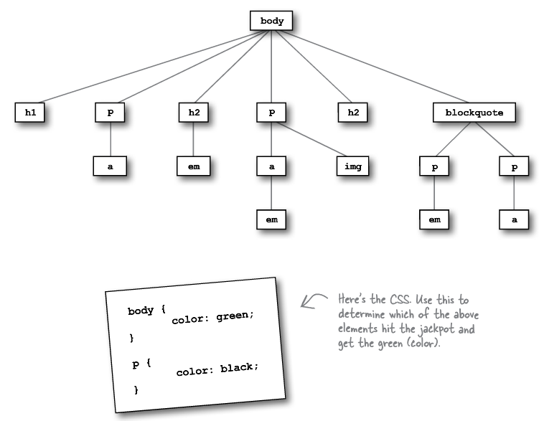
Book exercise: Which elements are green?

Slide 17
Book exercise: Finding errors in CSS
Find all of the errors in the stylesheet style.css to the right.
If you make an error in the CSS, usually all subsequent rules are ignored!
There is a CSS validator:
http://jigsaw.w3.org/css-validator/
<style>
body {
background-color: white
h1, {
gray;
font-family: sans-serif;
}
h2, p {
color:
}
<em> {
font-style: italic;
}
</style>

Slide 18
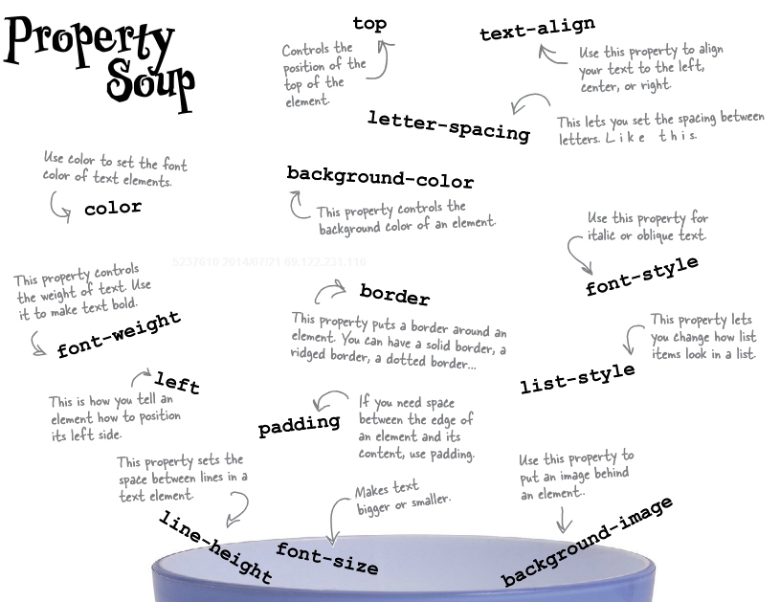
CSS Properties

Slide 19
Notes
This is primarily a summary of Chapter 7 of Head First HTML and CSS, 2nd Edition by Elisabeth Robson and Eric Freeman, 2012. It contains images, exercises, and code from the book.

