Slide 1
Lecture 6: Introduction to Industry Standard HTML
Dr. Jason Schanker

Slide 2
Industry standard HTML
To make sure your web pages display correctly on all of the major browsers, you need to adhere to the industry standard. If you don’t, browsers may need to “guess” what you intended and different browsers may guess differently, making it look bad on one even if it looks good on the one you’re using.
Back in the days of the browser wars in the mid 90’s, we couldn’t rely on this – Internet Explorer and Netscape duked it out for supremacy; these were the days of the “Best viewed using…” and a marquee element that would show a scroll on IE, but would not even work on Netscape.
Starting with HTML 4, the World Wide Web Consortium (W3C) created a standard for all browsers to adhere to via a specification that would give the valid list of html tags and attributes, say how they should work/display, etc.
HTML 5 is the newest version of HTML; after HTML 5, there will be no version numbers. Later additions and changes to HTML will not affect earlier code adhering to the HTML 5 standard. It will still work because of backward compatibility.

Slide 3
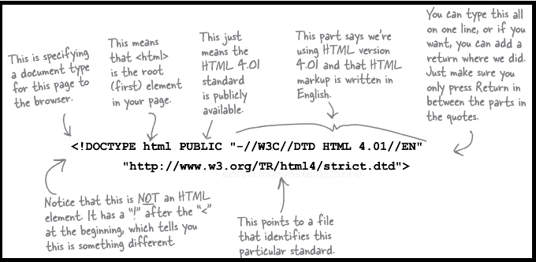
Key # 1 to adhering to the standard
Use a doctype command AT the top (above the <html> tag).
Because of the “living standard” HTML, the document type definitions for HTML that’s HTML5 compliant has been greatly simplified to the following:
<!doctype html>

Slide 4
More keys to successful validation
Make sure that every nonvoid element has a closing tag and that all of your tags are properly nested; the last tag you open is the first tag you should close. Also make sure you don’t include a tag that shouldn’t be nested in another one.
Proper indentation also helps; if you indent at least four spaces for every nonvoid element with an opening tag, you should be able to easily tell which one needs to be closed first. You can also insert a new tabbed tag you may have forgotten (at say 2 spaces).
All of your tags should have the required attributes, and all tags should only use attributes that are allowed for them.
Every page should have a doctype at the top, the <html> tag directly below it, a head, which includes the title and a meta tag specifying the character set (described soon), and a body.
Avoid using obsolete HTML tags and attributes such as ones used for styling (e.g., <font> tag, bgcolor attribute for <body>).

Slide 5
Use the W3C Validator
To check your HTML for correctness, you can (and should) use the W3C validator.
Exercise: Open your lounge.html page and add the doctype command at the top. Then validate it by either copying/pasting into the Direct Input or uploading the file using the File Upload option.
Warnings you can ignore:
Using experimental feature: HTML5 Conformance checker: Standard warning that the standards for HTML5 have not yet been finalized so HTML5 validation is a work in progress.
Using Direct Input mode: UTF-8 character encoding assumed: When you use direct input mode by pasting your HTML in the form box and submitting, your text will be converted to UTF-8 format. This warning is telling you that the validator is ignoring any character encoding you might have specified in the HTML for this reason, which is fine if your file text is in this format.

Slide 6
Mandatory attributes
Some tags come with mandatory attributes.
Example: The HTML5 standard specifies that the alt attribute is mandatory for images. Recall that the alt attribute helps the visually impaired (can use a screen reader for the text describing your image) and people who see a broken image (due to e.g., slow connections, server going down, incorrect path to image, etc.) get an idea of what image is showing or would show.
Example: Some tags would be useless without specific attributes (e.g., <a> tag) and are therefore required to have them.

Slide 7
Character encodings and using <meta> tags
The <meta> tags can be used to specify information about your document such as what type of character encoding you are using or keywords for search engines. See http://www.w3schools.com/tags/tag_meta.asp for more.
Since <meta> tags are used to describe your document, you should put them between <head> and </head>.
To specify a UTF-8 encoding, enter:
<meta charset = "utf-8">
All characters (letters, numbers, whitespace (space, tabs, etc.), symbols, etc.) are represented internally by numbers on the computer. Specifying the type of character encoding tells the browser what numbers should represent what characters. UTF-8 is a standard for web (in the Unicode family) and is “compatible with ASCII, which was a common encoding for English-only documents.”

Slide 8
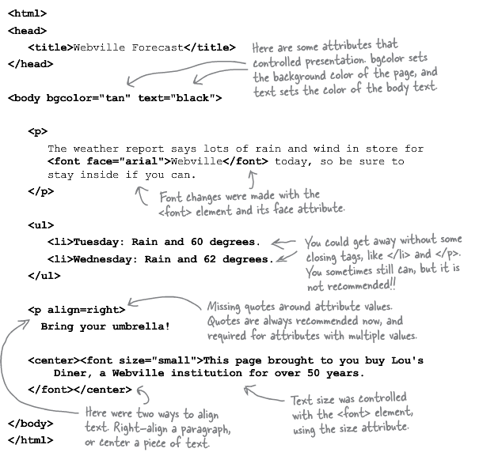
Mistakes and Obsolete (Legacy) tags

Slide 9
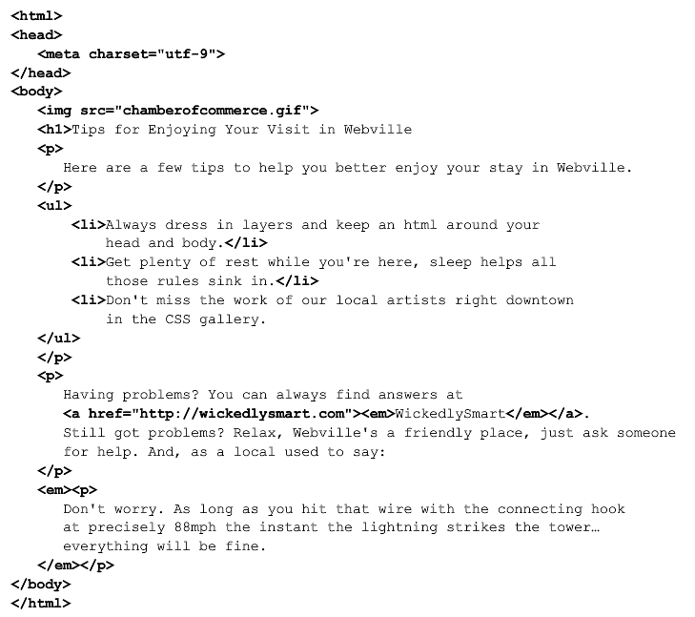
Be the validator exercise: Locate all the errors

Slide 10
Notes
This is primarily a summary of Chapter 6 of Head First HTML and CSS, 2nd Edition by Elisabeth Robson and Eric Freeman, 2012. It contains images, exercises, and code from the book.

