Slide 1




SOCIAL HOOKAH PLATFORM
HookahBuddys
The Social Platform for Hookah Culture, Creators,
Businesses, Meetups, and Local Communities
HookahBuddys · Investor Pitch Deck | Continued Platform Development
01 / 16

Slide 2
THE BIG IDEA
HookahBuddys Is Building the
Social Hub for Hookah Culture
HookahBuddys combines a free social network, creator monetization tools, local lounge
discovery, business pages, groups, meetups, events, and premium content into one
platform built around hookah culture and social connection.
Connect
Discover
Earn
Free member profiles ·
The Lounge social feed ·
Browse Buddys
Sparks short videos ·
Groups · Meetups and
Events
Business Pages and
Lounges · Creative
Buddy monetization ·
Credits and premium
access
HookahBuddys · Investor Pitch Deck
02 / 16

Slide 3
THE PROBLEM
Hookah Culture Is Social, But the
Online Experience Is Fragmented
Scattered communities
Inconsistent discovery
Hookah enthusiasts are scattered across
general social media platforms.
Local lounge discovery is limited and
inconsistent.
Limited creator fit
Disconnected local activity
Creators lack a niche platform built
around their audience and monetization
needs.
Businesses need better promotion.
Hookah events are difficult to organize
and discover in one place.
HookahBuddys · Investor Pitch Deck
03 / 16

Slide 4
THE SOLUTION
HookahBuddys Brings the Entire Ecosystem Together
Social Network
Creator Platform
Local Discovery
Free profiles, posts,
photos, Sparks,
comments, shares,
friends, follows
Creative Buddy profiles,
premium albums, custom
content, messages, video
sessions
Lounges, business
pages, 25-mile Lounge
Spotlight, events near
you
Groups and Meetups
Monetization Layer
Member-created groups, hookah
meetups, event planning, RSVPs
Credits, subscriptions, unlocks, business
promotions, featured placement
HookahBuddys · Investor Pitch Deck
04 / 16

Slide 5
PRODUCT OVERVIEW
Core Platform Features
Social
Community
Creative
Free Buddy Profiles · The
Lounge Feed · Browse
Buddys · Sparks
Groups · Meetups ·
Events · Business Pages ·
Lounge Spotlight
Creative Buddy Profiles ·
Premium Albums ·
Custom Photo/Video
Requests
Credits
Admin Dashboard
HookahBuddys is designed as a social platform first, with optional premium features layered
into the experience.
HookahBuddys · Investor Pitch Deck
05 / 16

Slide 6
USER TYPES
Built for Members, Creators,
Businesses, and Local Communities
Male Buddy
Female Buddy
Creative
Businesses
Buddy
Free profile •
Social feed •
Browse Buddys •
Credits • Groups
and Meetups •
Events
Free profile •
Social presence
• Optional
Creative Buddy
upgrade •
Content
monetization
tools
Business Pages •
Lounge
discovery •
Posts and events
• Local Spotlight
• Promotions and
leads
Premium content
• Custom pricing
• Private media
messages •
Video sessions •
Creator
dashboard
HookahBuddys · Investor Pitch Deck
06 / 16

Slide 7

CREATOR MONETIZATION
Creative Buddys Can Earn Inside the Platform
$24.99
Album model
/month
Free Album
5 free images
Creative Buddy upgrade — proposed pricing
Cool Album
25 credits
Premium content sales · Custom Photo/Video
Requests · Private messages including
photos/videos · Video session tools
Smokin Hot Album
100 credits
Smokin Hot includes Cool Album access.
Creator dashboard · Earnings tracking · Dedicated support ·
Verification tools
Request → credits held → creator
accepts → delivery → credits released.
Reuse requires mutual agreement.
HookahBuddys · Investor Pitch Deck
07 / 16

Slide 8

CREDIT ECONOMY
Credits Power Premium Interactions
1 credit = $0.10
Suggested credit bundles
Proposed reference value; bundle bonuses vary.
Mini Pack
$4.99 / 50
Private messages · Premium content unlocks
· Custom photo/video requests · Video
sessions · Album unlocks
Starter Pack
$9.99 / 110
Social Pack
$19.99 / 240
Popular Pack
$39.99 / 520
Credits create a flexible microtransaction system that allows
users to start free and pay only for premium access.
VIP Pack
$79.99 / 1,100
Proposal from brief; differs from current
app configuration.
HookahBuddys · Investor Pitch Deck
08 / 16

Slide 9

MEMBERSHIP MODEL
Free to Join, Optional Paid Upgrades
Create Free Profile → Male Buddy or Female Buddy → free or optional upgrade
Male Buddy options
Female Buddy options
Free Profile
$0/month
Free Profile
$0/month
Silver
$9.99 • 75 credits
Creative Buddy
$24.99/month
Gold
$19.99 • 175 credits
The free social network drives adoption,
while optional premium upgrades drive
revenue.
Platinum
$39.99 • 400 credits
Proposed monthly pricing and credits from brief; reconcile with live plans before investor distribution.
HookahBuddys · Investor Pitch Deck
09 / 16

Slide 10
BUSINESS MONETIZATION
Businesses Create Another Revenue Engine
Business Pages
Lounge Spotlight
Potential revenue
Profiles · Posts · Photos
and Sparks · Services ·
Products/catalog · Offers
· Events · Reviews ·
Check-ins · Messaging ·
Insights
Local businesses within
25 miles · Daily discovery
· Traffic to the lounge
directory
Featured placement ·
Sponsored Spotlight ·
Boosted posts · Event
promotion · Lead
generation · Business
subscriptions ·
Advertising
Business monetization channels are opportunities, not reported revenue or confirmed partnerships.
HookahBuddys · Investor Pitch Deck
10 / 16

Slide 11
LOCAL NETWORK EFFECTS
Meetups Turn Online Interest Into Local Activity
Members can start a Meetup by creating the full event in one flow: title, date, time, location,
RSVP rules, privacy, and invites.
Organize
Participate
Return
Hookah meetups ·
Lounge nights · Smoke
sessions · Business
networking
RSVP tracking · Attendee
management · Event
discovery
Global Events page · The
Lounge feed integration ·
Real-world community
activity
Designed to support repeat engagement and local community growth.
HookahBuddys · Investor Pitch Deck
11 / 16

Slide 12


COMPETITIVE POSITIONING
HookahBuddys Combines
Multiple Proven Platform Models
Platform Type
What It Does
HookahBuddys Advantage
Social network
Profiles, feed, friends,
Hookah-focused niche community
groups
Creator platform
Premium content,
Creative Buddy tools tied to social
requests
discovery
Meetup-style events
Local gatherings and
Hookah-first meetups and lounge
RSVPs
nights
Business directory
Local discovery
Business Pages, Spotlight, offers,
events
Short video platform
Short-form video
Sparks for culture and creator
discovery
HookahBuddys · Investor Pitch Deck
12 / 16

Slide 13
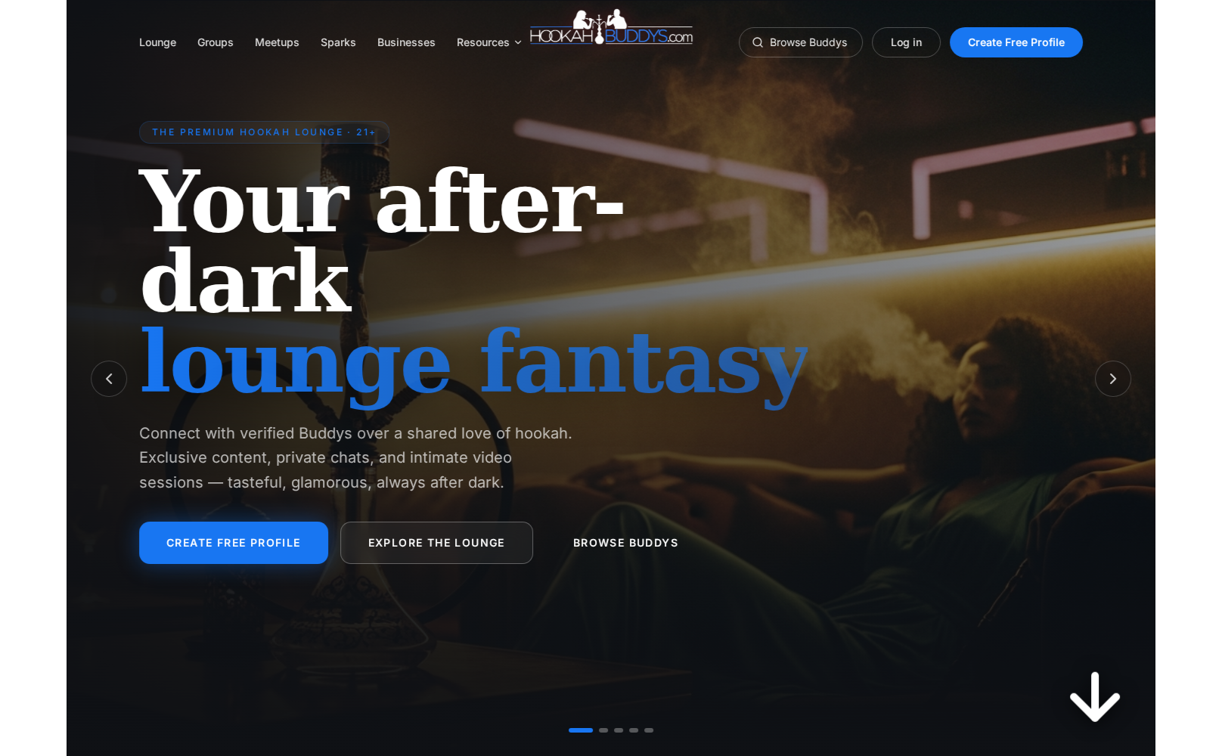
DEVELOPMENT STATUS
Platform Development Is Underway
Pre-launch / development-stage
platform.
Social profiles, The Lounge, Browse
Buddys, Sparks, Groups, Meetups,
Business Pages, Events, Credits,
Creator tools, and Admin controls.
Architecture and interfaces exist; launch readiness
and live payments require validation. No traction
claims are presented.
Production app
HookahBuddys homepage · Current development build
hookahdolls.replit.app
HookahBuddys · Investor Pitch Deck
13 / 16

Slide 14
ROADMAP
Development Roadmap
01 / MVP Completion
02 / Monetization
03 / Scale and
and Local Growth
Partnerships
Free profiles · Buddy
onboarding · The Lounge
· Browse Buddys · Sparks
· Admin dashboard ·
Credits and plans ·
Creator content
Creative Buddy
subscriptions · Albums ·
Custom requests · Video
sessions · Business
Pages · Lounge Spotlight
· Meetups and Events
Mobile readiness ·
Advertising · Sponsored
placements · Lounge
partnerships · Analytics ·
Payment/payout
automation · Growth and
compliance
Development priorities, not dated commitments. Some capabilities already have working implementations.
HookahBuddys · Investor Pitch Deck
14 / 16

Slide 15
USE OF FUNDS
Funding Will Accelerate Continued Development
$6,500 funding target
Build
Harden
Launch
Product development ·
UI/UX design · Mobile
optimization · Creator
tools
Payment/credit system ·
Video infrastructure ·
Admin/moderation ·
Security and compliance
Marketing and user
acquisition ·
Business/lounges
onboarding · Legal and
operational setup
Investor funding will be used to complete the MVP, harden the platform, support launch, onboard early users and businesses,
and accelerate monetization features.
HookahBuddys · Investor Pitch Deck
15 / 16

Slide 16
INVESTMENT OPPORTUNITY
Opportunity to Help Build the
Social Platform for Hookah Culture
Seeking strategic investors to
help fund continued
development, launch preparation,
and early growth.
Founder
Earl Halbert & William Jepson
Email
coolshirtsclublv@gmail.com
Phone
Free social adoption · Premium access ·
Creator tools · Local business
opportunities · Real-world engagement
(702) 328-9219
Website/App
hookahdolls.replit.app
This presentation is for discussion purposes only and does not constitute an offer to sell securities. Financial projections, if
added, should be reviewed with legal and financial advisors.
HookahBuddys · Investor Pitch Deck
16 / 16

