Slide 1
Final Project
Presented By:
Dhananjay Mishra
UCF ID.: 5414844
Course: Data Visualization (IDC 6700)

Slide 2
Suicides In India Dataset
[1] https://www.kaggle.com/datasets/rajanand/suicides-in-india
Columns: State, Year, Gender, Age_group, Type_code, Type, and Total
State: 28 states and 7 union territories.
Year: 2001-2012
Gender: Male and Female
Type_code: Causes, Education_Status, Means_adopted, Professional_Profile, and Social_Status
Type contains various variables which explain the Type_Code column
Age_group: 0-14, 15-29, 30-44, 45-59, 60+, 0-100+
Total: Lists the number of suicide for each row
Notes:
Type:"Causes":[1] "Illness (Aids/STD)" [2] "Bankruptcy or Sudden change in Economic" [3] "Cancellation/Non-Settlement of Marriage" [4] "Physical Abuse (Rape/Incest Etc.)" [5] "Dowry Dispute"
"Education_Status":[27] "Diploma" [28] "No Education" [29] "Post Graduate and Above" [30] "Middle" [31] "Graduate" [32] "Hr. Secondary/Intermediate/Pre-Universit" [33] "Primary" [34] "Matriculate/Secondary"
"Means_adopted":[35] "By Consuming Insecticides" [36] "By Hanging" [37] "By Jumping from (Other sites)" [38] "By touching electric wires" [39] "By Machine" [40] "By Fire/Self Immolation"
"Professional_Profile":[51] "Retired Person" [52] "Unemployed" [53] "Public Sector Undertaking" [54] "Service (Private)" [55] "House Wife" [56] "Self-employed (Busines
"Social_Status":[62] "Married" [63] "Seperated" [64] "Widowed/Widower" [65] "Divorcee" [66] "Never Married“

Slide 3
Objective
To explore the trend of suicides in India based on age, gender, state, and variables related with committing suicide
To help communicate patterns and trends through visualizations to generate various insights from the data

Slide 4
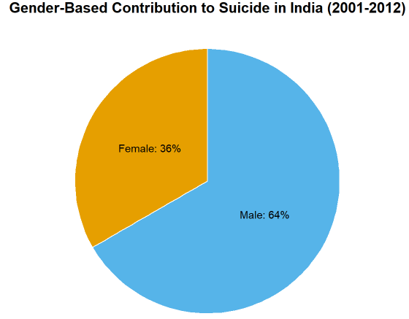
Visualization #1 (Pie-Chart)
65% of Male population constitute the overall suicide cases in India
Pie-chart a good visualization to represent two variables

Slide 5
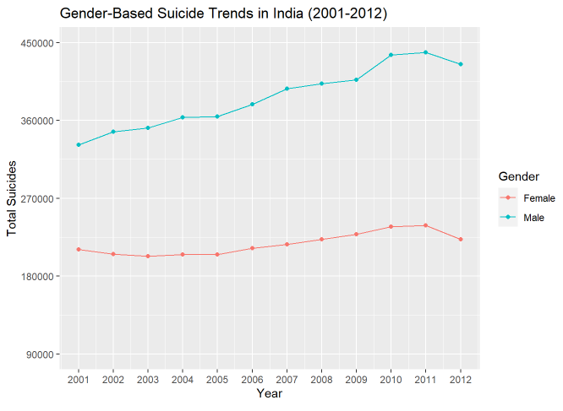
Visualization #2 (Line-Chart)
Male population has higher suicide rates over female in India
Line-chart a good visualization to show the suicide cases for Gender over the years

Slide 6
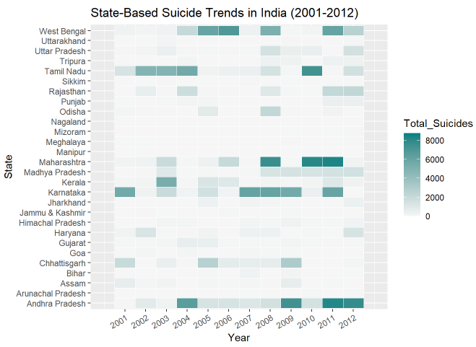
Visualization #3 (Heatmap)

Slide 7
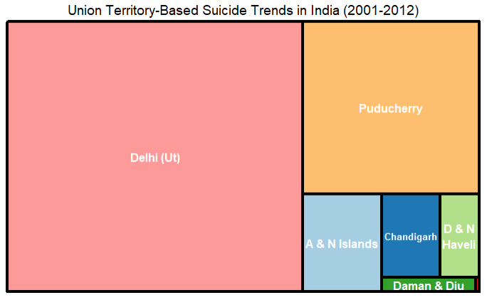
Visualization #4 (Treemap)
Delhi has the highest suicide case among the union territories in India

Slide 8
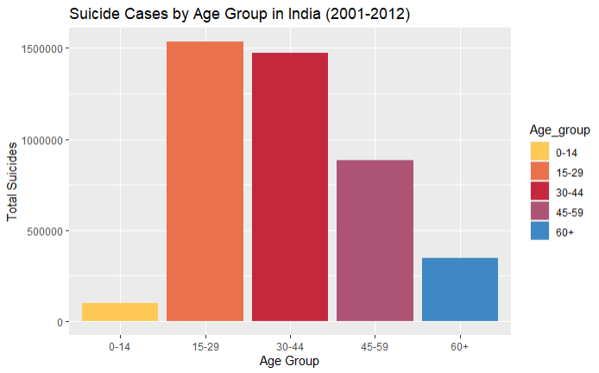
Visualization #5 (Bar Chart)
Highest number of suicides among 15-44 years age-group people in India

Slide 9
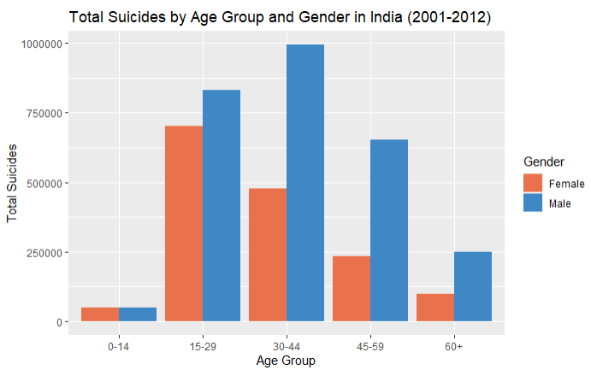
Visualization #6 (Grouped Bar-Chart)
Female suicide case highest among 15-29 age group
Male suicide case highest among 30-44 age group

Slide 10
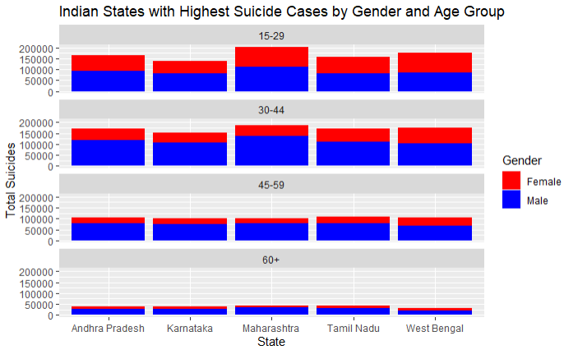
Visualization #7 (Faceted Grouped Bar Chart)
Maharashthra, West Bengal, Tamilnadu, Andhra Pradesh, Karnataka the five states with the highest suicide cases

Slide 11
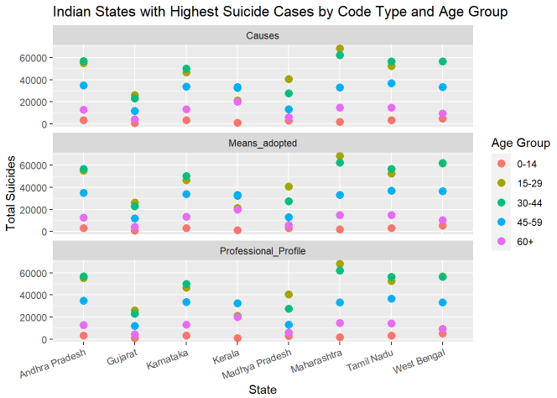
Visualization #8 (Scatterplot)

Slide 12
Thank You

