Slide 1
Mid-Term Project
Presented By:
Dhananjay Mishra
UCF ID.: 5414844
Course: Data Visualization

Slide 2
Research Papers
[1] Odugu Rama Devi, Julian Webber, Abolfazl Mehbodniya, Morsa Chaitanya, Parag S. Jawarkar, Mukesh Soni, Shahajan Miah, "The Future Development Direction of Cloud-Associated Edge-Computing Security in the Era of 5G as Edge Intelligence", Scientific Programming, vol. 2022, Article ID 1473901, 13 pages, 2022. https://doi.org/10.1155/2022/1473901
[2] Rahman Ali, Farkhund Iqbal, Muhammad Sadiq Hassan Zada, "Multicriteria Decision Making for Carbon Dioxide (CO₂) Emission Reduction", Scientific Programming, vol. 2022, Article ID 2333821, 14 pages, 2022. https://doi.org/10.1155/2022/2333821

Slide 3
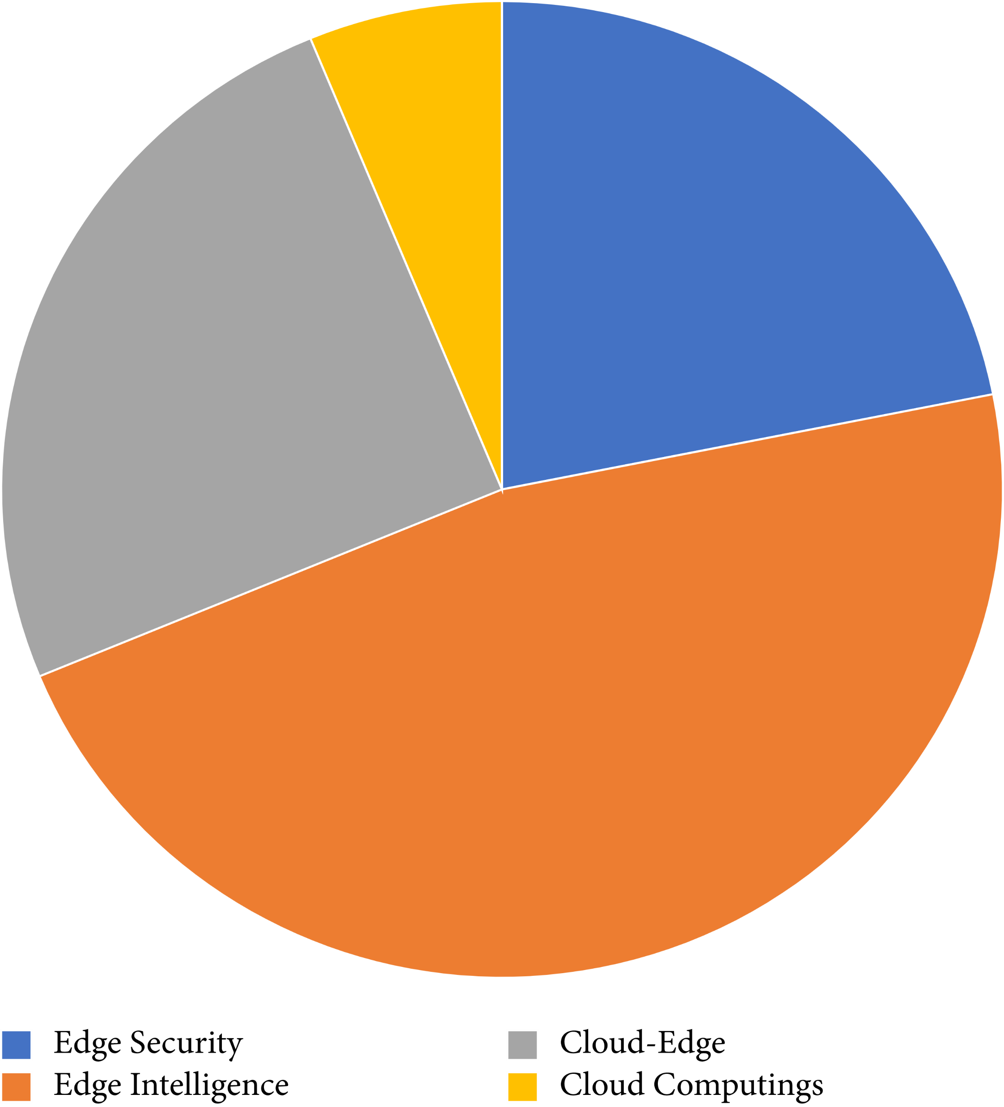
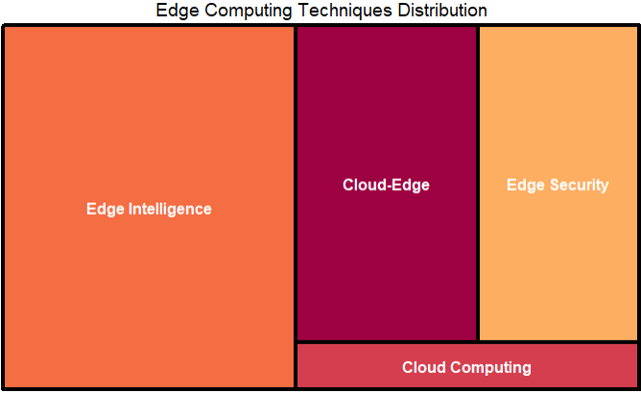
Visualization #1
BEFORE
AFTER
Figure 3: Edge computing techniques distribution [1]
Figure 1: Edge Computing Techniques Distribution
Notes:
Based on the data provided, the dataset has two columns: "Edge_Computing_Techniques" and "Distribution".
The "Edge_Computing_Techniques" column lists four different edge computing techniques, namely "Edge Security", "Edge Intelligence", "Cloud-Edge", and "Cloud Computing".
The "Distribution" column contains the distribution or percentage of each technique.
- Edge Intelligence is a popular technique in edge computing, while Cloud Computing is the least popular.

Slide 4
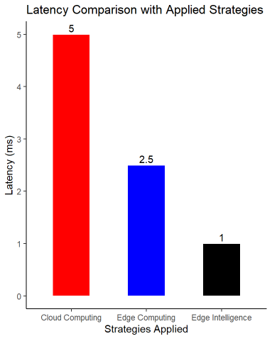
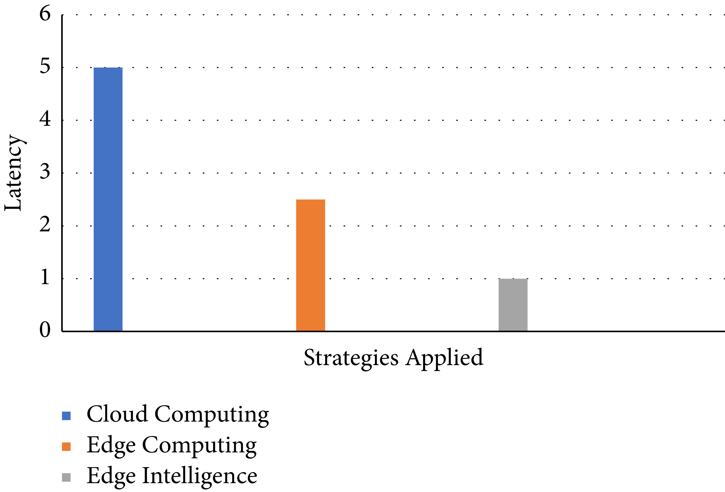
Visualization #2
BEFORE
AFTER
Figure 4: Latency comparison with applied strategies [1]
Figure 2: Latency Comparison with Applied Strategies
Notes:
Based on the data provided, the dataset has two columns named "Strategies" and "Latency".
The "Strategies" column lists out three different strategies.
The "Latency" column shows the latency values associated with each strategy.

Slide 5
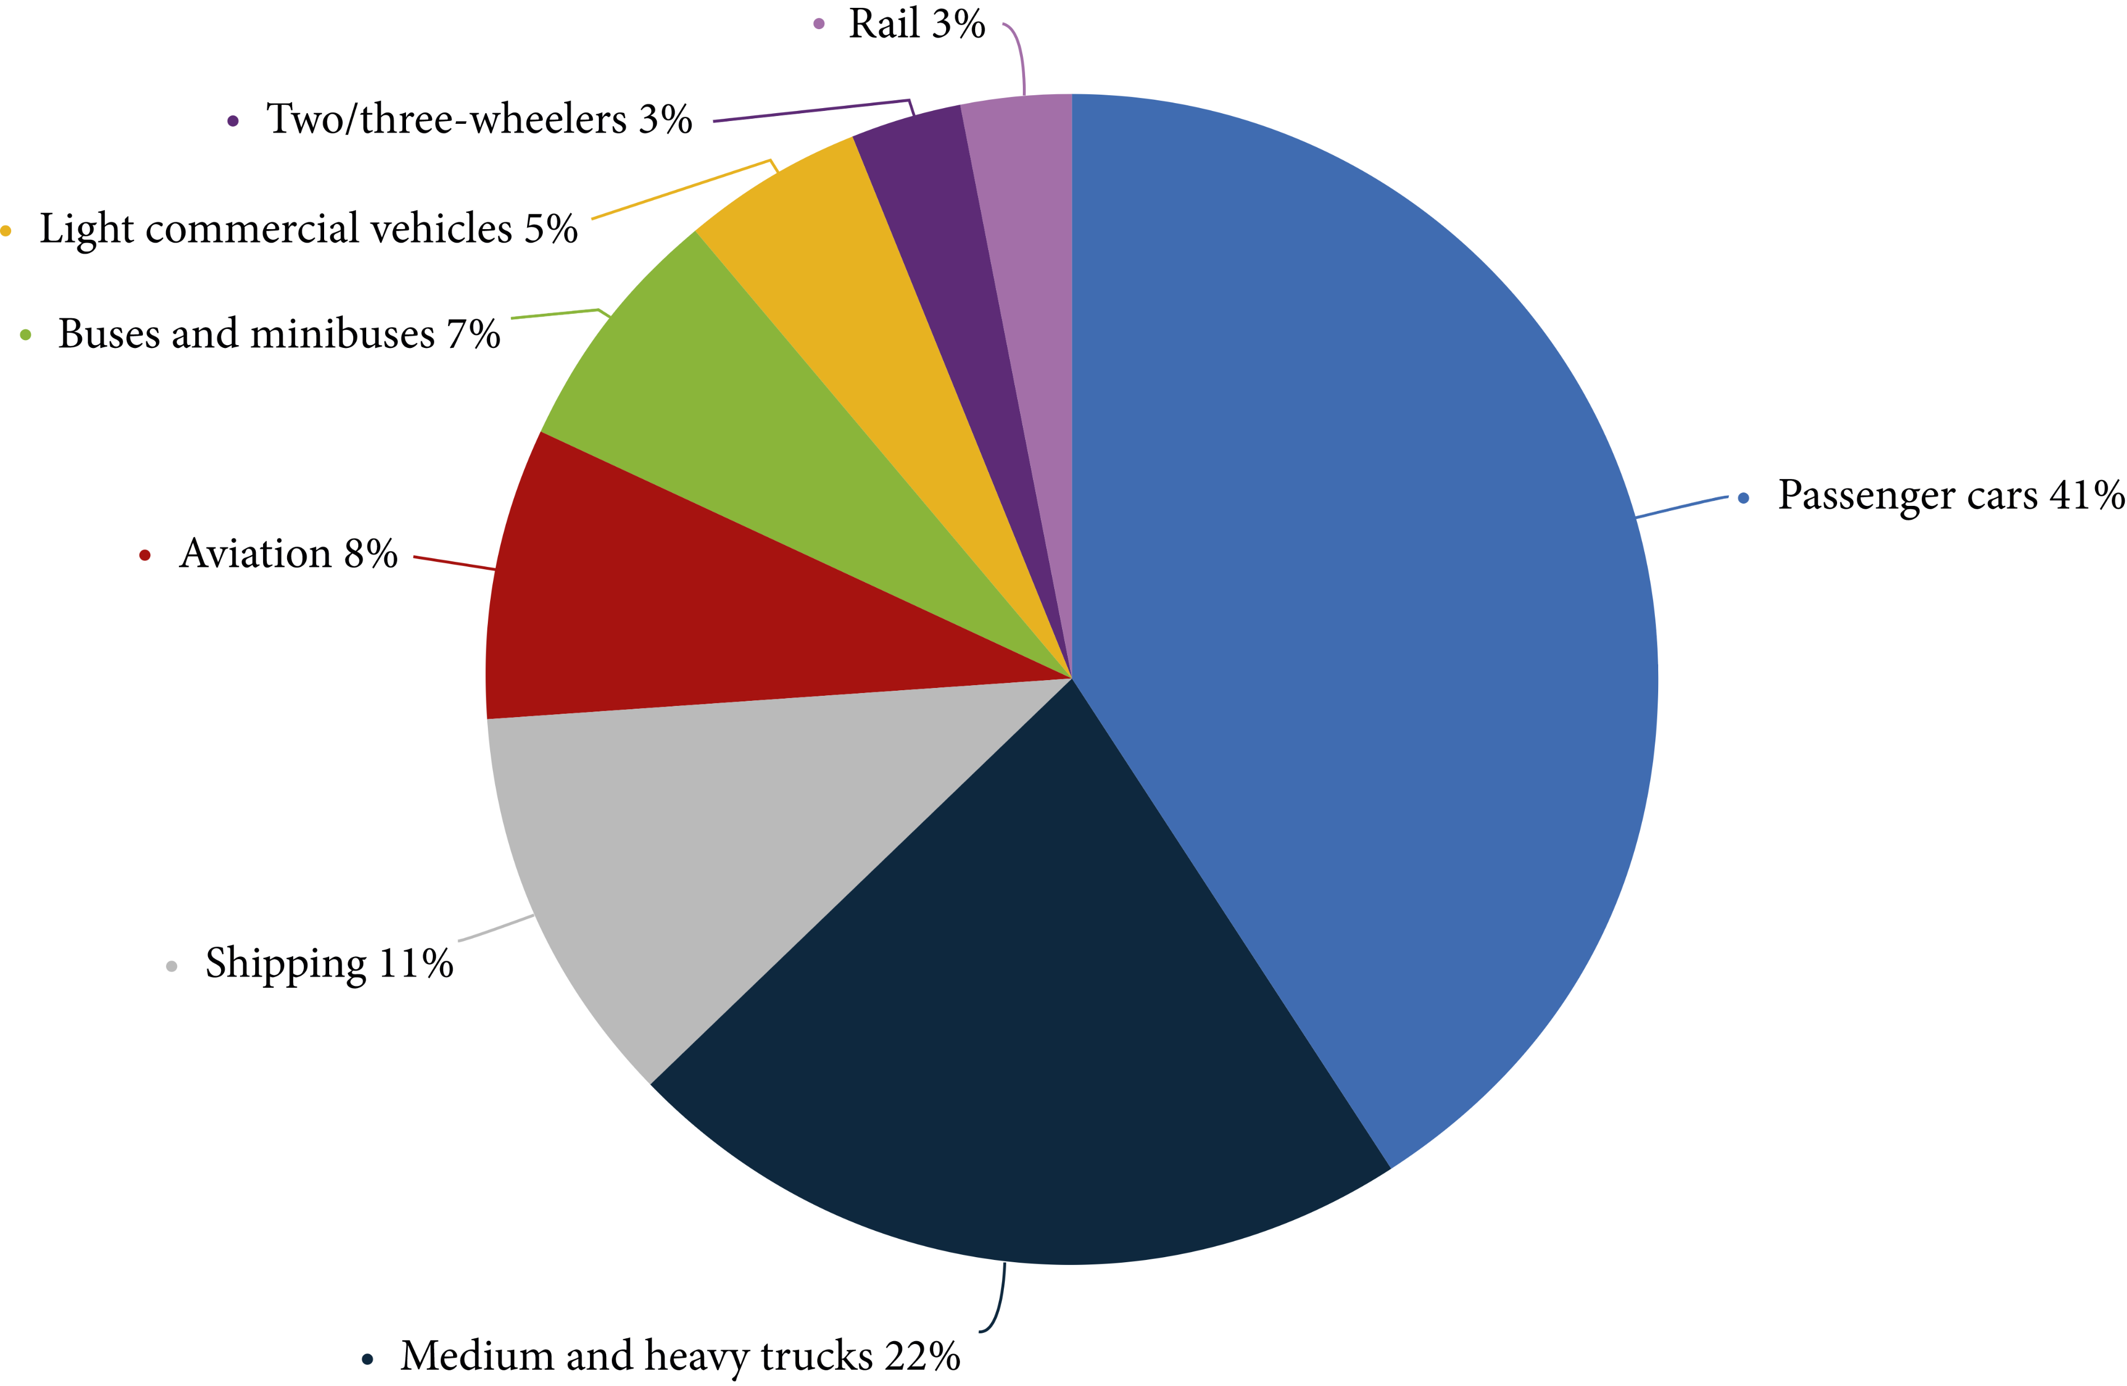
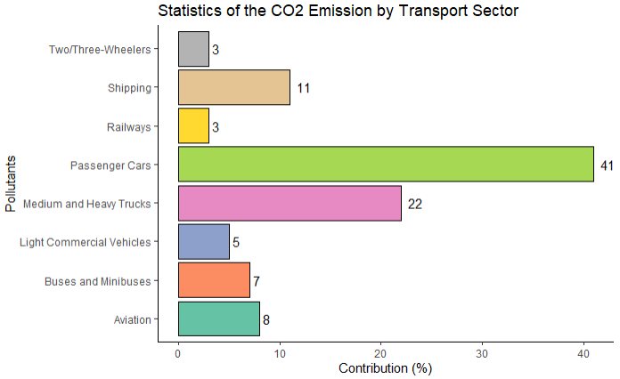
Visualization #3
BEFORE
AFTER
Figure 1: Statistics of the CO2 emission by transport sector [2]
Figure 4: Statistics of the CO2 emission by transport sector

Slide 6
Thank You

