Slide 1
HEX & BINARY XOR, AND, OR Calculator
Dalton Neely

Slide 2
Description
My final project is an app that does XOR, AND, and OR operations on HEX and BINARY input
API USED: 27 (Oreo)
Testing Framework: Junit 4

Slide 3
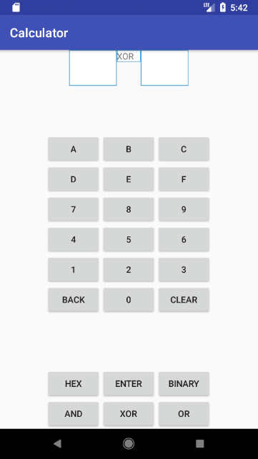
App Running on Emulator
Input Box 1
Input Box 2
Operation Box
Input Numbers
Back Button
Clear Button
Enter Button
HEX/BINARY buttons
AND/XOR/OR buttons

Slide 4
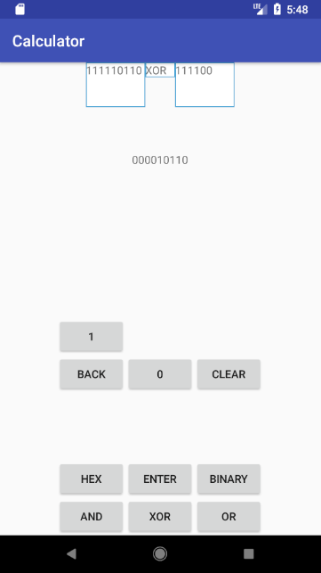
BINARY Mode
Input Box 1: 111110110
Input Box 2: 111100
Operation Box: XOR
Result Box: 000010110

Slide 5
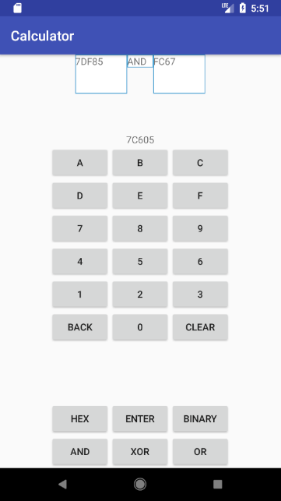
HEX Mode
Input Box 1: 7DF85
Input Box 2: FC67
Operation Box: AND
Result Box: 7C605

Slide 6
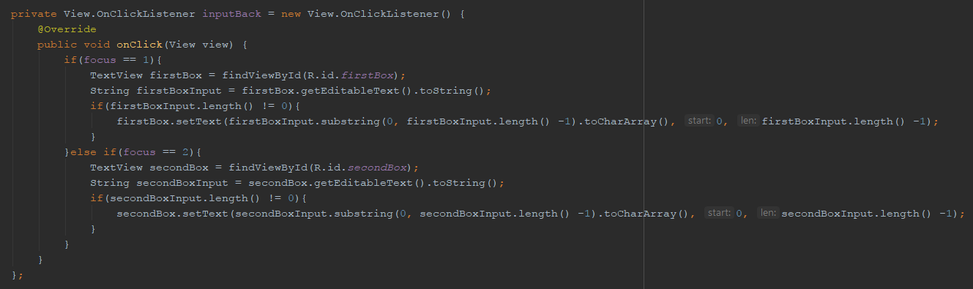
Event Listener Example

Slide 7
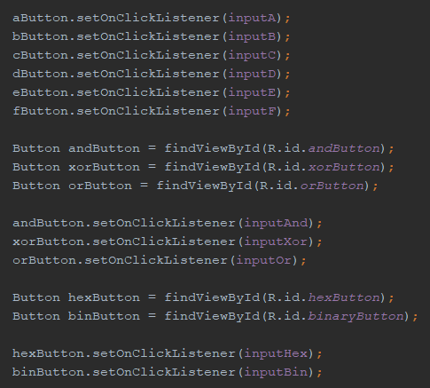
Assigning Listeners to Views

