Slide 1
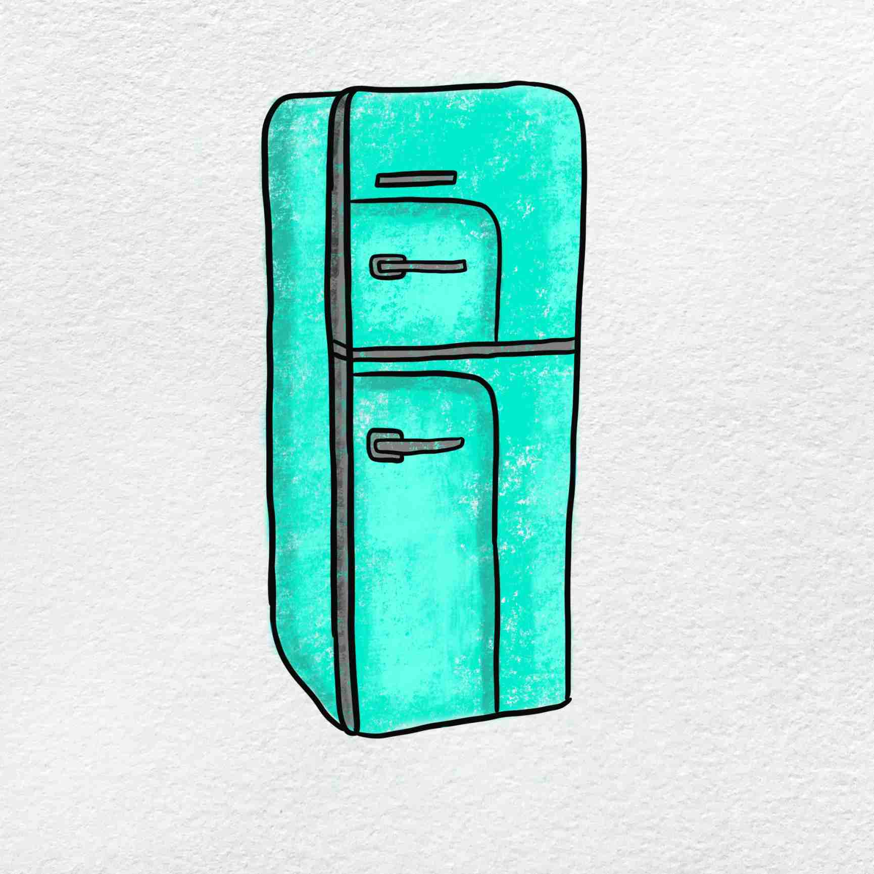
Refrigerator management system
Takacs Alexandru

Slide 2
Hello! In this application I present an implementation of a system to handle food and beverage items in a fridge!

Slide 3



Main Features and User Interaction

Slide 4
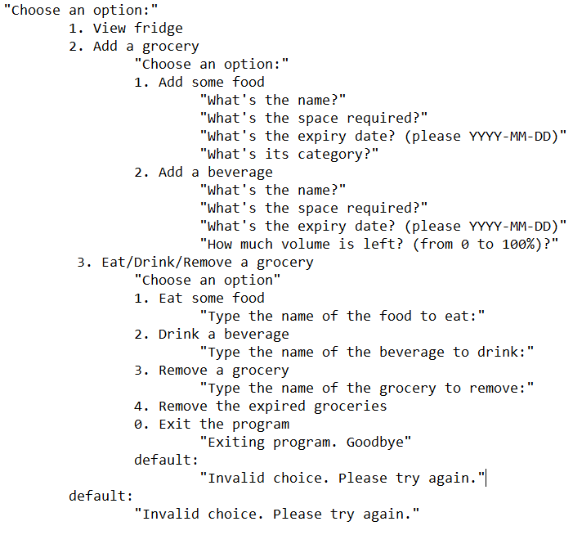
In order to use the program, the user must run it from Main.java and use the console accordingly, by providing the data that the user has been asked for.
The purpose of each button from the main menu:
Displays the whole content of the table “groceries” from the database in which grocery items are stored. In this way, the user finds out what there is left to consume.
Adds any type of grocery to the database and asks for the necessary details afterwards. This gives the user the option to add his fresh or even old groceries in the database in no time.
Removes a grocery item from the database or removes all the expired groceries by searching for a certain name inside the table. Also, by using this method we can also make sure that we never keep expired food inside the refrigerator for too long.

Slide 5
Classes and Structure

Slide 6
Main.java: The main entry point, handling the user interface and menu.
Refrigerator.java: Manages the fridge content, including storing and removing groceries into and from the database by organizing all data with the help of a map collection.
Grocery.java, Beverage.java, Food.java : Classes representing different grocery items.
Storable.java and Expirable.java : Interfaces defining methods for storing and checking expiration.
Tests.java and ConcurrentTests.java : Unit tests.
DBManager.java : Establishes connection with the database.

Slide 7
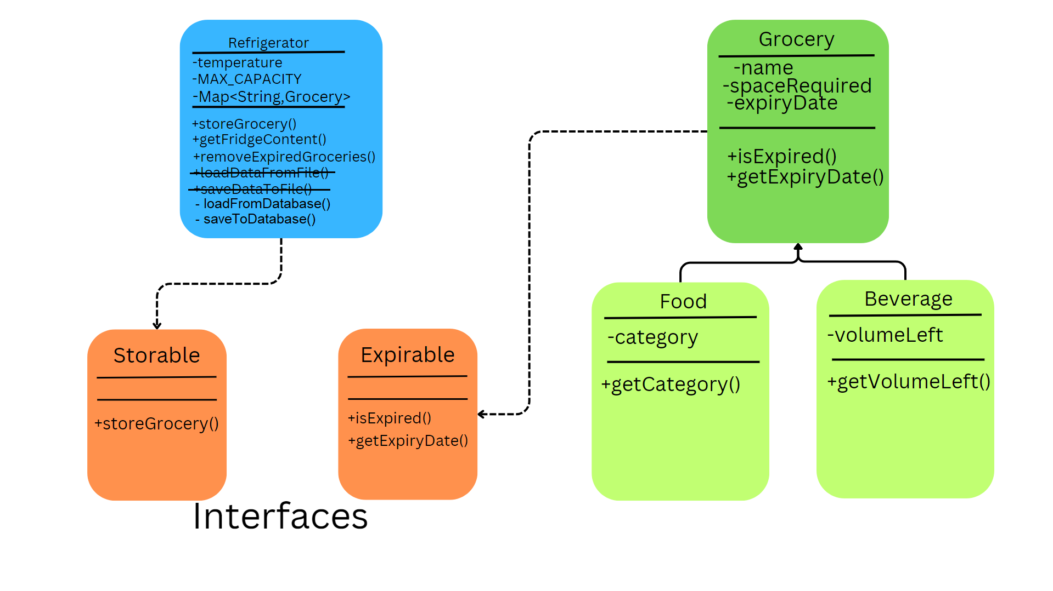

Slide 8
Input data validation

Slide 9
1. validateIntegerInput() to ensure an entered value is an integer.
2. validateDoubleInput() to validate the input as a double (for volume left).
3. validateStringInput() verifies that an entered string is not empty
4.validateDateInput() validates that an entered date has the YYYY-MM-DD format.

Slide 10
JDBC & Connectivity to the Database

Slide 11
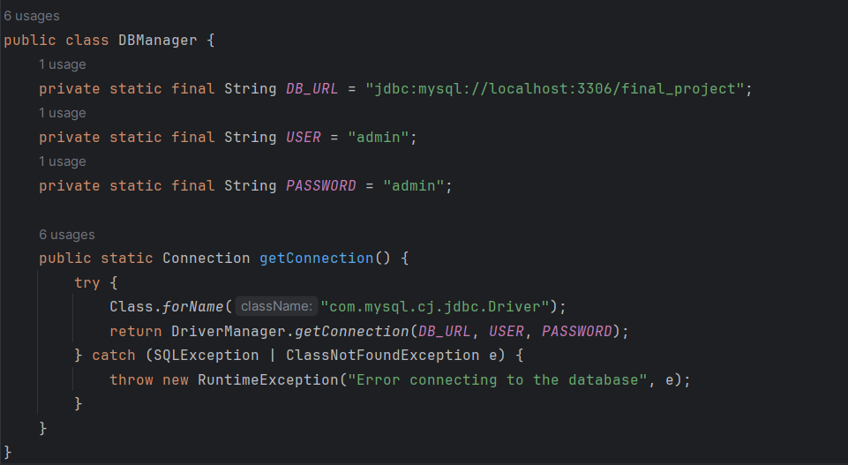
The software used for the database are MySQL Workbench and XAMPP to run the server
The program establishes connection to the database with the following code snippet:
GRANT ALL PRIVILEGES ON final_project.* TO 'admin'@'localhost' IDENTIFIED BY 'admin’
This query was used in MySQL in order to create the admin user.

Slide 12
The database and the schema were created with the following queries in MySQL Workshop:
CREATE DATABASE final_project;
USE final_project;
CREATE groceries (
id INT AUTO_INCREMENT PRIMARY KEY,
name VARCHAR(255) NOT NULL,
type VARCHAR(255) NOT NULL,
space_required INT,
expiry_date DATE,
volume_left DOUBLE,
category VARCHAR(255));

Slide 13
Unit testing & Threading

Slide 14
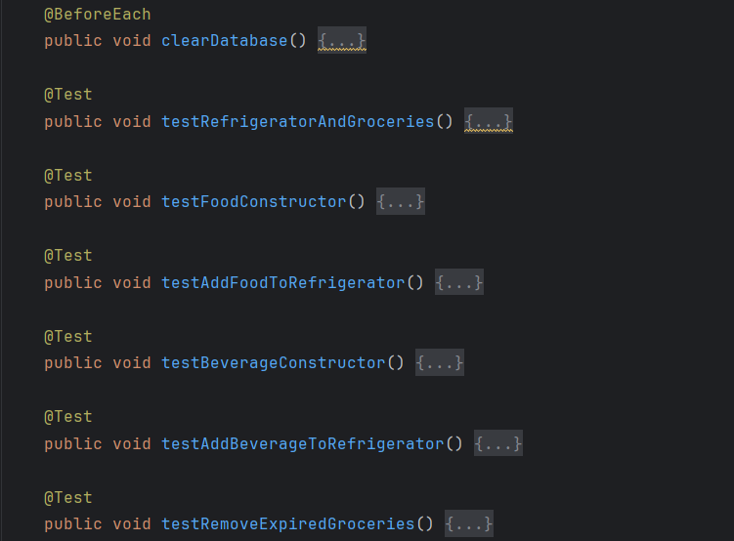
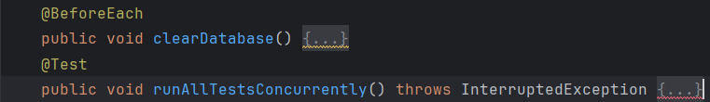
In order to make sure that everything runs right, Unit Tests were made for each constructor.
In order to address the matter of Threading, I created Concurrent Tests which runs all the tests at the same time, reducing the time necessary for the usual operation with the help of Executors import.

Slide 15
Future improvements
Add more functionalities in order to make the program more useful.
Handle more exceptions and also create custom ones.
Create better unit tests in order to preserve the database.

Slide 16
Thank you
Takacs Alexandru
alexandru.takacs03@e-uvt.ro

