Slide 1
API 21 Transitions
In this section you learn about new transition APIs introduced in Android 5.0

Slide 2
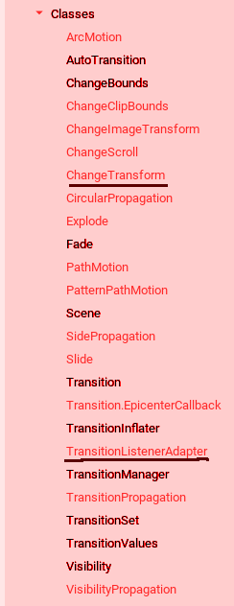
Android 5.0 New Transition Classes
Regular typeface classes (except those underlined)
are introduced in API 21

Slide 3
Classes
ArcMotion
ChangeClipBounds
ChangeImageTransform
ChangeScroll
ChangeTransform
CircularPropagation
Explode
Slide
SlidePropagation
PathMotion
...

Slide 4
Activity Transitions
Another Addition is Activity transitions.
Content Transitions
Shared Element Transitions

