Slide 1
MotionLayout

Slide 2
What is MotionLayout?
A New Layout System in Android With Built-In Support for Animation
Subclass of ConstraintLayout

Slide 3
How MotionLayout Works
Has separate XML file aka motion scene
Animates changes between end points

Slide 4
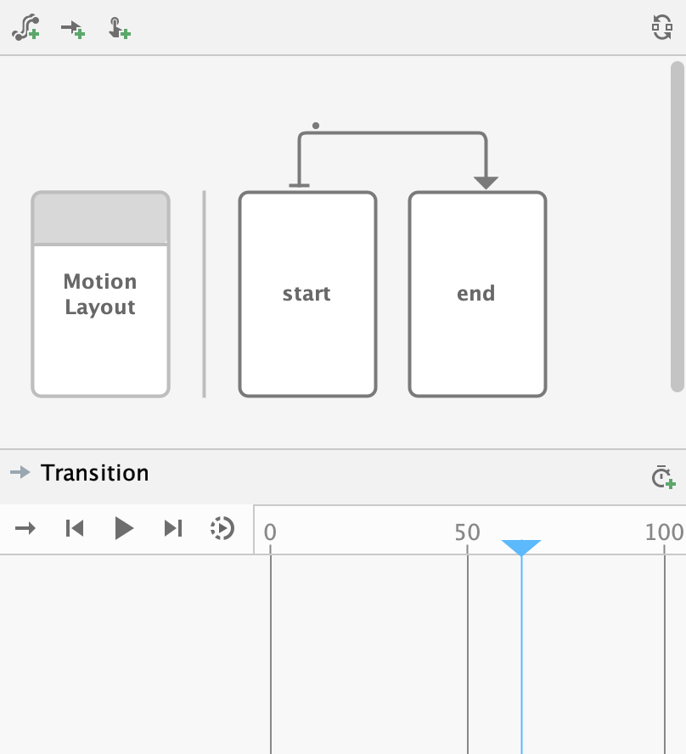
How MotionLayout Works(2)

Slide 5
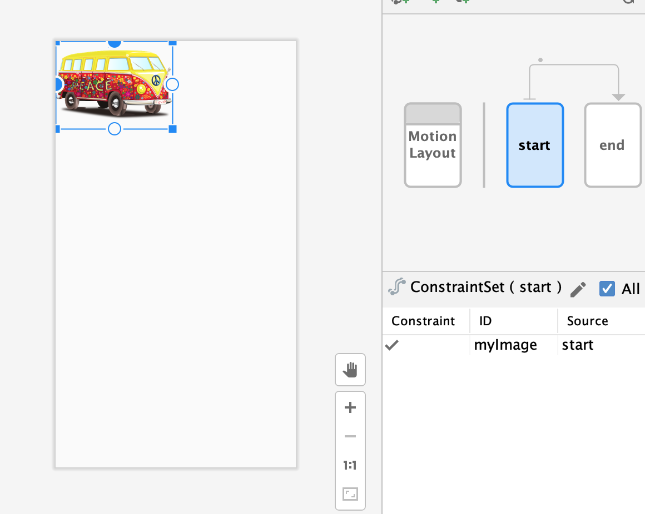
How MotionLayout Works(3)

Slide 6
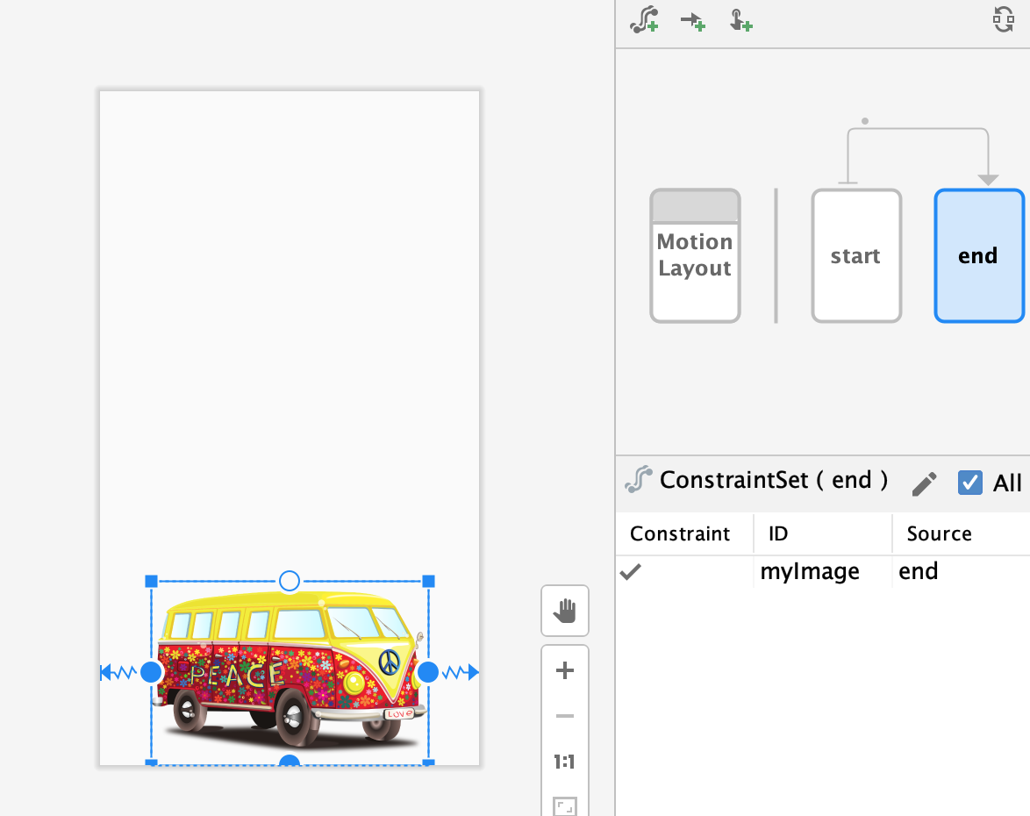
How MotionLayout Works(4)

Slide 7
Advantages
Declarative animation (all in XML)
No coding needed
Visual editor
Support for keyframes (Advanced motion)

Slide 8
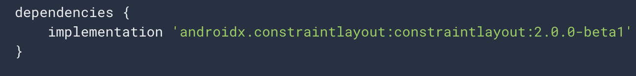
Prerequisites
ConstraintLayout 2.0

