Slide 1
An Introduction to Convolutional Neural Network
Ximo Liang
Notes:
Hello everyone. Today im gonna talk about CNN, which is short for Convolutional Neural Network.

Slide 2
Introduction
Neural Network
CNN
Example
Resources
Notes:
So here are the main topics I will cover today.

Slide 3
Neural Network
An Artificial Neural Network (ANN) is a computational model that is inspired by the way biological neural networks in the human brain process information. Artificial Neural Networks have generated a lot of excitement in Machine Learning research and industry fields, such as:
Signal Processing, e.g. Adaptive Echo Cancellation
Pattern Recognition, e.g. Character Recognition
Speech Synthesis (e.g. Text-to-Speech)& recognition
Forecasting and prediction
Control & Automation (neuro-controllers) e.g. Broom-Balancing
Radar interpretation
Interpreting brain scans
Stock market prediction
Optimization, etc…

Slide 4
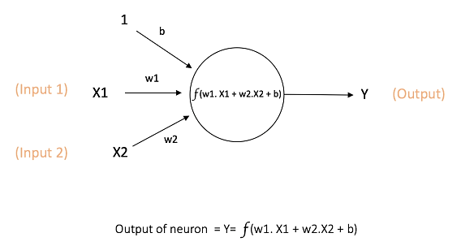
Neural Network
Source: https://ujjwalkarn.me/2016/08/09/
Notes:
The basic unit of a neural network is neuron or node. It receives input from some other nodes, or from an external source and computes an output.
Each input has an associated weight. The above network takes inputs X1 and X2. There are weights w1 and w2 associated with those inputs. Additionally, there is another input 1 with weight b associated with it. This weight b is Bias. The output Y from the neuron is computed as the figure shows. The function f is usually non-linear and is called the Activation Function. The purpose of the activation function is to introduce non-linearity into the output of a neuron. This is important because most real world data is non linear and we want neurons to learn these non linear patterns properly.
Bias value allows you to shift the activation function and make the computation more flexible.

Slide 5
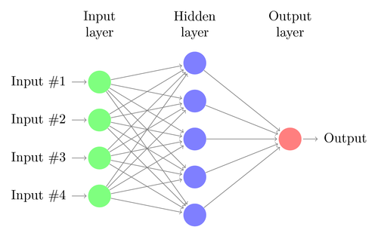
Neural Network
A standard neural network (MultiLayer Perceptron, MLP)
Source: https://towardsdatascience.com/
Notes:
To get multiple neurons arranged in layers and combine these layers, we got a neural network or multilayer perceptron. Here is a example of a simple neural network with 3 layers.
Nodes from adjacent layers have connections between them. All these connections have weights associated with them, just like what’s inside a single neuron.
Input Layer – The Input nodes pass on the information to the hidden nodes and no computation is performed here. Each input node is for a feature or dimension from the data.
Hidden Layer – The Hidden nodes have no direct connection with the outside world. They perform computations and transfer information from the input nodes to the output nodes.
Output Layer – The Output nodes finish computations and convert results from intermediate form to a format we expect.
Now, the question is how ANN get trained and works.

Slide 6
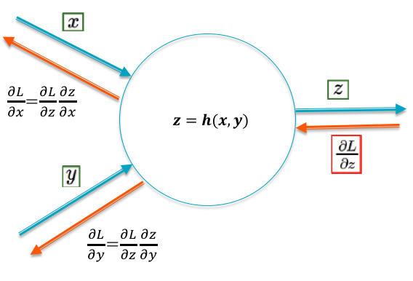
Neural Network
Backward Propagation
Assign weights randomly.
Calculate output based on random weights and get the loss or error.
Feed the loss back to previous layers and change weights to minimize the loss.
Repeat until reach a particular threshold.
Notes:
So initially all the edge weights are randomly assigned. For every input in the training dataset, the ANN is activated and its output is observed. This output is compared with the desired output that we already know, and the error is “propagated” back to the previous layer. This error is noted and the weights are “adjusted” accordingly. This process is repeated until the output error is below a predetermined threshold. And this is called backward propagation algorithm.

Slide 7
Neural Network
Drawbacks of MLP for image:
The number of trainable parameters becomes extremely large and unfeasible to be processed.
Little or no adaptability to shifting, scaling, and other forms of distortion in image.
The topology of the input data is ignored, i.e. the spatial relationship between pixels (voxels) is lost.
Notes:
MLP is definitely not a good choice for image data. Here are the main reasons.

Slide 8
CNN
CNN is motivated by the findings of locally sensitive and orientation-selective nerve cells in the visual cortex.
CNN has a network structure that implicitly extracts relevant features.
CNN is a special type of multi-layer neural network.
Notes:
So CNN was created to solve these problems in processing image data.

Slide 9
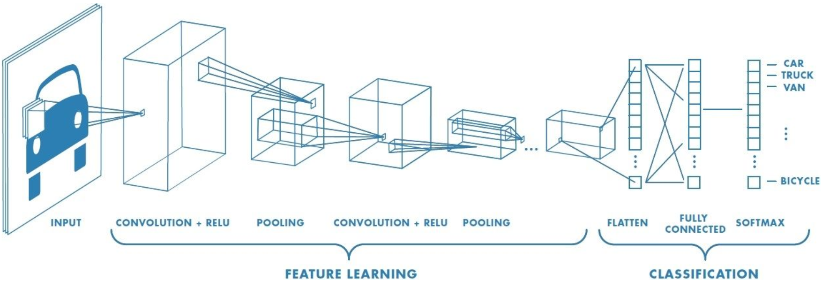
CNN
Notes:
This is a typical CNN architecture for classification. As it shows, we can divide the whole network into two parts: Feature extraction and Classification. The Classification is basically done by a traditional MLP as a classifier based on features. And the core of CNN is in the feature extraction part. We will start from it.

Slide 10
CNN
The computer will assign each pixel a value based on the color (greyscale or RGB, etc). All the numbers are put into an 2D array (for 2D image) and the computer does computations on that array. This is how the number 8 is displayed in Greyscale and numeric array.
Source: https://medium.com/@ageitgey/
Notes:
To understand CNN, firstly we need to know how computer read and store image data.

Slide 11
CNN
Filter in Convolution Layer:
Source: http://machinelearninguru.com/computer_vision/basics/convolution/
Notes:
Lets go to the convolution layer. Filter or kernel, is what we use to do image convolution in this layer. The gif shows us how it works. The filter concludes feature of the image in a small area covered by it. Specifically, the filter calculates the “dot products” between kernel matrix and inputs, slides across the rows then moves down the columns and strides across the rows again until it reaches the end of the image. The figure above can be regarded as convolution of an image with only 1 channel or greyscale image.

Slide 12
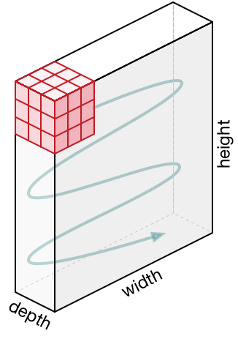
CNN
Filter in Convolution Layer:
Source: https://machinethink.net/images/vggnet-convolutional-neural-network-iphone/
Notes:
For 2D image in RGB color space, it looks like this. The depth is 3 cuz we got 3 color channels in this case. The output matrix generated by the filter, will be a feature map containing features of small areas across the whole input image.

Slide 13
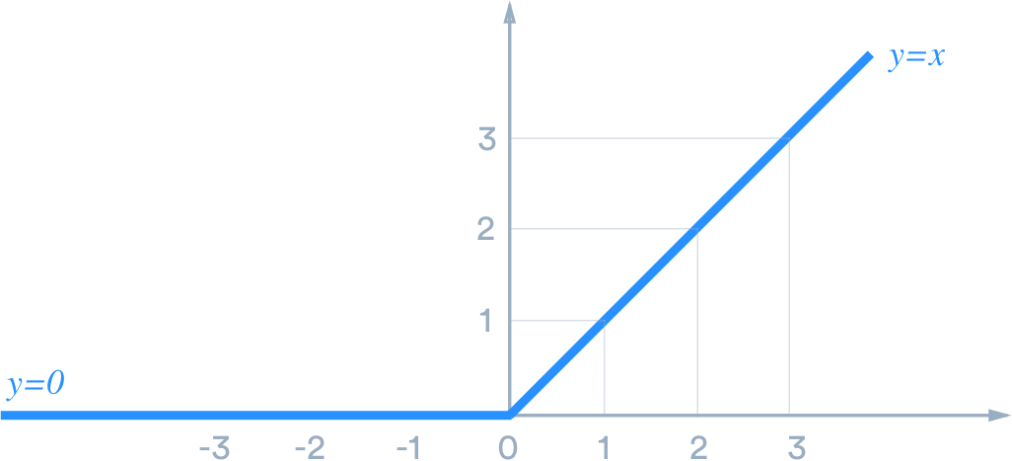
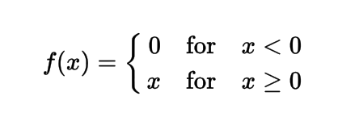
CNN
ReLU in Activation Layer:
The Curve of ReLU (REctified Linear Unit)
Source: https://medium.com/@danqing/a-practical-guide-to-relu-b83ca804f1f7
Notes:
Activation Layer is an activation function that decides the final value of a neuron. It is usually after a convolution layer. ReLU is the most commonly used activation function in neural networks, especially in CNN. Here is the curve of Relu function. As we see, this layer just changes all the negative activations to 0. ReLU works far better than other functions because the network is able to train a lot faster without making a significant difference to the accuracy.

Slide 14
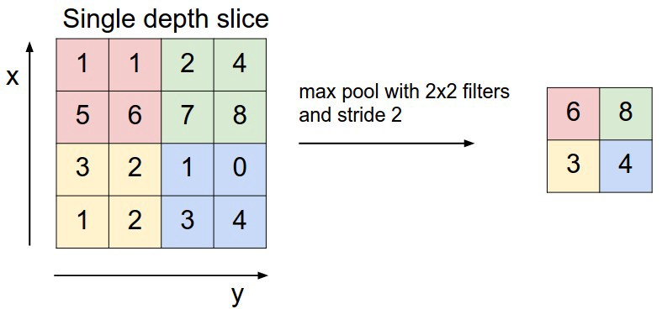
CNN
Pooling Layer:
Source: https://machinethink.net/images/vggnet-convolutional-neural-network-iphone/
Notes:
It is common to insert a Pooling layer in-between successive convolution layers. The function of Pooling Layer is to progressively reduce the spatial size of the representation to reduce the amount of parameters, computation in the network, and to control overfitting. In short, it performs downsampling on the feature maps. In general, there are 2 types of pooling, Max pooling and average pooling. Here we got a example for max pooling. It reduce the dimensions of the feature map by taking the maximum pixel value of a grid. Average pooling is similar but just taking the average.

Slide 15
CNN
Fully Connected Layer:
Fully Connected Layer (FC Layer)
Notes:
The last step of CNN is an estimator, which could be a classifier or a regressor, it depends on the type of the task. It is called fully connected layer. As I mentioned before, it is just an traditional MLP.
Just like any other estimator, an FC layer needs a feature vector as input.

Slide 16
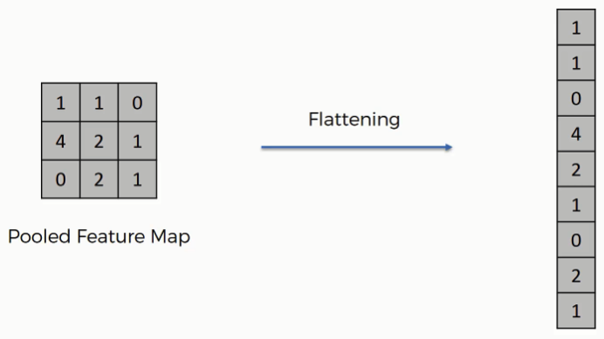
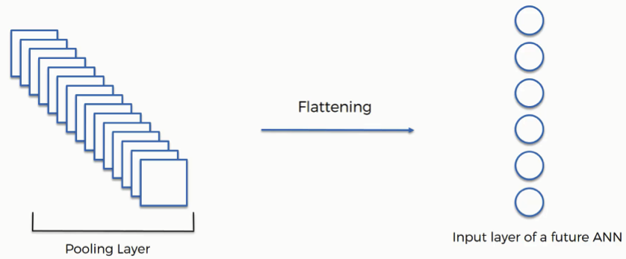
CNN
Flattening Layer:
Source: https://www.superdatascience.com/blogs/convolutional-neural-networks-cnn-step-3-flattening
Notes:
So you need to convert the output of the convolutional part of the CNN into a 1D feature vector, to be used by the MLP. This operation is called flattening. In other words, Flattening Layer receives the feature maps, flattens all of them to create a single long 1D array to be used by the FC layers for the final prediction. Basically, Flattening Layer works as a bridge connecting feature selection part and the prediction part.

Slide 17
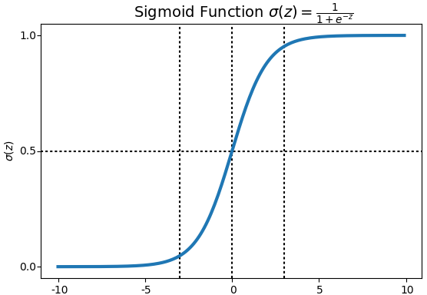
CNN
Sigmoid in Activation Layer:
Source: https://datasciencefortoday.wordpress.com/tag/logistic-regression/
Notes:
If you apply CNN for classification problem, the final layer should be Activation Layer using Softmax (or sigmoid) function. I will talk about sigmoid function today cuz I couldn’t find figures for softmax. So the figure above shows us the curve of sigmoid function. What it does is to compress a series of inputs into the range from 0 to 1. Commonly, we use sigmoid in binary classification cuz the probability of data class must be in the range of 0 to 1. Softmax function works in a similar way but for both bi-class and multiclass data. After the transforming, the final output will be the probability for each data class.

Slide 18
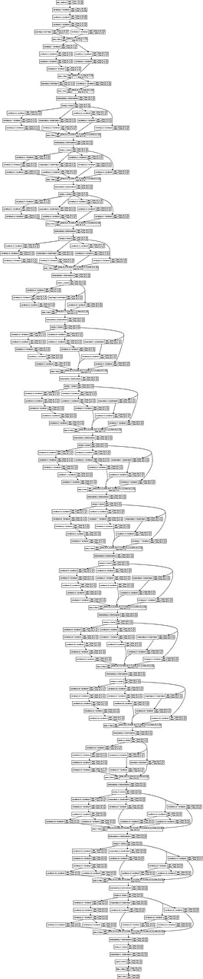
CNN
Architecture of Inception v4
Source: http://www.aaai.org/ocs/index.php/AAAI/AAAI17/paper/download/14806/14311
Notes:
We have already known how a simple CNN works. Here is the Architecture of Inception v4, which is one of the new and powerful CNN right now. It has a depth of 75, hundreds of layers and more than 4 millions of parameters. And we got more complex networks such as Inception ResNet with a larger architecture and more parameters. So we can see that the computational cost for deep learning network is pretty high, and it’s why we have to combine deep learning with distributed computation of GPU or TPU.

Slide 19
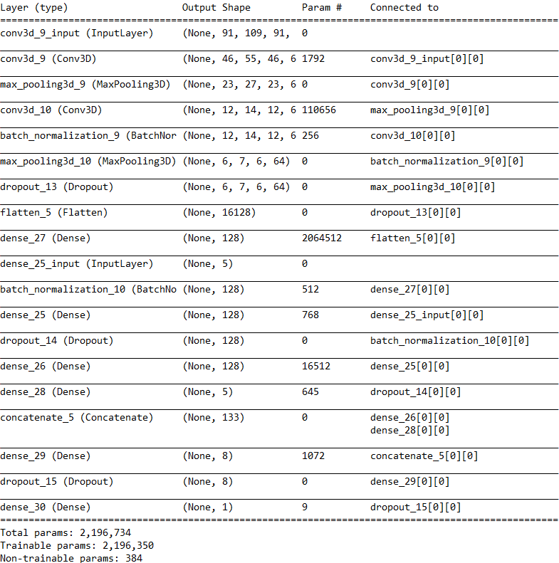
Example
CNN for Regression in fMRI Image
Layers:
19
Parameters:
2.1m
Training time (5-folds CV):
50 min
Notes:
This is the CNN model I am currently working on. Totally there are 19 layers and more than 2millions of parameters. Since it’s still being tuned, there is no performance comparison here. But theoretically, it should perform better than non-ensemble models like linear regression, svm, knn, and so on.

Slide 20
Resources
For more info about CNN, visit:
https://victorzhou.com/blog/intro-to-cnns-part-1/
https://medium.com/@purnasaigudikandula/a-beginner-intro-to-convolutional-neural-networks-684c5620c2ce/
https://towardsdatascience.com/an-introduction-to-convolutional-neural-networks-eb0b60b58fd7

Slide 21
Thank you.

