Slide 1
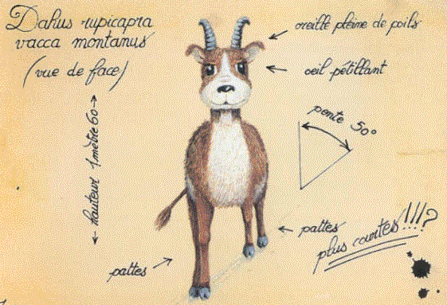
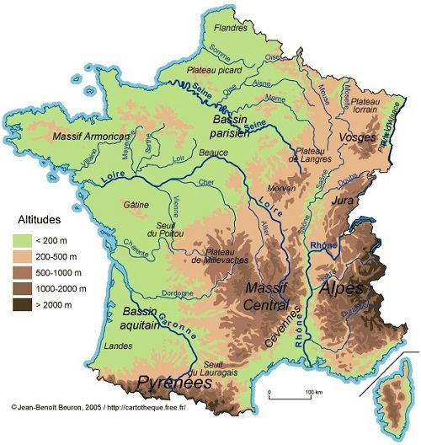
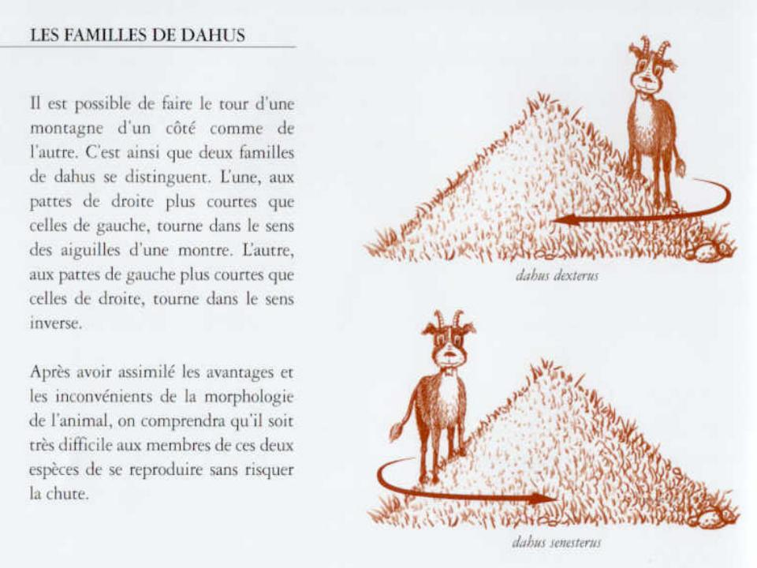
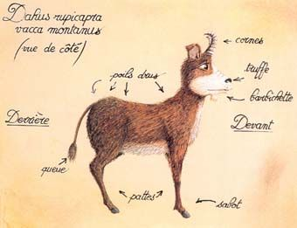

Baby sasquatch October 1st 2018
Romain Duprat

Slide 2
Baby sasquatch October 1st 2018
Mounting a folder locally
Running parallels jobs locally
Running jobs in the background with SCREEN command
Quick tips

Slide 3
Mounting a folder locally
Useful when you need to repeatedly download/upload files
Prerequisite:
Install fuse and sshfs
https://osxfuse.github.io/
Create your local folder to mount the desired folder on

Slide 4
Mounting a folder locally
MOUNTING
sshfs pennID@chead:<path to cluster folder> <path to local folder> -oauto_cache,daemon_timeout=600,reconnect,defer_permissions,noappledouble,volname=<name to local folder>
Enter your password
UNMOUNTING
diskutil unmount CNDScfn/

Slide 5
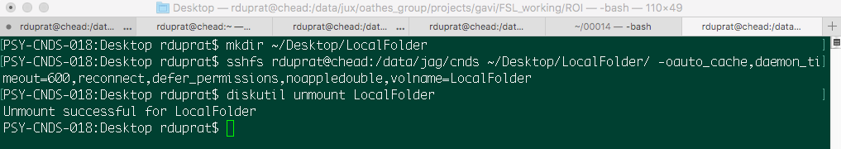
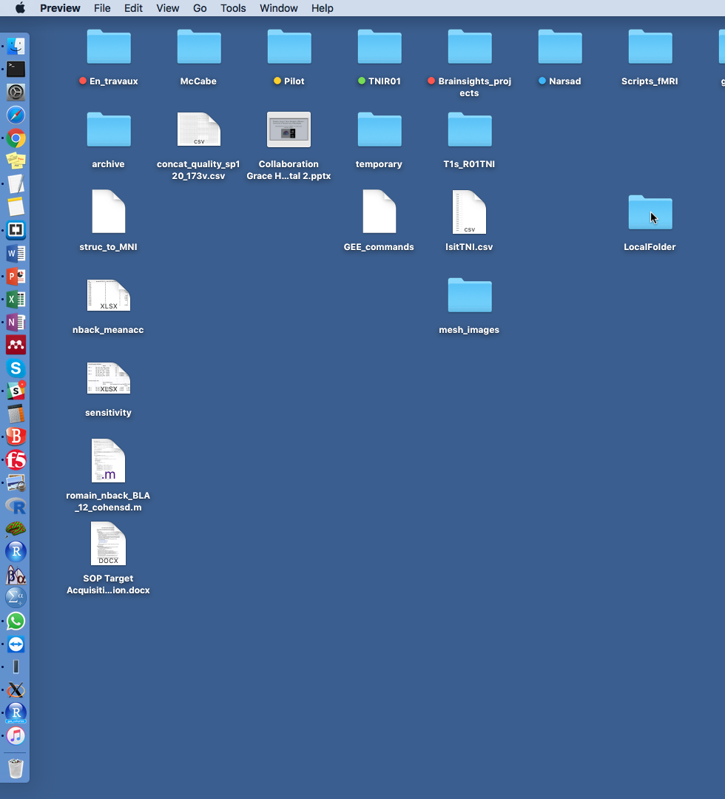
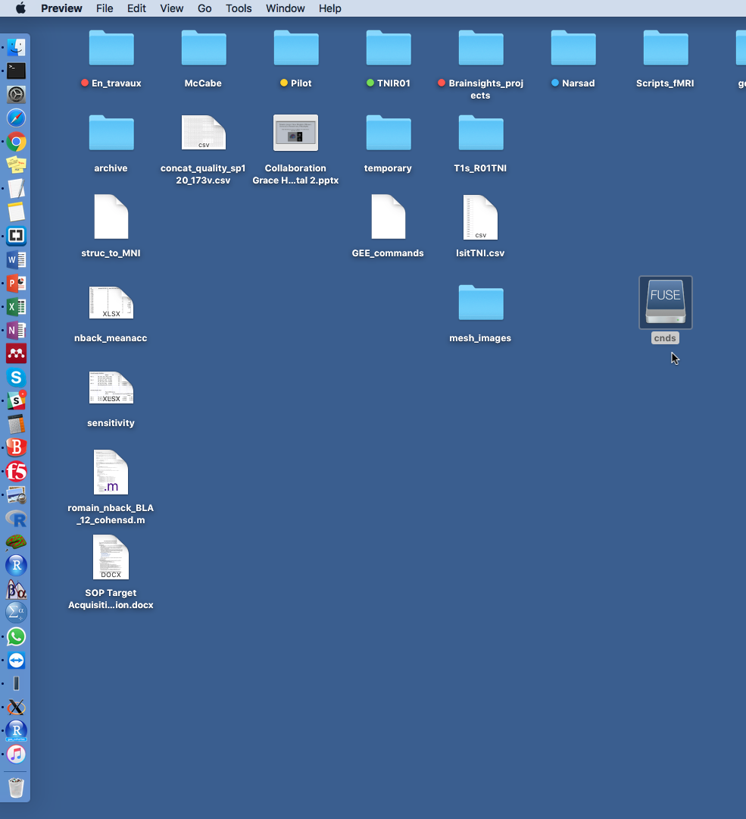
Create Local Folder
Mounted folder

Slide 6
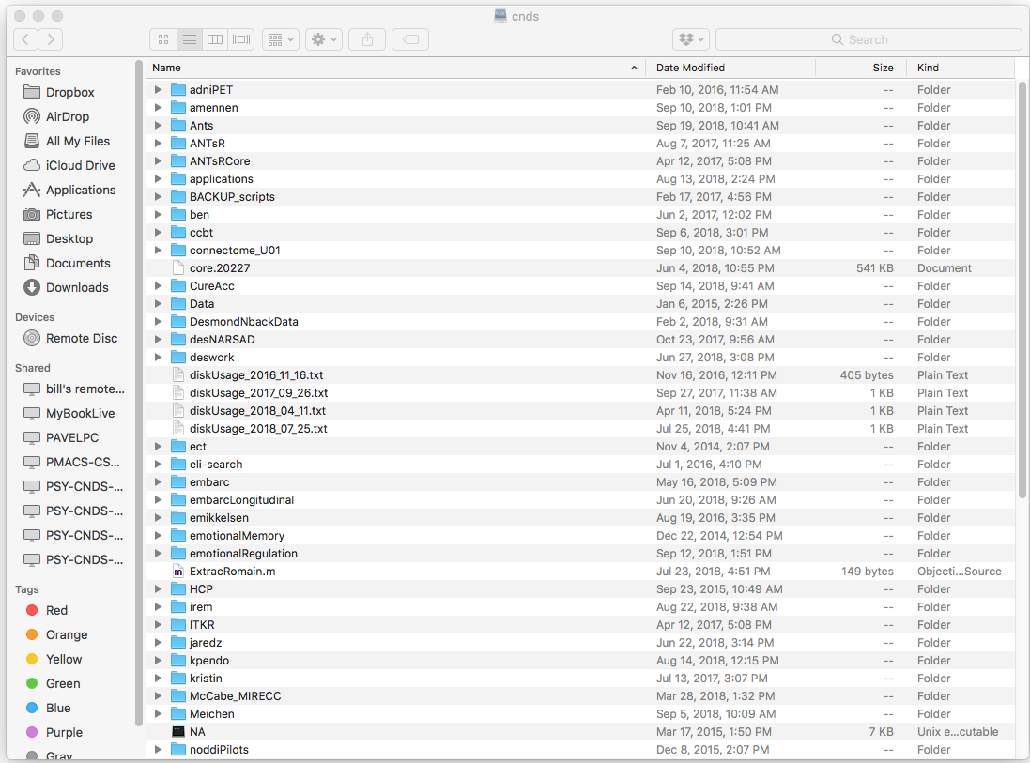
Mounted folder

Slide 7

Running parallels jobs locally
Install homebrew
/usr/bin/ruby -e "$(curl -fsSL https://raw.githubusercontent.com/Homebrew/install/master/install)"
What is homebrew
Homebrew is a package manager that “installs the stuff you need that Apple didn’t”
No compiling
Takes care of dependencies for you

Slide 8
Many useful packages
cask
easy install Mac OS GUI apps
brew install cask
brew cask install google-chrome
links
links is a command line web browser, allowing you full web access (text/image support)
irssi
Chat on the IRC ➔ many chats about ubuntu / bash / R / matlab / neuroscience specific etc.
tmux
A better screen?

Slide 9
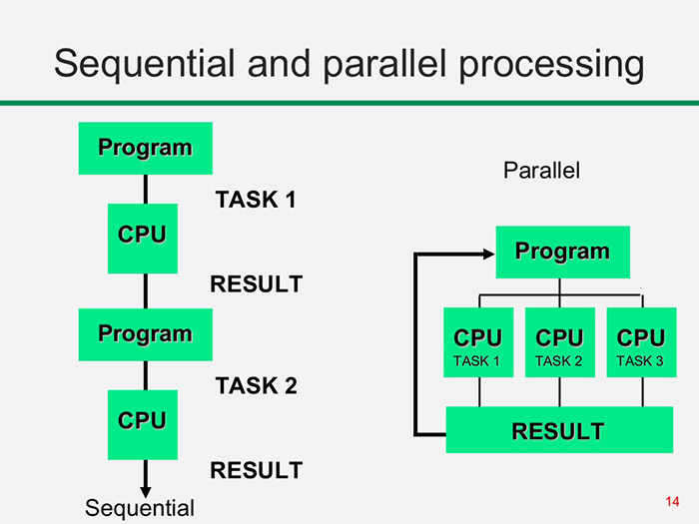
parallel
parallel
is a package allowing you to easily run several jobs locally in parallel
Brew install parallel
<input files> | parallel --jobs <#jobs> <command>
ls *.nii.gz | parallel --jobs 8 recon-all -s {.} -i {} –all # freesurfer
ls *.nii.gz | sed 's/.nii.gz//' | parallel --jobs 8 mri2mesh --all {} {}.nii.gz # mri2mesh
➔if computer is hyper threading to calculate number of job, optimal number of jobs is number of processing cores *2

Slide 10
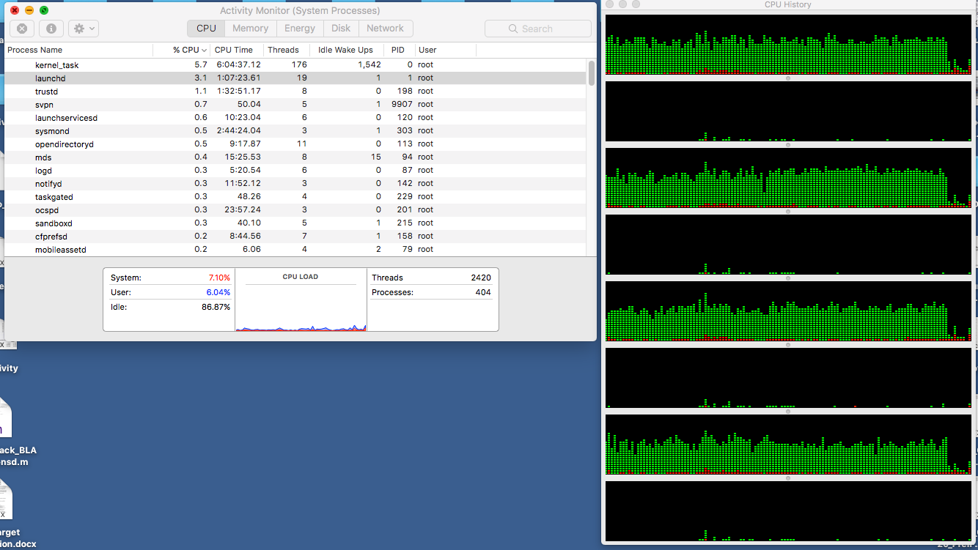
You can check on activity monitor

Slide 11
parallel
Brute force
you can also parallel a list of jobs to run at the same time
parallel --jobs 6 < jobs2run.csv
No limit
Small jobs, no need to specify how many jobs
find . -name "*jpeg" | parallel -I% --max-args 1 convert % %.png

Slide 12

screen
Useful for long running processes locally or on the cluster
Don’t worry about disconnection
Access your terminal windows from any computer and as you left them!!
Check the status of the running process as it goes
Can run nested screens and navigate between them

Slide 13
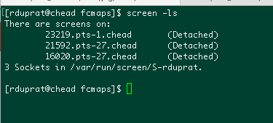
screen
Useful commands:
Screen =>create new screen window
Ctrl-a ? =>see all options
Ctrl-a A =>rename your screen
Ctrl-a d =>detach screen
Ctrl-a K => kill screen (or type ‘exit’)
Screen ls => list open screens
Screen -r <id> =>reattach screen <id>
Ctrl-a n =>navigate to next screen
Ctrl-a p =>navigate to previous screen

Slide 14
screen
And many more things:
You can log all your commands in a text file
you can lock your screen
You can lock and password protect your screen
…..

Slide 15
Quick tips:
Caffeinate your terminal
caffeinate -t 3600 &
caffeinate -i my_script.sh
Reading your log in real time
tail -f path_to_Log
tail -f path_to_log | grep search_term
Reverse research history of commands
Ctrl-r

Slide 16
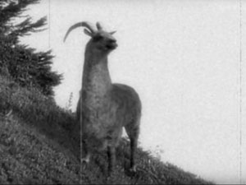

Thank you!!
Find the slides on: https://github.com/djo155/babySASQUATCH
Dahu Dexterus
Dahu Senesterus

