Slide 1
Introduction to Data Processing in Python
Ximo Liang
Notes:
Hello everyone. I am very glad to be here and make a presentation. Today im gonna talk about python. It’s not an animal, it’s a extremely powerful programming language. I believe a lot of people have heard of it.

Slide 2
Introduction
What’s python?
Why Python?
Install & Run
Examples
Resources
Notes:
So here are the main topics we have today.

Slide 3
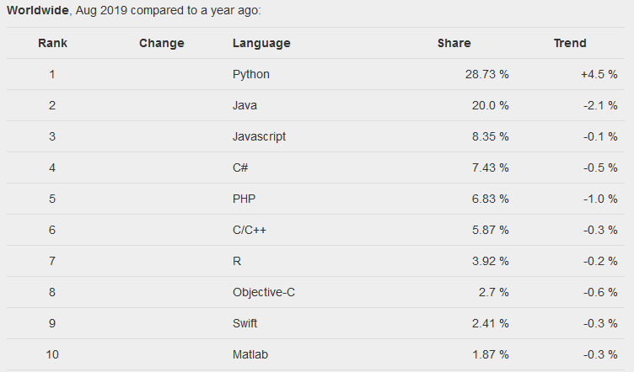
What is Python?
Python is a general purposed high-level programming language.
Web development
Networking
Scientific computing
Data analytics
...
© Pierre Carbonnelle, 2019
Notes:
Python is a general purpose programming language and it’s not only for Data Science. It has been widely used around the world.
Here is the programming language ranking from Google. Python has almost 30% of the market share.

Slide 4
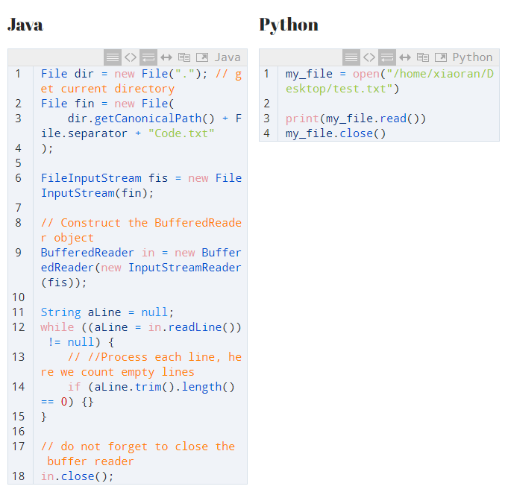
Why Python?
Easy to learn
Readable
Extensive set of libraries
Easy integration with other apps
Active community & ecosystem
…
Source: https://python-scripts.com/
Notes:
Python is a high-level language. It means, that in terms of CPU-time it’s not the most efficient language. But on the other hand it was made to be simple, “user-friendly” and easy to interpret.
We got a comparison here, to open a text file, read, print and close it in both JAVA and Python.

Slide 5
Why Python?
Library | Usage
numpy, scipy | Scientific & technical computing
pandas | Data manipulation & aggregation
mlpy, scikit-learn | Machine learning
theano, tensorflow, PyTorch | Deep learning
statsmodels | Statistical analysis
nltk, gensim | Text processing
networkx | Network analysis & visualization
bokeh, matplotlib, seaborn, plotly | Visualization
beautifulsoup, scrapy | Web scraping
Notes:
This table shows us some famous packages for data science. In fact, besides these usages, you can do text mining, object detection, facial recognition, real-time voice recognition, NLP, translation and other fancy jobs in python.

Slide 6

Install & Run
Anaconda is a package manager, an environment manager, a Python/R data science distribution with over 1,500+ open source packages.
Source: https://www.anaconda.com/
Notes:
To start coding in python, we need to install and setup the environment first. It could be pretty cumbersome if you do it manually, fortunately we got one stop solution for all of this.
*It allows user level installation of multiple versions of python
*It’s able to install/update packages completely independent of system libraries
*It comes either in full version, with all kinds of popular packages. or in minimal version (miniconda) where you can install what you want, when you need it
*There is no risk of messing up existing system libraries

Slide 7
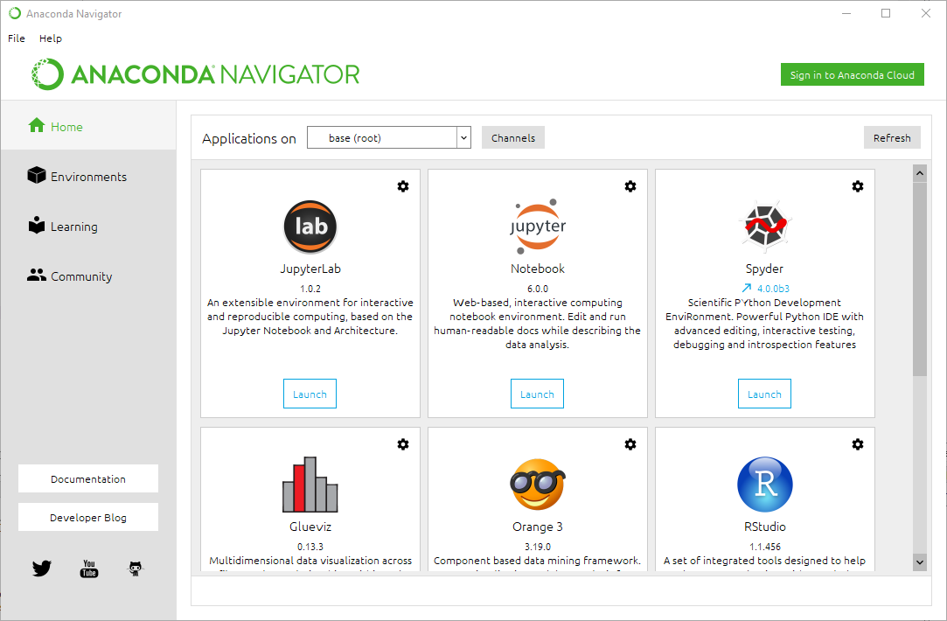
Install & Run
Notes:
The interface of anaconda is like this. These 2 apps are what we need for common python coding. Both of them allow you to write your code and run it and show the results. But personally, I prefer Spyder since it’s pretty similar to r-studio so its very friendly to R users.

Slide 8

Install & Run
Spyder is a powerful Integrated development environment (IDE) written in Python, for Python, and designed by and for scientists, engineers and data analysts.
It supports data exploration, interactive execution, deep inspection, and beautiful visualization.
Source: https://www.spyder-ide.org/
Notes:
Of course we can directly write our code in a python command line interface without any graphic accessibility, but that’s definitely not what we want. A easier way is to use IDE.

Slide 9
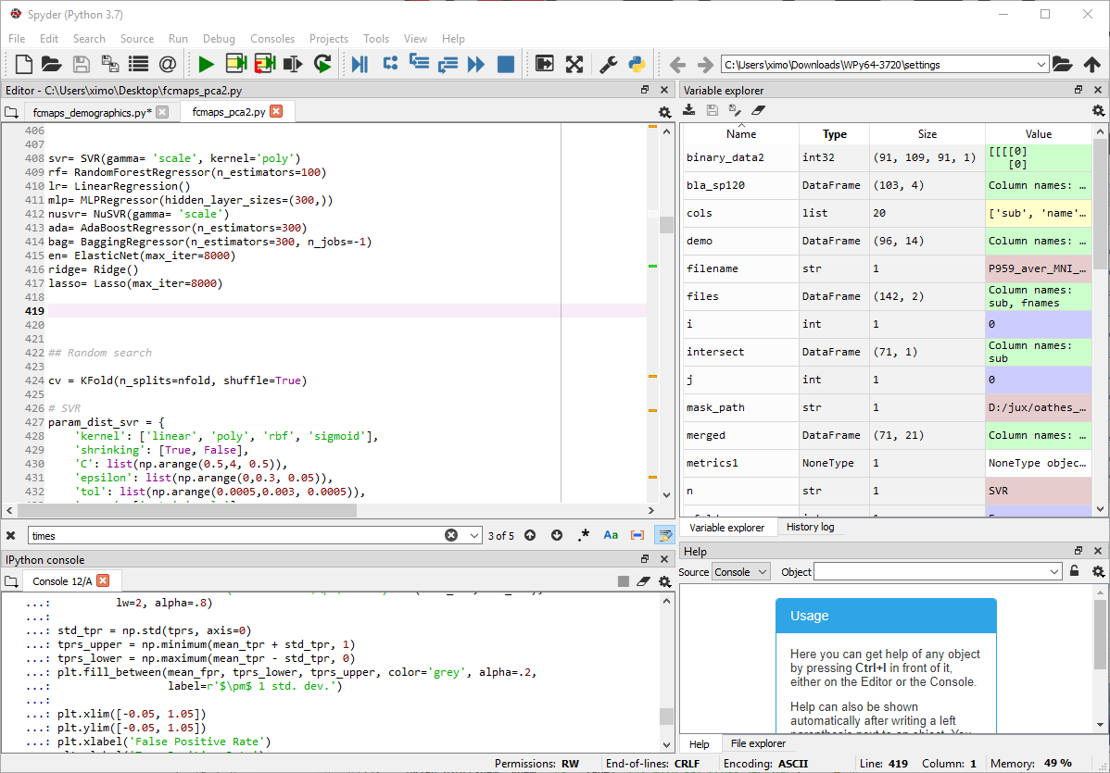
Install & Run
Editor
Variable Explorer
Console
Help
Notes:
This is how it looks like. The Editor pane is where you write your code, and when you run the code, all results will appear in the console. And defined variables will be in the variable explorer. You are able to double click and view it if the datatype is able to be displayed, such as text, array, matrix, etc. Help pane will show you function documents which have explanations and examples for the function to help you code and debug.

Slide 10
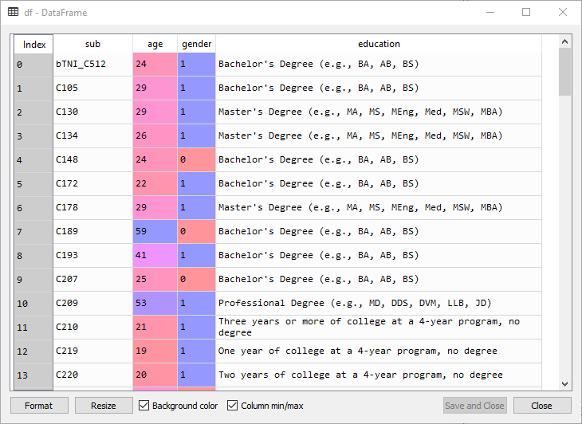
Example: Import data
## Import necessary packages
import pandas as pd
import numpy as np
## For excel file
df= pd.read_excel('C:/Users/ximo/Desktop/demographics.xlsx')
## For csv file
df2= pd.read_csv('C:/Users/ximo/Desktop/demographics.csv')
Notes:
Now we are ready to code in python. At the very beginning of your code, necessary libraries should be imported for later use. After importing them, Then you can use the methods and functions in them. Here we call read_excel function in pandas to read excel file to python and save it to a variable named df.

Slide 11
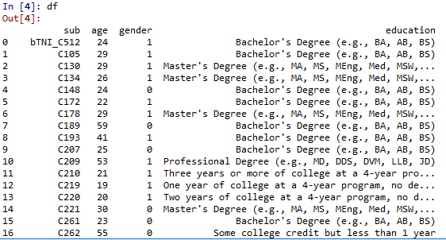
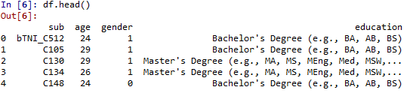
Example: Display data
## Show the data
df
## or
print(df)
## Preview of data
df.head()

Slide 12
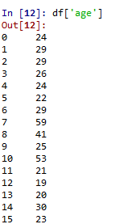
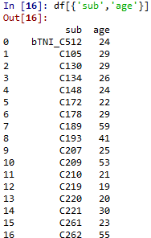
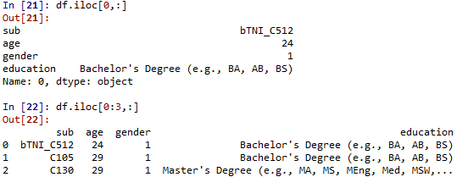
Example: Display data
## Show specific column(s)
df[‘age’]
df[{'sub','age'}]
## Show specific row(s)
df.iloc[0,:] ## Show first row
df.iloc[0:3,:] ## Show first 3 rows
Notes:
The index of row in python starts from 0. So zero is the first row, 1 is the 2nd, and so on.

Slide 13
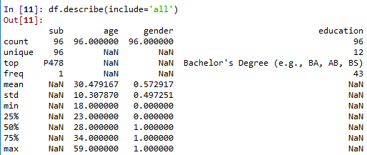
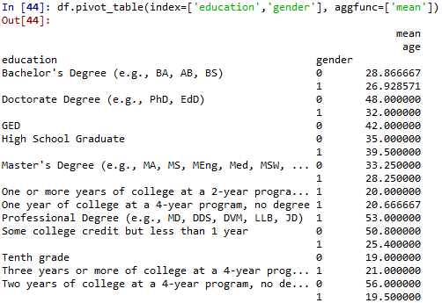
Example: Descriptive analysis
## Descriptive summary
df.describe(include='all')
## Pivot table
df.pivot_table(index=['education','gender'], aggfunc=['mean'])

Slide 14
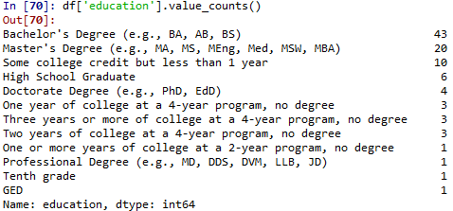
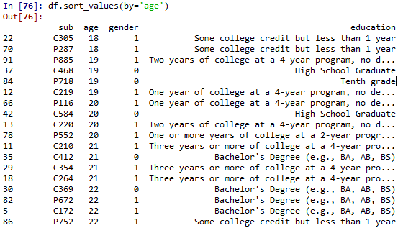
Example: Descriptive analysis
## Count the number of instances in each type
df['education'].value_counts()
## Sort data by specific feature
df.sort_values(by='age')

Slide 15
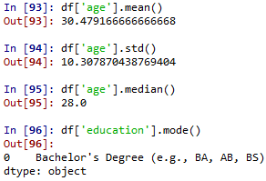
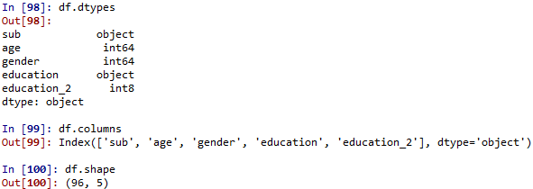
Example: Descriptive analysis
## Calculate mean, standard deviation, median and mode
df['age'].mean()
df['age'].std()
df['age'].median()
df['education'].mode()
## Show data types, column names, size of data
df.dtypes
df.columns
df.shape

Slide 16
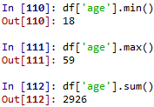

Example: Descriptive analysis
## Minimum, maximum, sum
df['age'].min()
df['age'].max()
df['age'].sum()
## Calculate correlation matrix
df.corr()
Notes:
In this dataset, gender is in a binary format, 0 stands for female, and 1 is for male. So the correlation coefficient tells us the average age for females is higher.

Slide 17
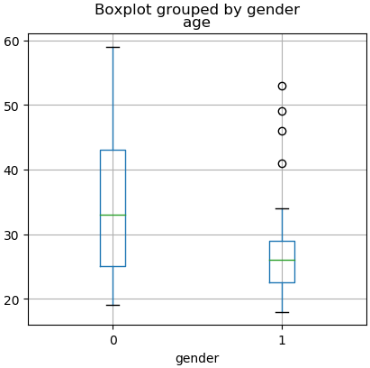
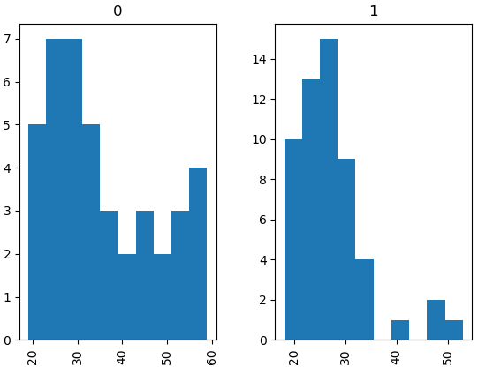
Example: Visualization
## Boxplot
df.boxplot(column='age', by='gender')
## Histogram
df.hist(column='age', by='gender')
Notes:
Furthermore, We can easily create visualizations in python. Box plot is usually used for compare value distributions between several groups. In this plot, we have the same conclusion as what we got from correlation matrix, that females have a higher average age. And we are able to check the details of age distribution by plotting a histogram.

Slide 18
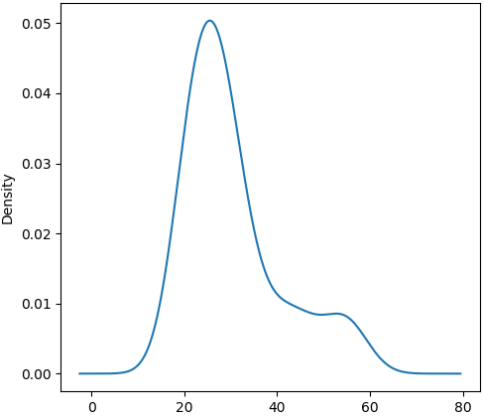
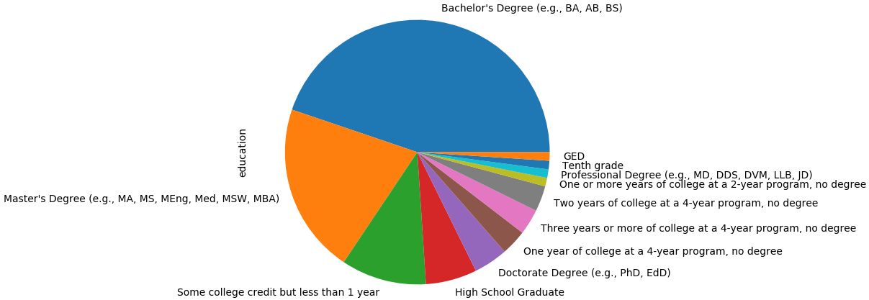
Example: Visualization
## Pie chart
df['education'].value_counts().plot.pie()
## Density plot
df['age'].plot.kde()
Notes:
We can also create a pie chart to show the share or frequency of each category of feature. Density plot is pretty similar to histogram, it’s basically another way to show data distribution but with a smoothed curve.

Slide 19
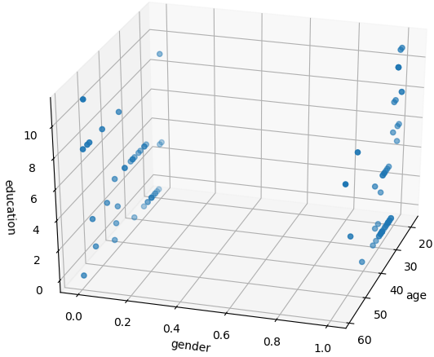
Example: Visualization
## 3D scatter plot
from matplotlib import pyplot
from mpl_toolkits.mplot3d import Axes3D
import random
fig = pyplot.figure()
ax = Axes3D(fig)
df['education_2'] = df['education'].astype('category').cat.codes
ax.scatter(df['age'], df['gender'], df['education_2'])
ax.set_xlabel('age')
ax.set_ylabel('gender')
ax.set_zlabel('education')
pyplot.show()
Notes:
And of course we can create a 3D scatter plot and investigate the data and clusters from different angles. Although it might be not the best choice for our sample dataset cuz we have only one continuous variable which is ‘AGE’. But 3D visualization could be a good way to interpret specific datasets.

Slide 20
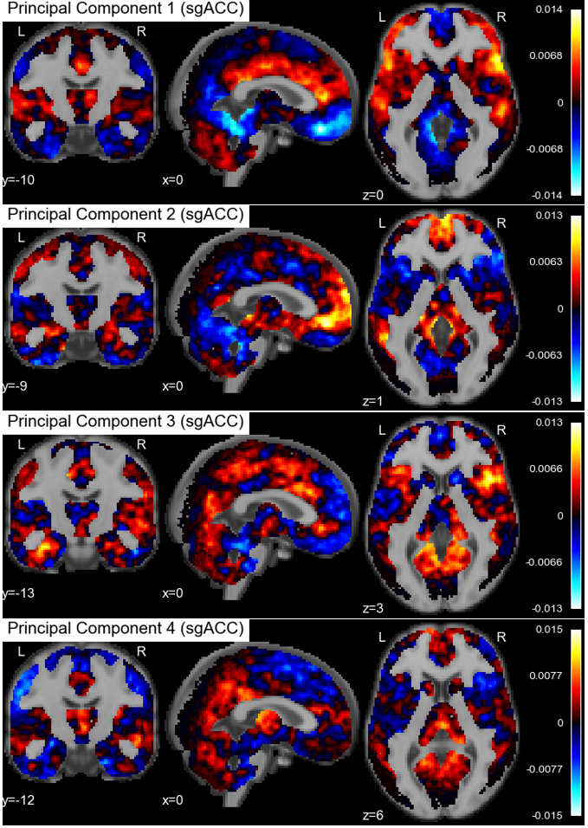
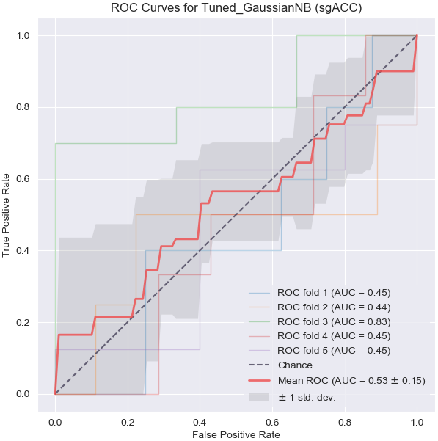
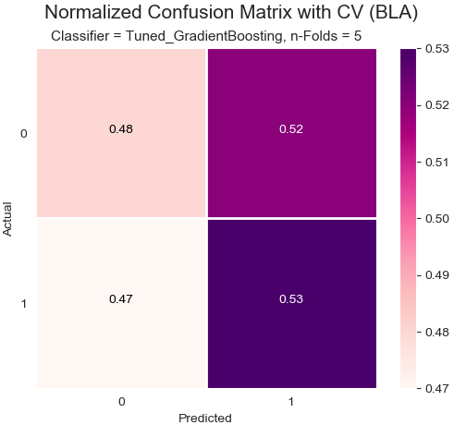
Example: Visualization
Other examples:
Notes:
Here are some other examples of visualization I made. And you can create more complicated plots with matplotlib or other python libraries.

Slide 21
Resources
For more Python tutorials, visit:
http://www.data-analysis-in-python.org/
https://www.analyticsvidhya.com/blog/2016/01/complete-tutorial-learn-data-science-python-scratch-2/
https://towardsdatascience.com/exploratory-data-analysis-tutorial-in-python-15602b417445

Slide 22
Thank you.

