Slide 1


ERASMUS+ INTERNSHIP DEFENCE
My Erasmus+ Internship in France
Haithem Cheniti
Host company: KHELA (Khelaf), France
Sending institution: Klaipėdos valstybinė kolegija (KVK)
Erasmus+
Notes:
Good morning. My name is Haithem Cheniti, a student at Klaipėdos valstybinė kolegija. Today I will present my Erasmus+ internship at KHELA in France: the programme, the company, my tasks, the tools I used, the skills I gained, the challenges I faced and what this mobility meant for me.

Slide 2
01
Erasmus+ programme
Why I went and what I wanted to achieve
02
Host company
Who KHELA is and what it does
OVERVIEW
Agenda
03
My role
Daily tasks and responsibilities
Six parts, from the programme's goals to what I take away from the experience.
04
Digital tools
How I used Word, Excel and document management
05
Skills & challenges
What I learned and how I adapted
06
Personal growth
The Erasmus experience and key takeaways
Haithem Cheniti · Erasmus+ Internship Defence
02 / 12
Notes:
Here is the structure of my presentation. I will start with the Erasmus+ programme and my objectives, then introduce KHELA, describe my role and the digital tools I used, and finish with the skills I developed, the challenges I faced and my personal growth.

Slide 3






KEY FACTS
Internship at a Glance
PROGRAMME
DESTINATION
HOST COMPANY
Erasmus+ traineeship
France
KHELA (Khelaf)
SENDING INSTITUTION
POSITION
MAIN TOOLS
KVK — Klaipėda, Lithuania
Administrative / office intern
Microsoft Word & Excel
Haithem Cheniti · Erasmus+ Internship Defence
03 / 12
Notes:
Here are the key facts. This was an Erasmus+ traineeship in France. My host company was KHELA, and my sending institution is KVK in Klaipėda, Lithuania. I worked as an administrative intern, and my main tools were Microsoft Word and Excel.

Slide 4



ERASMUS+ PROGRAMME
Why Erasmus+? My Objectives
Erasmus+ gives students the chance to gain real work experience abroad, combining professional practice with intercultural learning. My mobility had three objectives:
01
02
03
Practical experience
Global exposure
Career development
Apply what I learned at KVK in a real company, with real deadlines and responsibilities.
Live and work in France, inside a multicultural team and a new business culture.
Build the competencies European employers look for: digital, organisational and communication skills.
Haithem Cheniti · Erasmus+ Internship Defence
04 / 12
Notes:
The Erasmus+ programme supports student traineeships abroad. My mobility had three objectives: first, to gain practical experience by applying what I learned at KVK in a real company; second, to be exposed to an international workplace in France; and third, to develop the competencies that European employers value.

Slide 5
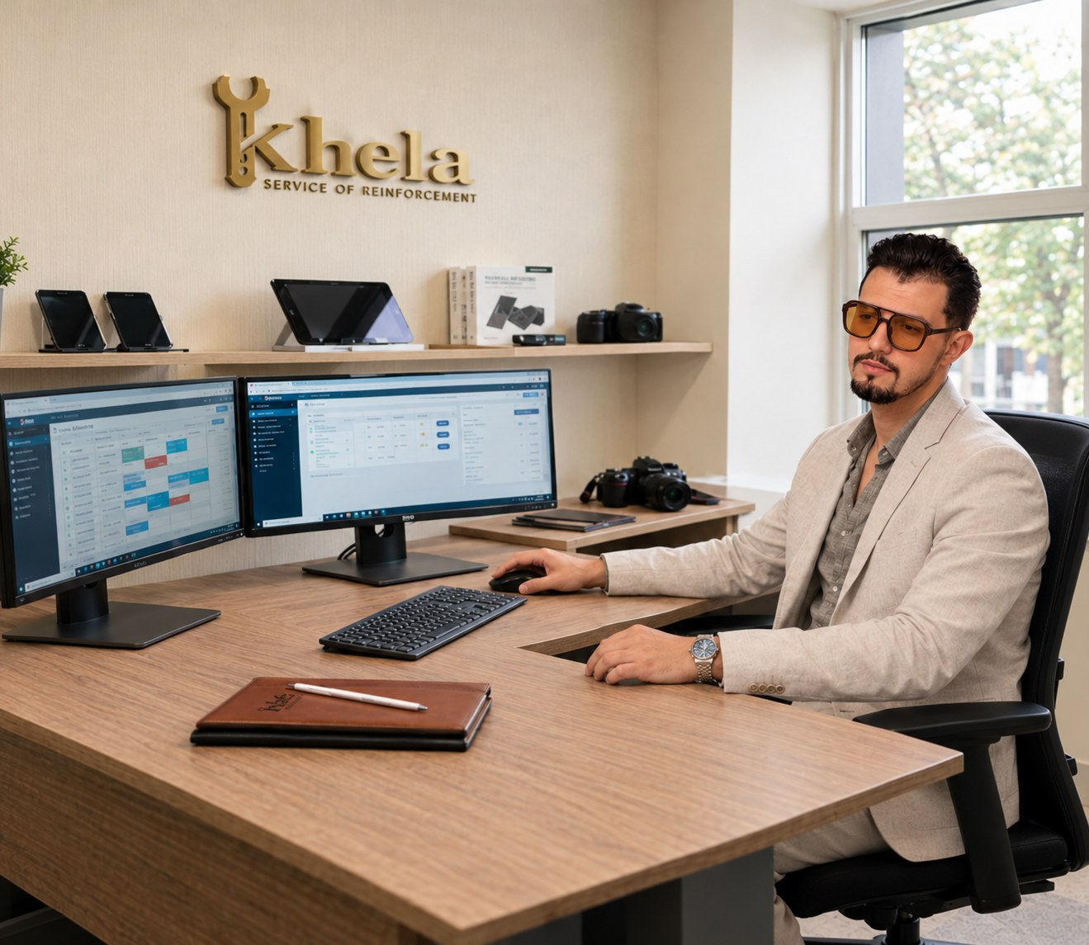





HOST COMPANY
About KHELA
A medium-sized French company specialised in buying, selling, repairing and refurbishing machines, electronics and technological equipment.
Buy & Sell
Repair & Maintain
Trade of machines and electronic devices
Technical services for industrial devices
Refurbish & Resell
Skilled team
Giving used equipment a second life
Many workers and technicians
Circular-economy model: refurbishing extends the life of equipment and reduces electronic waste.
Haithem Cheniti · Erasmus+ Internship Defence
05 / 12
Notes:
KHELA is a medium-sized French company. Its main activities are buying and selling machines and electronics, repairing and maintaining devices, and refurbishing equipment for resale. It employs a significant number of workers and technicians. By refurbishing equipment, the company also follows a circular-economy model that reduces electronic waste.

Slide 6






MY ROLE
My Internship Tasks
My position was mainly administrative. I supported the office in five areas:
STEP 1
STEP 2
STEP 3
STEP 4
STEP 5
Administration
Documents
Data
Information
Operations
Daily office and administrative work
Preparing and editing professional documents
Organising data and keeping records up to date
Managing office information and files
Supporting daily business activities
Core focus: intensive daily use of Microsoft Word and Microsoft Excel — the backbone of every task above.
Haithem Cheniti · Erasmus+ Internship Defence
06 / 12
Notes:
My position was mainly administrative. I handled daily office work, prepared and edited documents, organised data and kept records up to date, managed office information and files, and supported the company's daily operations. Word and Excel were my main tools every single day.

Slide 7





DIGITAL TOOLS
Office Work & Digital Tools
W
Microsoft Word
MY TYPICAL WORKFLOW
Letters, reports and templates formatted to professional standards, with consistent styles and layouts.
Collect
Gather information from colleagues and operations
Microsoft Excel
Record
X
Enter and organise the data in Excel
Tables, inventories and records that keep company data organised, accurate and easy to update.
Produce
Turn it into clear, professional documents in Word
Document management
File
A structured filing system with clear naming, so information can be found quickly.
Archive everything so it is easy to retrieve
Haithem Cheniti · Erasmus+ Internship Defence
07 / 12
Notes:
In Word, I created and formatted letters, reports and templates to professional standards. In Excel, I built tables, inventories and records to keep data accurate and organised. I also helped keep a structured filing system so information could be found quickly. A typical task followed four steps: collect the information, record it in Excel, produce the document in Word, and file it.

Slide 8






RESULTS
Skills & Achievements
Technical
Professional
Interpersonal
Microsoft Word
Problem-solving
Communication
Professional documents and templates
Practical solutions to daily issues
Clear exchanges with colleagues
Microsoft Excel
Organisation
Teamwork
Structured tables and records
Records kept complete and up to date
Collaboration in a multicultural team
Data management
Business support
Adaptability
Accurate, well-organised information
Helping daily operations run smoothly
Adjusting to a new culture and workplace
Haithem Cheniti · Erasmus+ Internship Defence
08 / 12
Notes:
I developed three groups of skills. Technical: strong Word and Excel skills and data management. Professional: problem-solving, organising records and supporting business operations. Interpersonal: communication, teamwork in a multicultural team, and adapting to an international environment.

Slide 9




LESSONS LEARNED
Challenges & How I Handled Them
THE CHALLENGE
MY RESPONSE
A new language and work culture
Listened carefully, asked questions and adapted to French workplace habits step by step.
Large amounts of information
Built clear Excel tables and a consistent filing structure to keep everything organised.
Many different daily tasks
Prioritised my work and kept tidy records so nothing was missed.
Haithem Cheniti · Erasmus+ Internship Defence
09 / 12
Notes:
Like any mobility, this internship came with challenges. Working in a new language and business culture required me to listen carefully, ask questions and adapt step by step. The volume of information I handled pushed me to build clear Excel tables and a consistent filing structure. And with many different daily tasks, I learned to prioritise and keep tidy records so nothing was missed.

Slide 10




PERSONAL GROWTH
My Erasmus Experience
Cultural adaptation
International experience
Adjusting to French work habits, language and everyday life.
Collaborating with colleagues from different backgrounds and cultures.
Independence
Future benefits
Managing daily life abroad on my own built confidence and responsibility.
A stronger CV and real readiness for a European career.
Haithem Cheniti · Erasmus+ Internship Defence
10 / 12
Notes:
Beyond work, Erasmus helped me grow personally. I adapted to a new culture, worked in an international setting, became more independent by managing daily life abroad, and gained experience that will strengthen my future career in Europe.

Slide 11




CONCLUSION
Key Takeaways
Real office experience
Strong digital skills
International confidence
Genuine daily responsibilities inside a French company.
Confident, efficient use of Word and Excel for real business needs.
Ready to live and work in an international environment.
Acknowledgements I sincerely thank KVK, KHELA and the Erasmus+ programme for this opportunity, and my colleagues in France for their support and trust.
Haithem Cheniti · Erasmus+ Internship Defence
11 / 12
Notes:
To conclude, this internship gave me real office experience, strong digital skills and the confidence to work internationally. I would like to thank KVK, KHELA and the Erasmus+ programme for this opportunity, and my colleagues in France for their support.

Slide 12

ERASMUS+ INTERNSHIP DEFENCE
Thank you!
Questions are welcome.
Haithem Cheniti · Erasmus+ internship at KHELA, France
Erasmus+
Notes:
Thank you for your attention. I am happy to answer your questions.

