Slide 1
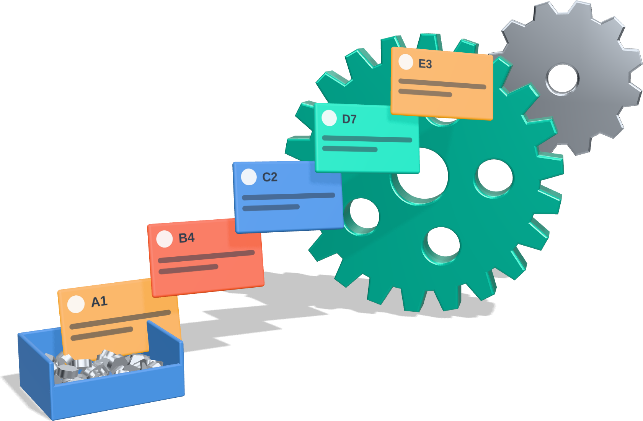
Kanban & TPM
LEAN METHODS · PRACTICAL ASSIGNMENT · GROUP 1
Kanban: visual workflow and inventory management. TPM (Total Productive Maintenance): equipment maintenance and reliability.
Notes:
Hello, we are Group 1. Our Lean methods are Kanban, which manages workflow and inventory visually, and TPM, Total Productive Maintenance, which keeps equipment reliable. For each method we cover its purpose, principles and implementation steps, the problems it solves and practical examples. Then we answer why organizations implement Lean and what the main challenges are.

Slide 2
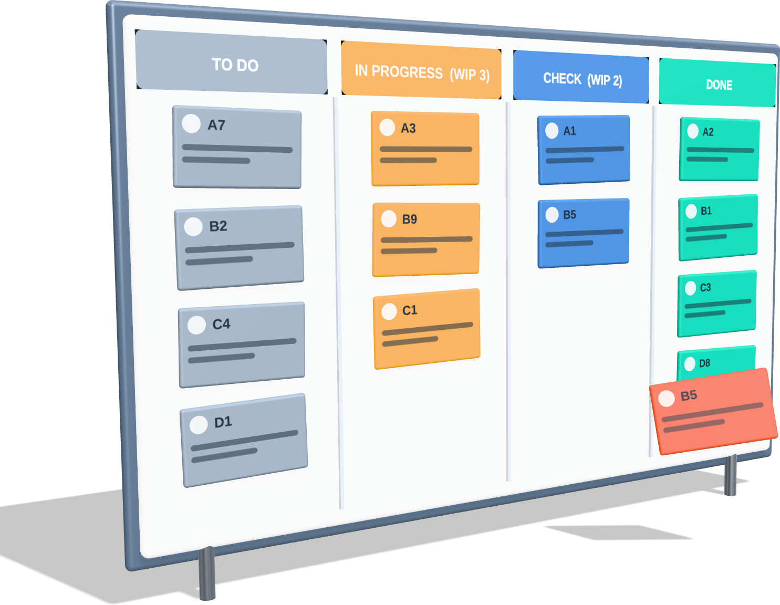






Kanban: purpose and principles
KANBAN · PURPOSE & PRINCIPLES
PURPOSE
Manage workflow and inventory visually: each step makes or moves work only when the next step pulls it, so there is no overproduction and no excess stock.
MAIN PRINCIPLES
Visualize the work
Pull, don’t push
Limit work in progress
No kanban, no production
Never pass defects on
Improve continuously
Kanban (看板) means “signboard”: a visual signal that authorizes work.
Notes:
Kanban means signboard. Its purpose is to manage workflow and inventory visually: a step only produces or moves work when the next step pulls it, so nothing is overproduced and stock stays low. The main principles are: make the work visible on a board, pull instead of push, limit work in progress, produce nothing without a kanban signal, never pass defects to the next step, and keep improving.

Slide 3
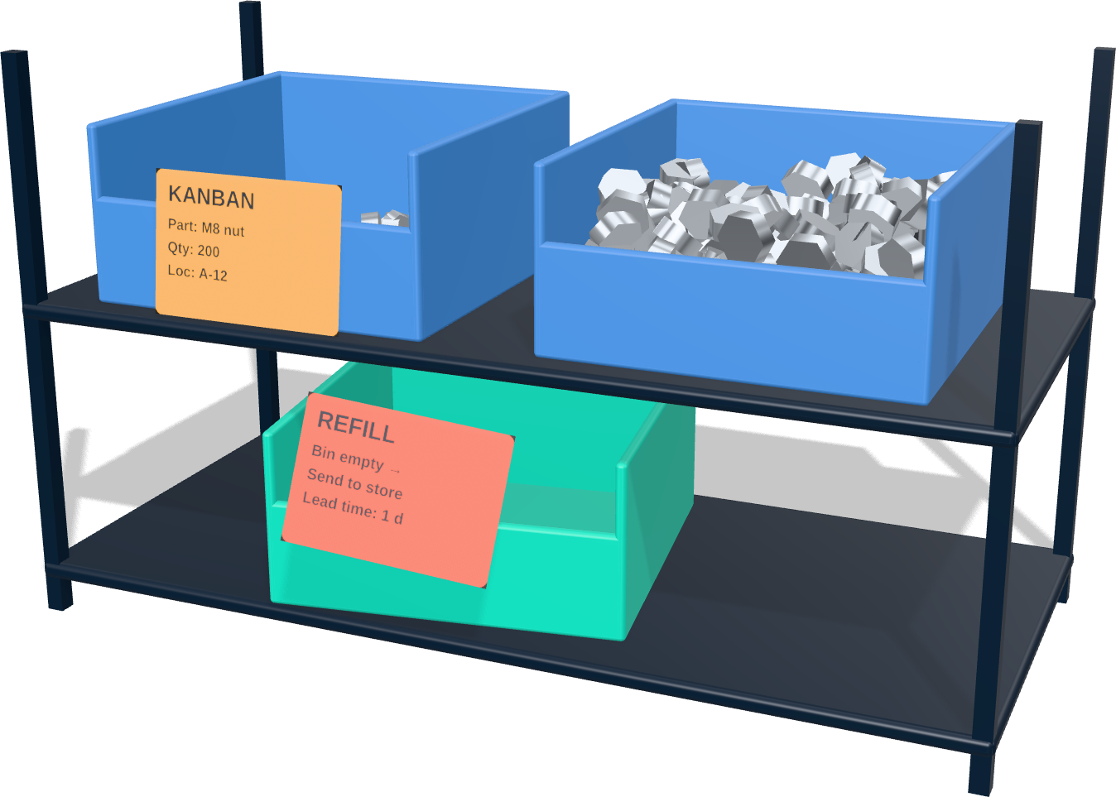
Kanban: implementation steps
KANBAN · IMPLEMENTATION
1
Map the process
See where stock and waiting build up
2
Choose the signal
Card, two-bin or electronic kanban
3
Size the loop
Cards = demand × lead time × safety ÷ bin size
4
Build board & cards
Columns, card data, storage locations
5
Set WIP limits & rules
Who pulls, when and how much
6
Train & pilot
Start on one line or one team
Two-bin system: when bin 1 is empty, its card triggers a refill while work continues from bin 2.
7
Review & improve
Track lead time; remove cards over time
Notes:
To implement Kanban: first map the process to see where stock and waiting build up. Choose the signal: a card, a two-bin system or an electronic kanban. Calculate how many cards the loop needs from demand, lead time, a safety factor and bin size. Build the board and cards, set WIP limits and clear rules, train people and start with a pilot. Then review lead times and remove cards step by step. The picture shows the simplest version, the two-bin system.

Slide 4









Kanban: problems solved and examples
KANBAN · PROBLEMS & EXAMPLES
PROBLEMS IT SOLVES
PRACTICAL EXAMPLES
Overproduction & excess stock
Car assembly line
Hospital ward
Cards cap inventory and free up cash
Stockouts & line stops
Line-side parts in two-bin racks
Supplier kanbans trigger deliveries
Two-bin cabinets for gloves, syringes
Empty-bin card is scanned to reorder
Refills follow real usage
Long lead times
WIP limits keep queues short
Hidden bottlenecks
Software team
Office / HR
The board shows where work waits
Board: To do → Doing → Done
Max 3 tasks per column
Each request or vacancy is a card
Shows where approvals wait
Overload & multitasking
Finish work before starting new work
Notes:
Kanban solves overproduction and excess stock, because the number of cards caps inventory. It prevents stockouts, because refills follow real usage. WIP limits shorten lead times, the board shows bottlenecks, and teams stop multitasking. Examples: car plants use two-bin racks and supplier kanbans; hospitals use two-bin cabinets for supplies; software teams use boards with WIP limits; and offices track requests or vacancies as cards.

Slide 5







TPM: purpose and principles
TPM · TOTAL PRODUCTIVE MAINTENANCE
0 breakdowns
0 defects
0 accidents
Purpose: keep equipment reliable and fully effective. Operators and maintenance share ownership: “I take care of my equipment.”
8 PILLARS
Autonomous Maintenance
Planned Maintenance
Focused Improvement
Quality Maintenance
Early Equipment Mgmt.
Training & Education
Safety, Health & Env.
Office TPM
Operators clean, inspect, lubricate
Service planned on failure data
Teams remove the biggest losses
Conditions for zero defects
New machines easy to run & fix
Skills for operators & technicians
Zero accidents and pollution
Fewer losses in admin work
Foundation: 5S + small-group team activities
Notes:
TPM, Total Productive Maintenance, aims for perfect production: zero breakdowns, zero defects and zero accidents. Its purpose is reliable, fully effective equipment, and the key idea is shared ownership: operators take care of their own machines instead of saying 'I operate, you fix'. TPM rests on eight pillars built on 5S: autonomous maintenance, planned maintenance, focused improvement, quality maintenance, early equipment management, training, safety, and TPM in the office.

Slide 6
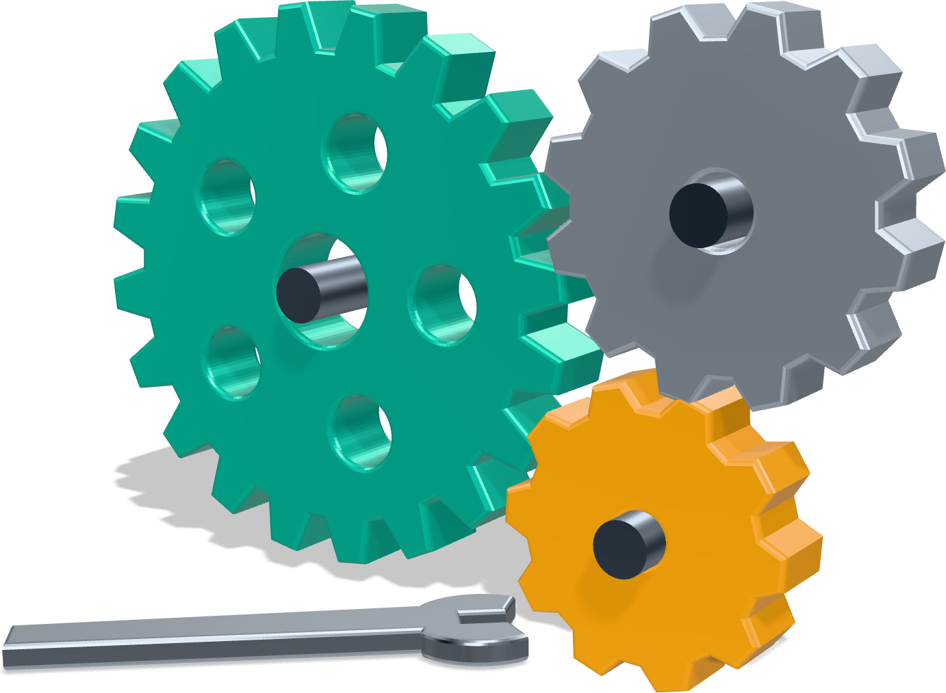
TPM: implementation steps
TPM · IMPLEMENTATION
Preparation
Steps 1–5
Management announces TPM, trains staff, sets up a TPM team, sets targets and a master plan
Introduction
Step 6
Kick-off with all employees; pilot on one model machine
Implementation
Steps 7–11
Roll out the pillars: autonomous and planned maintenance, focused improvement, training, quality, safety
Stabilization
Step 12
Sustain the system, audit results and raise targets
12 steps of the Japan Institute of Plant Maintenance (JIPM), grouped in four phases
Notes:
TPM is usually introduced in twelve steps grouped in four phases. In preparation, management announces TPM, trains people, creates a TPM team and sets targets and a master plan. Introduction is the kick-off, often with a pilot on one model machine. In implementation the pillars are rolled out: autonomous and planned maintenance, focused improvement, training, quality and safety. Finally, stabilization: sustain the system, audit it and raise the targets.

Slide 7







TPM: problems solved and examples
TPM · PROBLEMS & EXAMPLES
PROBLEMS IT SOLVES
PRACTICAL EXAMPLES
Unplanned breakdowns
Every shift: 5-minute CILT check
Daily checks and planned service prevent failures
Clean, inspect, lubricate, tighten marked points
Minor stops & slow running
Focused improvement removes chronic losses
Abnormality tags
Defects caused by machines
Operators tag leaks and loose parts for repair
Stable equipment conditions mean fewer defects
High maintenance costs
Planned maintenance calendar
Fewer emergency repairs and rush spare parts
Service based on failure history, not breakdowns
Safety incidents
Clean, inspected machines reveal hazards early
Monthly OEE review
“I operate, you fix” silos
The team picks the biggest loss and fixes it
Production and maintenance share goals
Notes:
TPM solves unplanned breakdowns, chronic minor stops and slow running, defects caused by poorly maintained machines, high maintenance costs and safety incidents. It also removes the 'I operate, you fix' split between production and maintenance. In practice: operators do a five-minute check every shift, cleaning, inspecting, lubricating and tightening; they tag abnormalities like leaks; maintenance follows a planned calendar; and every month the team reviews OEE, overall equipment effectiveness, and fixes the biggest loss.

Slide 8





Why Lean, and how to overcome its challenges
QUESTIONS 1 & 2
1 · WHY ORGANIZATIONS IMPLEMENT LEAN
2 · MAIN CHALLENGES AND HOW TO OVERCOME THEM
Eliminate waste
Challenge | How to overcome it
Resistance to change | Involve staff early, show quick wins, no layoffs from improvement
Weak leadership support | Leaders visit the shop floor and review the boards themselves
Lean seen as just tools | Explain the “why” and link every tool to a real problem
No time for training | Plan training time; one-point lessons; internal coaches
Gains not sustained | Standards, daily audits and regular reviews
Unreliable machines or supply | Start TPM on bottlenecks; work with suppliers; pilot first
Remove what the customer does not pay for
Lower costs
Less inventory, scrap, rework, overtime
Faster delivery
Shorter, more reliable lead times
Higher quality
Problems fixed at the source
Engaged employees
Daily problem-solving and teamwork
Competitiveness
Flexibility when demand changes
Notes:
Why do organizations implement Lean? To eliminate waste, which lowers costs, speeds up delivery and raises quality, while employees solve problems every day and the company becomes more competitive. The main challenges are resistance to change, weak leadership support, treating Lean as just a set of tools, no time for training, losing the gains, and unreliable machines or suppliers. We overcome them by involving people early, leading from the shop floor, explaining the why, planning training, using standards and audits, and starting TPM on bottleneck machines. Thank you.

