Slide 1
Event Driven Architecture
Order microservices Diagrams

Slide 2



Orders Microservice: Event Sourcing & CQRS
Order Dashboard Web
Order UI Web SPA
BUSINESS
USER
END
USER
Complex Queries
Add, read by ID,
update Order
APIS
APIS
APIS
Order Command MS
Order Queries MS
BFF
orderCommands
0
1
2
3
4
5
6
7
0
1
2
3
orders
Notes:
Here is a traditional modern architecture with some focus on API and channels

Slide 3
Orders Microservice: Event Sourcing & CQRS
Order Dashboard Web
Order UI Web SPA
BUSINESS
USER
END
USER
Complex Queries
Add, read by ID,
update Order
APIS
APIS
APIS
Order Command MS
Order Command MS
BFF
orderCommands
0
1
2
3
4
5
6
7
0
1
2
3
orders
Notes:
Here is a traditional modern architecture with some focus on API and channels

Slide 4
Order Life Cycle
Order Settlement
Order Delivery
Create Order
Pending
Work on Order
Rejected
Update Order
Confirm Order
Reefer off ship
Reject Order
Cancel Order
Booked
Initiate land
Transportation
Reefer on ship
Cancel Order
Allocate Voyage and
Container
Delivered
Cancelled
Assigned
In Transit
Complete
delivery
Cancel Order
Initiate land
Transportation
Completed

Slide 5
Event Sourcing Pattern
Order UI Web SPA
APIS
Order MS
Order id, addresses, customer id, product id, container id
Order specifics attributes
Status …
END
USER
Customer id
Src and dest addresses
Product id, quantity
Target delivery date
OrderEvents
OrderCreated
OrderCancelled
OrderDelivered…

Slide 6

Command Query Responsibility Segregation Pattern
Order UI Web SPA
USER
Order Service
Order Command MS
CRUD APIs
Error Log
Write Model
Admin APIs
4
Consumer
DB
3
1
2
5
Events
Topic
0
1
2
3
4
5
6
7
CLI
6

Slide 7

Event Sourcing Integration Test Env
Order Events Producer
orders
0
1
2
3
4
5
6
7
Topic Consumer

Slide 8
Data Replication: Orders table to kafka
1 table to 1 topic mapping
Topic acts as a transaction log
DB operations are implemented by record writes to a Kafka topic
Legacy runtime
RDBMS
Orders
Orders
0
1
2
3
4
5
6
(24, (24, “abc”)),
[ primary_key, values]
Cloud native runtime clusters
source
(key,values)
sink
RDBMS
Notes:
Representing DB2 table to distinct Kafka topic
A unique row in a DB2 table is represented by the Kafka record’s “Key”
The “Kafka Key” is comprised of a subset of the columns in the DB2 table which make the row unique
The “Kafka Key” is comprised of a subset of the columns in the DB2 table which make the row unique
Could be a unique index or the primary index defined on the DB2 table
Also possible for the rows to logically be unique, needn’t be a created index
The Kafka record’s “Value” contains the current values for all columns in the row
The messages in a topic represent the changes to the rows of a table over time
At any given sample offset in the topic, taking the most recent value up to that point for each unique key in the topic gives the original DB2 table at that point
Sample offset most useful if at a transaction boundary
For table orders ( orderID int, anAttribute varchar (30))
A Kafka mapping might use orderID=24 as the key value.
The Topic for orders (Topic_orders) might consist of the following (key,value) pairs: (24, (24, “abc”)), (25,(25, “def”)), (24, (24, “ghi”))
The aggregate result of these records would be a table with 2 rows: (24, “ghi”), (25, “def”)
Operations are implemented by record writes to a Kafka topic
Deletes
•Kafka represents a delete as a record with a key and null for the value.
•To represent a delete of the row with i1 value 1, send the (key, value) pair (1, null)
•New users often confused when they view values and simply see null.
•Displaying the key portion of the record is useful. (print.key=true)
Updates
•If the value being updated is not part of the key, an update is simply an insert.
•To represent a row update of (1, “abc”) to (1, “ghi) send the (key, value) pair (1,(1, “ghi”))
•If the value being updated is a key, it is represented by a delete record and an insert record.
•To represent the update of row (1, “abc”) to (5, “abc”) send two (key, value) pair records (1, null) , (5, (5,“abc”))

Slide 9
Problem statement
How do you model the reefer shipment domain?
Manufacturer
Place Shipment Order
Fresh Cargo Shipment Order Placed
Order business conditions and SLA
Received
Confirm Order
Shipping Inc Clerk
Define contract conditions and SLA
New
shipment order created
Voyage for shipment
selected
Container Assigned
Order Confirmed accepting business conditions and SLA
Whenever shipment order placed, reserve voyage and container
Whenever shipment order placed, trigger adjust confirmation penalty clauses

Slide 10
Weather
forecast system
Customer Relationship
system
container-shipping Domain
Reefer Container
subdomain (core)
Shipping subdomain (core)
Order subdomain (support)
Voyage subdomain (core)
Contract subdomain (support)
Inventory subdomain (support)
Fleet monitoring
system
Invoice
system
Notes:
Core Domain
Core business, this is where your organization is earning its money
High degree of differentiation to competitors
Development: Inhouse with your best teams
Supporting Subdomain:
Supporting functionality, that is not available as COTS-Software
Can be implemented with external support but inhouse teams should be in the lead
Generic Subdomain:
Suitable for Outsourcing, COTS

Slide 11
Weather
forecast system
Customer Relationship
system
container-shipping Domain
Reefer Container
subdomain (core)
Shipping subdomain (core)
Order subdomain (support)
Voyage subdomain (core)
Contract subdomain (support)
Inventory subdomain (support)
Fleet monitoring
system
Invoice
system
Notes:
Core Domain
Core business, this is where your organization is earning its money
High degree of differentiation to competitors
Development: Inhouse with your best teams
Supporting Subdomain:
Supporting functionality, that is not available as COTS-Software
Can be implemented with external support but inhouse teams should be in the lead
Generic Subdomain:
Suitable for Outsourcing, COTS

Slide 12
Entities – Value Objects
Shipping Order
orderID
Emitter customerID
Receiver customer ID
*
Delivery History
*
Delivery Specifications
Good Type
Expected Temperature
Tracking Number
Origin Address
Destination Address
Expected PickUp Date

Slide 13
Shipping Order
orderID
*
Delivery History
role
Customer
name
customerID
*
Delivery Specifications
Good Type
Expected Temperature
Tracking Number
Origin Address
Destination Address
Expected PickUp Date
Reefer Container
containerID
type
Reefer Telemetry
containerID
Power
Temperature
Co2
O2
Location
Port Code
To
*
Voyage
voyageID
schedule
To
From
Vessel Movement
voyageID
Vessel name
Leg
Departure Date
Expected Arrival Date
From
*
Inspired from Eric Evans‘s shipping domain

Slide 14
Root aggregate
Shipping Order
orderID
*
Delivery History
role
Root aggregate
Customer
name
customerID
*
Delivery Specifications
Good Type
Expected Temperature
Tracking Number
Origin Address
Destination Address
Expected PickUp Date
Reefer Container
containerID
type
Root aggregate
Reefer Telemetry
containerID
Power
Temperature
Co2
O2
Location
Port Code
To
*
Voyage
voyageID
schedule
To
From
Vessel Movement
voyageID
Vessel name
Leg
Departure Date
Expected Arrival Date
From
*

Slide 15
Root aggregate
Shipping Order
orderID
*
Delivery History
*
Delivery Specifications
Good Type
Expected Temperature
Tracking Number
Origin Address
Destination Address
Expected PickUp Date

Slide 16
Commands
Shipping Inc Clerk
Customer
Place Shipment Order
Update Shipment Order
Confirm Shipment Order
Define contract conditions and SLA
Assign
Voyage
Assign
Reefer
Cancel
Order
Initiate land transportation
Fresh cargo shipment order placed
Shipment order updated
Order confirmed accepting business conditions and SLA
business conditions and SLA sent
Voyage for shipment
selected
Reefer container assigned
Order cancelled
Land transportation initiated
Whenever shipment order placed, reserve voyage and container
Whenever shipment order placed, trigger adjust confirmation penalty clauses

Slide 17
Manufacturing Submitting and updating orders
UI BFF
Order Command MS
Order Query MS
Whenever 0rder is in ”noAvailability” state,
user can expand the transport window.
This will trigger a new (automated) voyage booking .
saveOrder
orderCommands
Create
Order Evt
{orderID…}
0
1
2
Order Created
Orders
orders
Order
Created
0
1
2
3
Order
Query
Views
Explanation:
If a manufacturers order request asked for a delivery window for which there is no voyage available
the order will be in “no Availability” state
Manufacture is allowed to update order with new dates or addresses
this will trigger new (automated) voyage selection
Above approach will save us from writing logic to
Determine if previous booking
Cancel it
New booking
Possible race conditions

Slide 18
Command MS main Classes
OrderCommandProducer
ShippingOrderResource
emit(OrderEventBase event)
POST /orders
ShippingOrderService
createOrder(ShippingOrder order)
ShippingOrderRepository
addNewShippingOrder(ShippingOrder order)
OrderCommandAgent
poll()
OrderEventProducer
emit(OrderEventBase event)
App
Domain
Infrastructure

Slide 19
Manufacturing Submitting and updating orders
UI BFF
Order Command MS
Order Query MS
Better ( more easily demoable policy) :
Whenever 0rder is in ”noAvailability” state,
user can expand the transport window
This will trigger a new ( (automated) voyage booking .
saveOrder
orderCommands
Create
Order Evt
{orderID…}
0
1
2
Order Created
Order
Order
Created
0
1
2
3
Order
Query
Views
orders
Explanation:
If a manufacturers order request asked for a delivery window for which there is no voyage available
the order will be in “no Availability” state
Manufacture is allowed to update order with new dates or addresses
this will trigger new (automated) voyage selection
Above approach will save us from writing logic to
Determine if previous booking
Cancel it
New booking
Possible race conditions
getCreatedOrders
updateOrder
orderCommands
0
1
2
3
Order
Order
Updated
0
1
2
3
Order
Query
Views

Slide 20
Sequence Diagram
Shipping Order Resource
Shipping Order Service
Order
Command
Producer
Order Command
Agent
Shipping Order Repository
Order
Event
Producer
POST /orders
saveOrder
emitEvent
orderCommands
0
1
2
poll
Order
handle
0
1
2
3
orders

Slide 21
Event and payload model
OrderEventBase
Time stamp
Type
Version
payload
OrderEvent
Reefer Assigned Event
Voyage Assigned Event
Order Command Event
Shipping Order payload
Reefer assigned payload
Voyage assigned payload
Reefer assigned payload
Shipping Order Payload
Reefer assignment Payload
Voyage assignment Payload
Shipping Order
orderID
productid
customerID
….
orderID
containerID
orderID
voyageID
orderID
containerID

Slide 22
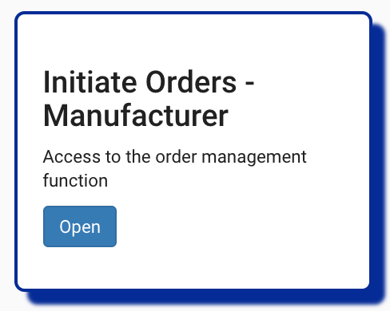
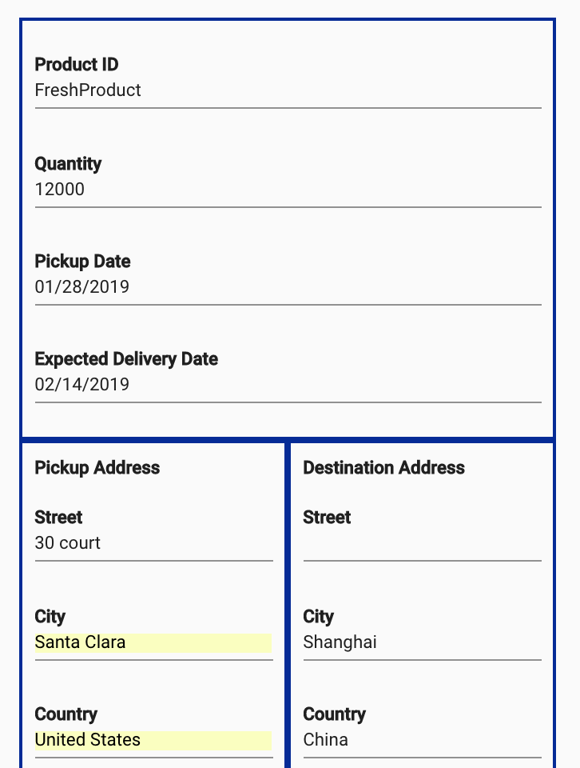
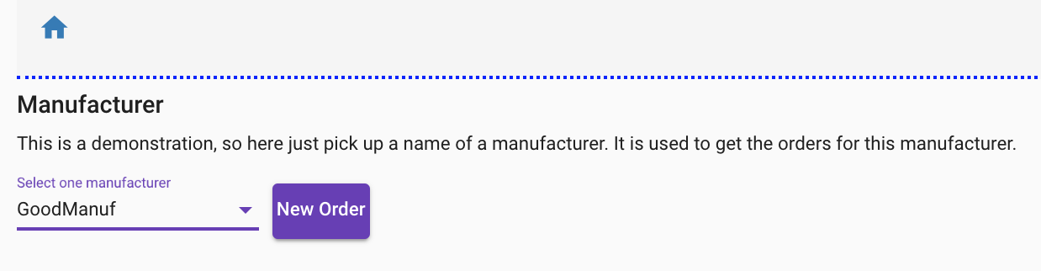
Manufacturing Creating Order

Slide 23

Order MS
order-command-ms
Create
OrderCreated
Topic orders
validation
Update
OrderUpdated
validation
GetAll
OrderCreated
OrderUpdated
OrderAssigned
Partition 0
GetById
order-query-ms
OrderCreated
OrderUpdated
OrderAssigned
GetByManuf
GetAllPending

Slide 24
order-command-ms Create Order: POST to /
Body:
{
"productID":"myProductID",
"quantity":101,
"customerID": "GoodManuf",
"expectedDeliveryDate":"2019-01-10T13:30Z",
"pickupDate":"2019-01-10T13:30Z",
"pickupAddress": {"street": "200 1st street", "city": "Shanghai", "country": "China", "state": "", "zipcode": "09430"},
"destinationAddress": {"street": "500 main street", "city": "San Leonardo", "country": "USA", "state": "CA", "zipcode": "95030"}
}
Response:
{
"orderID":"dfd79376-c46e-41c4-aa88-08a3594fe2f8",
"productID":"myProductID",
"customerID":"GoodManuf",
"quantity":101,
“status”: “Created”,
"pickupAddress":{"street":"200 1st street","city":"Shanghai","country":"China","state":"","zipcode":"09430"},
"pickupDate":"2019-01-10T13:30Z",
"destinationAddress":{"street":"500 main street","city":"San Leonardo","country":"USA","state":"CA","zipcode":"95030"},
"expectedDeliveryDate":"2019-01-10T13:30Z”
}
Order:
estimate delivery data
Destination and pickup adresses
Pickup date
Product ID
quantiry

Slide 25
order-command-ms Update Order : PUT to /{orderID}
Body:
{
"orderID": "dfd79376-c46e-41c4-aa88-08a3594fe2f8",
"productID":"myProductID",
"quantity":101,
"customerID": "GoodManuf",
“status”: “Created”,
"expectedDeliveryDate":"2020-01-10T13:30Z",
"pickupDate":"2020-01-10T13:30Z",
"pickupAddress": {"street": "100 2nd street", "city": "Shanghai", "country": "China", "state": "", "zipcode": "09430"},
"destinationAddress": {"street": "200 other street", "city": "San Leonardo", "country": "USA", "state": "CA", "zipcode": "95030"}
}
Response:
{
"orderID":"dfd79376-c46e-41c4-aa88-08a3594fe2f8",
"productID":"myProductID",
"customerID":"GoodManuf",
"quantity":101,
“status”: “Created”,
"pickupAddress":{"street":"100 2nd street","city":"Shanghai","country":"China","state":"","zipcode":"09430"},
"pickupDate":"2020-01-10T13:30Z",
"destinationAddress":{"street":"200 other street","city":"San Leonardo","country":"USA","state":"CA","zipcode":"95030"},
"expectedDeliveryDate":"2020-01-10T13:30Z”
}
Order:
estimate delivery data
Destination and pickup adresses
Pickup date
Product ID
quantiry

Slide 26
Manufacturing Get list of orders
Manuf UI BFF
Order Command MS
Order Query MS
getOrdersByManuf
orders
Order
Query
Views

Slide 27
order-query-ms Get by manufacturer: GET to /byManuf/{ManufID}
Get all pending: GET to /pending/
Same schema, just different filter
Response:
[{
"orderID":"dfd79376-c46e-41c4-aa88-08a3594fe2f8",
"productID":"myProductID",
"customerID":"GoodManuf",
"quantity":101,
“status”: “Created”,
"pickupAddress":{"street":"100 2nd street","city":"Shanghai","country":"China","state":"","zipcode":"09430"},
"pickupDate":"2020-01-10T13:30Z",
"destinationAddress":{"street":"200 other street","city":"San Leonardo","country":"USA","state":"CA","zipcode":"95030"},
"expectedDeliveryDate":"2020-01-10T13:30Z”
},
{….},
]
Whenever the status of the order is not completed ?

Slide 28
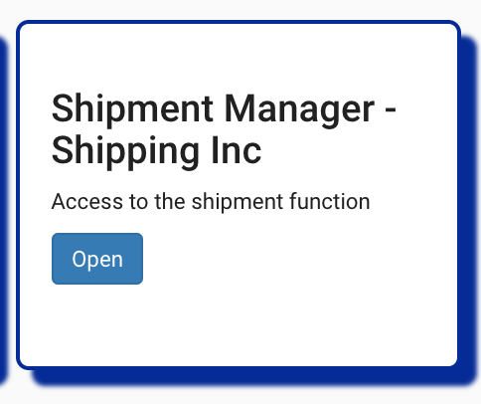
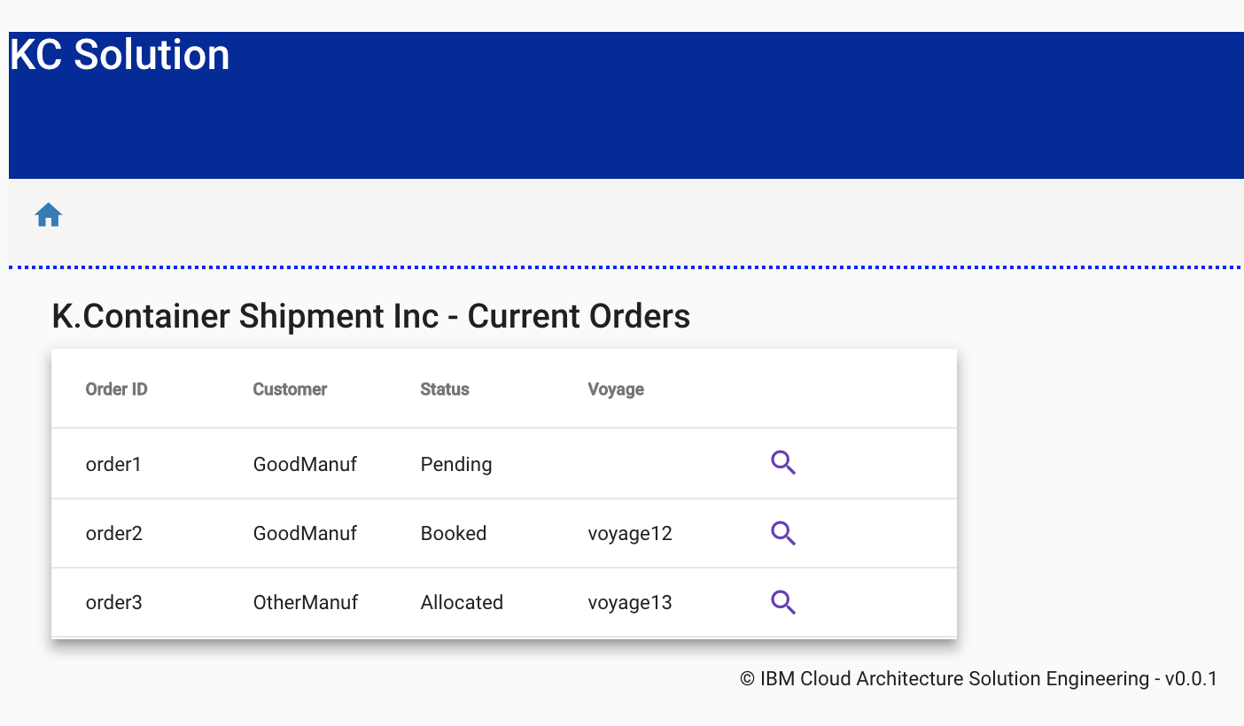
K Container Shipment Inc – Order management

Slide 29
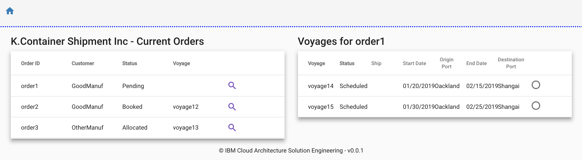
K Container Shipment Inc – Order management

Slide 30
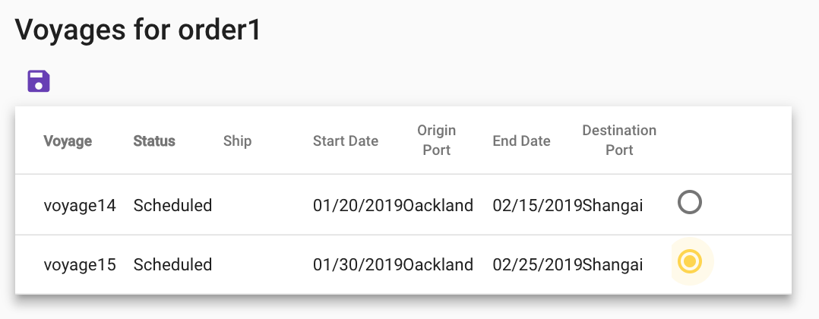
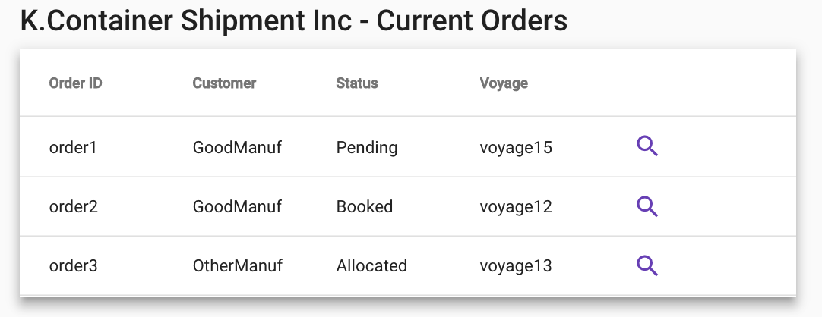
K Container Shipment Inc – Order management
Select one of the possible voyage
Save is going to the backend

Slide 31
Shipment Inc – Manual voyage assignment
Shipment UI BFF
Order Command MS
Order Query MS
Voyage Command MS
Container Command MS
getCreatedOrders
Order
Query
Views
searchVoyage
voyages
Order
0
1
2
3
Voyages
Order Pending
voyageBooked
orders
{orderID, voyageID, shipID…}
0
1
2
3
Order
Query
Views
Order Booked
Order
allocateContainer
Order Allocated to Container

Slide 32
Shipment Inc – Automatic best voyage
Manuf UI BFF
Order Command MS
Voyage Command MS
Container Command MS
Order Query MS
saveOrder
orders
Create
Order Evt
{orderID…}
0
1
2
Order
orders
Order Pending
Order
Created
0
1
2
3
Voyages
voyageBooked
orders
0
1
2
3
4
Order Booked
Order
orders
0
1
2
3
4
5
6
Order Allocated to Container
{orderID, voyageID, shipID…}
Order
Query
Views
Order

Slide 33
order-query-ms
Topic orders
GetByManuf
OrderCreated
OrderUpdated
OrderAssigned
GetById
GetAllPending

Slide 34
Assigning an order to a voyage
The UI displays pending orders 3) and available voyages 4). A operator or external process does the matching
User Interface
1) New order
3) Get pending orders
4) Get voyages
5) Assign order to voyage
Order-command-ms
Order-query-ms
Voyages-ms
2) OrderCreated
2) OrderCreated
6) OrderAssigned
6’) OrderDenied
6) OrderAssigned
6’) OrderDenied
6) OrderAssigned
6’) OrderDenied
Topic orders

Slide 35
order-command-ms Get all orders: GET to /
Response:
[{
"orderID":"dfd79376-c46e-41c4-aa88-08a3594fe2f8",
"productID":"myProductID",
"customerID":"GoodManuf",
"quantity":101,
“status”: “Created”,
"pickupAddress":{"street":"100 2nd street","city":"Shanghai","country":"China","state":"","zipcode":"09430"},
"pickupDate":"2020-01-10T13:30Z",
"destinationAddress":{"street":"200 other street","city":"San Leonardo","country":"USA","state":"CA","zipcode":"95030"},
"expectedDeliveryDate":"2020-01-10T13:30Z”
}]

Slide 36
Voyages Management Service

Slide 37
voyages-ms Assign order to voyage: POST to /{voyageID}/assign
Body:
{
"orderID": " dfd79376-c46e-41c4-aa88-08a3594fe2f8 ",
"containers": 2
}
Response: TBD

Slide 38
voyages-ms
Get all: GET to /
Response:
[
{"voyageID":"100", "shipID":"ship1", "srcPort":"NYC", "plannedDeparture":"2019-02-01T20:20Z", "destPort":"LON", "plannedArrival":"2019-02-10T20:20Z"},
{"voyageID":"200", "shipID":"ship2", "srcPort":"NYC", "plannedDeparture":"2019-02-01T20:20Z", "destPort":"LON", "plannedArrival":"2019-02-10T20:20Z"},
{"voyageID":"300", "shipID":"ship3", "srcPort":"NYC", "plannedDeparture":"2019-02-01T20:20Z", "destPort":"LON", "plannedArrival":"2019-02-10T20:20Z"}
]
Should include remaining free slots
Also include current voyage status ? Waiting, in transit, completed?

Slide 39
voyages-ms
Get by ID: GET to /{voyageID}
Response:
{"voyageID":"100", "shipID":"ship1", "srcPort":"NYC", "plannedDeparture":"2019-02-01T20:20Z", "destPort":"LON", "plannedArrival":"2019-02-10T20:20Z"},
Should include remaining free slots
Also include current status ? Waiting, in transit, completed?

Slide 40
voyages-ms
OrderAssigned
Assign
Topic orders
GetAll
OrderAssigned
GetById

Slide 41
K Containers example - Event Bus Topics
Topic | EventType | Event Data | Emitter | Users
Orders | newOrder | pickupFrom, deliverTo, pickupAfter, deliverBy,refid | OrdersMS | OrdersMS, OrdersQ
 | bookedVoyage | OrderID, Voyage, Ship, Dates, refid | VoyagesMS | OrdersMS , OrdersQ
 | noAvailability | OrderId, refid | VoyagesMS | OrdersMS, OrdersQ
 | allocatedContainer | OrderId, container ID | ContainersMS | OrdersMS, OrdersQ
 | ContainerOnShip | ContainerId, OrderId, VoyageId | VoyagesMS | OrdersMS, OrdersQ
Containers | needEmpty | OrderId, atPort, date, | OrdersMS | ContainersMS
Voyages | FullContainerReady | OrderId,ContainerId,VoyageId | OrdersMS | Voyages MS , ShipsSim, OrdersQ
 | ShipStartedVoyage | ShipId, VoyageId , manifest{<Orderid,ContainerId>} | ShipsMS | VoyagesMS
Ships | ShipPosition | ShipId, | ShipsMS | OrdersQ, ShipsQ
Containers | ContainerTemp+GPS | ContainerId, temp, position | ContainersStreams | OrdersQ, ContainersQ
 | ContainerAction | ContainerId, Action | ContainersStreams | OrdersQ, ContainersQ
 | ContainerTempError | ContainerId, FailCode | ContainersStreams | OrdersQ, ContainersQ
Voyages | ShipEndedVoyage | ShipId, VoyageId | ShipsSim | VoyagesMS, OrdersQ
Orders | ContainerOffShip | ContainerId, OrderId | VoyagesMS | OrdersMS, OrdersQ
 | ContainerDelivered | ContainerId, OrderId | OrdersMS | OrdersMS, OrdersQ
Containers | containerReleased | ContainerId | OrdersMS | ContainersMS
Orders | OrderCompleted | OrderId | OrdersMS | OrdersMS, OrdersQ

Slide 42
Container Management Service

Slide 43
Event Storming - Container
Container added to inventory
Container landed at location
Container on vessel
Container off vessel
Container on truck
Container off truck
Container removed from inventory
Container assigned to order
Container released from order
Container loaded
Container unloaded
Container in maintenance
Container off maintenance
Container door closed
Container door opened
Continue…

Slide 44
Shipping Oinc Clerk
Add Reefer Container to inventory
Container added to inventory
Whenever shipment order is created, reserve container
Whenever shipment order delivered, release container
Remove Reefer Container inventory
Container removed from inventory
Assign Container to order
Release Container from order
Set Reefer Container in maintenance
Container in maintenance
Container assigned to order
Container released from order
Release Reefer Container from maintenance
Container off maintenance
1
2
3

Slide 45
Container Bounded Context
Container on truck
Container on vessel
Container off truck
Container off vessel
Add Container to inventory
Container added to inventory
Container removed from inventory
Container loaded
Container:
Type
Location
Capacity
Brand
Status
Container landed at location
Assign Container to order
Container unloaded
Container assigned to order
Release Container to order
Container released from order
Container door closed
Container in maintenance
Container door opened
Remove Container from inventory
Container out maintenance

Slide 46
OLD Container - HL
UI Web SPA
USER
Fleet / Ships
Simulator MS
Container
MS
Order Mgt MS
Voyages MS
Ship
fleet
ReeFer
Order
voyages
Voyages
Event Backbone
ship
container
orders
Problems
Store
Streaming Analytics
Customs
Simulator
Redis
aggregates
Port Load/Unload
Simulator
Land Transportation
Mgt MS
Import
Export docs
Order
Containers Mules
Farms
Notes:
Map geographic
Multiple ships
Ship

