Slide 1
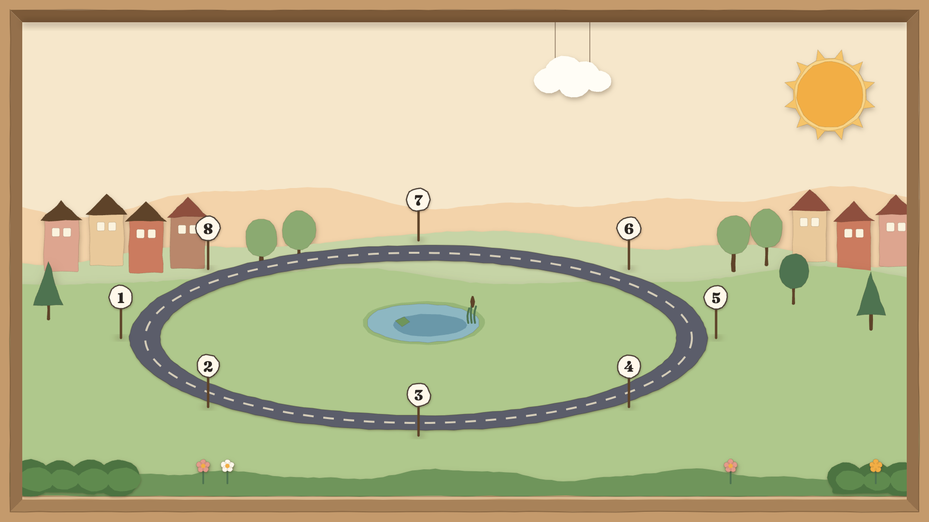

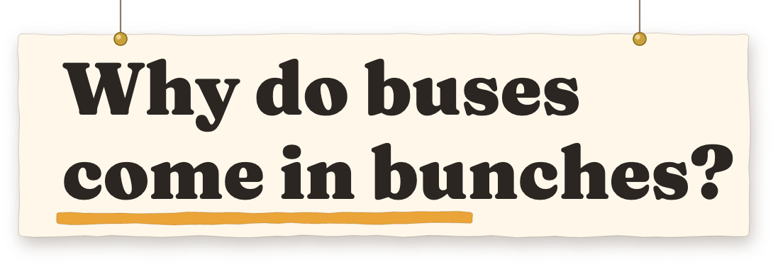
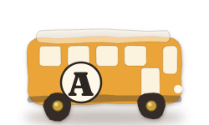
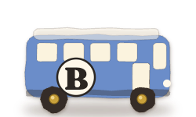
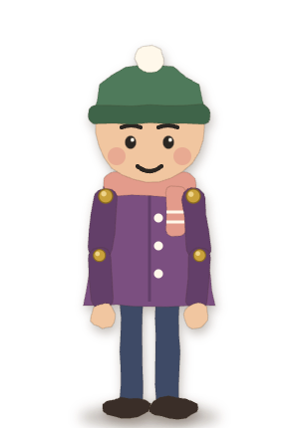
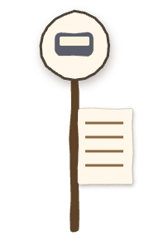
Notes:
SAY
You wait a long time for a bus, and then two come together. Why does a regular schedule turn into a bunch?
CLICK
Click after the question.
IN PLAIN WORDS
This is an invented example to explain the mechanism, not measured city data.

Slide 2
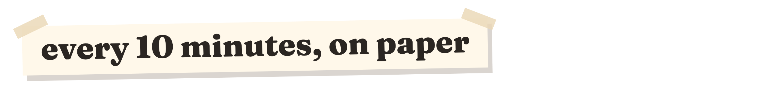
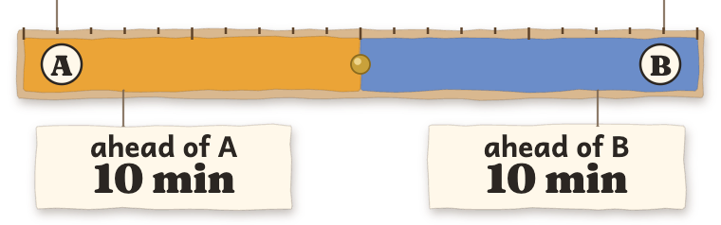
Notes:
SAY
Start with two buses on one twenty-minute loop. The gap ahead of each bus is ten minutes. So a rider arriving at a random time waits five minutes on average.
CLICK
Click after 'five minutes on average.'
IN PLAIN WORDS
Even spacing means neither bus is close behind the other.
DETAIL
For gaps 10 and 10, expected wait is (10 squared + 10 squared) divided by 40: 5.0 minutes.

Slide 3
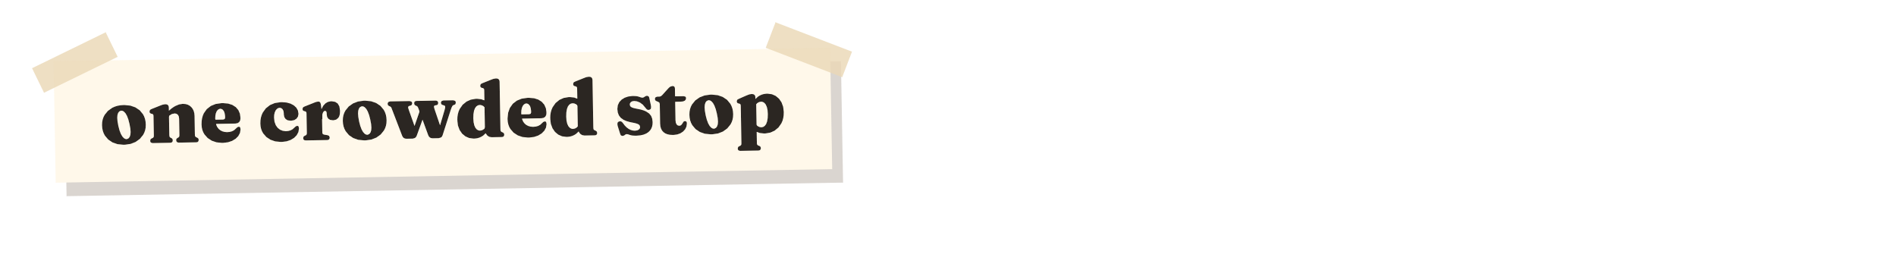
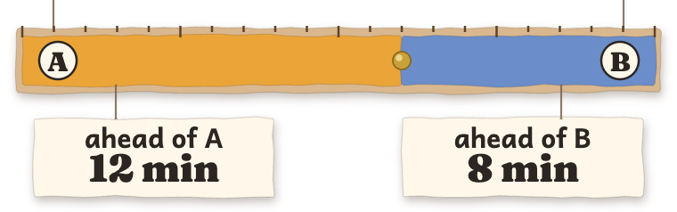
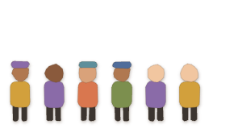
Notes:
SAY
Now one stop gets crowded. Bus A spends longer boarding people. Its gap to the bus ahead grows to twelve minutes, while the gap to the bus behind shrinks to eight.
CLICK
Click after 'shrinks to eight.'
IN PLAIN WORDS
One delay makes the spacing uneven, even though there are still two buses.
DETAIL
The two gaps still add to one twenty-minute lap. At 12 and 8, the model gives a 5.2-minute average wait.

Slide 4
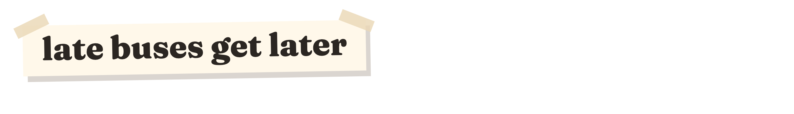
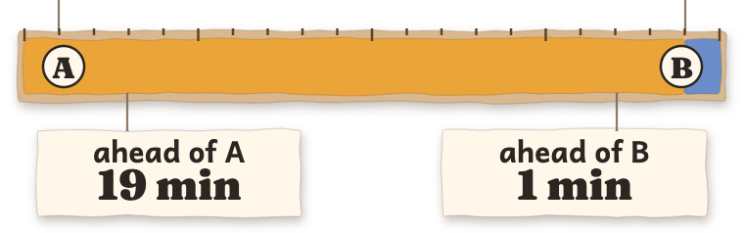
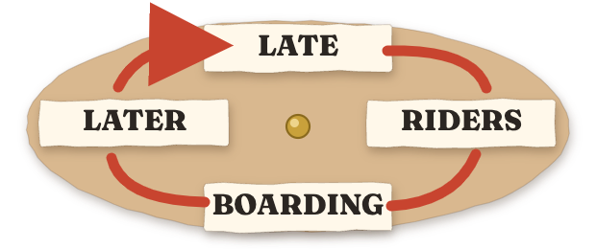
Notes:
SAY
A late bus meets more waiting riders, so its stops take longer. The bus behind finds emptier stops and catches up. In our example, the gaps become nineteen and one.
CLICK
Click after 'nineteen and one.'
IN PLAIN WORDS
The little delay feeds on itself until the buses travel almost together.
DETAIL
This is a feedback mechanism illustrated with chosen gaps; the slide is not a transit simulation.

Slide 5
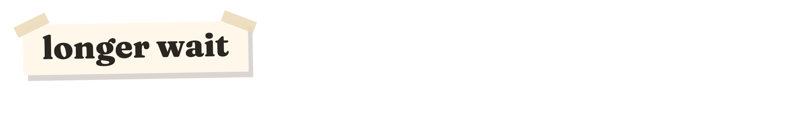
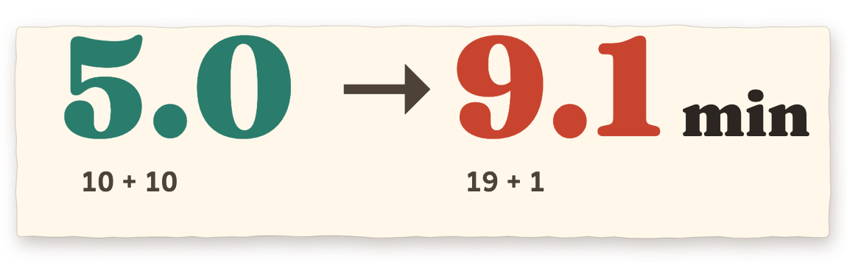
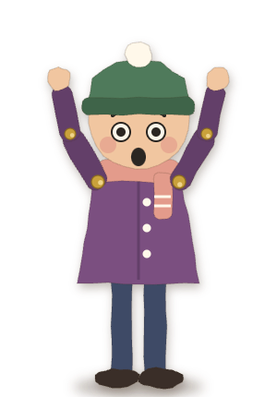
Notes:
SAY
The number of buses never changed. But unequal gaps make a randomly arriving rider wait longer: five minutes becomes about nine. The point is the spacing, not just the timetable.
CLICK
End of demo.
IN PLAIN WORDS
When two buses come together, one leaves a long empty stretch behind it.
DETAIL
Expected wait is the sum of squared gaps divided by twice their sum. For 19 and 1: (361 + 1) / 40 = 9.05, rounded to 9.1 minutes. This is illustrative, not observed data.

