Slide 1
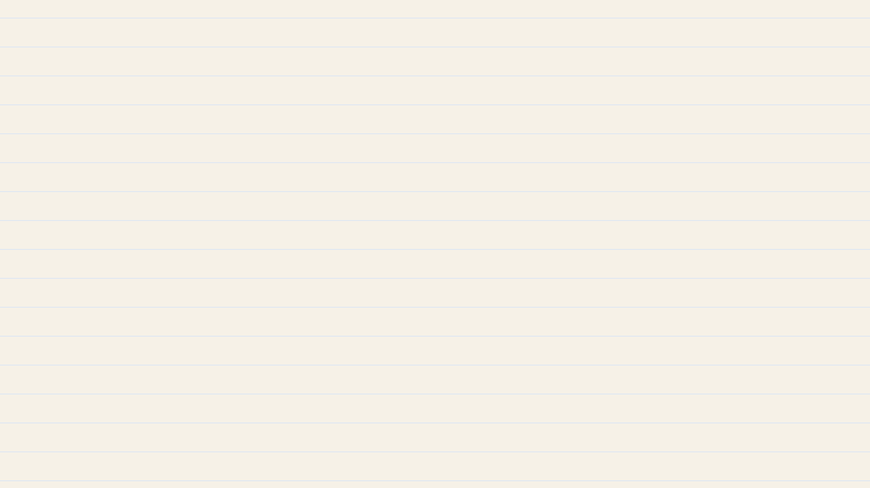



Notes:
SAY
You wait twenty minutes for a bus, and then two arrive at once. Why?
CLICK
Click after 'Why?'

Slide 2

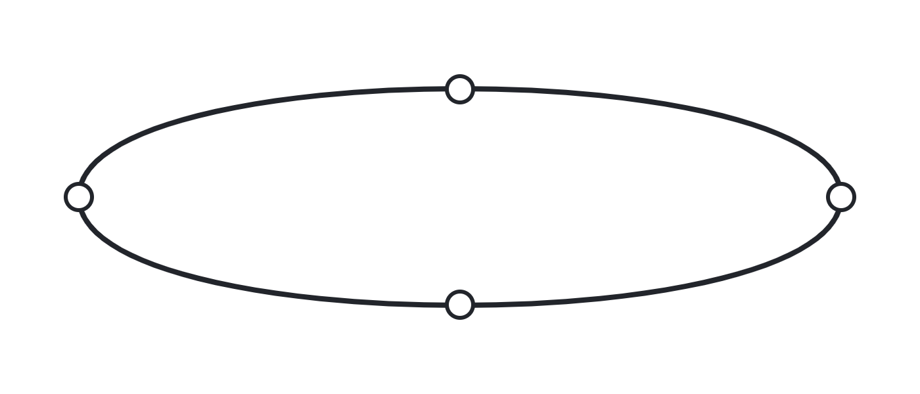


Notes:
SAY
On paper, two buses share one loop, ten minutes apart.
CLICK
Click after 'ten minutes apart.'
IN PLAIN WORDS
The timetable spaces buses evenly.

Slide 3



Notes:
SAY
Bus A falls a little behind, so more riders are waiting at each stop.
CLICK
Click after 'each stop.'
DETAIL
Dwell time grows with the number of boarding riders.

Slide 4



Notes:
SAY
More riders means longer stops, so the late bus gets later and the next bus catches up.
CLICK
End of smoke deck.

