Slide 2











App Thread Flow
06/05/2025
API/WSS
CProcess
App
CMain
CProcess
CProcess
?
CProcess
Order API
Update

Slide 3
Internal IPC Flow 06/05/2025
Start
App
CMain
ipc
CProcess
Initialize
init
ipc
init
WebSocket
api
init
ipc
init
init
ipc
init
update
api
ipc
api
API
Load Candles
api
ipc
api
wait
update
ipc
update
Update
Update
Fractal
Orders
update
ipc
update
Ready

Slide 4
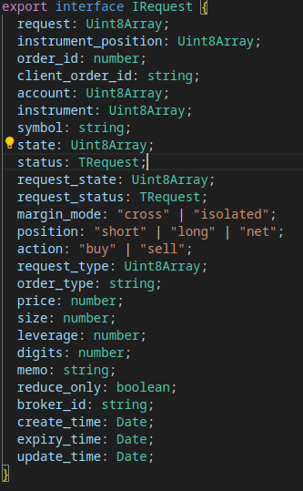
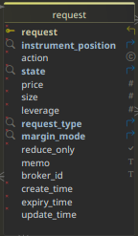
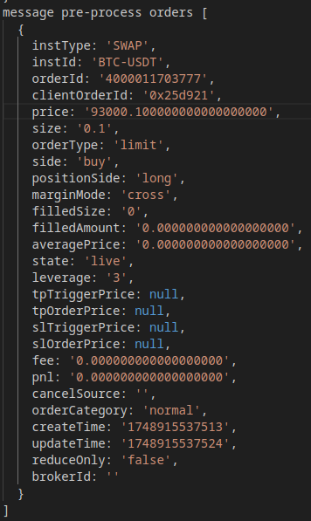
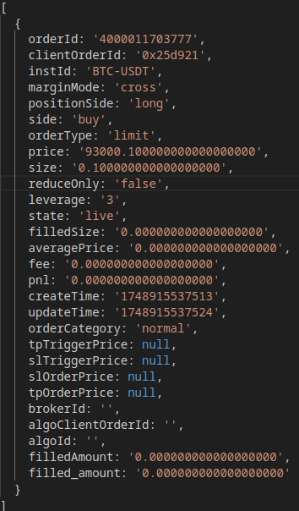
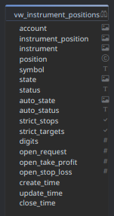
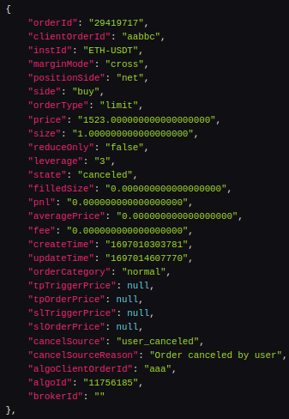
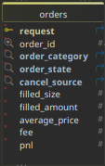
S
_{Submit}
R
API/WSS Request Flow
06/05/2025
_{app}
Interface
Submit
success?
REST API
Found?
y
Place Order
n
queued
pending
Set State
y
F
Fulfilled
rejected
n
C
C
Newer?
y
Pending?
y
Hold
success?
REST API
y
Cancel Order
C
n
Publish
closed
Set State
_{stops}
y
Expired
canceled
n
Expiry?
y
R
Websocket
live
partial
cancel?
n
Publish
order array
Message
Format Order
Timer
request
Fetch Request
partial
fill?
Expiry?
y
R
symbol
Fetch Instrument
canceled?
Queued?
Duplicate?
y
REST API
y
y
Import
y
Fetch Active
live
live?
failed?
canceled?
Canceled?
C
Instrument
Position?
n
n
F
y
filled?
Rejected?
Hold?
y
y
REST API
Process
S
Import
Fetch
requests
Fetch History
history
Pending?
Fetch
orders
Request
Found?
Hold
y
n
Queued
Publish
Rejected
Canceled
Pending

Slide 5
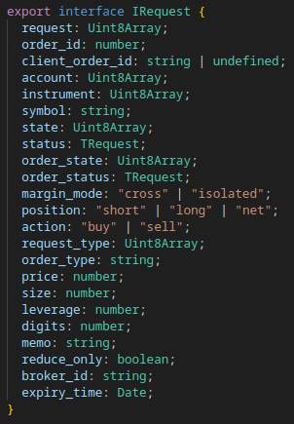
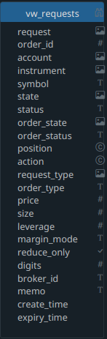
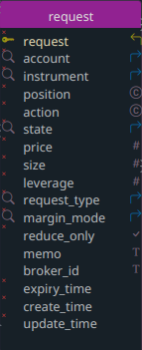
App Request Submit Flow
08/13/2025
_{submit}
Submit
Format Request
request id?
n
auto?
y
Insert
Fetch
pending
y
pending?
Update
n
request
Fetch
y
exists?
n
insert
request
> max
create?
y
queued
request
> max
create?
y
y
update
cancel
array
Cancel
pending
Cancels

Slide 6
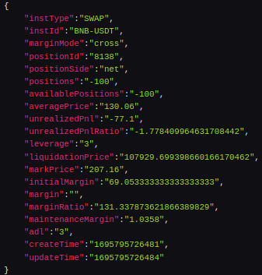
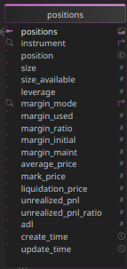
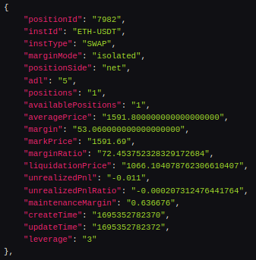
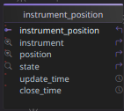
API/WSS Positions Flow
06/05/2025
_{positions}
wss message array
Websocket
Publish
Message
update
Publish
Timer
REST API
api positions array
Import
Publish
Fetch Active
update
Publish
Published
active
open
Fetch
Compare
S_{o}
open
y
active?
Process
open
Reconcile
closed
n
Reconcile
closed
S_{c}

Slide 7
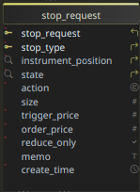
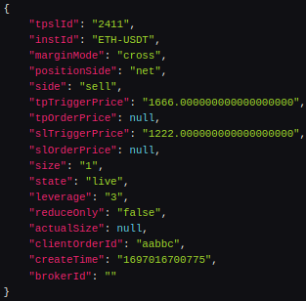
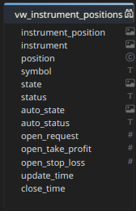
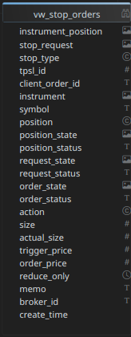
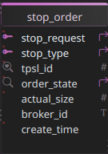
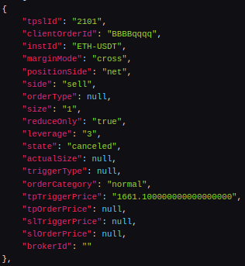
API/WSS Stops Flow
06/05/2025
Import Legend
Queued
Pending
Canceled
P
_{stops}
S
REST API
Application
queued
pending
y
success?
Place Order
Websocket
1
Submit
Set State
Timer
Websocket
2
C
Timer
closed
K
Fetch
Import
REST API
REST API
Fetch
position
success?
Cancel Order
Import
Fetch
live
closed
y
Set State
Fetch Active
Process
Reconcile
auto?
y
auto?
Publish
api/wss stops
Fetch
stop orders
open > 1?
position
Fetch
y
Compare
y
Canceled?
tpsl id?
y
C
create time < latest?
n
n
n
Queued?
publish
y
order missing?
S
y
request missing?
n
auto?
n
y
P
create time < latest?
n
y
live?
y
system generated?
n
C
y
n
K
K

Slide 8
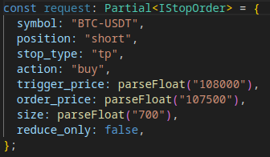
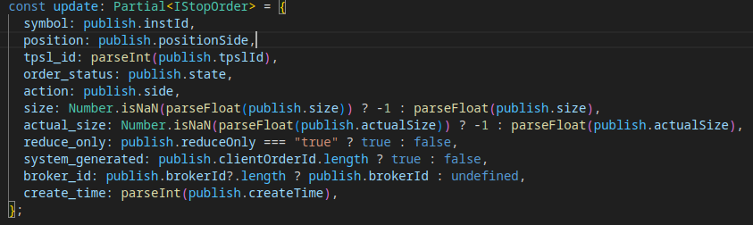
API/WSS Stops Submit Flow
08/02/2025
S
Websocket
Timer
valid position?
app
Submit
REST API
Fetch
Import
Fetch Active
y
Format
auto?
n
y
Error
n
position open?
S
Log
_{RTS}
y
S
y
tpsl open?
n
tpsl exists?
n
publish
y
_{RTS}

Slide 9
Websocket
Trades Flow
08/03/2025
Positions [api]
_{positions}
_{orders}
Orders [api]
Stops [api]
_{stops}
Reconcile Queue
Projects Rejected
Process Pending
Process Canceled
S
Process Queued
valid position?
app
Submit
REST API
Fetch
Import
Fetch Active
y
Format
auto?
n
y
Error
n
position open?
S
Log
_{RTS}
y
S
y
tpsl open?
n
tpsl exists?
n
publish
y
_{RTS}

Slide 10
app request
Submit
Queued
Pending
Canceled
Rejected
Fulfilled
Closed

