Slide 1




Main
Symbol
Algorithm
Account
Order
App
Symbol
Algorithm
API
Account
Order
API
Process
?
Symbol
Algorithm
API
Account
Order
API
Symbol
Algorithm
Account
Order

Slide 2








API/WSS
CProcess
App
CMain
CProcess
CProcess
?
CProcess
Order API
Update
App Thread Flow
06/05/2025

Slide 3
Start
App
CMain
ipc
CProcess
Initialize
init
ipc
init
WebSocket
api
init
ipc
init
init
ipc
init
update
api
ipc
api
API
Load Candles
api
ipc
api
wait
update
ipc
update
Update
Update
Fractal
Orders
update
ipc
update
Ready
Internal IPC Flow 06/05/2025

Slide 4
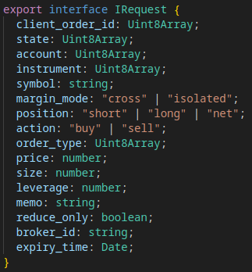
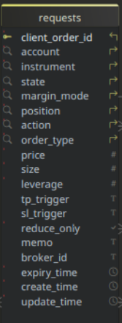
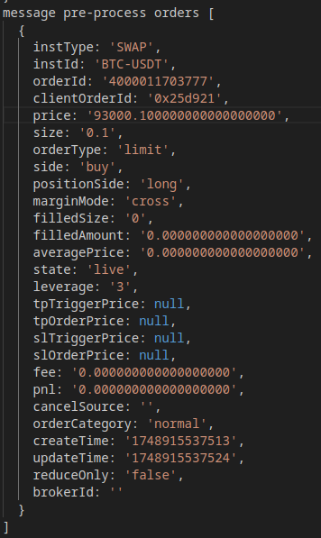
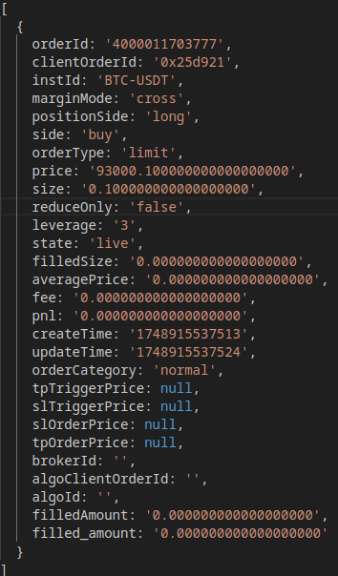
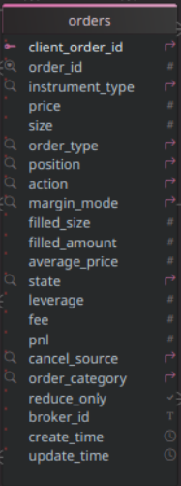
B
API/WSS Flow
06/05/2025
Application
A
success?
REST API
Publish
y
Place Order
pending
Set State
app request array
Requests
rejected
n
C
Submit
Queued
Pending
REST API
y
Canceled
success?
Cancel Order
Rejected
pending
y
Set State
y
Closed
Fulfilled
rejected
n
Websocket
partial
cancel?
n
Message
Publish
Expiry?
y
Publish
api/wss order array
Timer
partial
fill?
requests
Fetch
canceled?
B
y
Publish
REST API
Fetch Active
live?
failed?
filled?
api client
order id?
Publish
y
n
Untracked
Queued?
Log Untracked
y
Cancel
A
Submit
Update
symbol
match?
Fetch
requests
orders
y
n
Unknown
Fetch
orders
Log Error
C
Set State
Cancel

Slide 5
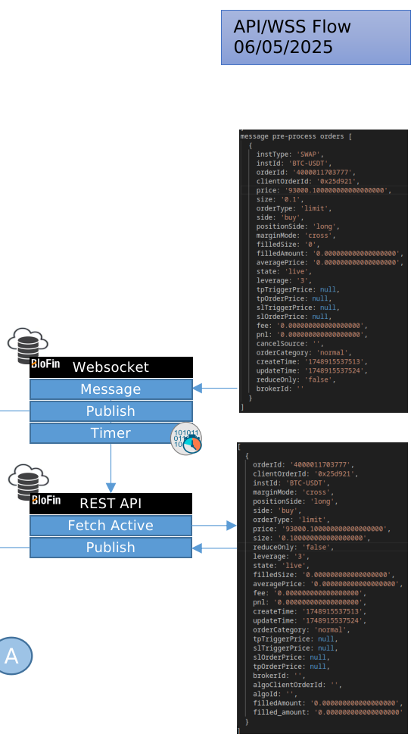
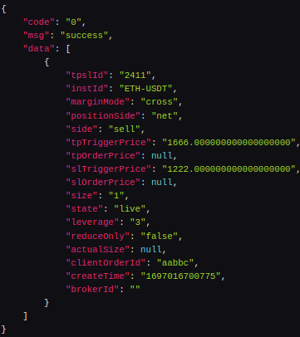
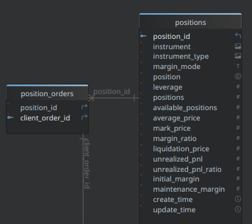
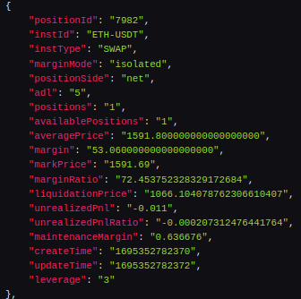
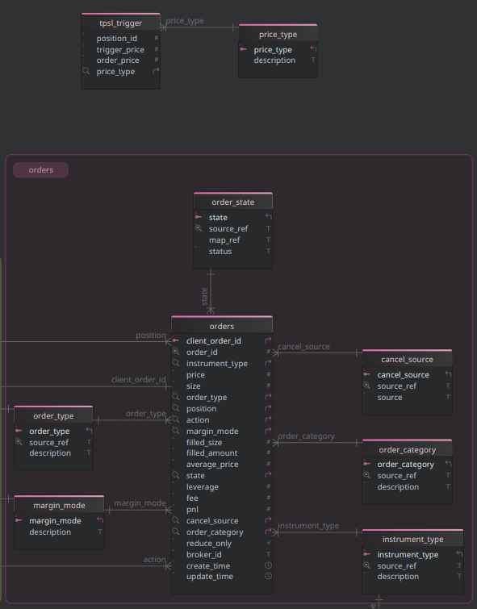
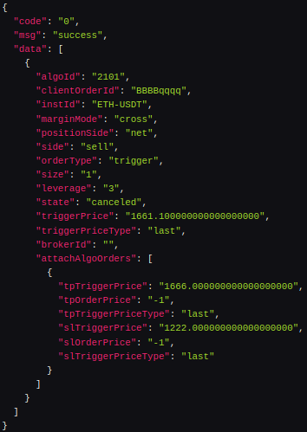

Slide 6
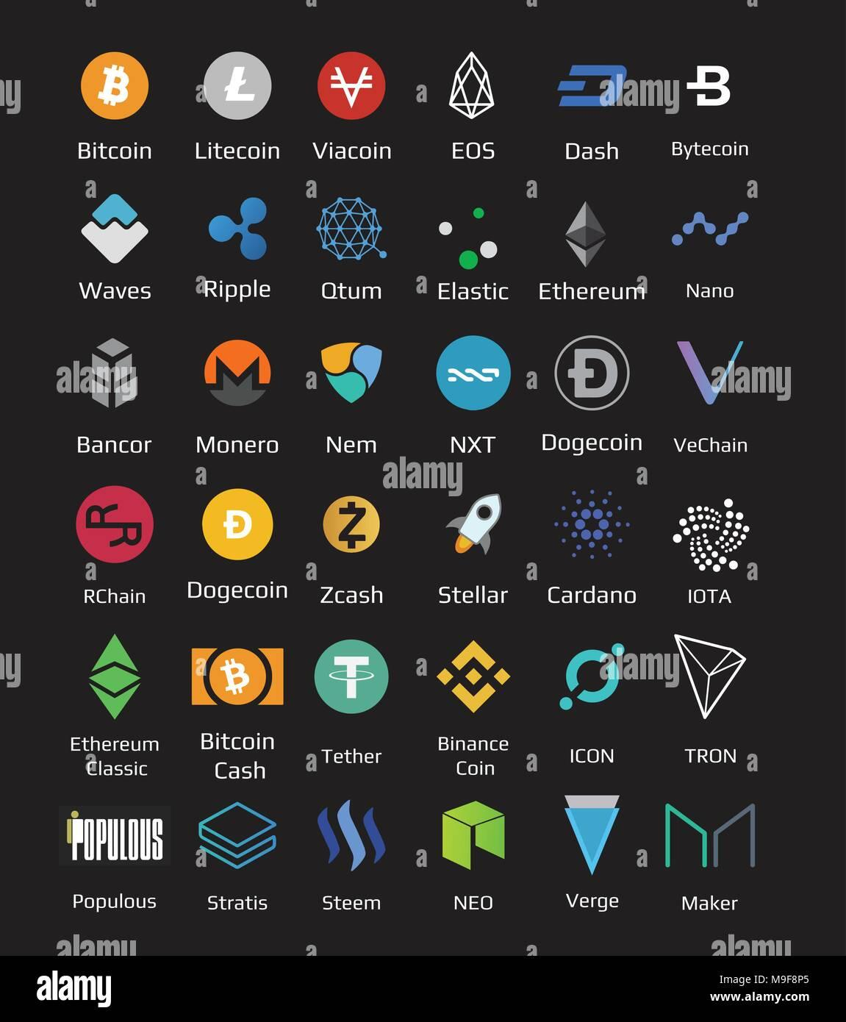
WSS
REST API

Slide 7
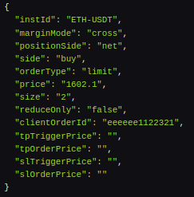
Place Order w/ TPSL
WSS
REST API

