Slide 1
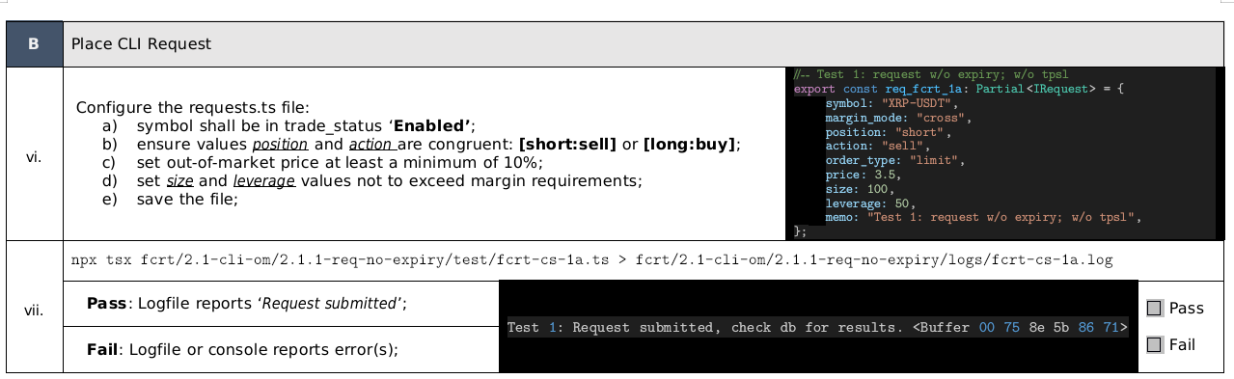
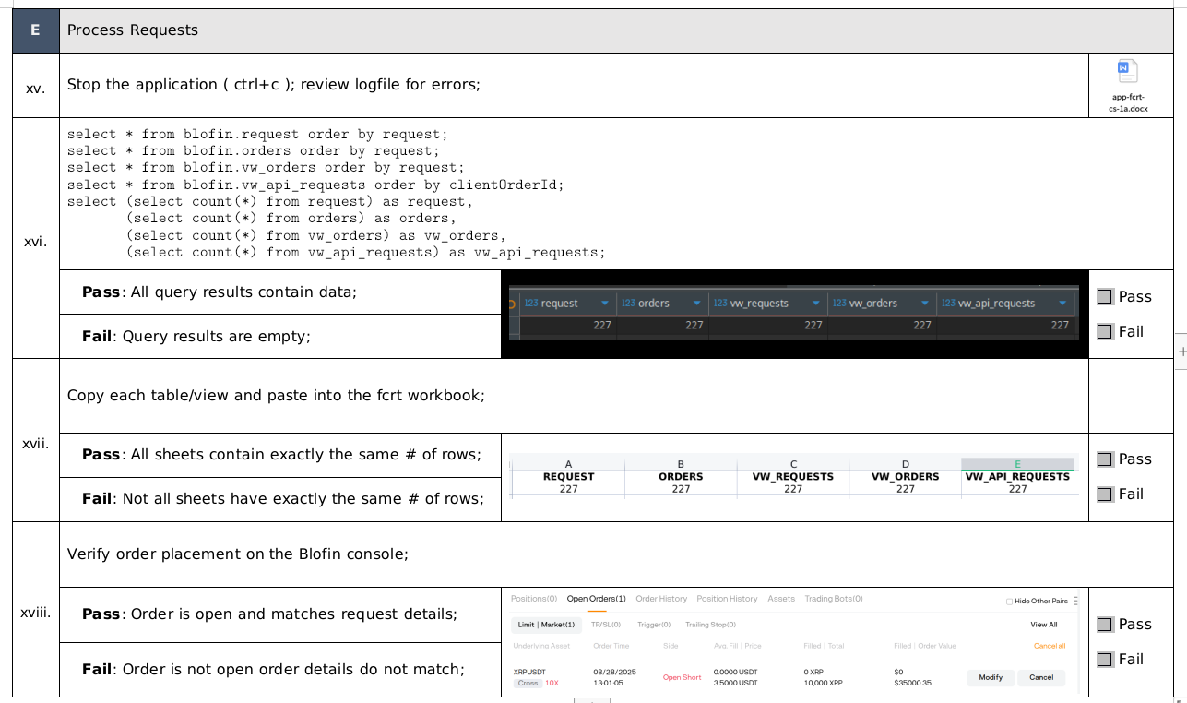
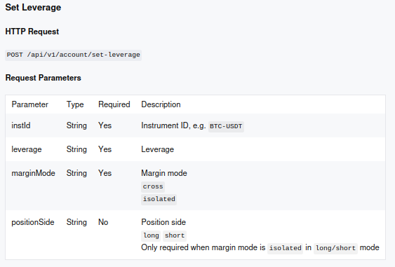
Issue:
Since 9/1/2025 - leverage is not being accepted on the REST API Path "/api/v1/trade/batch-orders". Was the approach of sending leverage with the request deprecated in favor of the “/api/v1/account/set-leverage” call (below)?

