Slide 1


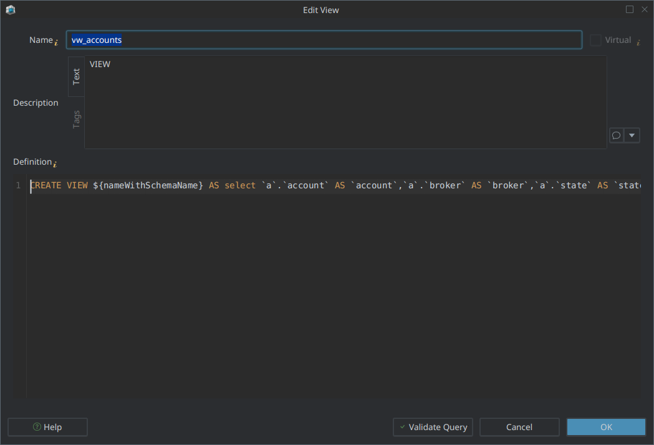
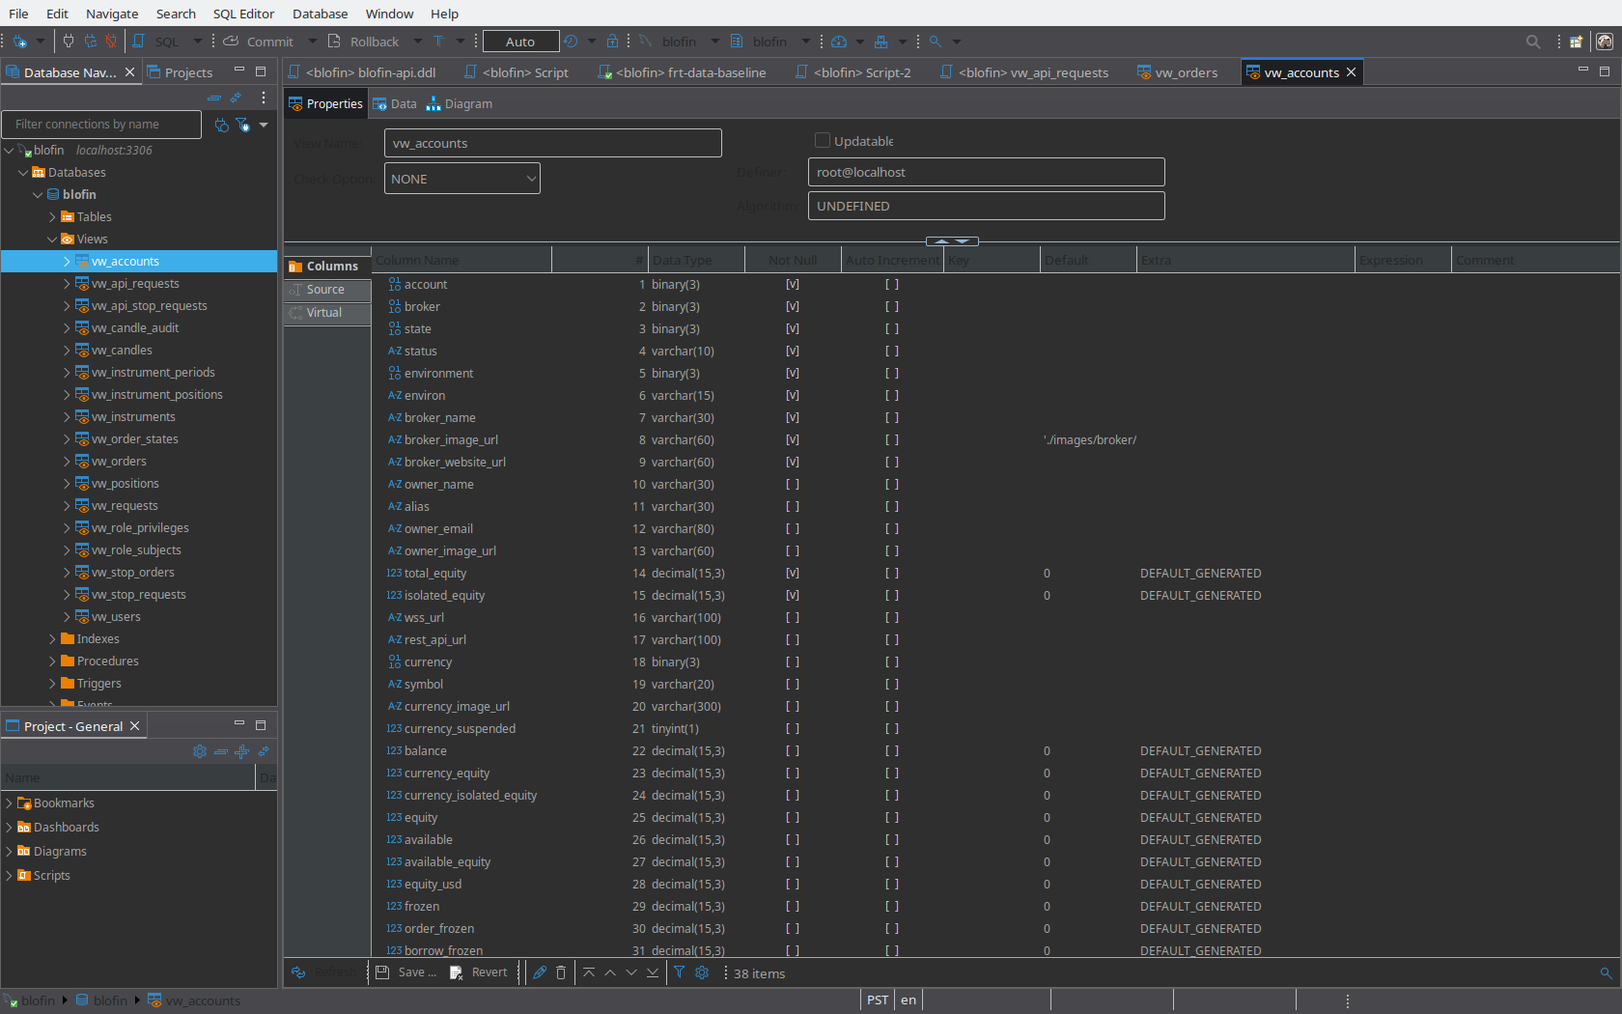
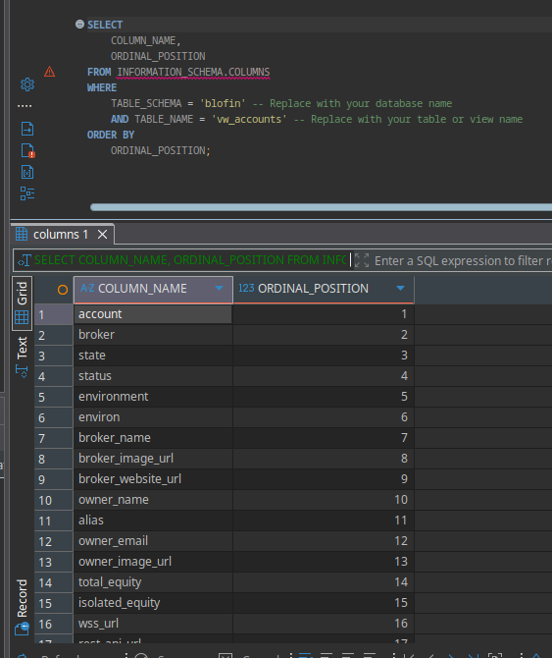
Sequencing on Sync

Slide 2
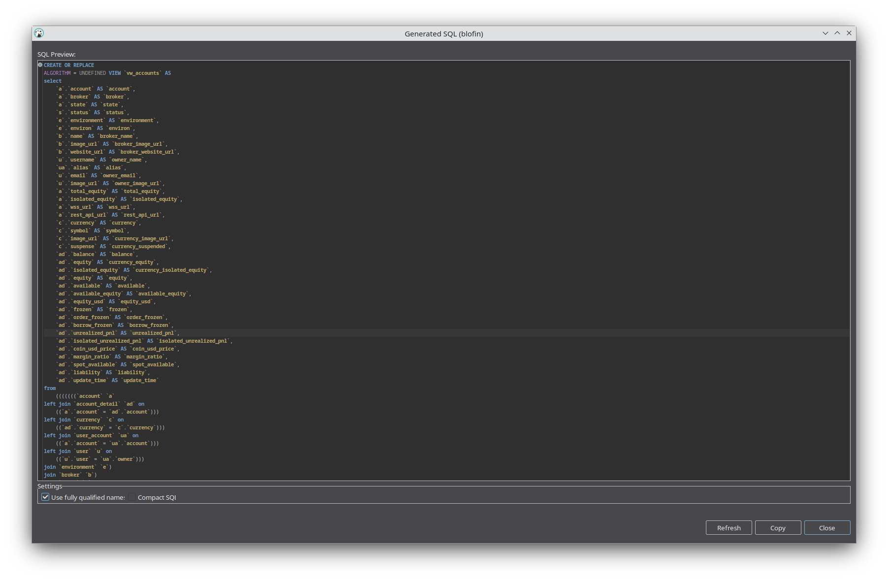
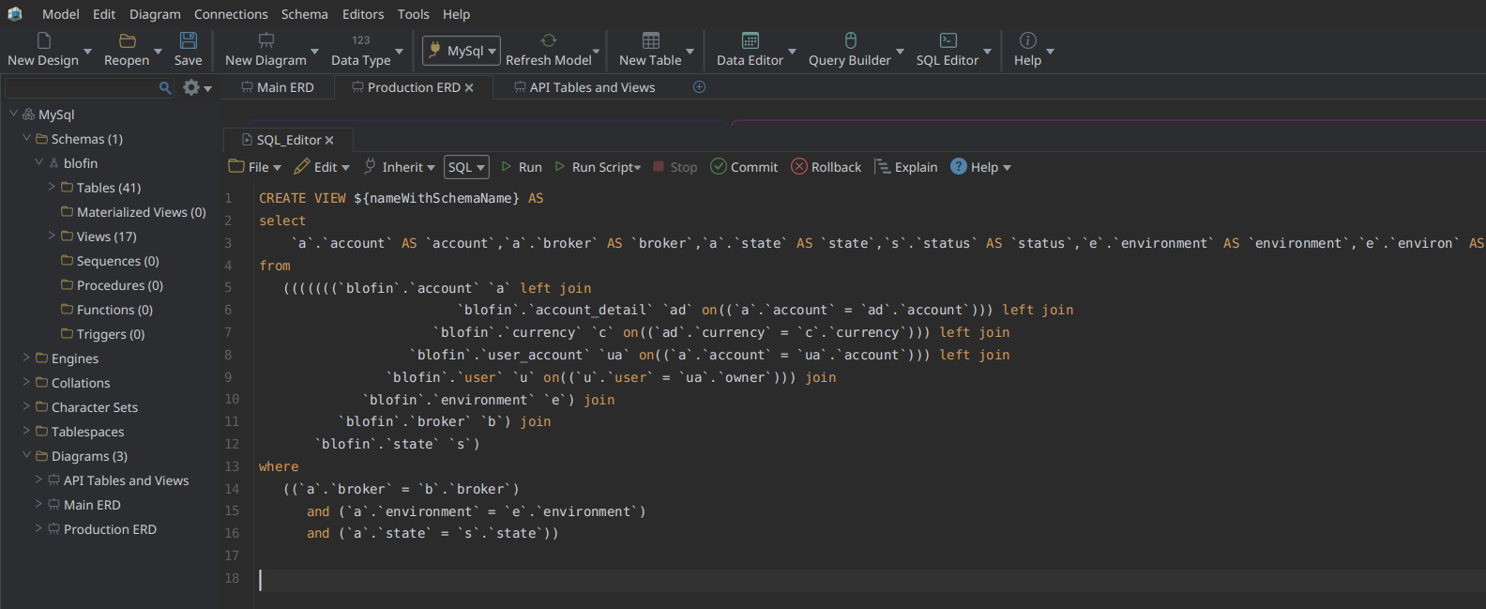
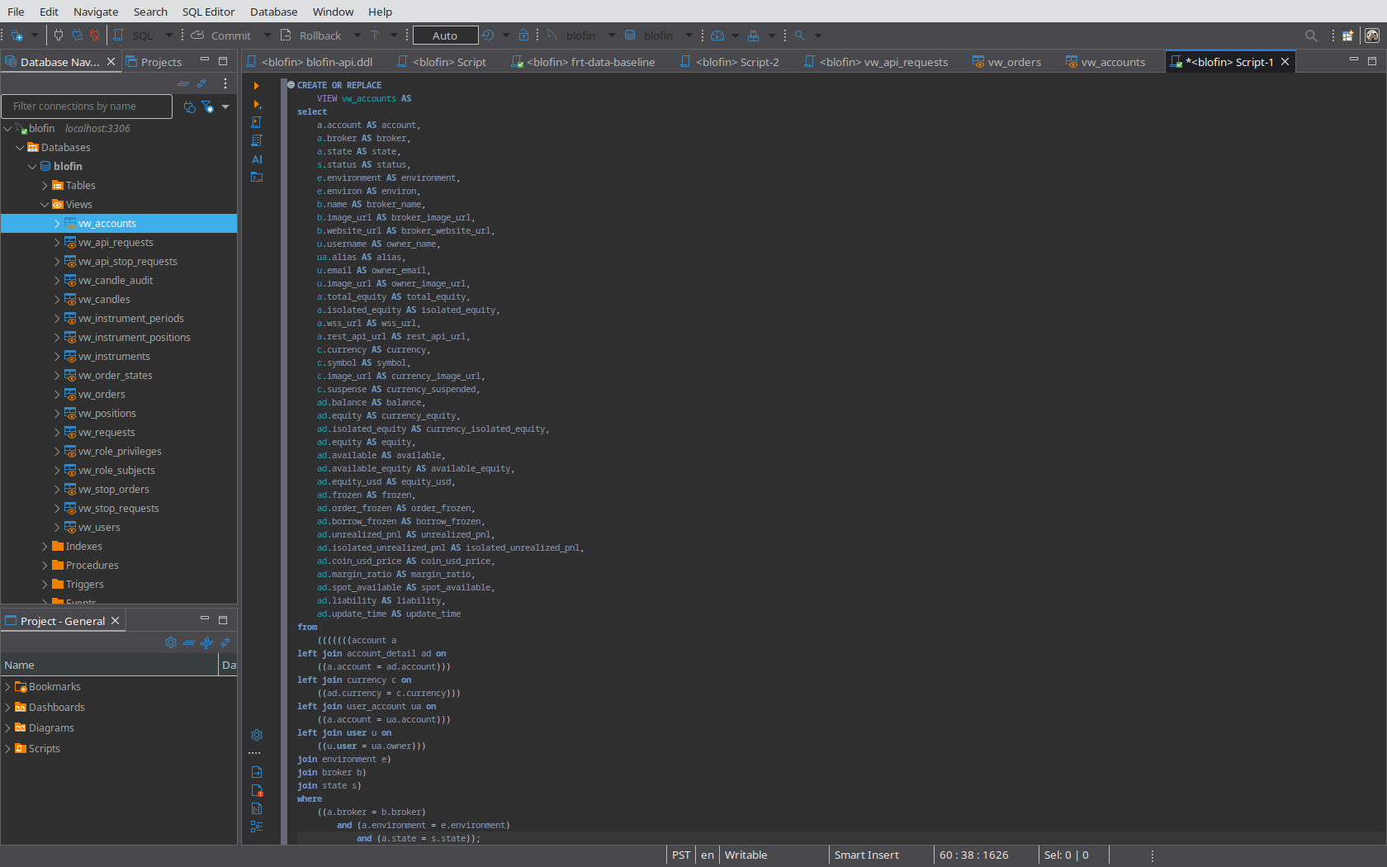
SQL Formatting

Slide 3
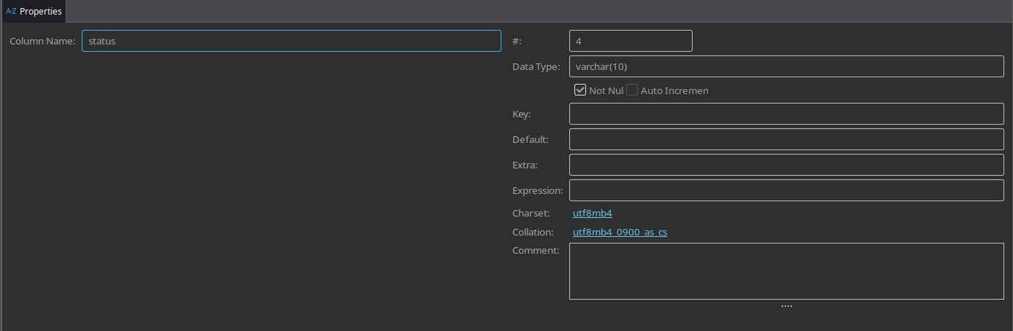
View Editor

Slide 4
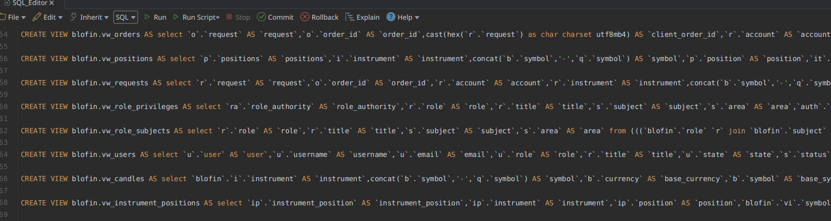
Nice to Haves:
A
View Editing/Editor
Add Tables to Views
Add Columns to Views
Set the Join Condition(s)
Add Derived Columns (formula Editor?)
Modify Column Sequence
SQL Formatting
Improve View DDL
Now: Single line on export (A)
Reduced indentation (B)
B

