Slide 1
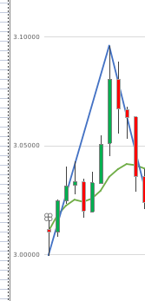





Reversal
Fractal Flow
04/15/2025
root = expansion
long
base = resistance
origin = root
A
candles
bars
Reversal
Fractal
BarOOB?
Direction
Changed?
root = expansion
Start
y
short
base = support
origin = root
A
n
Expansion
high >
expansion?
Expansion
expansion = low
low <
expansion?
Direction?
expansion = high
retrace = close
y
short
long
y
retrace = close
recovery = close
recovery = close
n
n
New
Low?
New
High?
New
Boundary?
New
Boundary?
New
Low?
New
High?
n
y
y
n
B
n
y
y
n
n
y
y
n
C
recovery > low?
retrace > high?
recovery > close?
Pullback
Rally
recovery < close?
retrace < low?
recovery < high?
y
recovery= close
recovery= close
y
y
y
n
n
y
y
Pullback
Rally
retrace < close?
Rally
Pullback
retrace > close?
Pullback
Rally
recovery = low
retrace = high
y
retrrace = close
retrrace = close
y
retrace = low
recovery = high
recovery = close
recovery = close
n
n
Close
close = bar
support = iLow
resistance = iHigh
2
Connects to Fibonacci Flow
range = iHigh - iLow

Slide 2
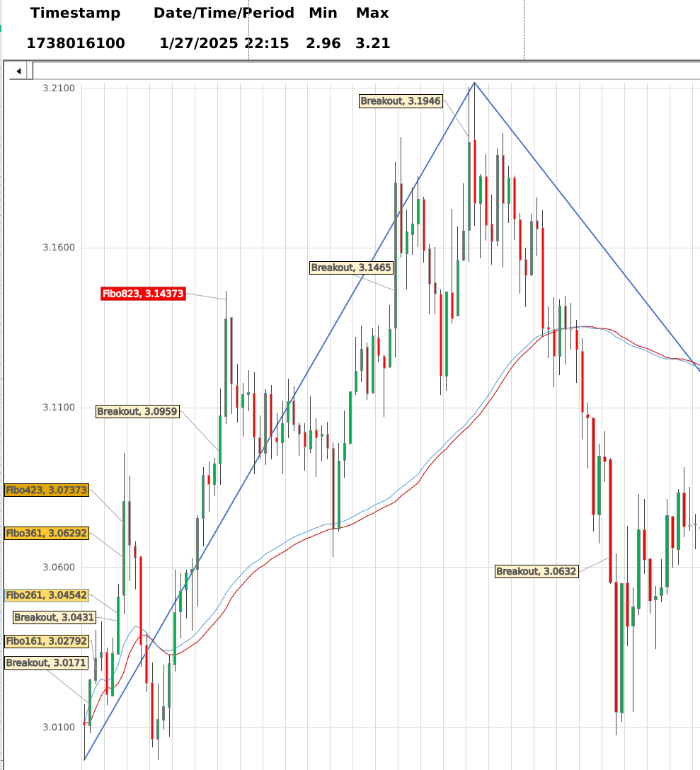
2
Fibonacci Flow
04/15/2025
Fractal
Expansion?
Rreversal?
Reversal
next
y
y
setEvent()
postReport()
Extension< max?
Extension
n
y
setEvent()
postReport()
retrace > f23.6%
Breakout
y
setEvent()
postReport()
A
Retrace
Initialize Retrace
n
n
next
Retrace < max?
Retrace
y
setEvent()
postReport()
n
End

Slide 3
Account Flow
05/08/2025
success?
Error
Start
next
y
Handle Crash
Retrieve
Exists?
Import
env.Accounts
n
setOwner()
setBroker()
setPosition()
y
setDescription()
setState()
End

Slide 4
Logon Flow
05/15/2025
Logon
Retrieve
enabledAdmin() #
Create Admin
Exists?
getUsername()
n
n
Valid?
getEmail()
Error
Error
y
getPassword()
setInvalid()
y
setInvalid()
n
Valid?
confirmPassword()
y
Logon
getUsername()
Connect
Valid?
getEmail(user)
y
compareHash()
Exit
setAdmin()
setSuccess()
getPassword()
Connect
Error
End
y
compareHash()
Success?
n
setInvalid()
y
Retrieve
getSubjectAreas()
menu
User
Account
Instrument
Job
Broker
Currency
Role
runUser()
runAccount()
runInstrument()
runJob()
runBroker()
runCurrency()
runRole()
5
6
7
8
9
10
11

Slide 5
User Flow
05/15/2025
5
A
menu
Edit
Drop
View
User
edit()
drop()
view()
n
create()
Edit User
Drop User
View User
Create User
getUsers()
getUsers()
getUsers()
getUsername()
Blank?
selectUser()
selectUser()
selectUser()
y
setRole()
setState(Disabled)
getEmail()
setState()
Valid?
n
Error
A
Admin?
setImage()
setInvalid()
n
storeCredentials()
y
setRole()
getPassword()
setState()
y
setImage()
n
confirmPassword()
getPassword()
confirmPassword()
Valid?
y
Connect
A
compareHash()
storeCredentials()

