Slide 1




Main
Symbol
Algorithm
Account
Order
App
Symbol
Algorithm
API
Account
Order
API
Process
?
Symbol
Algorithm
API
Account
Order
API
Symbol
Algorithm
Account
Order

Slide 2








API/WSS
CProcess
App
CMain
CProcess
CProcess
?
CProcess
Order API
Update
App Thread Flow
06/05/2025

Slide 3
Start
App
CMain
ipc
CProcess
Initialize
init
ipc
init
WebSocket
api
init
ipc
init
init
ipc
init
update
api
ipc
api
API
Load Candles
api
ipc
api
wait
update
ipc
update
Update
Update
Fractal
Orders
update
ipc
update
Ready
Internal IPC Flow 06/05/2025

Slide 4
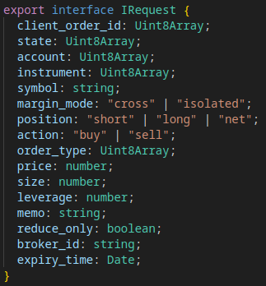
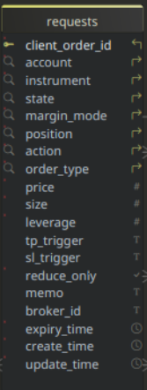
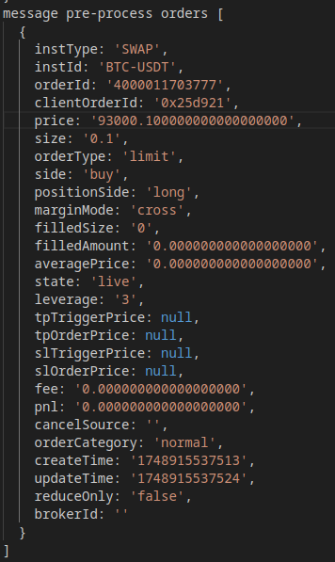
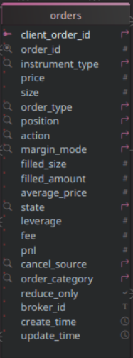
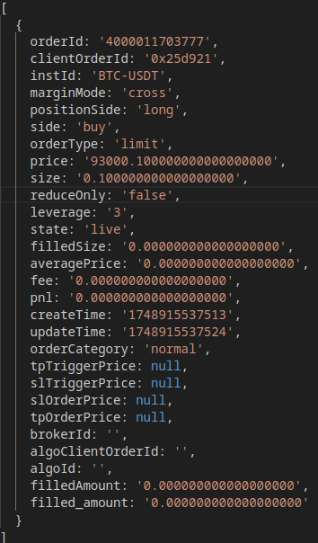
B
API/WSS Flow
06/05/2025
Application
A
success?
REST API
Publish
y
Place Order
pending
Set State
app request array
Requests
rejected
n
C
Publish
Queued
Pending
REST API
y
Canceled
success?
Cancel Order
Rejected
pending
y
Set State
y
Closed
Fulfilled
rejected
n
Websocket
partial
cancel?
n
Message
Timer
partial
fill?
Expiry?
y
Publish
api/wss order array
requests
Fetch
canceled?
B
y
Publish
REST API
Import
live?
failed?
y
filled?
api client
order id?
Fetch Active
n
Untracked
Queued?
Log Untracked
y
Cancel
A
Submit
Process
symbol
match?
Fetch
requests
orders
y
n
Unknown
Fetch
orders
Log Error
C
Set State
Cancel

Slide 5
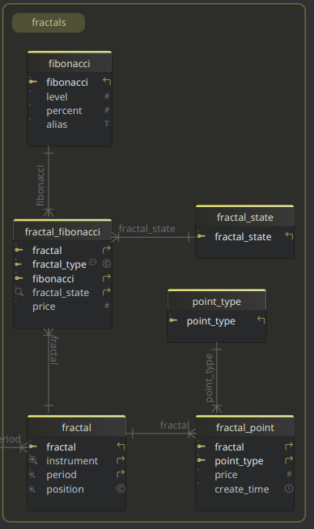
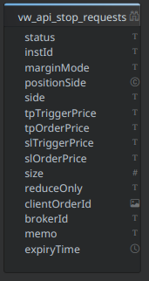
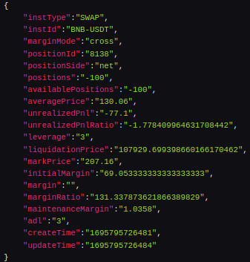
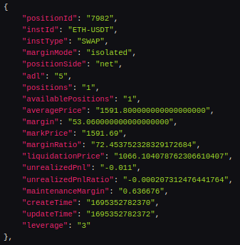
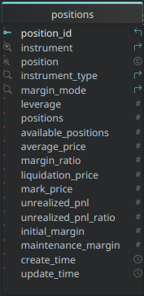
B
API/WSS Flow
06/05/2025
success?
REST API
Application
A
y
Place Order
Publish
pending
Set State
Fractal
Requests
rejected
n
C
Publish
Queued
REST API
Pending
success?
Cancel Order
y
Canceled
pending
y
Set State
Rejected
y
Closed
rejected
n
Fulfilled
Websocket
partial
cancel?
n
Message
Timer
partial
fill?
Expiry?
y
Publish
api/wss positions array
requests
Fetch
canceled?
B
y
Publish
REST API
Import
live?
failed?
y
filled?
request?
Fetch Active
Queued?
n
New Position
Submit
Process
position
y
A
Fetch
requests
Fetch
orders
Set State

Slide 6
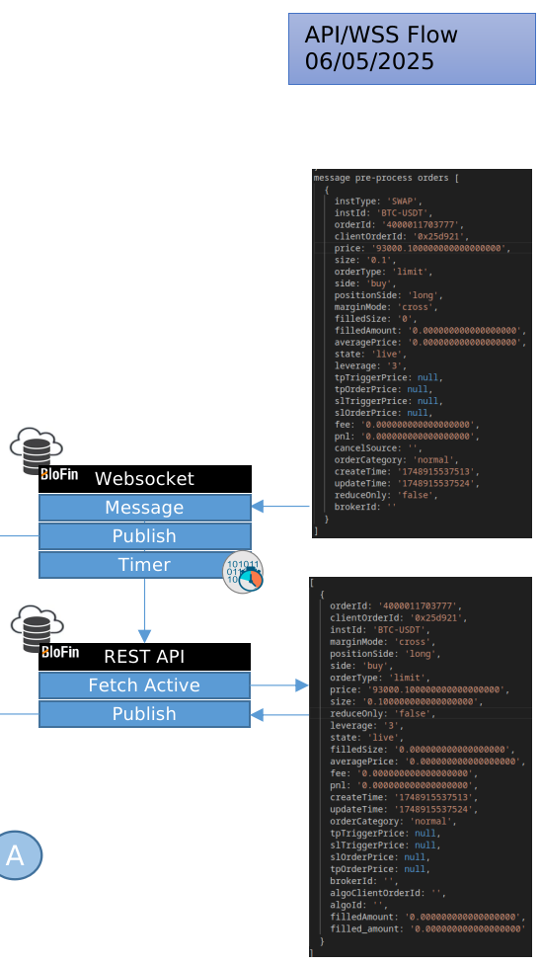
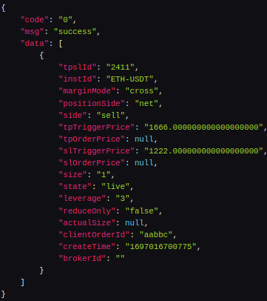
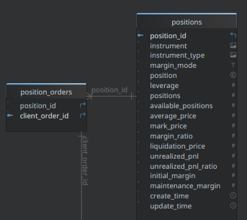
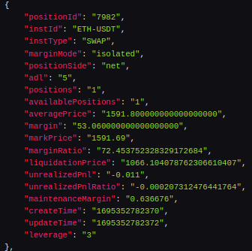
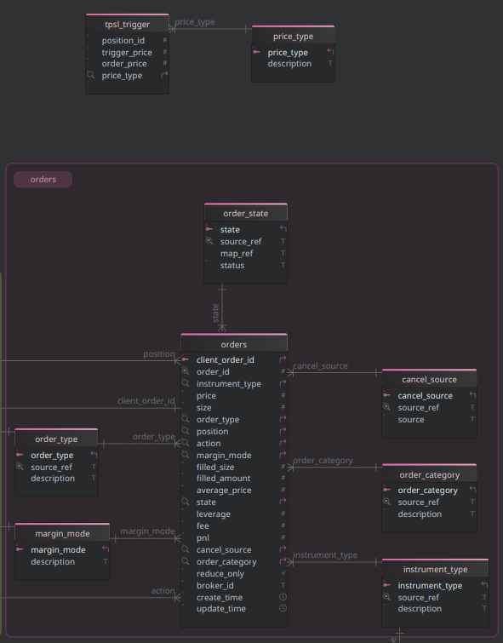
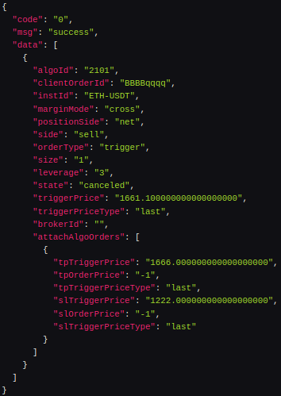

Slide 7
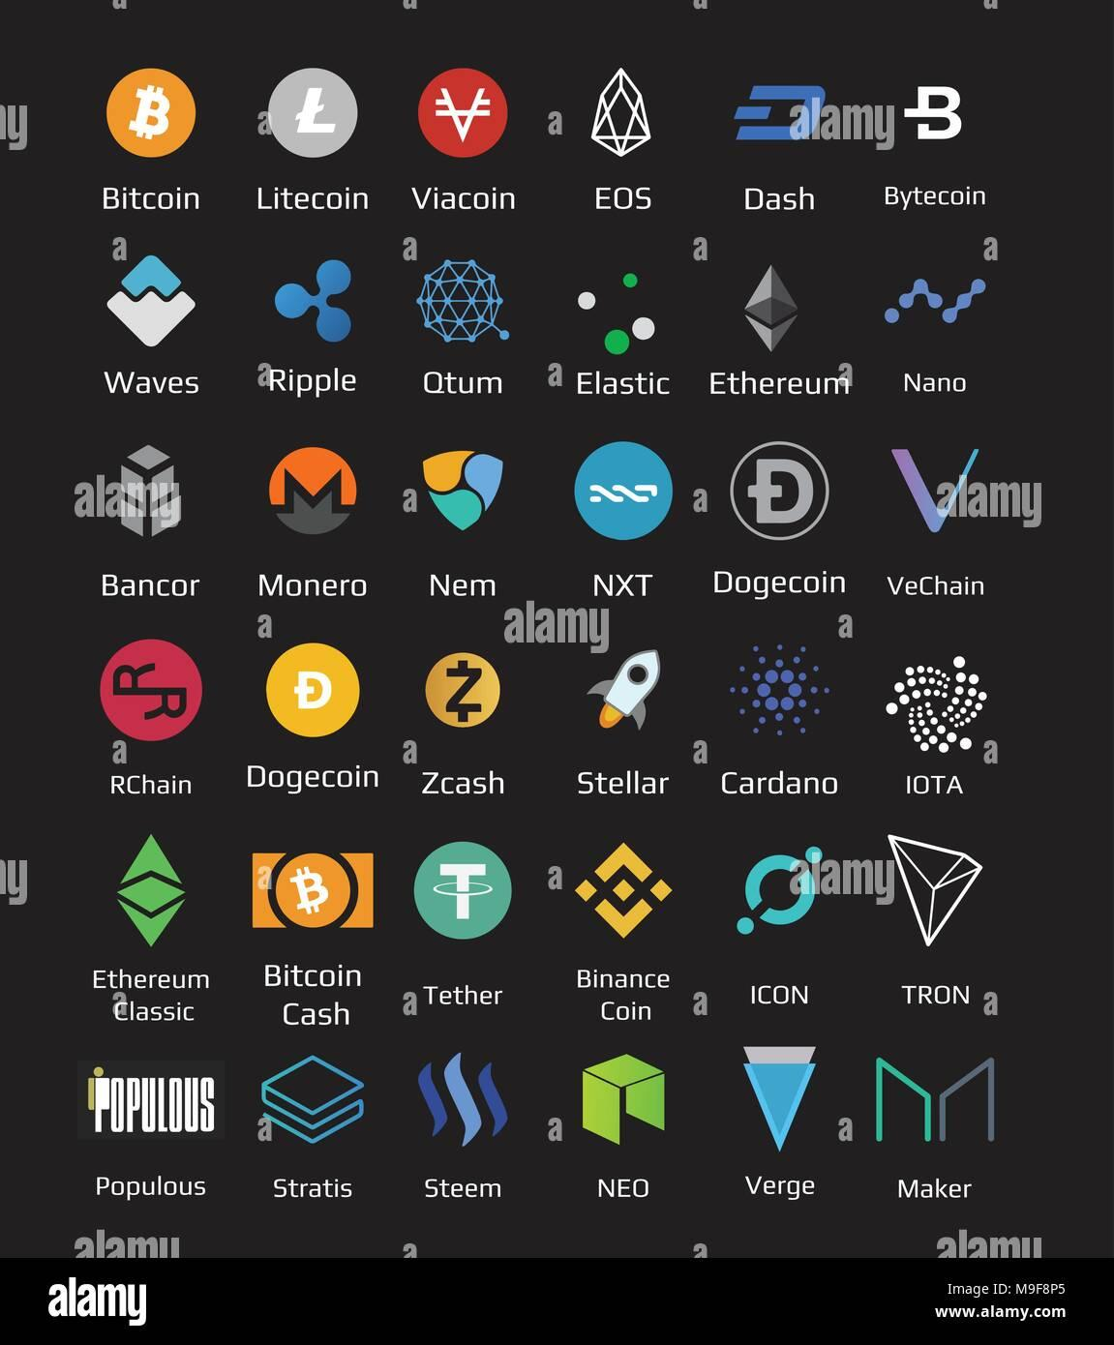
WSS
REST API

Slide 8
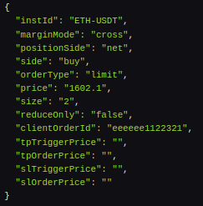
Place Order w/ TPSL
WSS
REST API

