Slide 1




Main
Symbol
Algorithm
Account
Order
App
Symbol
Algorithm
API
Account
Order
API
Process
?
Symbol
Algorithm
API
Account
Order
API
Symbol
Algorithm
Account
Order

Slide 2








API/WSS
CProcess
App
CMain
CProcess
CProcess
?
CProcess
Order API
Update
App Thread Flow
06/05/2025

Slide 3
Start
App
CMain
ipc
CProcess
Initialize
init
ipc
init
WebSocket
api
init
ipc
init
init
ipc
init
update
api
ipc
api
API
Load Candles
api
ipc
api
wait
update
ipc
update
Update
Update
Fractal
Orders
update
ipc
update
Ready
Internal IPC Flow 06/05/2025

Slide 4
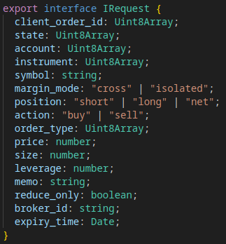
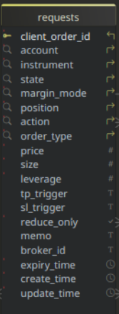
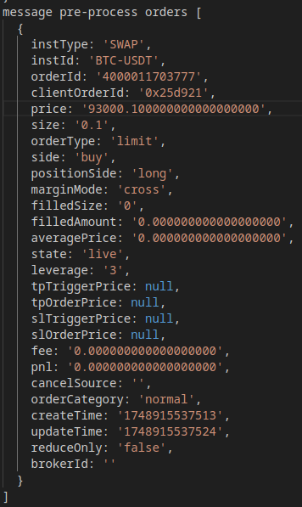
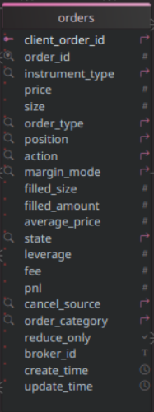
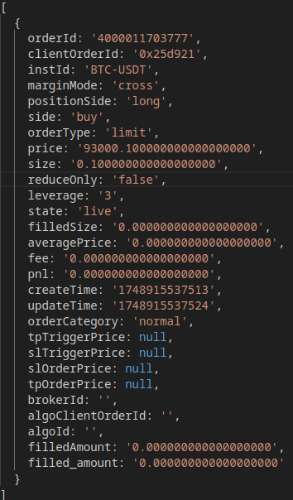
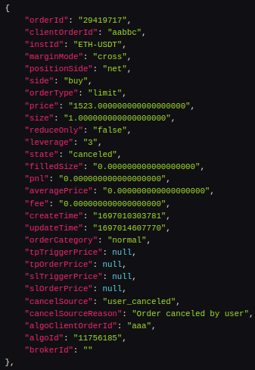
S
API/WSS Flow
06/05/2025
Application
S
success?
REST API
Submit
y
Place Order
pending
Set State
app request array
Submit
rejected
n
C
Queued
Pending
Canceled
REST API
C
F
Rejected
success?
Cancel Order
Fulfilled
Closed
y
Set State
C
Closed
y
canceled
n
Websocket
Expiry?
S
Message
y
Timer
partial
cancel?
n
Publish
api/wss order array
y
requests
Fetch
REST API
partial
fill?
Expiry?
Publish
Import
api client
order id?
Fetch Active
canceled?
Queued?
n
Untracked
y
Log Untracked
y
Cancel
S
live?
failed?
Submit
Canceled?
orders
y
symbol
match?
n
Unknown
n
history
Log Error
C
filled?
Rejected?
Cancel
F
y
Process
Fetch
requests
REST API
Pending?
Fetch
orders
Fetch History
Queued
Publish
Rejected
Canceled
Pending

Slide 5
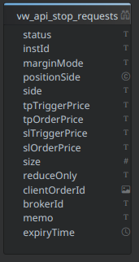
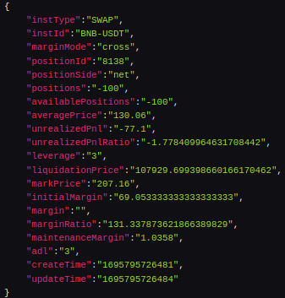
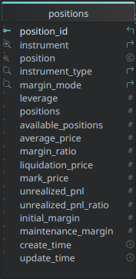
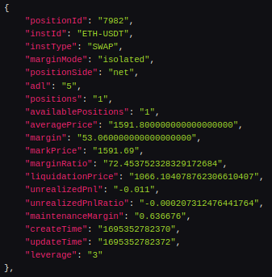
B
API/WSS Positions/Stops Flow
06/05/2025
success?
REST API
Application
A
y
Place Order
Publish
pending
Set State
Fractal
Requests
rejected
n
C
Publish
Queued
REST API
Pending
success?
Cancel Order
y
Canceled
pending
y
Set State
Rejected
Fulfilled
rejected
n
y
Closed
partial
cancel?
n
partial
fill?
Expiry?
y
canceled?
B
y
Websocket
live?
failed?
filled?
api/wss positions array
Message
y
Publish
Timer
fulfilled
Publish
Queued?
Published
active
fulfilled
Fetch
Compare
REST API
Import
Process
active?
Fetch Active
Fetch
requests
n
Fetch
orders
closed*
Set State

Slide 6
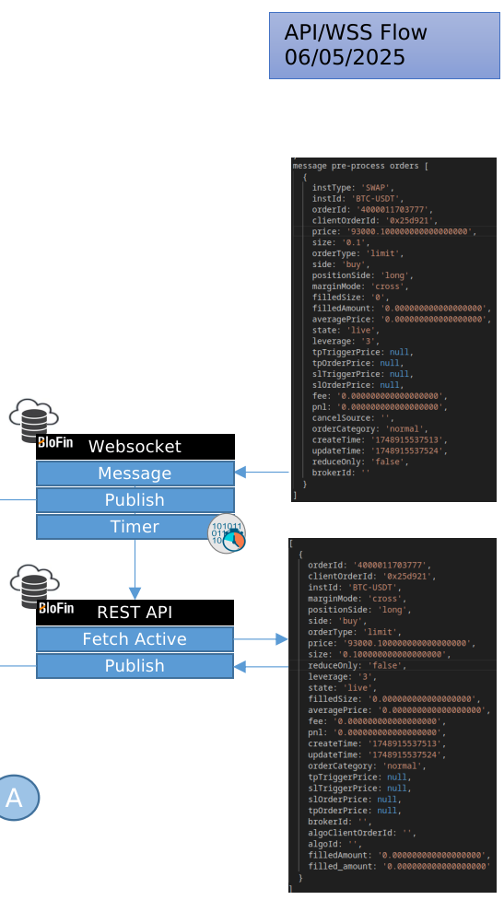
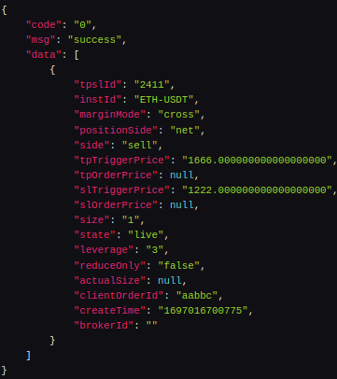
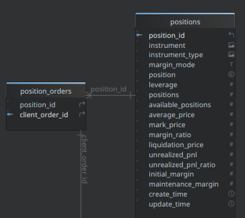
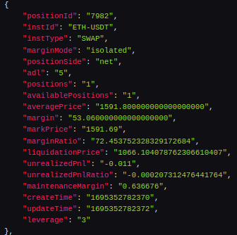
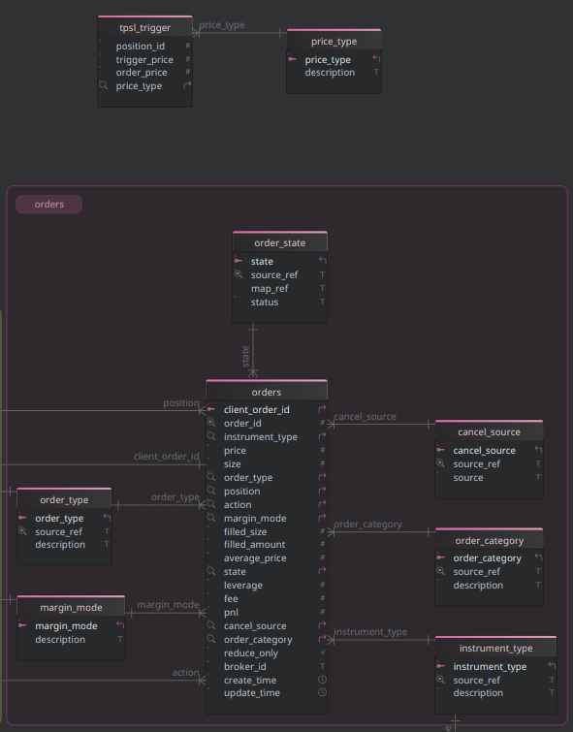
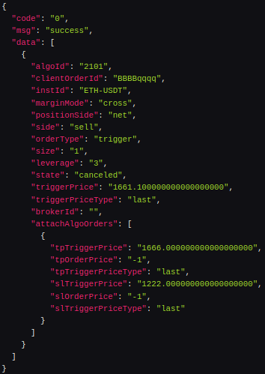

Slide 7
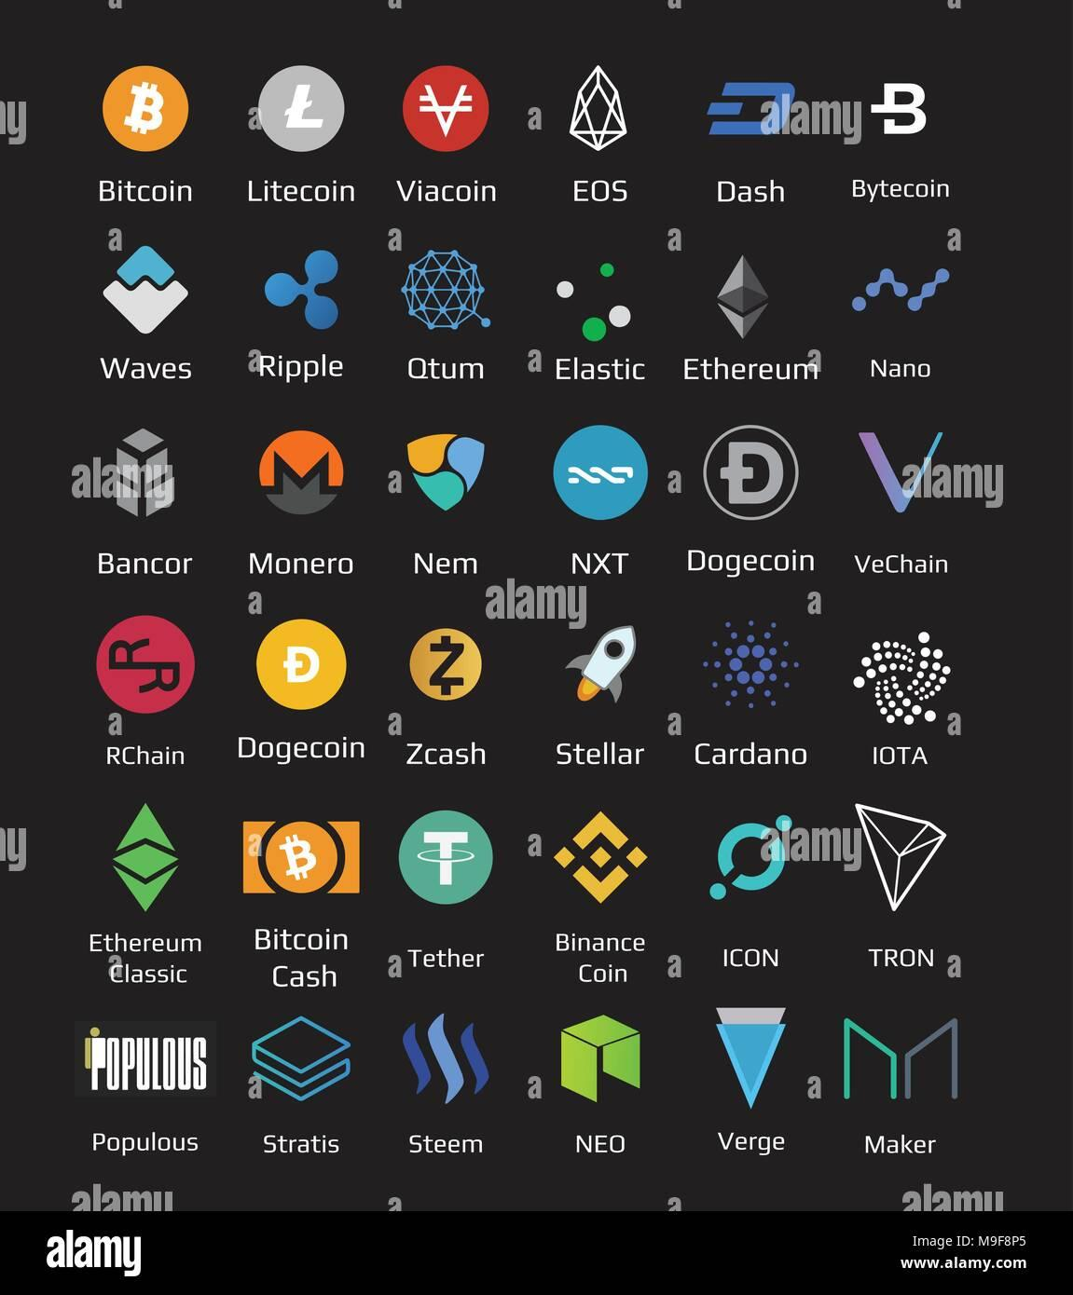
WSS
REST API

Slide 8
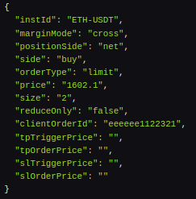
Place Order w/ TPSL
WSS
REST API

