Slide 2











App Thread Flow
06/05/2025
API/WSS
CProcess
App
CMain
CProcess
CProcess
?
CProcess
Order API
Update

Slide 3
Internal IPC Flow 06/05/2025
Start
App
CMain
ipc
CProcess
Initialize
init
ipc
init
WebSocket
api
init
ipc
init
init
ipc
init
update
api
ipc
api
API
Load Candles
api
ipc
api
wait
update
ipc
update
Update
Update
Fractal
Orders
update
ipc
update
Ready

Slide 4
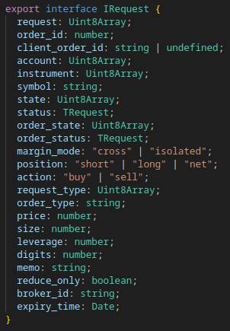
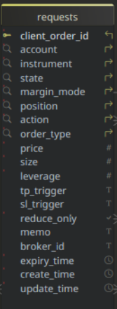
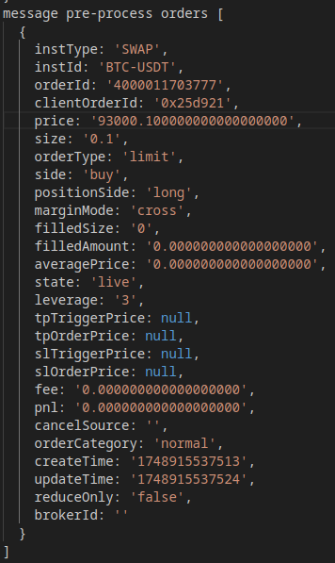
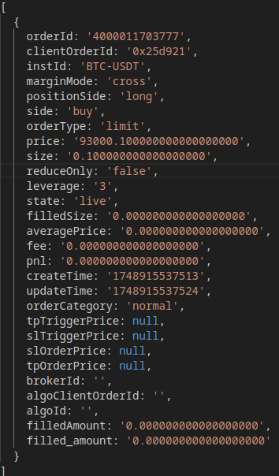
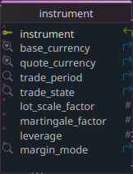
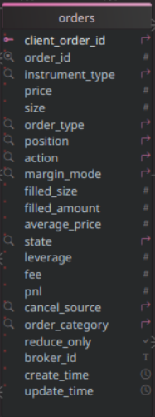
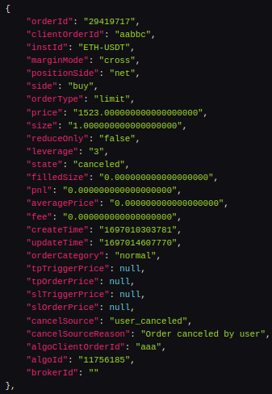
S
_{Submit}
R
API/WSS Request Flow
06/05/2025
_{app}
Interface
success?
REST API
Submit
y
Place Order
pending
Set State
app request array
Submit
rejected
n
C
Queued
Pending
Canceled
REST API
C
F
Rejected
success?
Cancel Order
_{stops}
Fulfilled
closed
y
Set State
C
Closed
y
canceled
n
Websocket
Expiry?
R
Message
y
Timer
partial
cancel?
n
Publish
order array
y
request
Format Order
Fetch Request
partial
fill?
Expiry?
symbol
Fetch Instrument
REST API
symbol
match?
Import
canceled?
y
Queued?
Fetch Active
live?
failed?
y
Canceled?
n
request exists
?
n
REST API
Rejected?
S
Fetch History
F
y
filled?
y
Publish
Process
y
modified?
Fetch
requests
Pending?
Fetch
orders
Queued
n
Rejected
Canceled
missing?
Pending
orders
y

Slide 5
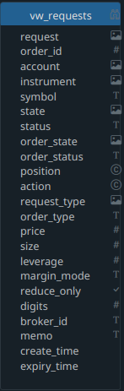
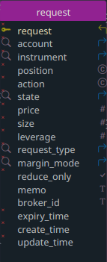
App Request Submit Flow
08/13/2025
_{submit}
Submit
Format Request
request id?
n
auto?
y
Insert
Fetch
pending
y
pending?
Update
n
request
Fetch
y
exists?
n
insert
request
> max
create?
y
queued
update
y
cancel
array
Cancel
pending
Cancels

Slide 6
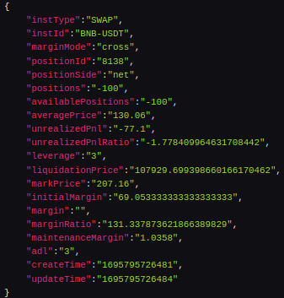
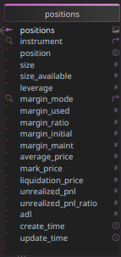
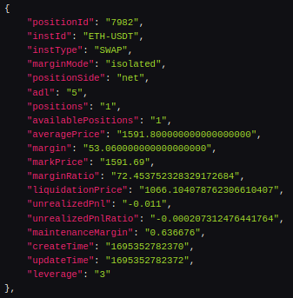
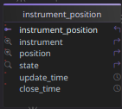
API/WSS Positions Flow
06/05/2025
_{positions}
wss message array
Websocket
Publish
Message
update
Publish
Timer
REST API
api positions array
Import
Publish
Fetch Active
update
Publish
Published
active
open
Fetch
Compare
S_{o}
open
y
active?
Process
open
Reconcile
closed
n
Reconcile
closed
S_{c}

Slide 7
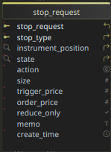
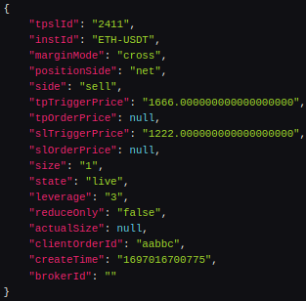
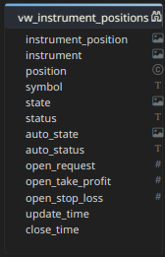
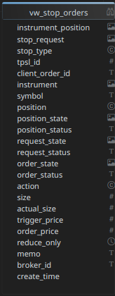
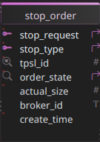
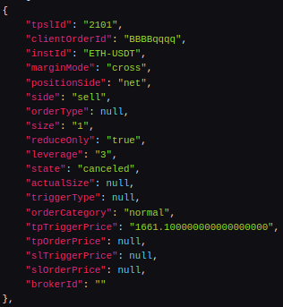
API/WSS Stops Flow
06/05/2025
Import Legend
Queued
Pending
Canceled
P
_{stops}
S
REST API
Application
queued
pending
y
success?
Place Order
Websocket
1
Submit
Set State
Timer
Websocket
2
C
Timer
closed
K
Fetch
Import
REST API
REST API
Fetch
position
success?
Cancel Order
Import
Fetch
live
closed
y
Set State
Fetch Active
Process
Reconcile
auto?
y
auto?
Publish
api/wss stops
Fetch
stop orders
open > 1?
position
Fetch
y
Compare
y
Canceled?
tpsl id?
y
C
create time < latest?
n
n
n
Queued?
publish
y
order missing?
S
y
request missing?
n
auto?
n
y
P
create time < latest?
n
y
live?
y
system generated?
n
C
y
n
K
K

Slide 8
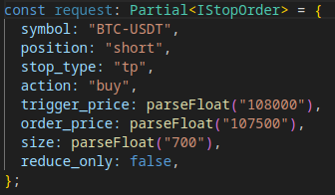
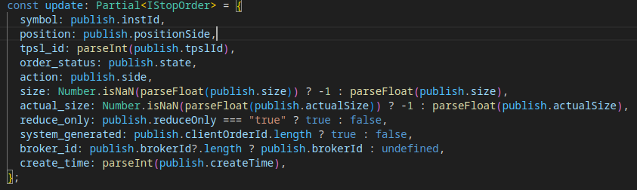
API/WSS Stops Submit Flow
08/02/2025
S
Websocket
Timer
valid position?
app
Submit
REST API
Fetch
Import
Fetch Active
y
Format
auto?
n
y
Error
n
position open?
S
Log
_{RTS}
y
S
y
tpsl open?
n
tpsl exists?
n
publish
y
_{RTS}

Slide 9
Websocket
Trades Flow
08/03/2025
Positions [api]
_{positions}
_{orders}
Orders [api]
Stops [api]
_{stops}
Reconcile Queue
Projects Rejected
Process Pending
Process Canceled
S
Process Queued
valid position?
app
Submit
REST API
Fetch
Import
Fetch Active
y
Format
auto?
n
y
Error
n
position open?
S
Log
_{RTS}
y
S
y
tpsl open?
n
tpsl exists?
n
publish
y
_{RTS}

Slide 10
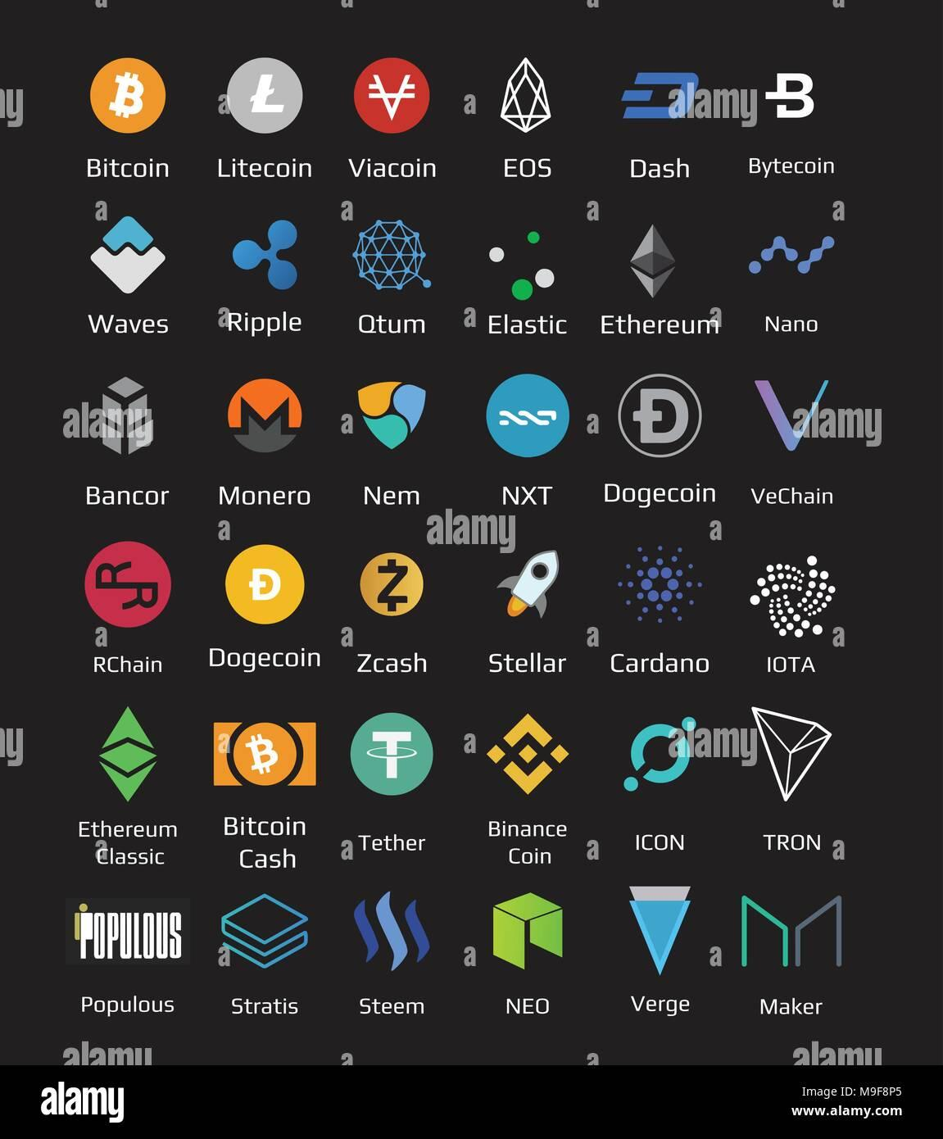

Slide 11
