Slide 2











App Thread Flow
06/05/2025
API/WSS
CProcess
App
CMain
CProcess
CProcess
?
CProcess
Order API
Update

Slide 3
Internal IPC Flow 06/05/2025
Start
App
CMain
ipc
CProcess
Initialize
init
ipc
init
WebSocket
api
init
ipc
init
init
ipc
init
update
api
ipc
api
API
Load Candles
api
ipc
api
wait
update
ipc
update
Update
Update
Fractal
Orders
update
ipc
update
Ready

Slide 4
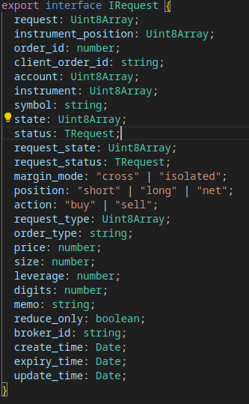
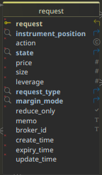
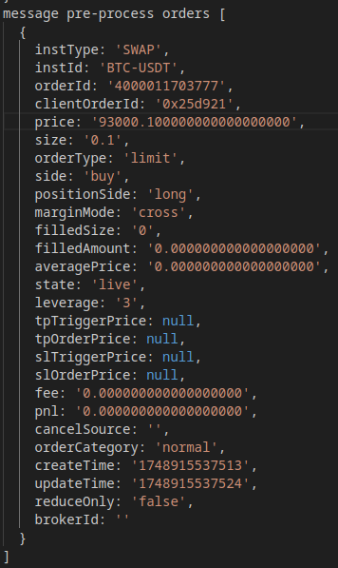
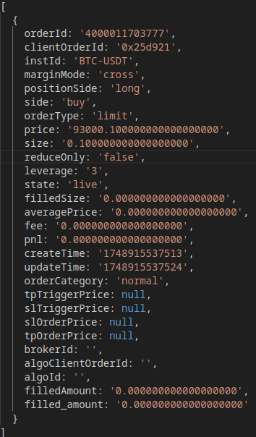
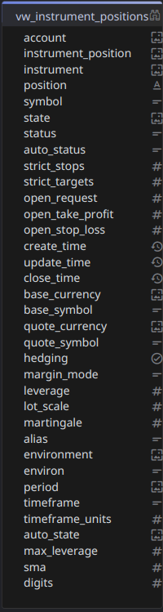
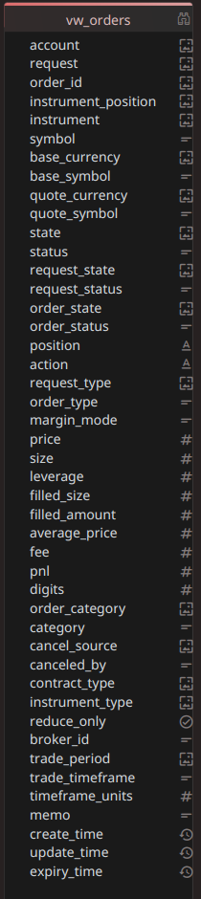
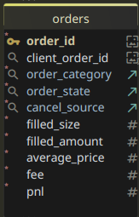
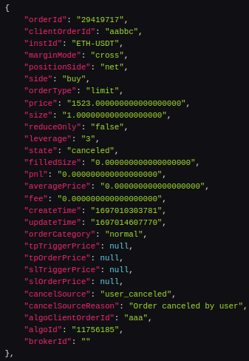
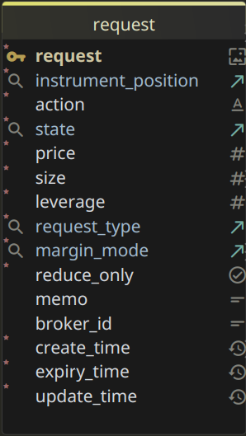
S
API/WSS Request Flow
06/05/2025
_{Submit}
R
Interface
_{app}
Submit
success?
REST API
y
Submit
Found?
n
queued
pending
Publish
y
F
Fulfilled
rejected
n
C
Newer?
y
Pending?
y
Hold
success?
REST API
y
Submit
n
Publish
closed
Publish
Websocket
C
Expired
canceled
n
Message
wss
y
C
Publish
_{Trades}
Expiry?
Fetch
y
De-Duplicate:keep latest
partial
cancel?
y
Update
y
Order Found?
Instrument
Position?
REST API
Insert
n
Import
live
partial
fill?
Expiry?
n
R
Fetch Active
y
canceled?
y
Queued?
y
Publish
Format Order
live?
failed?
canceled?
client
1
Publish Order
order
2
Fetch Request
REST API
n
Canceled?
C
Request
Found?
Import
filled?
Rejected?
Hold?
Insert
n
Fetch
history
F
y
y
2
_{orders}
Expire
y
y
1
Pending?
API/WSS
Pending?
History?
_{orders}
Update
n
y
Process
orders
Fetch
Hold
Hold
n
Queued
n
Rejected
API/WSS
Pending?
Auto?
Newer?
Canceled
y
y
Pending

Slide 5
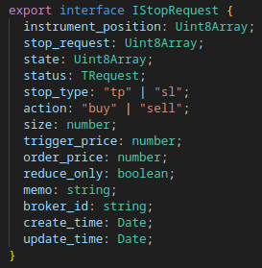
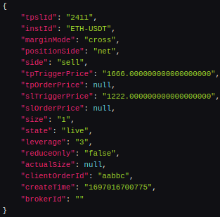
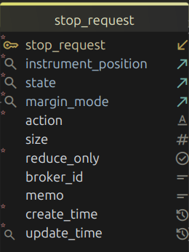
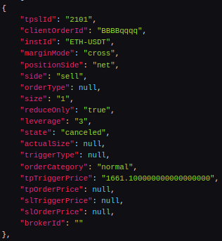
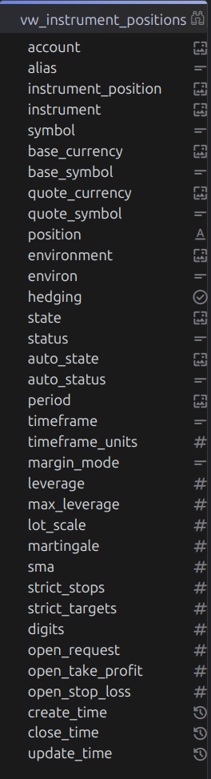
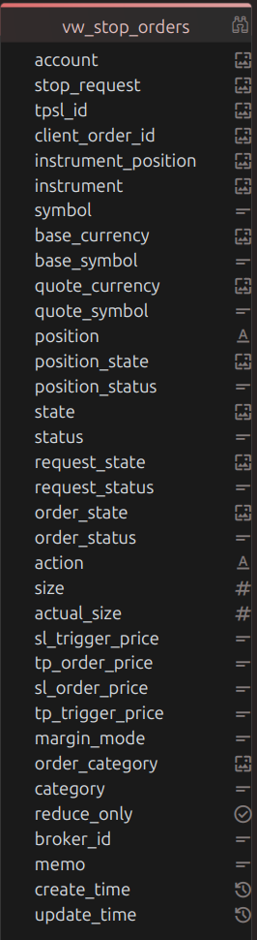
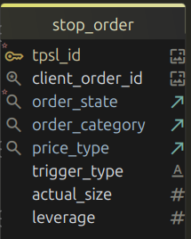
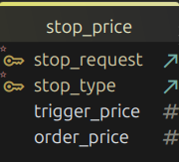
S
_{Submit}
P
API Stops Flow
06/05/2025
_{app}
Interface
REST API
Submit
success?
Place Order
_{Trades}
Found?
n
queued
pending
y
Set State
rejected
n
C
REST API
y
n
Publish
Import
Newer?
success?
REST API
Fetch Active
live
y
Pending?
y
Hold
y
Cancel Order
closed
Set State
canceled
n
Publish
api stops array
Fetch
De-Duplicate (latest)
REST API
Instrument
Position?
Import
history
Update
y
Fetch History
Insert
n
Order Found?
y
_{stops}
Publish
Format Order
client
1
Publish Order
tpsl
2
Fetch Request
Insert
n
Request
Found?
n
Insert
Expire
y
y
Update
Update
n
API
Pending?
y
History?
y
Hold
n
n
n
API
Pending?
y
Auto?
y
Newer?
y
Auto?

Slide 6
Publish
orders
Fetch
position
Fetch
orders
Process
Compare
Fetch
position
Fetch
instrument
position?
Process
Rejected?
y
position
open?
y
queued
y
S
Order?
n
n
closed
n
Canceled?
y
C
y
n
Pending?
position
open?
y
request?
y
pending
S
publish
y
n
n
expired
Hold?
y
position
open?
y
C
closed?
y
queued
S
n
n
expired
Queued?
y
position
open?
n
request
open?
y
y
queued
S
y
P
n
expired

Slide 7
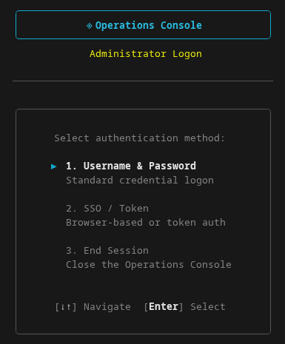
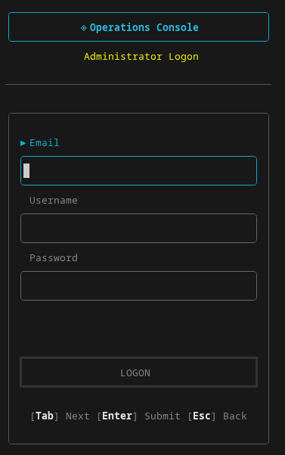
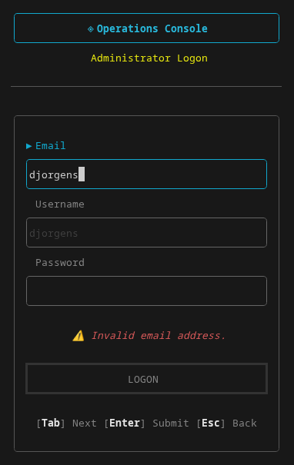
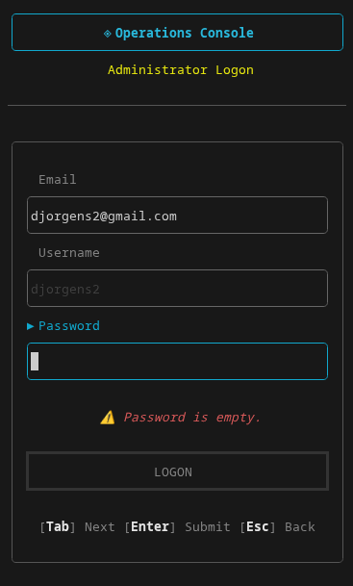
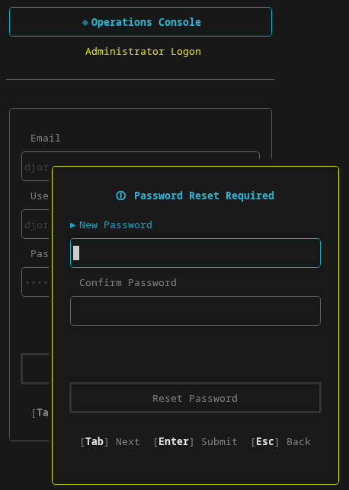
Mode
Selector
Logon
Form
EMail
Event
Password
Event
Reset
Modal

Slide 8
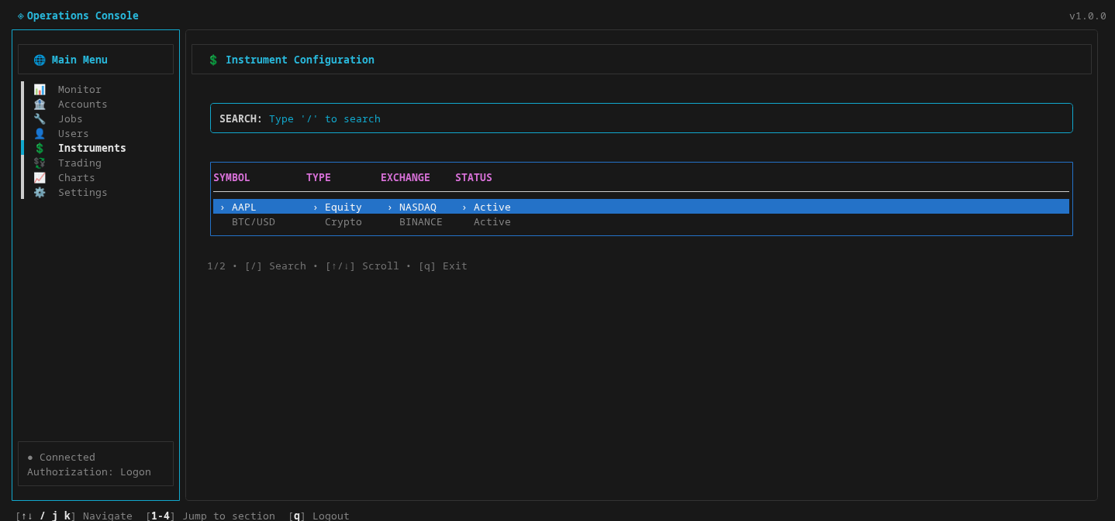

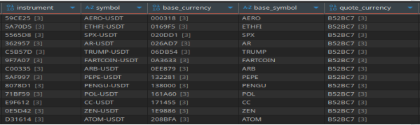

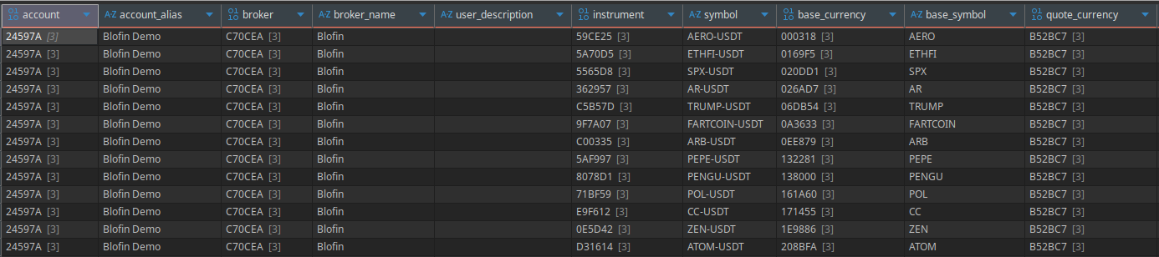
[pg-up|dn] scroll [esc] back

Slide 9

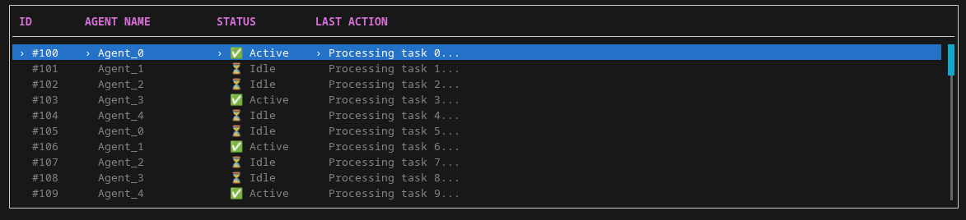
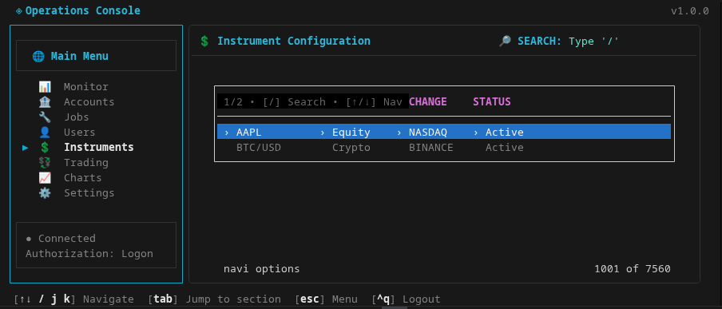


ᯤ
Account
Symbol
Enabled
≡
SYMBOL
TYPE
ACCOUNT
STATUS

Slide 10
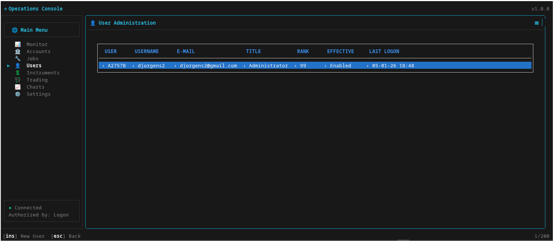

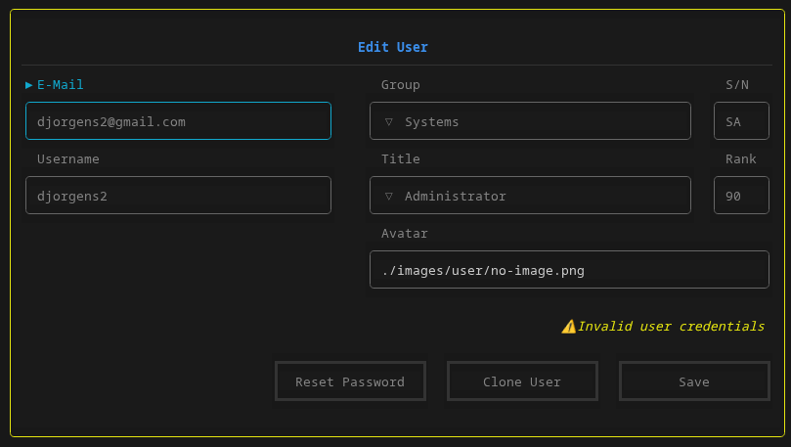


Create User
E-Mail
Title
Username
Rank
Avatar/Image
Status
Reset Password
Cancel
Save
Title
Title
Title
Use ↑↓ to select
Use ↑↓ to select
Use ↑↓ to select
Title
Title
Title
Use ↑↓ to select
Use ↑↓ to select
Use ↑↓ to select
Title
Title
Title
Administrator
Administrator
Administrator
Title
Title
Title
Administrator
Administrator
Administrator

Slide 11
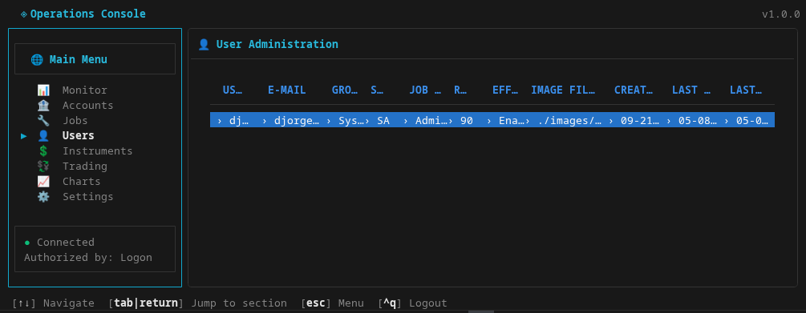
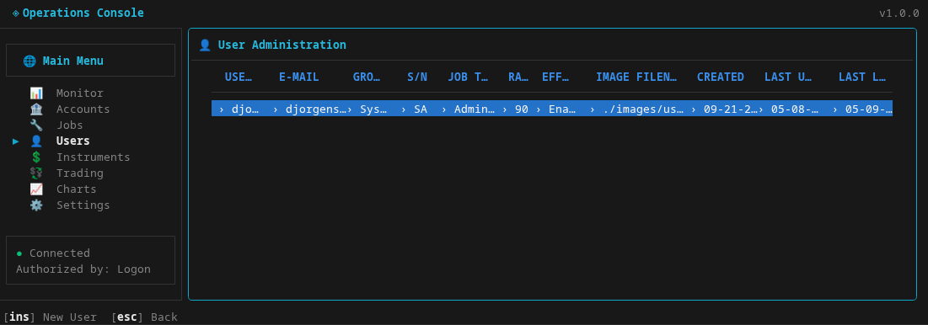
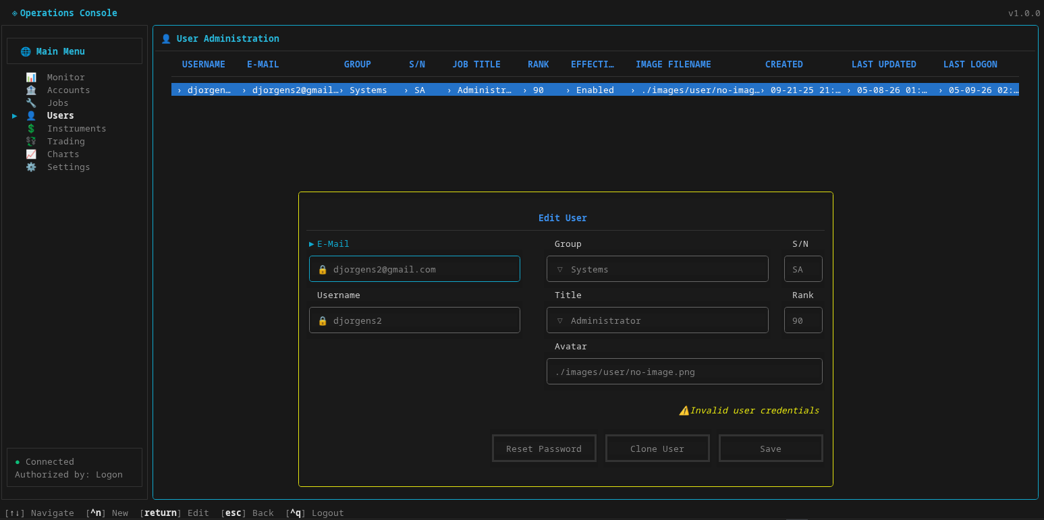

Administrator
pg 1 of 1 | 1 / 1
Administrator
pg 1 of 1 | 1 / 1
Left | Center | Right
Dynamic based on RBAC rules | Session.user title | pg (if more than 1) | index / total
Left | Center | Right
Viewer
pg 1 of 1 | 1 / 1
Left | Center | Right
[tab|return] Next [shift-tab] Previous [esc] Back [^q] Logout
Administrator
pg 1 of 1 | 1 / 1
Left | Center | Right

Slide 12
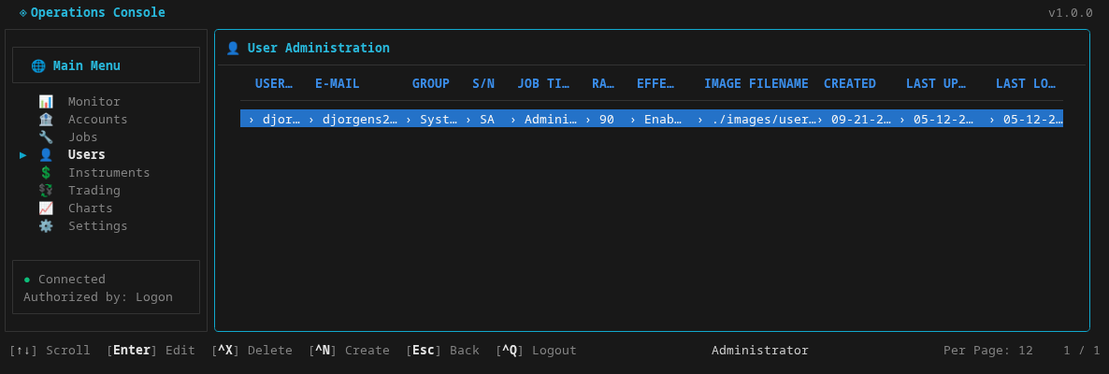
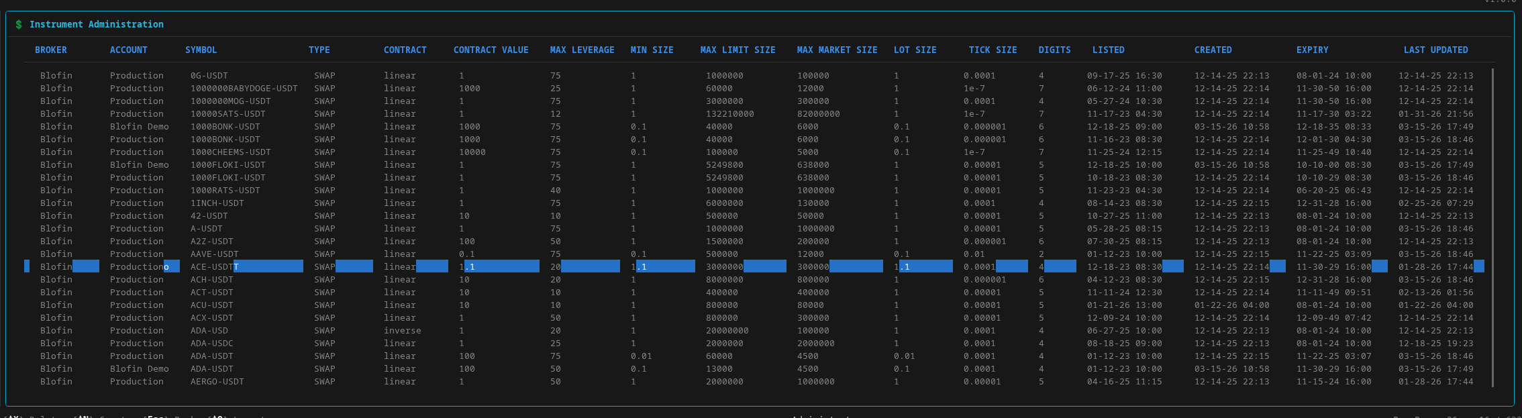
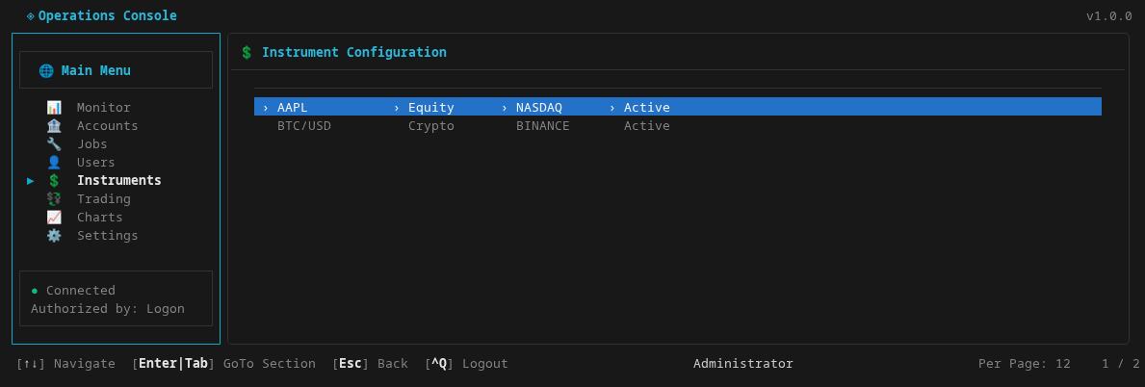
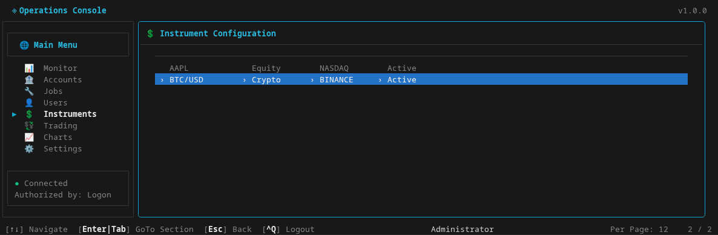
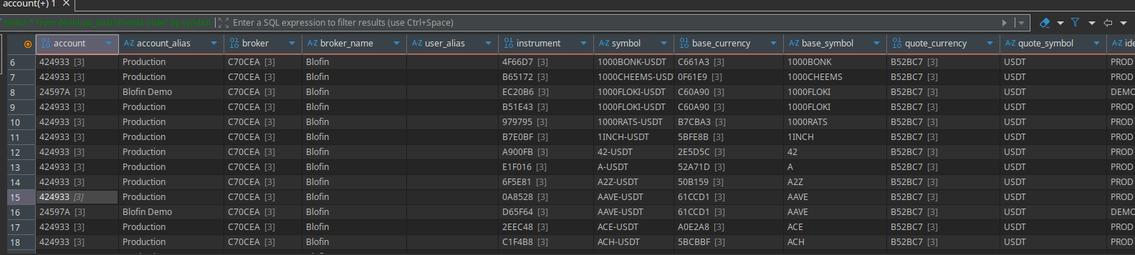
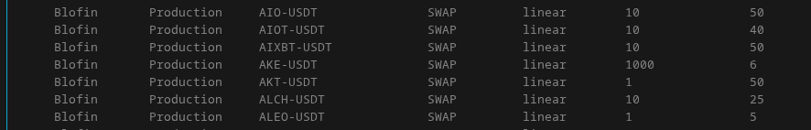
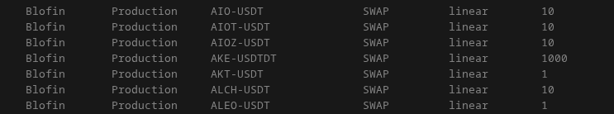

Slide 13
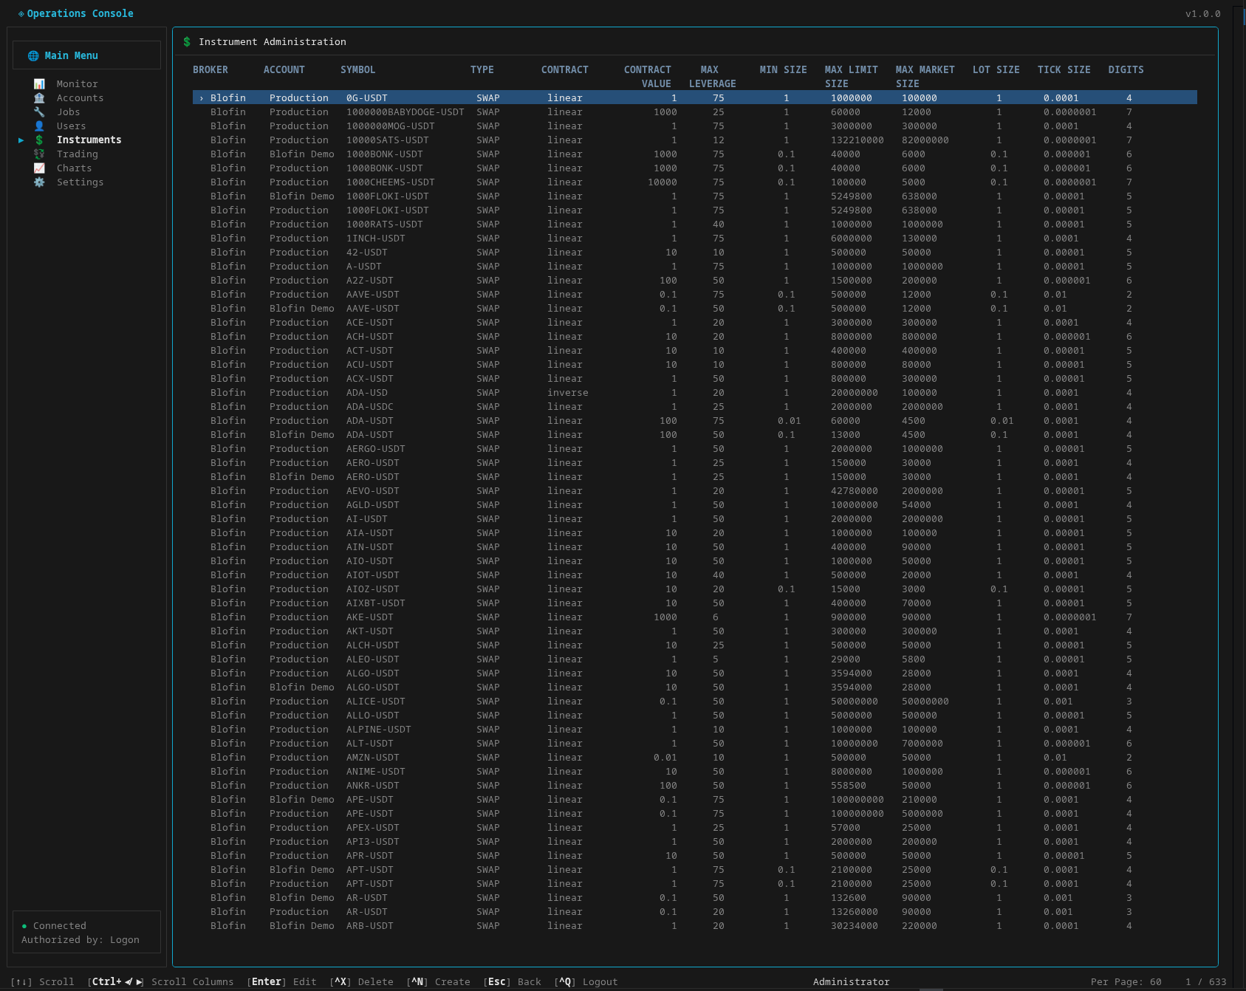
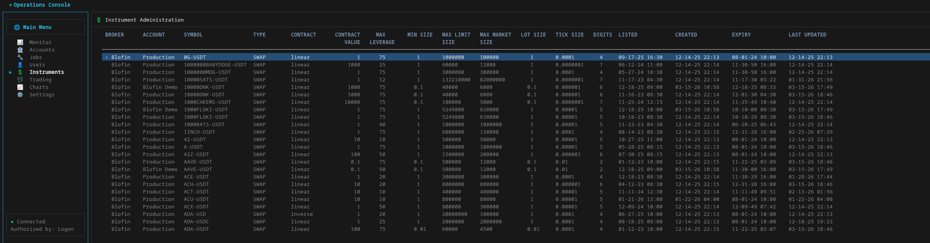
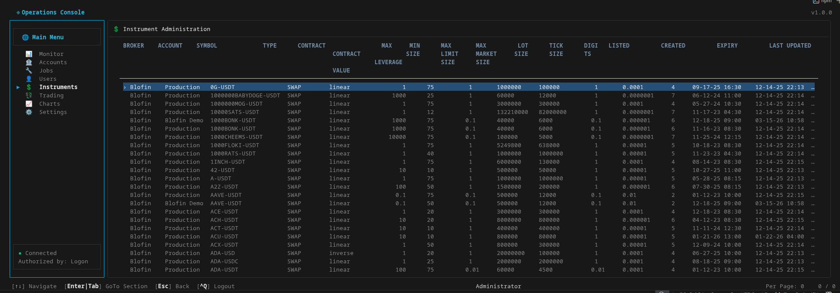
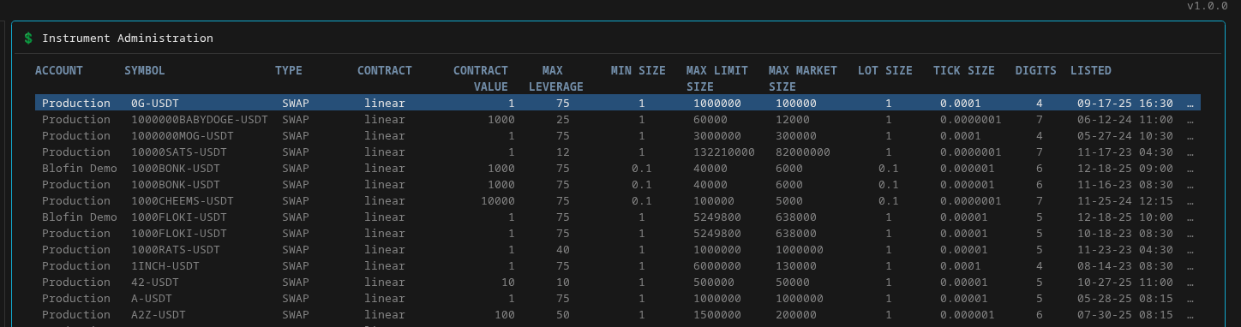
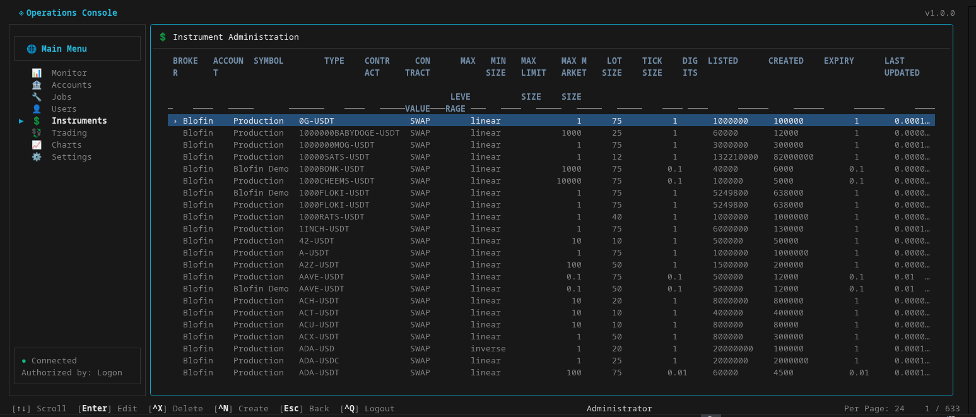
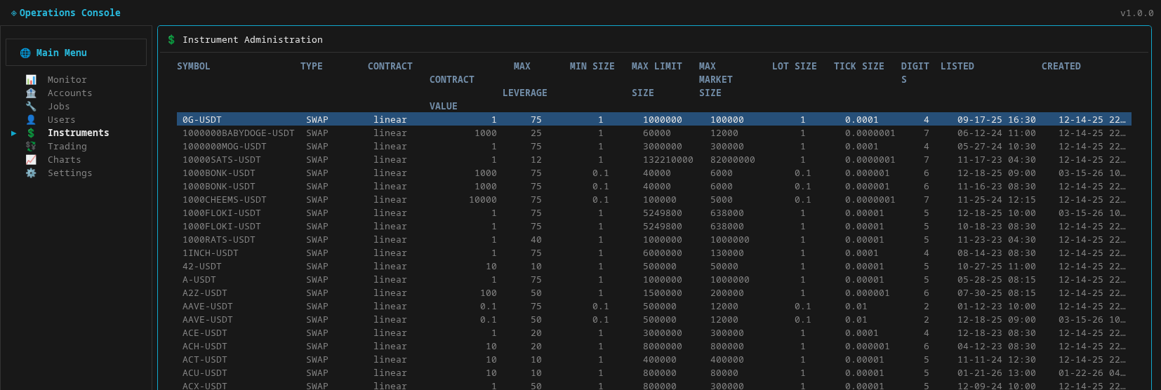
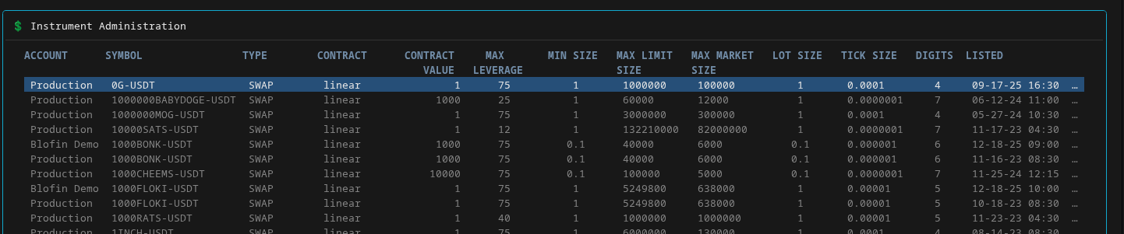
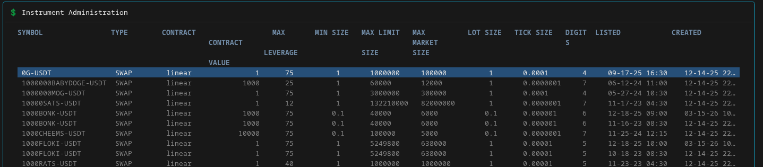

Slide 14
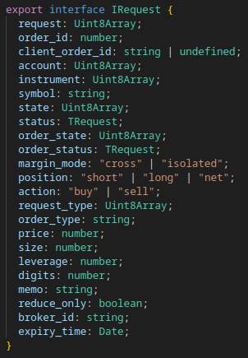
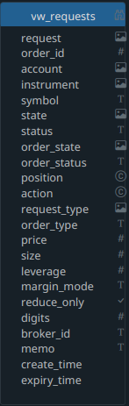
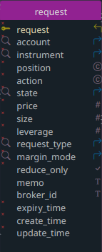
App Startup & Authentication 03/08/2026
_{submit}
Submit
Format Request
request id?
n
auto?
y
Insert
Fetch
pending
y
pending?
Update
n
request
Fetch
y
exists?
n
insert
request
> max
create?
y
queued
request
> max
create?
y
y
update
cancel
array
Cancel
pending
Cancels

Slide 15
App Request Submit Flow
08/13/2025
_{submit}
Submit
Format Request
request id?
n
auto?
y
Insert
Fetch
pending
y
pending?
Update
n
request
Fetch
y
exists?
n
insert
request
> max
create?
y
queued
request
> max
create?
y
y
update
cancel
array
Cancel
pending
Cancels

Slide 16




API/WSS Positions Flow
06/05/2025
wss message array
Websocket
Publish
Message
Publish
update
REST API
api positions array
Import
Publish
Fetch Active
active
Publish
Published
active
open
Fetch
Compare
_{position}
open
y
active?
closed
n

Slide 17




API Instrument Positions Flow
011/20/2025
_{import}
REST API
Fetch by Account
instruments
Import
Fetch Active
all
active?
Publish
active
open
y
Publish
REST API
closed
n
leverages
Import
Fetch Active
active

Slide 18




API/WSS Stops Submit Flow
08/02/2025
S
Websocket
Timer
valid position?
app
Submit
REST API
Fetch
Import
Fetch Active
y
Format
auto?
n
y
Error
n
position open?
S
Log
_{RTS}
y
S
y
tpsl open?
n
tpsl exists?
n
publish
y
_{RTS}

Slide 19

Trades
Trades Flow
08/03/2025
API Imports
_{orders}
_{positions}
_{stops}
S
Orders
valid position?
app
Submit
REST API
Rejected
Fetch
Import
Pending
Fetch Active
Canceled
Format
Hold
y
Queued
auto?
Stops
n
Rejected
y
Pending
Canceled
Hold
Error
position open?
S
Queued
Log
n
_{RTS}
y
S
y
tpsl open?
n
tpsl exists?
n
publish
y
_{RTS}

Slide 21
App Thread Flow
06/05/2025
API/WSS
CProcess
App
CMain
CProcess
CProcess
?
CProcess
Order API
Update

Slide 22
Internal IPC Flow 06/05/2025
Start
App
CMain
ipc
CProcess
Initialize
init
ipc
init
WebSocket
api
init
ipc
init
init
ipc
init
update
api
ipc
api
API
Load Candles
api
ipc
api
wait
update
ipc
update
Update
Update
Fractal
Orders
update
ipc
update
Ready

Slide 23
S
API/WSS Request Flow
06/05/2025
_{Submit}
R
Interface
_{app}
Submit
success?
REST API
y
Submit
Found?
n
queued
pending
Publish
y
F
Fulfilled
rejected
n
C
Newer?
y
Pending?
y
Hold
success?
REST API
y
Submit
n
Publish
closed
Publish
Websocket
C
Expired
canceled
n
Message
wss
y
C
Publish
_{Trades}
Expiry?
Fetch
y
De-Duplicate:keep latest
partial
cancel?
y
Update
y
Order Found?
Instrument
Position?
REST API
Insert
n
Import
live
partial
fill?
Expiry?
n
R
Fetch Active
y
canceled?
y
Queued?
y
Publish
Format Order
live?
failed?
canceled?
client
1
Publish Order
order
2
Fetch Request
REST API
n
Canceled?
C
Request
Found?
Import
filled?
Rejected?
Hold?
Insert
n
Fetch
history
F
y
y
2
_{orders}
Expire
y
y
1
Pending?
API/WSS
Pending?
History?
_{orders}
Update
n
y
Process
orders
Fetch
Hold
Hold
n
Queued
n
Rejected
API/WSS
Pending?
Auto?
Newer?
Canceled
y
y
Pending

Slide 24
S
_{Submit}
P
API Stops Flow
06/05/2025
_{app}
Interface
REST API
Submit
success?
Place Order
_{Trades}
Found?
n
queued
pending
y
Set State
rejected
n
C
REST API
y
n
Publish
Import
Newer?
success?
REST API
Fetch Active
live
y
Pending?
y
Hold
y
Cancel Order
closed
Set State
canceled
n
Publish
api stops array
Fetch
De-Duplicate (latest)
REST API
Instrument
Position?
Import
history
Update
y
Fetch History
Insert
n
Order Found?
y
_{stops}
Publish
Format Order
client
1
Publish Order
tpsl
2
Fetch Request
Insert
n
Request
Found?
n
Insert
Expire
y
y
Update
Update
n
API
Pending?
y
History?
y
Hold
n
n
n
API
Pending?
y
Auto?
y
Newer?
y
Auto?

Slide 25
Publish
orders
Fetch
position
Fetch
orders
Process
Compare
Fetch
position
Fetch
instrument
position?
Process
Rejected?
y
position
open?
y
queued
y
S
Order?
n
n
closed
n
Canceled?
y
C
y
n
Pending?
position
open?
y
request?
y
pending
S
publish
y
n
n
expired
Hold?
y
position
open?
y
C
closed?
y
queued
S
n
n
expired
Queued?
y
position
open?
n
request
open?
y
y
queued
S
y
P
n
expired

Slide 26






Slide 27




4. Configure Job options:
Production BloFin Hedged XRP-USDT
Long (Buyer):
Short (Seller):
[Tab] Next | [Shift-Tab] Previous | [^S] Save | [Esc] Cancel
[ ] Same settings as Buyer
**** Job Menu ****
add rempve delete view start/stop

Slide 28
App Startup & Authentication 03/08/2026
_{submit}
Submit
Format Request
request id?
n
auto?
y
Insert
Fetch
pending
y
pending?
Update
n
request
Fetch
y
exists?
n
insert
request
> max
create?
y
queued
request
> max
create?
y
y
update
cancel
array
Cancel
pending
Cancels

Slide 29
App Request Submit Flow
08/13/2025
_{submit}
Submit
Format Request
request id?
n
auto?
y
Insert
Fetch
pending
y
pending?
Update
n
request
Fetch
y
exists?
n
insert
request
> max
create?
y
queued
request
> max
create?
y
y
update
cancel
array
Cancel
pending
Cancels

Slide 30
API/WSS Positions Flow
06/05/2025
wss message array
Websocket
Publish
Message
Publish
update
REST API
api positions array
Import
Publish
Fetch Active
active
Publish
Published
active
open
Fetch
Compare
_{position}
open
y
active?
closed
n

Slide 31
API Instrument Positions Flow
011/20/2025
_{import}
REST API
Fetch by Account
instruments
Import
Fetch Active
all
active?
Publish
active
open
y
Publish
REST API
closed
n
leverages
Import
Fetch Active
active

Slide 32
API/WSS Stops Submit Flow
08/02/2025
S
Websocket
Timer
valid position?
app
Submit
REST API
Fetch
Import
Fetch Active
y
Format
auto?
n
y
Error
n
position open?
S
Log
_{RTS}
y
S
y
tpsl open?
n
tpsl exists?
n
publish
y
_{RTS}

Slide 33
Trades
Trades Flow
08/03/2025
API Imports
_{orders}
_{positions}
_{stops}
S
Orders
valid position?
app
Submit
REST API
Rejected
Fetch
Import
Pending
Fetch Active
Canceled
Format
Hold
y
Queued
auto?
Stops
n
Rejected
y
Pending
Canceled
Hold
Error
position open?
S
Queued
Log
n
_{RTS}
y
S
y
tpsl open?
n
tpsl exists?
n
publish
y
_{RTS}

