Slide 1




Main
Symbol
Algorithm
Account
Order
App
Algorithm
Symbol
API
Account
Order
Process
API
?
Algorithm
Symbol
Account
API
Order
API
Symbol
Algorithm
Account
Order

Slide 2
API
CProcess
App
CMain
CProcess
CProcess
?
CProcess
Orders
Update

Slide 3
Start
App
CMain
CProcess
ipc
Initialize
init
init
WebSocket
ipc
api
init
ipc
init
init
ipc
init
update
api
api
API
ipc
Load Candles
api
ipc
api
wait
update
update
Update
ipc
Fractal
Update
update
update
Orders
ipc
Ready

Slide 4



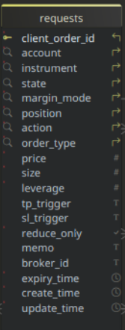


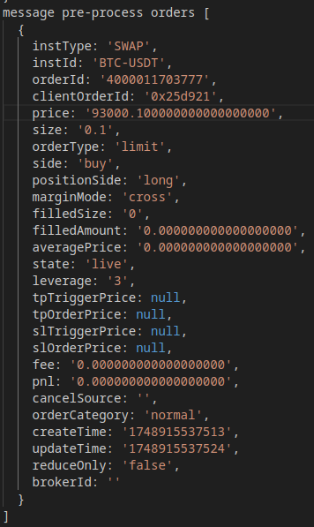
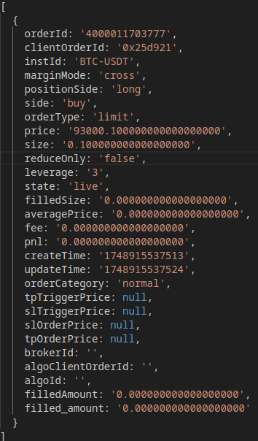
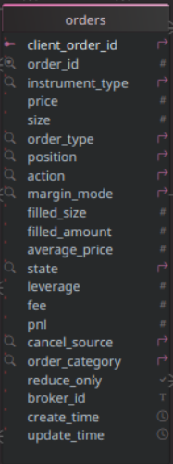
API/WSS Flow
06/05/2025
A
Requests
B
REST API
Submit
Place Order
Queued
setState
Pending
Canceled
success?
Rejected
pending
y
Closed
Fulfilled
Websocket
n
Message
y
rejected
Publish
req
Timer
n
y
y
partial
cancel?
y
Publish
orders
filled?
ord
Fetch
past
expiry?
Publish
REST API
partial
fill?
Fetch Active
Publish
canceled?
Queued?
B
client
order id?
live?
failed?
n
Untracked
Log Untracked
y
Cancel
A
Submit
instId
match?
Updated
n
Unknown
Fetch Open Requests
Log Error
Cancel
setState
y
Exists
Update

