Slide 1




Main
Symbol
Algorithm
Account
Order
App
Symbol
Algorithm
API
Account
Order
API
Process
?
Symbol
Algorithm
API
Account
Order
API
Symbol
Algorithm
Account
Order

Slide 2








API/WSS
CProcess
App
CMain
CProcess
CProcess
?
CProcess
Order API
Update
App Thread Flow
06/05/2025

Slide 3
Start
App
CMain
ipc
CProcess
Initialize
init
ipc
init
WebSocket
api
init
ipc
init
init
ipc
init
update
api
ipc
api
API
Load Candles
api
ipc
api
wait
update
ipc
update
Update
Update
Fractal
Orders
update
ipc
update
Ready
Internal IPC Flow 06/05/2025

Slide 4
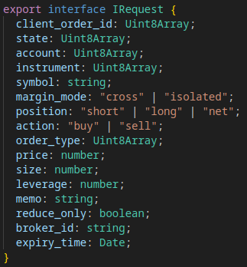
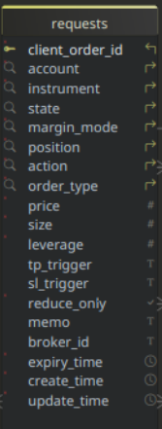
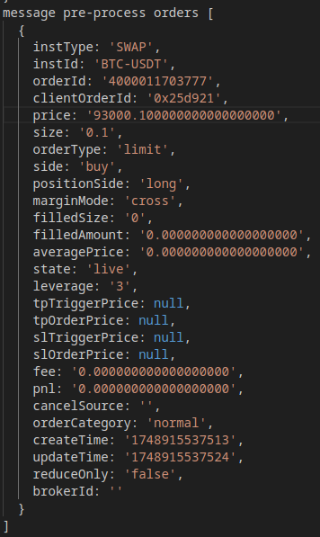
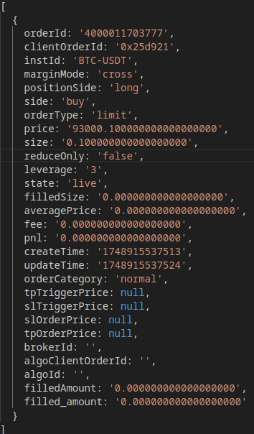
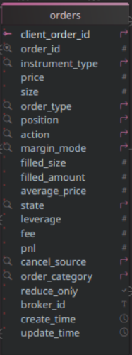
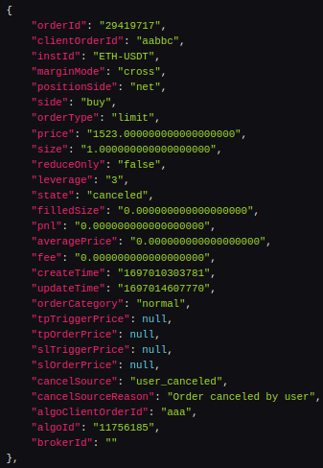
S
API/WSS Flow
06/05/2025
Application
S
success?
REST API
Submit
y
Place Order
pending
Set State
app request array
Submit
rejected
n
C
Queued
Pending
Canceled
REST API
C
F
Rejected
success?
Cancel Order
Fulfilled
closed
y
Set State
C
Closed
y
canceled
n
Websocket
Expiry?
S
Message
y
Timer
partial
cancel?
n
Publish
api/wss order array
y
requests
Fetch
REST API
partial
fill?
Expiry?
Publish
Import
api client
order id?
Fetch Active
canceled?
Queued?
n
Untracked
y
Log Untracked
Submit
S
live?
failed?
y
n
Canceled?
orders
y
symbol
match?
n
Unknown
filled?
Rejected?
history
Log Error
C
F
y
Cancel
Process
Fetch
requests
Pending?
Fetch
orders
REST API
Queued
Fetch History
Rejected
Publish
Canceled
Pending

Slide 5
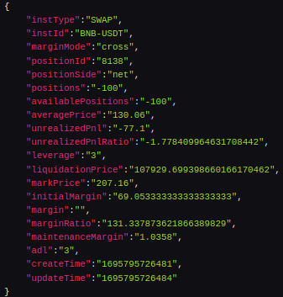
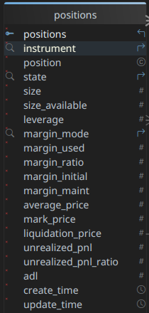
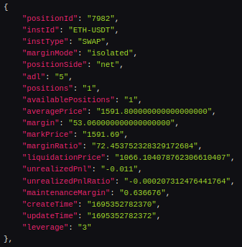
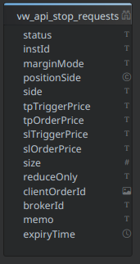
API/WSS Positions Flow
06/05/2025
Application
A
Publish
Fractal
Requests
Publish
Queued
Pending
Canceled
Rejected
Fulfilled
Closed
B
Websocket
Message
REST API
Timer
success?
Place Order
Publish
api/wss positions array
pending
y
Set State
open
Publish
REST API
rejected
n
C
Published
active
Import
open
Fetch
Fetch Active
Compare
success?
REST API
pending
y
Cancel Order
active?
Set State
closed
n
rejected
n

Slide 6
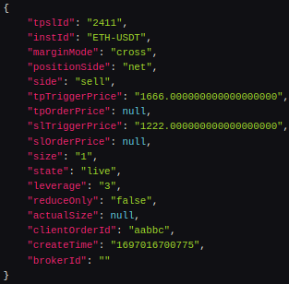
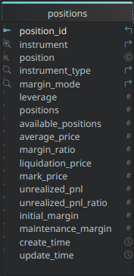
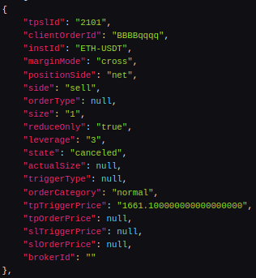
API/WSS Positions/Stops Flow
06/05/2025
Application
A
Publish
Fractal
Requests
Publish
Queued
Pending
Canceled
Rejected
Fulfilled
Closed
B
success?
REST API
y
Place Order
pending
Set State
rejected
n
C
success?
REST API
pending
y
Cancel Order
Set State
rejected
n
Websocket
api/wss positions array
Message
Publish
Timer
fulfilled
Publish
fulfilled
Published
active
Fetch
REST API
Compare
Import
active?
Fetch Active
closed*
n

Slide 7
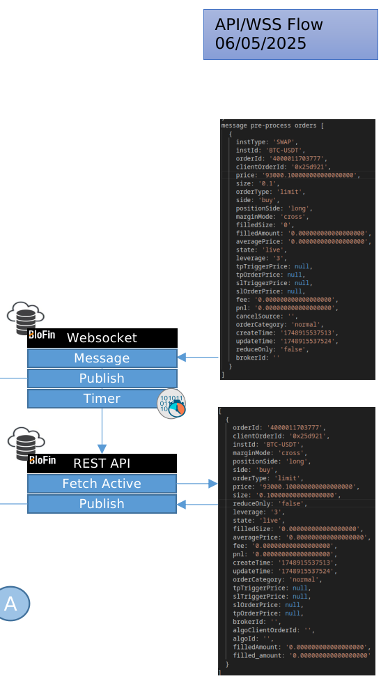
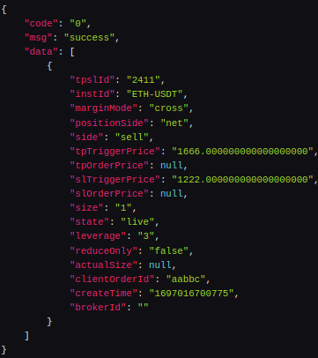
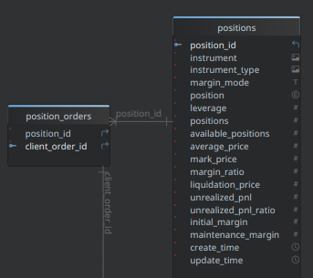
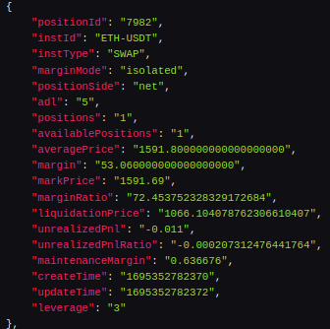
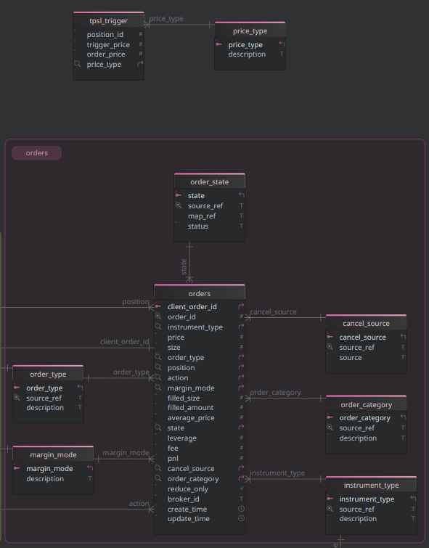
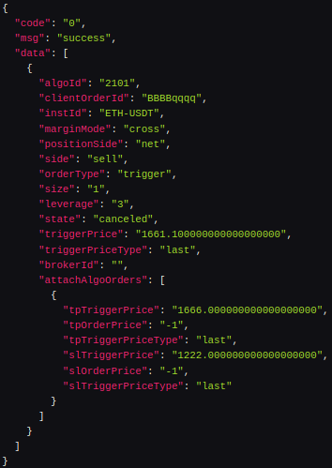

Slide 8
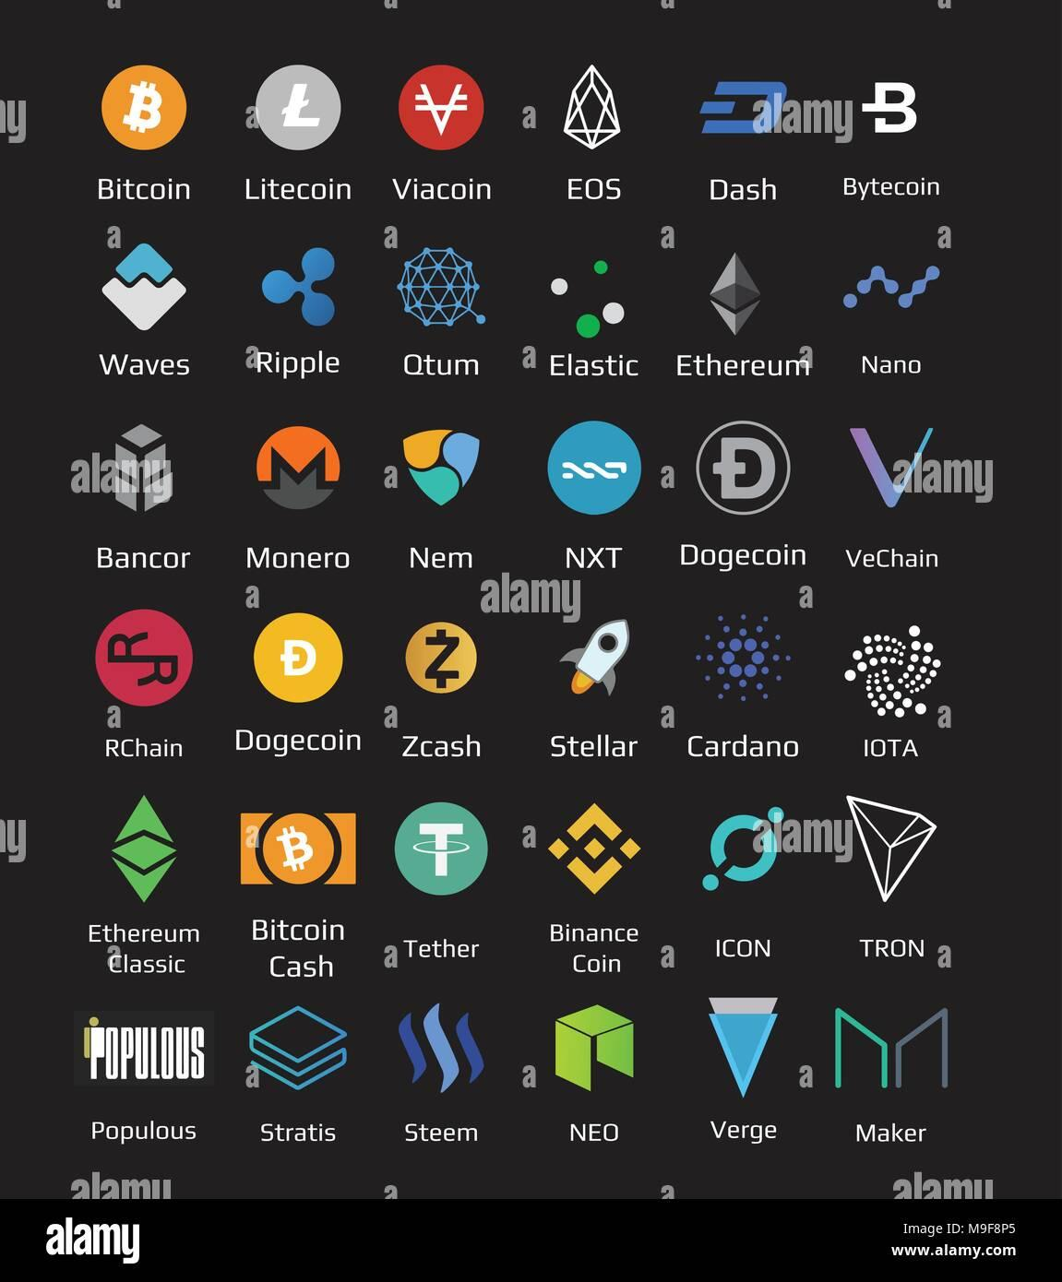
WSS
REST API

Slide 9
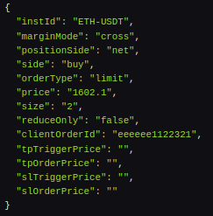
Place Order w/ TPSL
WSS
REST API

