Slide 1
INT 7213 Semester Project Data Warehouse design and ETL implementation Business Analytics and Intelligence
By
Disha Joshi

Slide 2
Project Objective and Proposal
The main focus of this project:
To design a data warehouse model for the business model described in this project.
Identify available open source database to use for the project.
Create a ETL plan to extract, load and transform this data from the database into data warehouse schema.
Finally load this sample data into the data warehouse schema and create some visualization dashboard to represent analytics.

Slide 3
Business background
The main business model I am targeting via this project is the manufacturing. Primarily in this manufacturing business the multiple entities of the business are tied in and interlinked i.e. starting from employee records to purchase orders and online transactions are very important for the success of the business.
Hence this project aims at designing a data warehouse model with the available database of all online transactions. Down the lane this will be used for various analytics activities to significantly improve any business related issues as well as understand market trend worldwide and how the business and transactions fluctuate as a function different entities.

Slide 4
Database description
In this project I plan to use the online open source AdventureWorks Database available from Microsoft.
Database: https://github.com/Microsoft/sql-server-samples/releases/tag/adventureworks

Slide 5
Analytical Theme
For the defined business model and the specific problem I am addressing - I would like to define the specifics needed in terms of data from the available databases.
This specific information set will be used to design a data warehouse schema by defining dimensions and fact table.
Later in Mysql I would like to extract, load and transform the data from the online data sources and make a sample data warehouse schema.
This sample schema will be used to develop some visual analytics and hence will be presented in the final presentation and report.

Slide 6
Requirements from the Database
Needed data from the database would be of Customer related tables, Product tables, Sales Tables, Purchase, vendor, and store tables.
This information will be extracted, filtered and loaded into schema and used for visualization.
The research and analytics process down the lane can use the data to understand business trends and possibly correlate different factors contributing towards sales

Slide 7
Dimensional Modelling
Dimensions and Facts chosen from the AdventureWorks 2017 Database for our Data Warehousing Project proposal:
FactInternetSales
FactInternetSalesReason
DimCustomer
DimGeography
DimSalesTerritory
DimProductCategory
DimProductSubCategory
DimProduct
DimCurrency
DimDate
DimPromotion

Slide 8
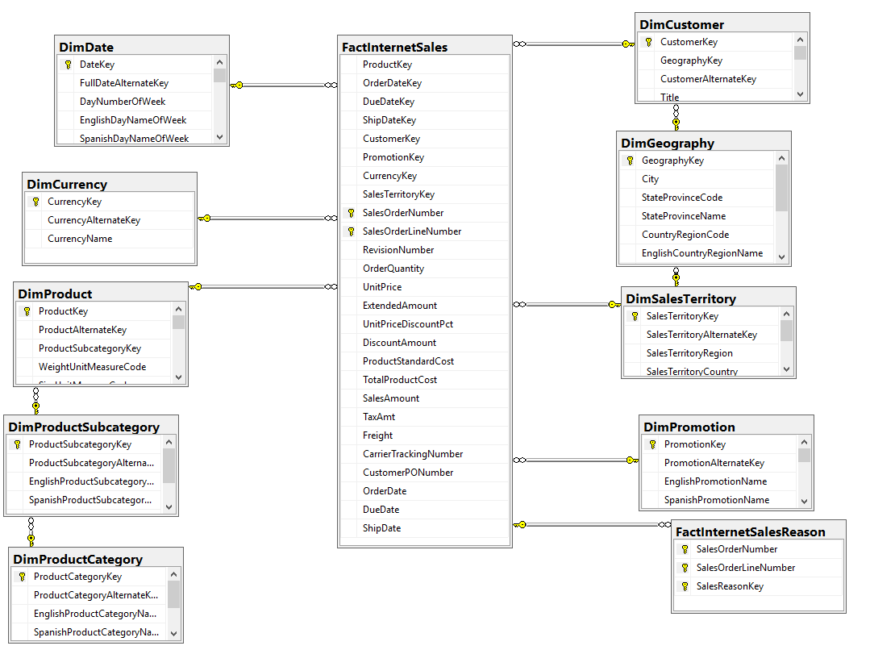
Dimensional Model

Slide 9
ETL Plan
This part of the project is mainly about creating a ETL plan to extract and load data from the source database into the data warehouse
The data from the source is imported and final pushes are made to the data warehouse.
First an Integration Services Project is initiated.
The process was all executed using the SSIS tools with visual studio 2017.

Slide 10
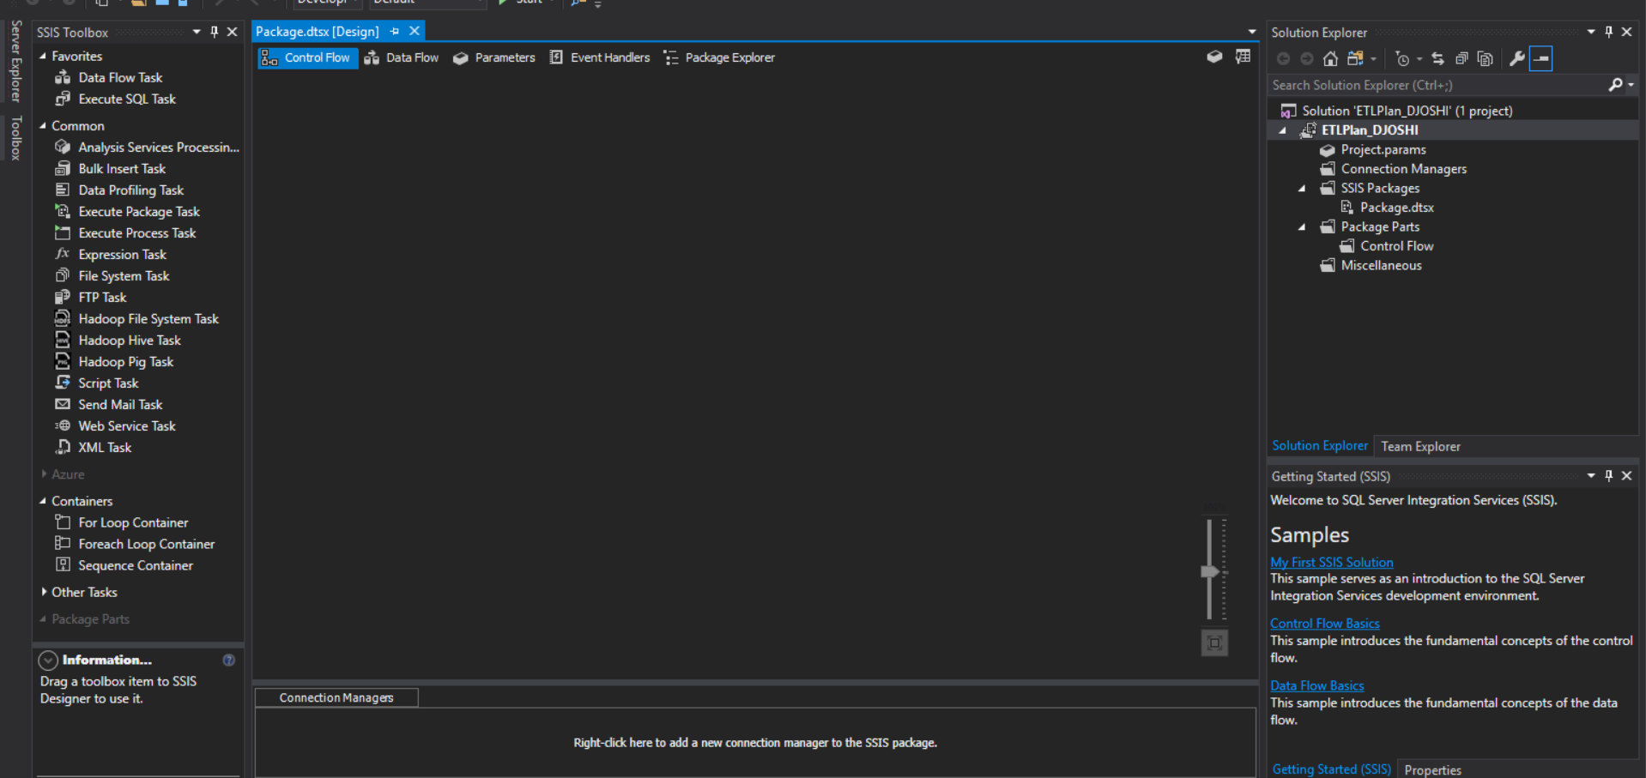
ETL Plan

Slide 11
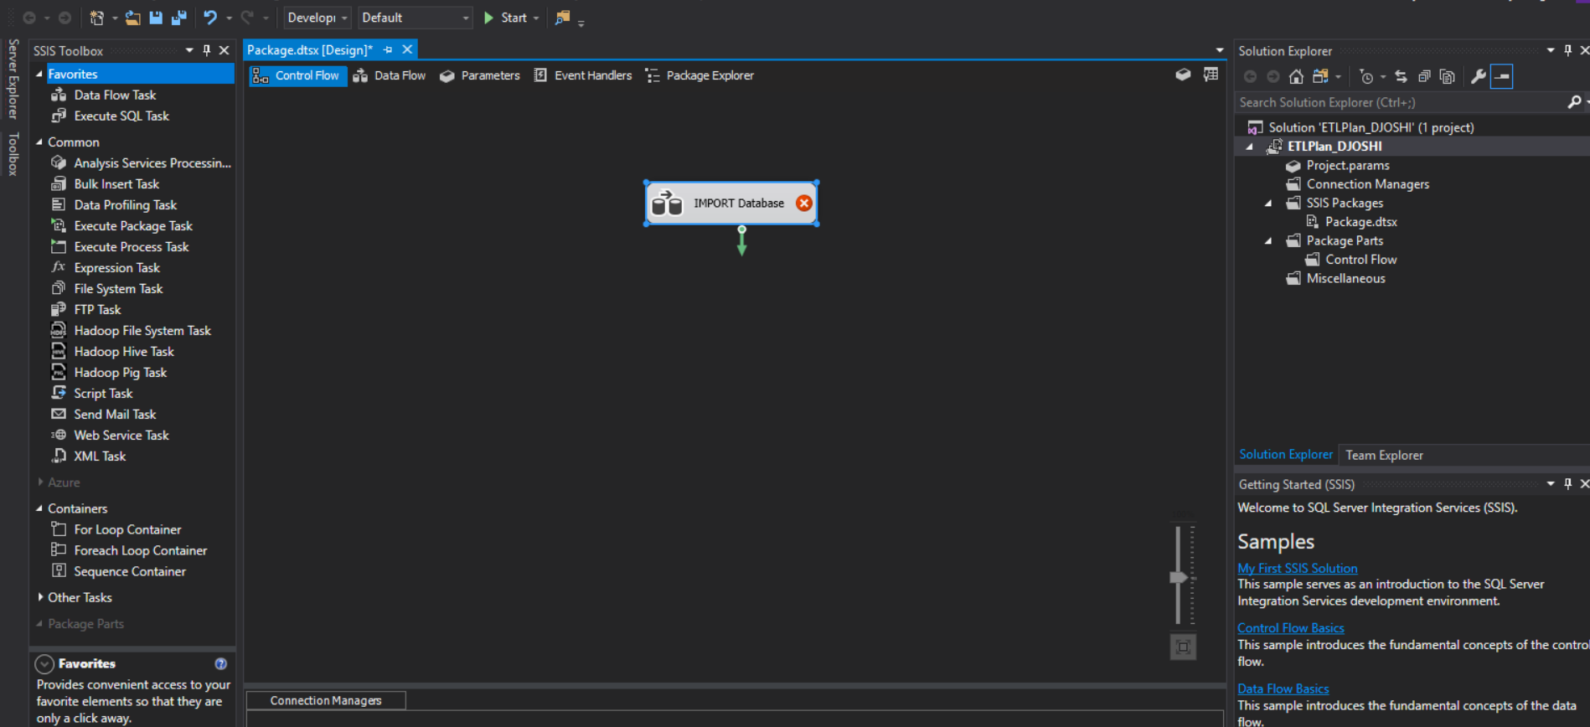
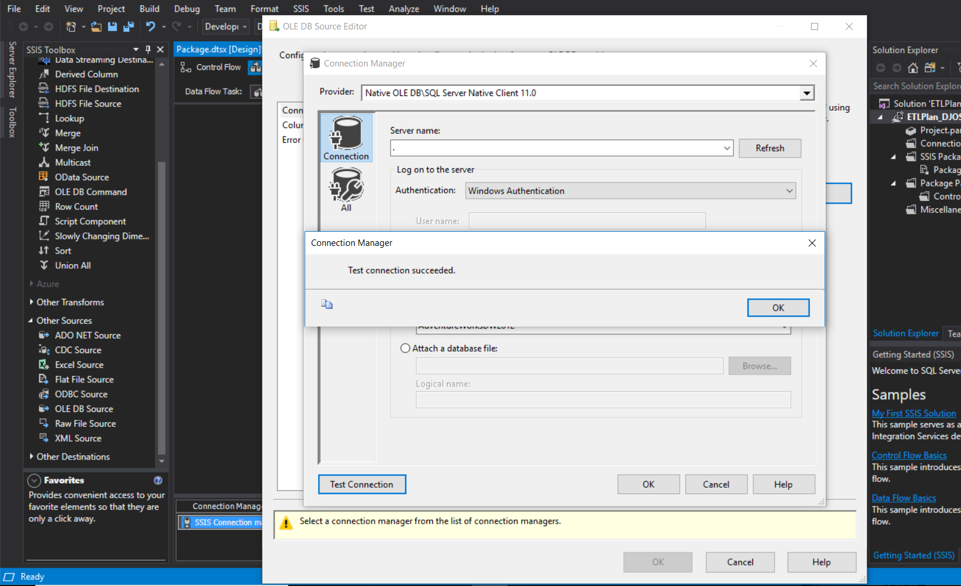
ETL Plan
Control flow tasks are created:

Slide 12
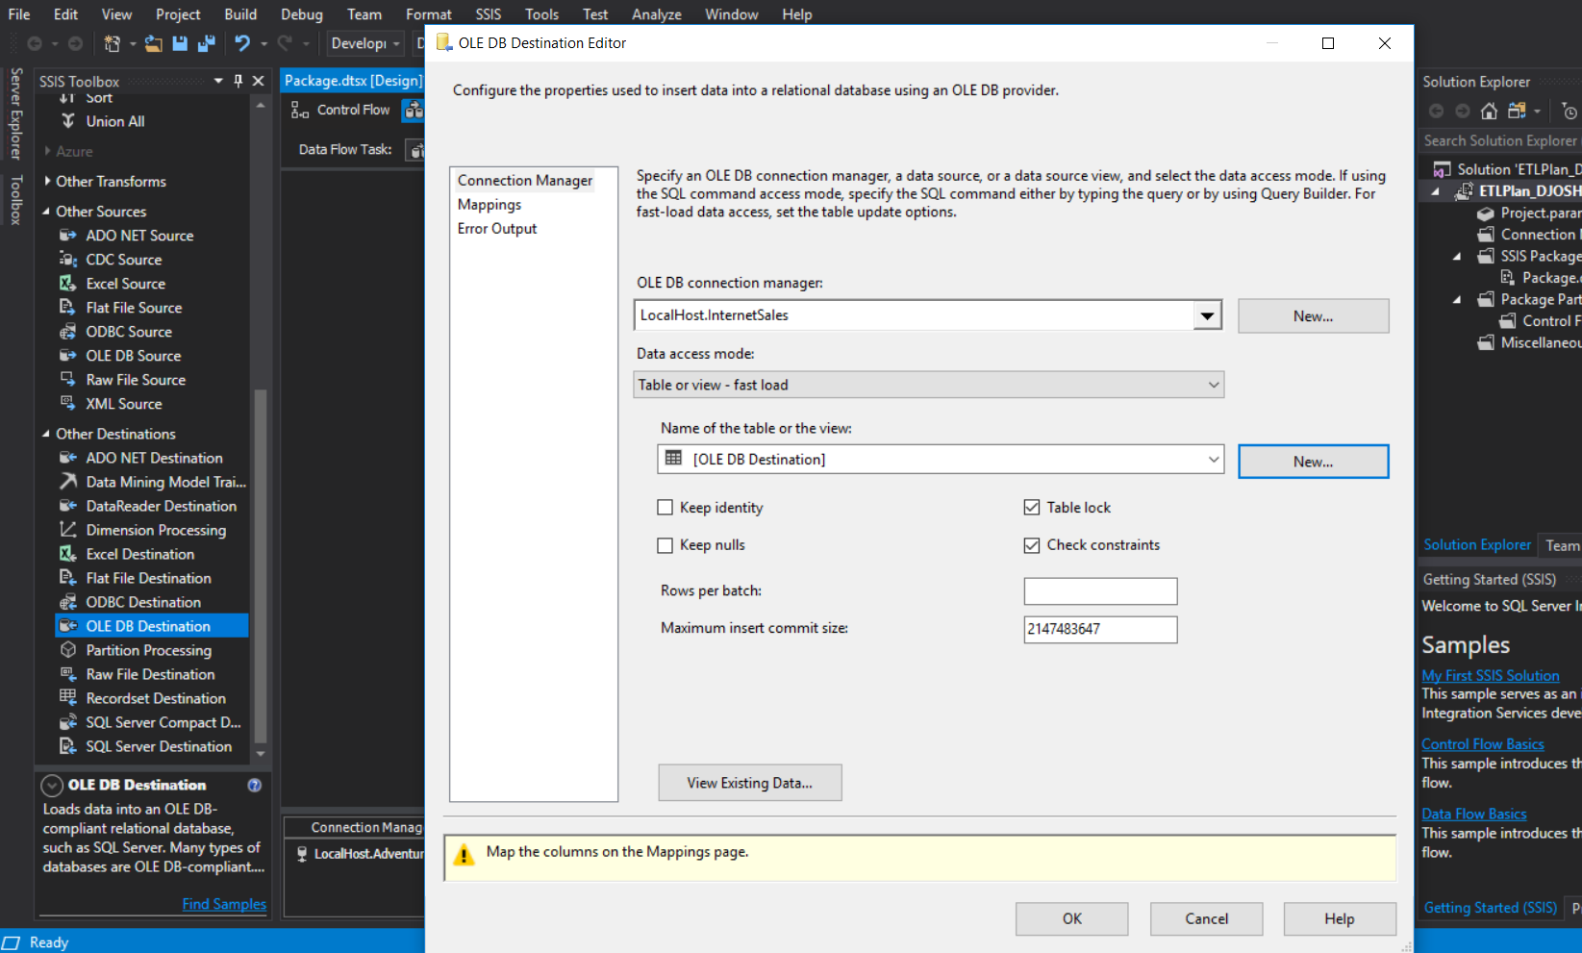
ETL Plan
Destination table and the SQL query along with the table name updated for Internet Sales Data

Slide 13
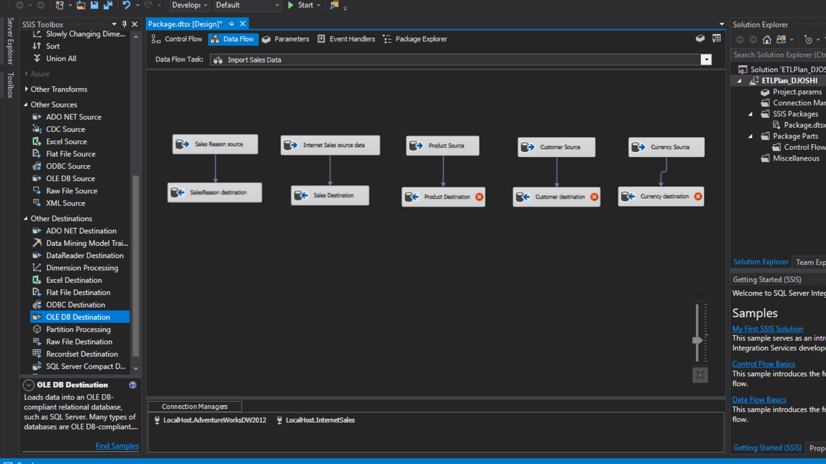
ETL Plan

Slide 14
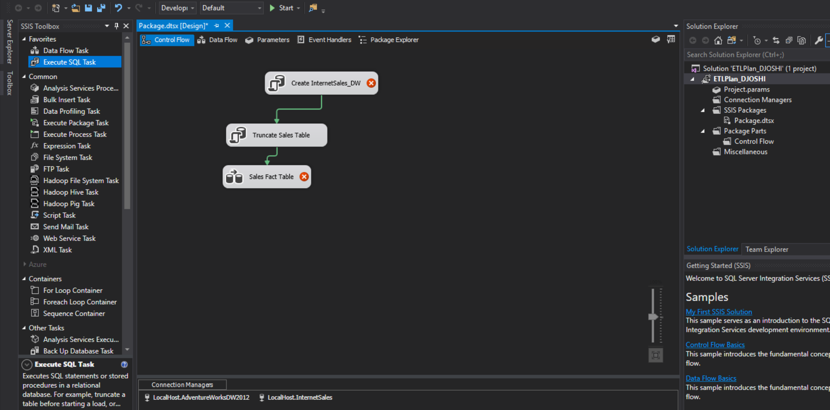
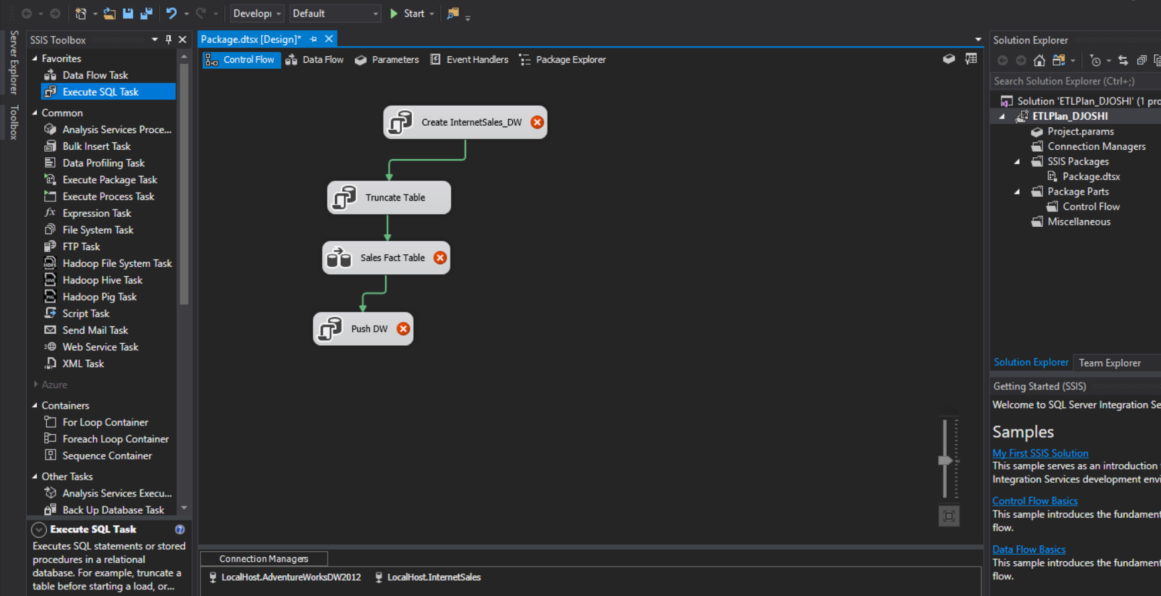
ETL Plan
Execute SQL queries added to control flow/

Slide 15
Conclusions
All the objectives of the data warehouse modelling project were met.
Successfully implemented ETL plan by extracting the required tables from the database and executing transform and loading steps to the new data warehouse
The hence transformed data can be easily visualized for further analytics in any database visualization tools or even Excel integrated with SQL.

