Slide 1
Collections

Slide 2
http://javaconceptoftheday.com/java-arraylist-programming-examples/
http://www.beginwithjava.com/java/arrays-arraylist/questions.html
http://www.neiljohan.com/java/
http://www.java67.com/2015/06/20-java-arraylist-interview-questions.html

Slide 3
An array is an indexed collection of fixed number of homogeneous data elements.
The main advantage of arrays is we can represent any number of values by using single name.
Example: int[ ] x=new int[600]; By using x variable we can represent 600 values.By means of index we can differentiate values.
The main limitations of Object Arrays are
Arrays are fixed in size i.e based on our requirements we can’t increase or we can’t decrease the size.hence with respect to memory arrays shows worst performance
Arrays can hold only homogeneous data elements.

Slide 4
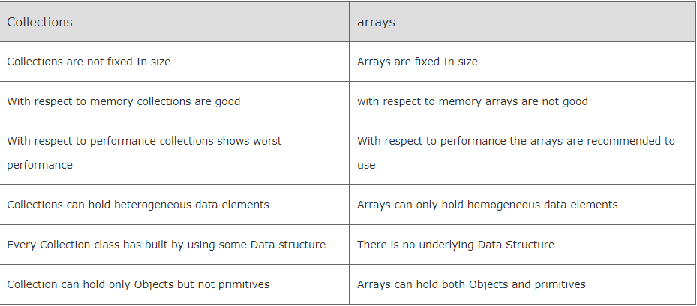

Slide 5
The Collection interface contains methods that perform basic operations, such as int size(), boolean isEmpty(), boolean contains(Object element), boolean add(E element), boolean remove(Object element), and Iterator<E> iterator().
It also contains methods that operate on entire collections, such as boolean containsAll(Collection<?> c), boolean addAll(Collection<? extends E> c), boolean removeAll(Collection<?> c), boolean retainAll(Collection<?> c), andvoid clear().
Additional methods for array operations (such as Object[] toArray() and <T> T[] toArray(T[] a) exist as well.
In JDK 8 and later, the Collection interface also exposes methods Stream<E> stream() and Stream<E> parallelStream(), for obtaining sequential or parallel streams from the underlying collection. (See the lesson entitled Aggregate Operations for more information about using streams.)

Slide 6
Primitive data types cannot be stored in ArrayList but can be in Array. ArrayList is a kind of List and List implements Collection interface. Collection container expects only Objects data type and all the operations done in Collections, like itterations, can be performed only on Objects and not Primitive data type. Primitive data can be stored in Collection only after wrapping them into their corresponding Wrapper classes eg: int to Integer and so on.

