Slide 1
Exception Handling

Slide 2
Topics
Meaning of Exception
Types of Exception: checked, unchecked and Error
Default Exception handling mechanism
Exception Hierarchy
Exception handling using try catch and throws
Understanding finally keyword
Customized exception using throw
Some common Exceptions

Slide 3
Exception Handling Introduction
Exception is an unwanted and unexpected event that disturbs normal flow of the program is called exception.
If we are not handling exception, the program may terminate abnormally without releasing allocated resources. This is not a graceful termination. It is a good programming practice to handle exceptions for graceful termination of the program.
Exception handling doesn’t mean repairing an exception just we have to provide alternative path to continue the program normally.

Slide 4
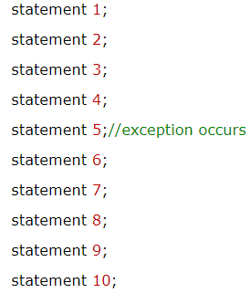
Advantage of Exception Handling
The core advantage of exception handling is to maintain the normal flow of the application. Exception normally disrupts the normal flow of the application that is why we use exception handling. Let's take a scenario:
Suppose there is 10 statements in your program and there occurs an exception at statement 5, rest of the code will not be executed i.e. statement 6 to 10 will not run. If we perform exception handling, rest of the statement will be executed. That is why we use exception handling in java.

Slide 5
Types of Exception
There are mainly two types of exceptions: checked and unchecked where error is considered as unchecked exception. The sun microsystem says there are three types of exceptions:
Checked Exception
Unchecked Exception
Error

Slide 6
Default Exception Handling
When ever an exception raised by the method ,then that method is responsible for the preparation of exception object by including the following information.
Name of Exception.
Description.
Location of Exception.
After preparation of Exception Object, The method handovers that object to the JVM.
JVM will check for Exception handling code in that method, if the method doesn’t contain any exception handling code then JVM terminates that method abnormally and removes corresponding entry from the stack.

Slide 7
Default Exception Handling
JVM will check for exception handling code in the caller, and if the caller method also doesn’t contain exception handling code then JVM terminates that caller method abnormally and removes corresponding entry from the stack.
This process will be continued until main method and if the main method also doesn’t contain any exception handling code then JVM terminates main method abnormally.
Just before terminating the program, JVM handovers the responsibilities of exception handling to the default exception handler.
Default exception handler prints the exception information to the console and terminates the program abnormally.

Slide 8
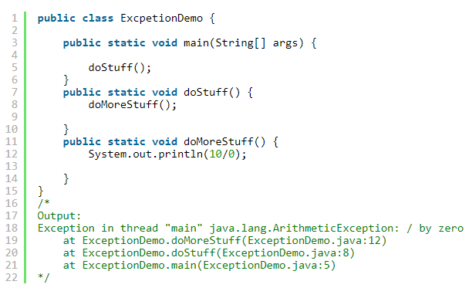
Example

Slide 9
Exception Hierarchy
The Java exception hierarchy starts from Throwable class i.e for all java Exceptions and Errors Throwable is parent class.
Throwable has 2 child classes:
Exception: Most of the times, Exceptions are caused by due to our program code only and these are recoverable.
Error: Most of the times errors are raised due to lack of system resources and Errors are non-recoverable. Ex. StackOverFlowError: It is the child class of Error and it is unchecked. Raised automatically by the JVM when ever we are performing recursive method invocation.

Slide 10
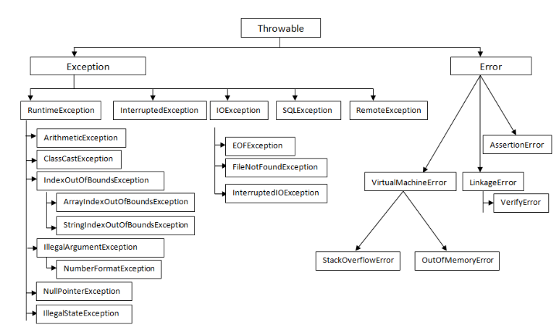

Slide 11
Checked Exceptions Vs Unchecked Exceptions
The Exceptions which are checked by the compiler for smooth execution of program are called checked exceptions. Example: FileNotFoundException, InterruptedException.
The Exceptions which are not checked by the compiler are called unchecked exceptions. Example: ArithmeticException, NullPointerException.
RuntimeException and it’s child classes, Error and it’s child classes are considered as unchecked exceptions and all the remaining considered as checked.

Slide 12
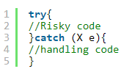
Exception Handling: using try, catch
We can handle the exceptions by using try catch.
We have to place the risky code inside the try block and the corresponding exception handling code inside catch block.

Slide 13
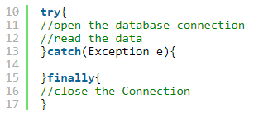
finally
It is not recommended to place cleanup code inside try statement because there is no guarantee for execution of all statements inside try block.
It is not recommended to maintain cleanup code in catch block because if there is no exception then catch blocks won’t be executed.
We required a block to maintain cleanup code which should execute always irrespective of whether the exception is raised or not , such block is nothing but “finally block“. Hence the main objective of finally block is to maintain cleanup code.

Slide 14
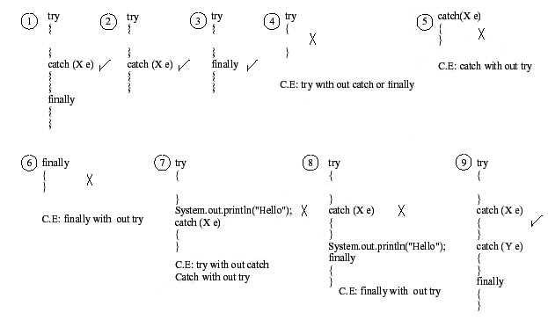
Possible combinations of try, catch, finally

Slide 15
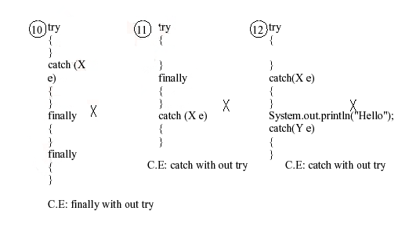
Possible combinations of try, catch, finally
Notes:
Rule: For each try block there can be zero or more catch blocks, but only one finally block.
Note: The finally block will not be executed if program exits(either by calling System.exit() or by causing a fatal error that causes the process to abort)

Slide 16
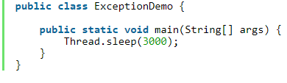
Exception handling using throws
If our code may be a chance of raising checked exception then compulsory we should handle that checked exception either by using try, catch or we have to delegate that responsibility to the caller using throws keyword other wise compile time error saying UnreportedException : XYZException must be caught or declared to be thrown.
Hence the main objective of throws keyword is to delegate the responsibilities of exception handling to the caller.
Ex1:
Unhandled exception type InterruptedException.
We can resolve this problem either by using try catch or by using throws keyword as follows

Slide 17
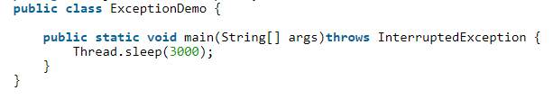
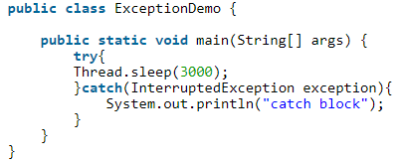
Exception handling
Exception handling using throws :
Exception handling
using try catch:

Slide 18
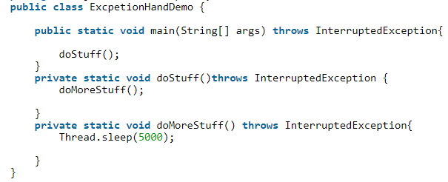
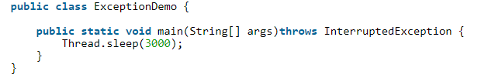
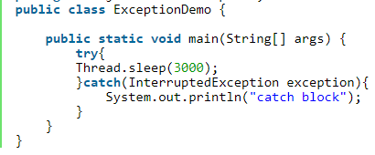
Exception handling using throws Ex2

Slide 19
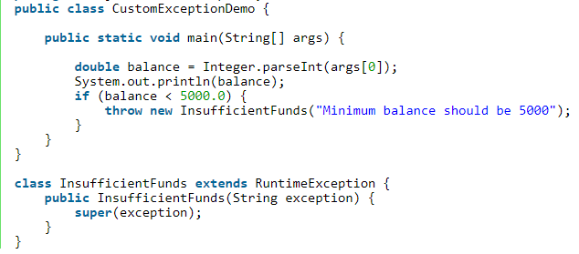
throw keyword
We can use throw keyword to handover our created exception object to the JVM explicitly.
Based on our programming requirement some times we have to create our own exception, which are nothing but “Customized Exception”.

Slide 20
Exceptions Example
1. NullPointerException: It is the direct child class of RuntimeException and it is unchecked. Thrown automatically by the JVM when ever we are performing any operation on null.
Example: String s = null System.out.println(s.length());// NullPointerException.
2. ArrayIndexOutOfBoundsException: It is the child class of RuntimeException and it is unchecked, thrown automatically by the JVM when ever we are accessing an array element with invalid index.(Out of range index)
Example: int [] a = {10, 20, 30}; System.out.println(a[0]); System.out.println(a[20]);// ArrayIndexOutOfBoundsException

Slide 21
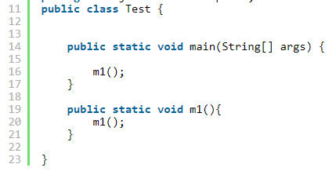
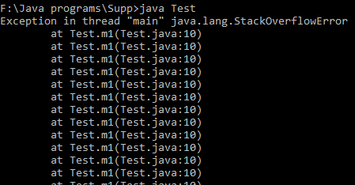
Exceptions Example
3. StackOverFlowError: It is the child class of Error and it is unchecked. Raised automatically by the JVM when ever we are performing recursive method invocation.

Slide 22
Exceptions Example
4. ClassNotFoundException: ClassNotFoundException is an exception that occurs when you try to load a class at run time using Class.forName() or loadClass() methods and mentioned classes are not found in the classpath.
It is a checked exception that occurs when you try to load a class at run time using Class.forName() or loadClass() methods and mentioned classes are not found in the classpath
class ExceptionEx3
{
public static void main(String[] args) throws ClassNotFoundException
{
Class.forName("Checked");
}
}

Slide 23
Exceptions Example
5. NoClassDefFoundError: It is an error that occurs when a particular class is present at compile time, but was missing at run time.
It is an error that is thrown when the Java Runtime System tries to load the definition of a class, and that class definition is no longer available. The required class definition was present at compile time, but it was missing at runtime.*/
class A
{
// some code
}
class B
{
public static void main(String[] args)
{
A a = new A();
}
}

Slide 24
Exceptions Example
6. ClassCastException: It is the child class of RuntimeException and it is unchecked. Thrown automatically by the JVM when ever we are trying to typecast parent class object to the child type. Ex:
class ExceptionEx1
{ public static void main(String[] args)
{
//typecast to parent object>> allowed
//typecast to child object>> allowed
//String s= new String("java");
//Object o= (Object)s;
Object o= new Object();
String s= (String)o;
}
}

Slide 25
7. IllegalArgumentException:
Child class of RuntimeException
Raised whenever a method is invoked with illegal argument
Ex: the valid range of thread priorities is 1 to 10. If we try to set the priority with any other value then we will get RuntimeException
class {
public static void main(String[] args)
{
Thread t= new Thread();
t.setPriority(7);
t.setPriority(11);
}
}

Slide 26
8. NumberFormatException:
Direct child class of IllegalArgumentException.
Raised when we try to convert String to number and the string is not properly formatted.

