Slide 1
Multithreading

Slide 2
Multitasking Introduction
The process of executing several tasks simultaneously is called ‘Multitasking‘. There are 2 types of multitasking.
Process based Multitasking.
Thread based Multitasking
a) Process based Multitasking
Executing several tasks simultaneously where each task is a separate independent process is called ‘Process based Multitasking‘. Example: While writing a java program in the editor, we can run MP3 player. At the same time we can download a file from the net. All these tasks are executing simultaneously and independent of each other. Hence it is process based Multitasking. Process based Multitasking is best suitable at operating system level.

Slide 3
Thread based Multitasking
b) Thread based Multitasking
Executing several tasks simultaneously where each task is a separate independent part of the same program is called ‘Thread based Multitasking‘
Whether it is Process based or Thread based the main objective of multitasking is to reduce response time and improve performance of the system.
The main application area of multithreading is video games implementation, Multimedia graphics etc.
we use multithreading than multiprocessing because threads share a common memory area. They don't allocate separate memory area so saves memory, and context-switching between the threads takes less time than process.

Slide 4
What is Thread in java
Thread are light weight process.
A thread belongs to java.lang package.
We can create multiple threads in java, even if we don’t create any Thread, one Thread at least do exist i.e. main thread.
Multiple threads run parallel in java.
Threads have their own stack.
Advantage of Thread : Suppose one thread needs 10 minutes to get certain task, 10 threads used at a time could complete that task in 1 minute, because threads can run parallel.

Slide 5
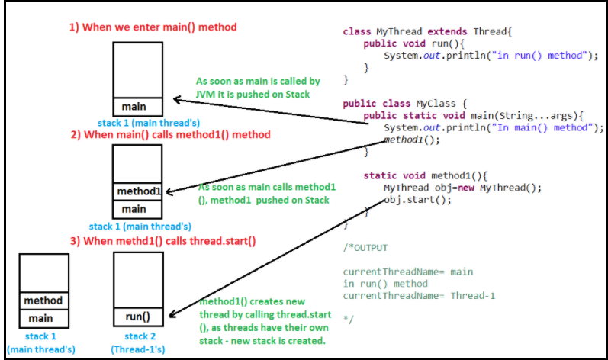

Slide 6
Defining, Instantiating & Starting a thread
We can define, instantiate and starting a thread by using the following 2 ways.
By extending Thread class.
By implementing Runnable interface.
By extending Thread Class
In the case of t.start() method, a new thread will be created and which is responsible for the execution of run method.
The start() method available in Thread class is responsible to register out thread with Thread Schedular. Hence without executing thread class start() method, there is no chance of starting the new thread.
If multiple threads are present, then which thread will get chance first for execution will be decided by “Thread Scheduler”.
The behavior of the Thread scheduler is vendor dependent and hence we can’t expect exact output for the above program.
Notes:
Note: It is not recommended to override start() method but highly recommended to override run() method.

Slide 7
By Implementing Runnable Interface
We can define a Thread by implementing Runnable interface also. Runnable interface available in java.lang package and contains only one method. i.e. public void run()
Thread Class vs Runnable Interface
If we extend the Thread class, our class cannot extend any other class because Java doesn’t support multiple inheritance. But, if we implement the Runnable interface, our class can still extend other base classes.
We can achieve basic functionality of a thread by extending Thread class because it provides some inbuilt methods like yield(), interrupt() etc. that are not available in Runnable interface.

Slide 8
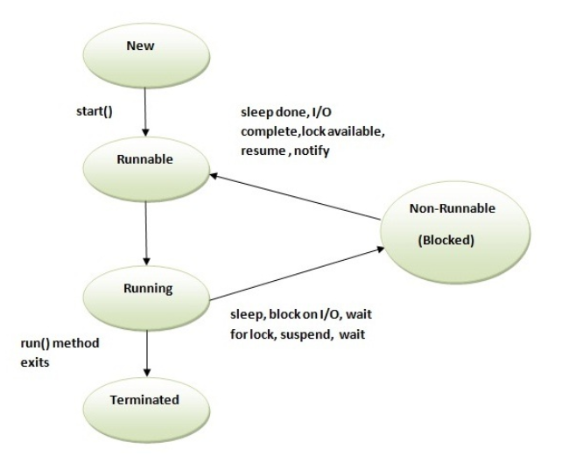
Life cycle of Thread

Slide 9
Preventing thread from execution
We can prevent a thread from execution by using the following methods.
yield()
join()
sleep()

Slide 10
yield() method
yield() method pauses the currently executing thread temporarily for giving a chance to the remaining waiting threads of the same priority to execute.
If there is no waiting thread or all waiting threads having low priority, then the same thread will get the chance immediately for the execution.
Syntax: public static native void yield();

Slide 11
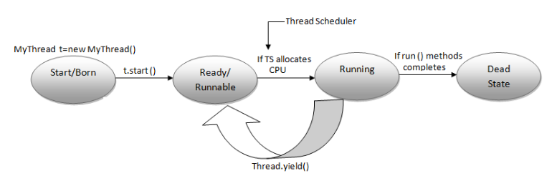
yield() method

Slide 12
yield() method Example
class Thread1 extends Thread {
public void run() {
for (int i = 1; i <= 5; i++)
{
System.out.println("Child thread");
}
}}
class YieldEx {
public static void main(String[] args) {
Thread1 t1 = new Thread1();
t1.start();
for (int i = 1; i <= 5; i++) {
System.out.println("Main thread");
Thread.yield(); }}
}
Notes:
n the above program, child thread will get chance more no of times for execution, Because main thread intentionally calling “yield()” method explicitly. As the yield method is native method, some Operating system may not provide the support for this.

Slide 13
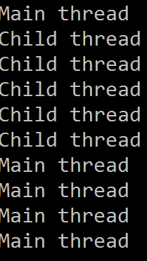
Output

Slide 14
join() method
If a thread wants to wait until some other thread completion then we should go for join method.
public final void join() throws InterruptedException
public final void join(long ms) throws InterruptedException
public final void join(long ms, int ns) throws InterruptedException

Slide 15
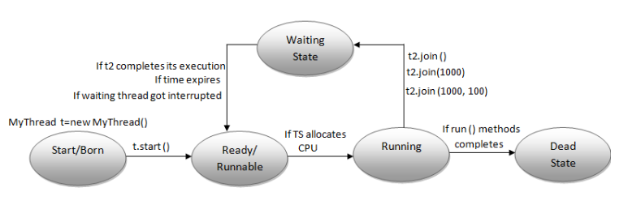
join() method

Slide 16
join() method Example
class Thread1 extends Thread {
public void run() {
for (int i = 1; i <= 5; i++)
{
System.out.println("Child thread"); } }}
class JoinEx {
public static void main(String[] args) throws InterruptedException {
Thread1 t1 = new Thread1();
t1.start();
t1.join();
for (int i = 1; i <= 5; i++) {
System.out.println("Main thread"); } }}
Notes:
If we are commenting line 1,then both threads will execute simultaneously and we can’t except exact output.
If we are not commenting line 1,then main thread will execute join() method on child thread object. Hence main thread will enter into the waiting state until child thread completion

Slide 17
Output
Child thread
Child thread
Child thread
Child thread
Child thread
Main thread
Main thread
Main thread
Main thread
Main thread

Slide 18
sleep() method
The sleep() method of Thread class is used to sleep a thread for the specified amount of time.
Syntax of sleep() method in java
public static void sleep(long ms)throws InterruptedException
public static void sleep(long ms, int ns)throws InterruptedException

Slide 19
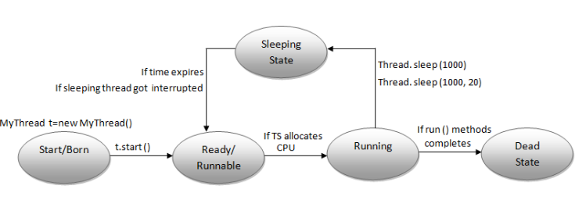
sleep() method

Slide 20
sleep() method Example
class Thread1 extends Thread {
public void run() {
for (int i = 1; i <= 5; i++)
{
System.out.println("Child thread");
}
}
}
class SleepEx {
public static void main(String[] args) {
Thread1 t1 = new Thread1();
t1.start();
for (int i = 1; i <= 5; i++) {
System.out.println("Main thread");
}
}
}

Slide 21
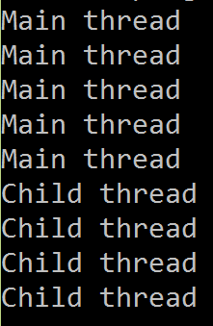
Output

Slide 22
Synchronization
‘synchronized’ is the keyword applicable for the methods and blocks.
We can’t apply this keyword for variables and classes.
If a method declared as synchronized, at a time, only one thread is allowed to execute that method on the given object.
The main advantage of synchronized keyword is, we can overcome data inconsistency problem.
There are two types of thread synchronization mutual exclusive and inter-thread communication.
1. Mutual Exclusive
Synchronized method.
Synchronized block.
static synchronization.
2. Cooperation (Inter-thread communication in java)
Notes:
Every object in java has a unique lock. When ever we are using synchronized keyword then object level lock concept will come into picture.
If a thread want to execute any synchronized method on the object first it should get the lock of that object.
Once a thread got the lock then it is allowed to execute any synchronized method on that object.

Slide 23
Synchronization
1. Mutual Exclusive
Mutual Exclusive helps keep threads from interfering with one another while sharing data. This can be done by three ways in java:
by synchronized method
by synchronized block
by static synchronization
Concept of Lock in Java
Synchronization is built around an internal entity known as the lock or monitor. Every object has an lock associated with it. By convention, a thread that needs consistent access to an object's fields has to acquire the object's lock before accessing them, and then release the lock when it's done with them.

Slide 25
Understanding the problem without Synchronization
In this example, there is no synchronization, so output is inconsistent. Let's see the example:
Class Table{
void printTable(int n){ //method not synchronized
for(int i=1;i<=5;i++){
System.out.println(n*i); } }
class MyThread1 extends Thread{
Table t;
MyThread1(Table t){
this.t=t;
}
public void run(){
t.printTable(5);
} }

Slide 26
Understanding the problem without Synchronization
class MyThread2 extends Thread{
Table t;
MyThread2(Table t){
this.t=t;
}
public void run(){
t.printTable(100);
}
}
Output:
5
100
10
200
15
300

Slide 27
Java synchronized method
If you declare any method as synchronized, it is known as synchronized method.
Synchronized method is used to lock an object for any shared resource.
When a thread invokes a synchronized method, it automatically acquires the lock for that object and releases it when the thread completes its task.
Example of java synchronized method :
Class Table{
Synchronized void printTable(int n){ //synchronized method
for(int i=1;i<=5;i++){
System.out.println(n*i); } }

Slide 28
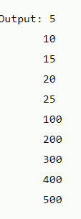
Java synchronized method
class MyThread1 extends Thread{
Table t;
MyThread1(Table t){
this.t=t;
}
public void run(){
t.printTable(5);
} }
class MyThread2 extends Thread{
Table t;
MyThread2(Table t){
this.t=t;
}
public void run(){
t.printTable(100); } }

Slide 29
Synchronized block in java
Synchronized block can be used to perform synchronization on any specific resource of the method.
Suppose you have 50 lines of code in your method, but you want to synchronize only 5 lines, you can use synchronized block.
If you put all the codes of the method in the synchronized block, it will work same as the synchronized method.
Syntax to use synchronized block
synchronized (object reference expression) {
//code block
}
Notes:
Race condition: if multiple threads are operating simultaneously on same data object then they may be a chance of data inconsistency problem. This is called race condition. We can overcome this problem by using synchronized keyword.

Slide 30
Program of synchronized block
class Table{
void printTable(int n){
synchronized(this){ //synchronized block
for(int i=1;i<=5;i++){
System.out.println(n*i);
}}}}
class MyThread1 extends Thread{
Table t;
MyThread1(Table t){
this.t=t;
}
public void run(){
t.printTable(5); }}}

Slide 31
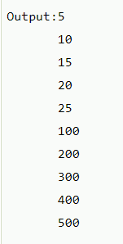
Program of synchronized block
class MyThread2 extends Thread{
Table t;
MyThread2(Table t){
this.t=t;
}
public void run(){
t.printTable(100);
}
}
public class TestSynchronizedBlock1{
public static void main(String args[]){
Table obj = new Table();//only one object
MyThread1 t1=new MyThread1(obj);
MyThread2 t2=new MyThread2(obj);
t1.start();
t2.start();
}

Slide 32
Inter Thread Communication
Inter-thread communication or Co-operation is all about allowing synchronized threads to communicate with each other.
Cooperation (Inter-thread communication) is a mechanism in which a thread is paused running in its critical section and another thread is allowed to enter (or lock) in the same critical section to be executed. It is implemented by following methods of Object class: wait(), notify(), notifyAll().

Slide 33
Inter Thread Communication
wait() method
It causes current thread to release the lock and wait until either another thread invokes the notify() method or the notifyAll() method for this object, or a specified amount of time has elapsed.
The current thread must own this object's monitor, so it must be called from the synchronized method only otherwise it will throw exception.
Method | Description
public final void wait()throws InterruptedException | waits until object is notified.
public final void wait(long timeout)throws InterruptedException | waits for the specified amount of time.

Slide 34
Inter Thread Communication
notify() method
Wakes up a single thread that is waiting on this object's monitor. If any threads are waiting on this object, one of them is chosen to be awakened. The choice is arbitrary and occurs at the discretion of the implementation. Syntax:
public final void notify()
notifyAll() method
Wakes up all threads that are waiting on this object's monitor. Syntax:
public final void notifyAll()

Slide 35
Important Points:
These methods are available in object class but not in thread class because threads can call these methods on any object.
We should call these methods only from synchronized area other wise we get runtime exception saying IllegalMonitorStateException.
If a thread executes wait() method it immediately releases the lock of that object(But not all locks) and entered into waiting state.
After giving the notification also the thread releases the lock but may not be immediately.

Slide 36
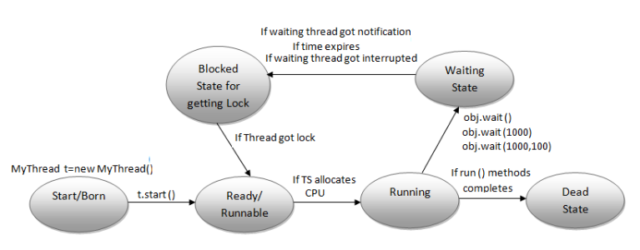
Inter Thread Communication

Slide 37
Inter Thread Communication
class ChildThread extends Thread {
int total = 0;
public void run() {
synchronized (this) {
System.out.println("Child thread calculating");
for (int i = 0; i <= 100; i++) {
total = total + i;
}
System.out.println("ChildThread giving notofication");
this.notify();
}
}
}

Slide 38
Inter Thread Communication Example
public class MainThread {
public static void main(String[] args)throws InterruptedException {
ChildThread thread=new ChildThread();
thread.start();
synchronized (thread) {
System.out.println("Main Thread calling Child thread");
thread.wait();
System.out.println("MainThread got notification");
System.out.println(thread.total);
}
}
}
Notes:
Output:
Main Thread calling Child thread
Child thread calculating
ChildThread giving notofication
MainThread got notification
5050

Slide 39
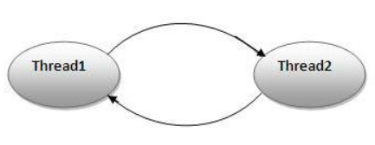
Deadlock in java
Deadlock in java
Deadlock in java is a part of multithreading. Deadlock can occur in a situation when a thread is waiting for an object lock, that is acquired by another thread and second thread is waiting for an object lock that is acquired by first thread. Since, both threads are waiting for each other to release the lock, the condition is called deadlock.

