Slide 1
Java package
A java package is a group of similar types of classes, interfaces and sub-packages.
Package in java can be categorized in two form, built-in package and user-defined package.
There are many built-in packages such as java, lang, awt, javax, swing, net, io, util, sql etc.
Package names are written in all lower case to avoid conflict with the names of classes or interfaces.

Slide 2
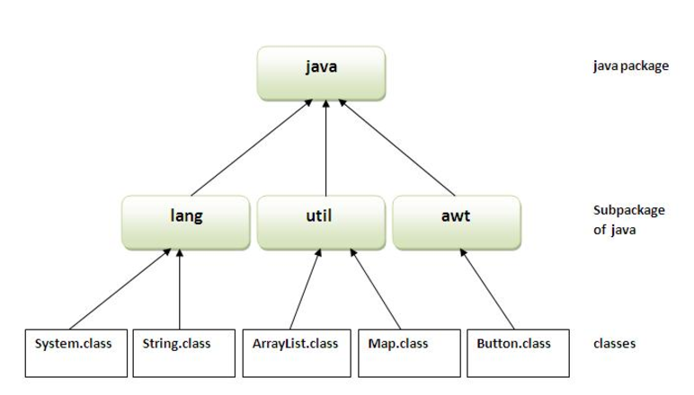
Contd..

Slide 3
Contd..
Advantage of Java Package
1) Modularity and maintainability is maintained.
2) Security: Java package provides access protection.
3) Java package removes naming collision.

Slide 4
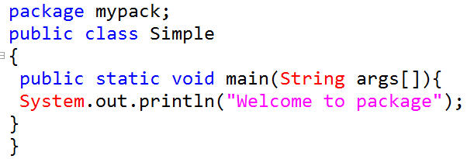

Java Package
The package keyword is used to create a package in java.
Compilation syntax :
javac -d directory javafilename

Slide 5

Contd.
How to run java package program?
We need to use fully qualified name e.g.

Slide 6
How to access package from another package?
There are three ways to access the package from outside the package.
import package.*;
import package.classname;
fully qualified name.
1. Using packagename.*
If you use package.* then all the classes and interfaces of this package will be accessible but not subpackages.
The import keyword is used to make the classes and interface of another package accessible to the current package.

Slide 7
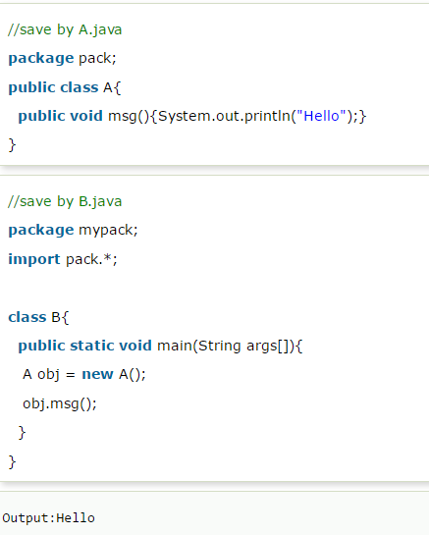
Contd.

Slide 8
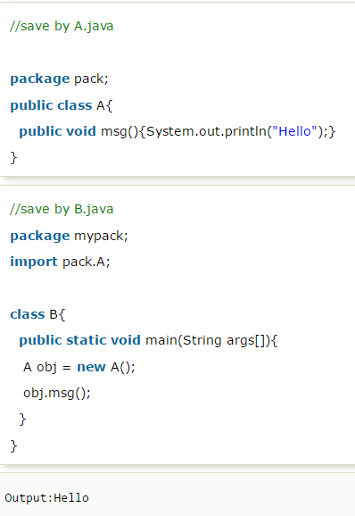
Example of package by import package.classname

Slide 9
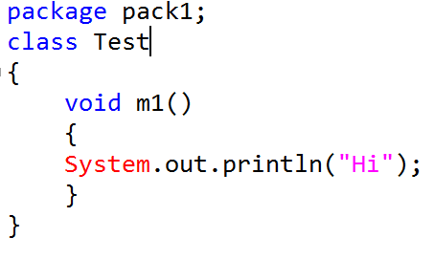
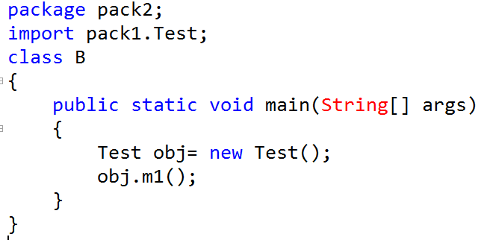
public modifier
Notes:
public applicable for: classes, methods, variables, enum, interface, constructors
error: Test is not public in pack1; cannot be accessed from outside package

Slide 10
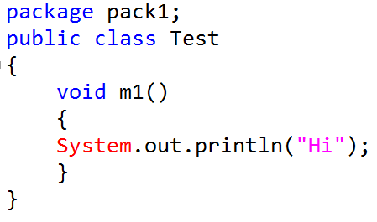
Contd..
Notes:
if a member is declared as public then we can access that member from anywhere, but corresponding class should be visible(public)
error: m1() is not public in Test; cannot be accessed from outside package
obj.m1();

Slide 11
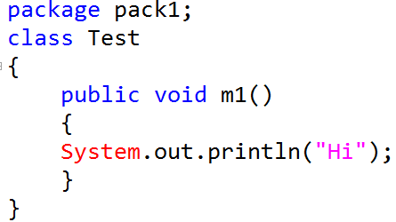
Contd..
Notes:
error: Test is not public in pack1; cannot be accessed from outside package
import pack1.Test;

Slide 12
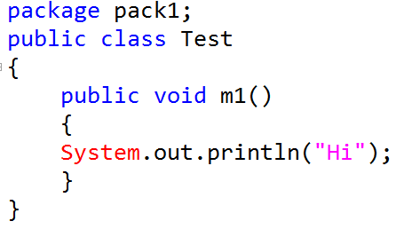
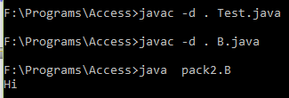
Contd..

Slide 13
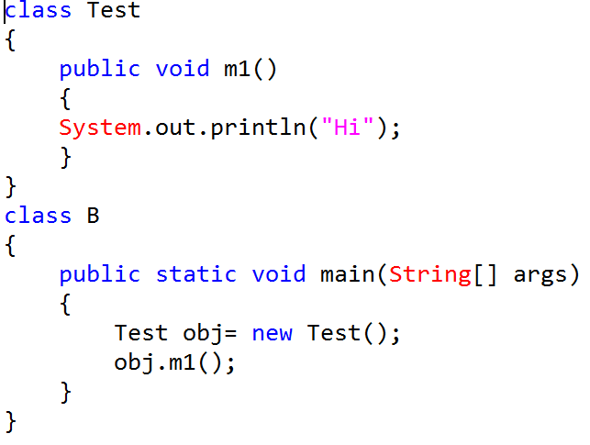
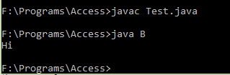
<default> modifier
Notes:
1. default applicable for: classes, methods, variables, enum, interface, constructors
2. If a class is declared as default then we can access that class within the package only.
Here, class B and class Test is in current working directory> default package

Slide 14
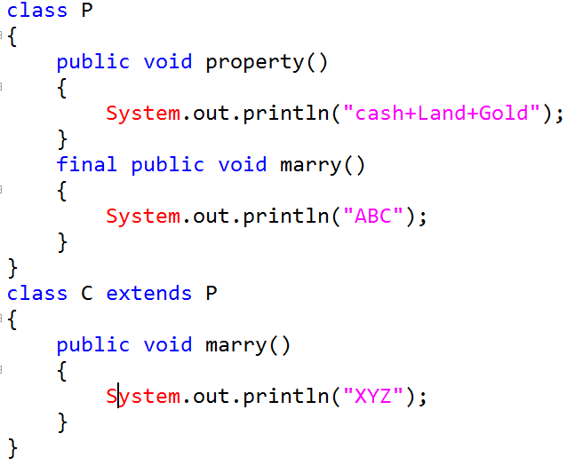

final modifier> final methods
Notes:
1.Applicable for class, methods and variables
2. Final method cannot be overridden

Slide 15
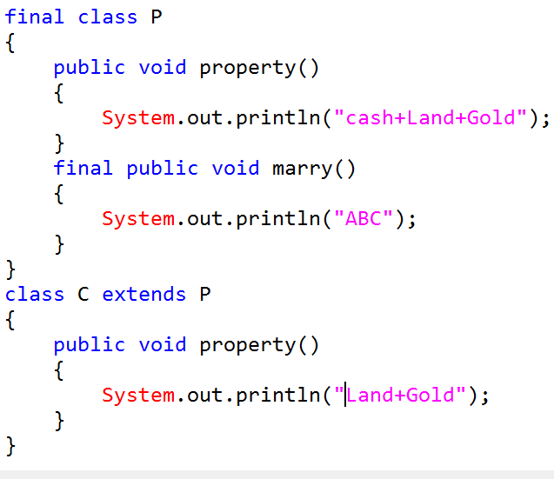
final class
Notes:
1. If a class is declared as final, we cannot create the child class.
2. Every method present in the final class is by default final.

Slide 16
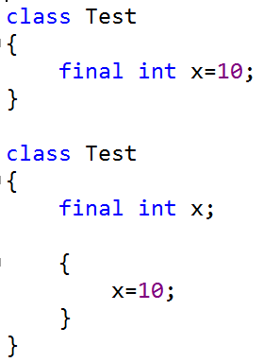
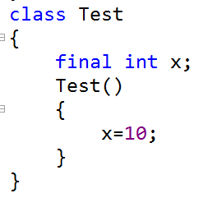
final instance variable
Notes:
Initialize final variables before constructor completion

Slide 17
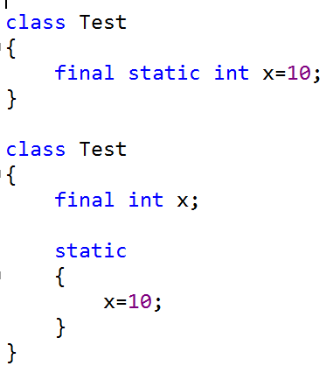
final static variables

Slide 18
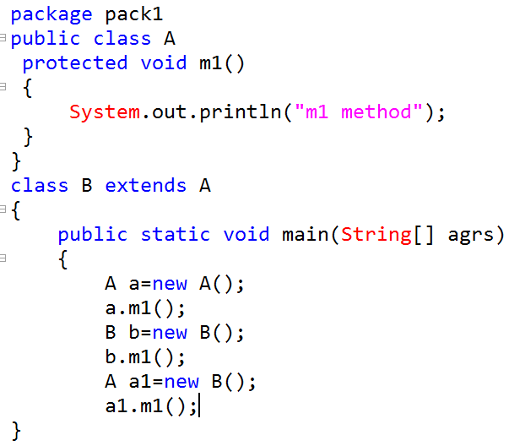
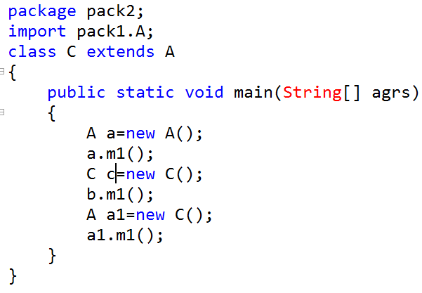
protected modifier

Slide 19
protected modifier
We can access protected members within the current package anywhere and from outside
package only in child class and we have to use that child class reference only.

Slide 20
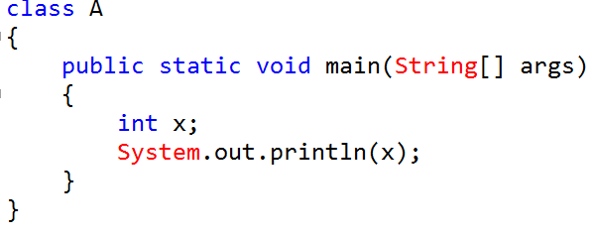
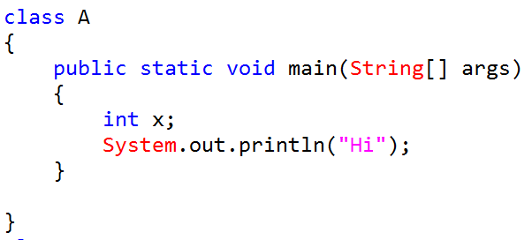
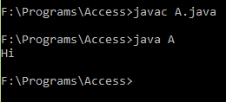
final local variable
Notes:
1.Variable declared inside a method, constructor, block etc. is local variable
2. Only applicable modifier for local variable is final

Slide 21
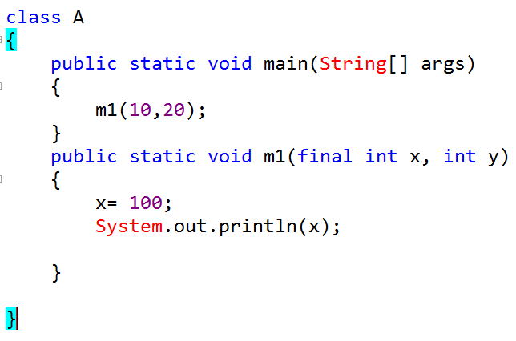
final local variable

Slide 22
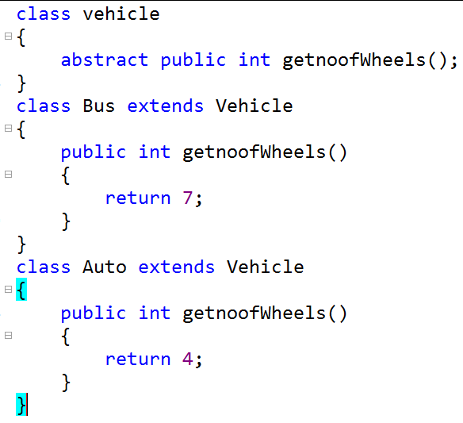
abstract modifier>abstract methods
Notes:
Applicable for class, methods but not for variables.
Abstract methods: Only declaration is available but not implementation.

Slide 23
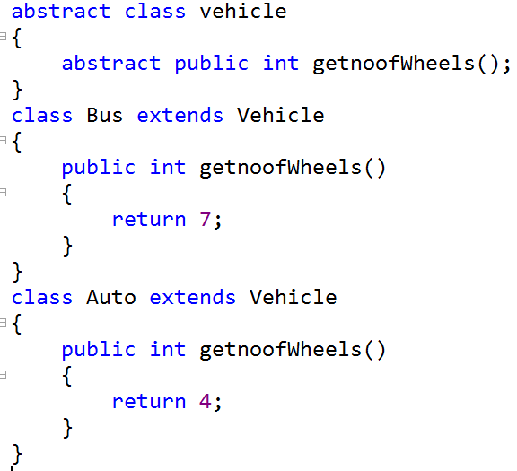
abstract class
Notes:
1. If a class contains atleast one abstract method, then class has to be declared as abstract.
2. By declaring parent class as abstract, we can provide guidelines to the child class that which methods compulsory child has to implement.
3. Implementation is not present in abstract class therefore instantiation is not possible for abstract classes.
4. abstract class can have zero abstract methods (declare class as abstract if we don’t want to create object for the class)

Slide 24
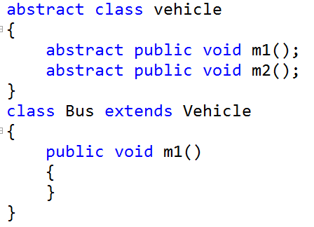
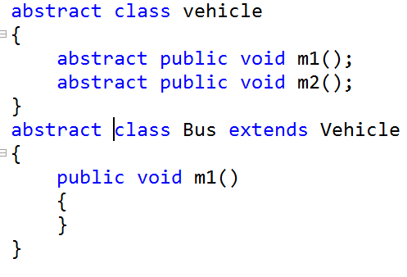
Contd..
Notes:
If we are extending abstract class then for every abstract method of parent class, we must provide implementation otherwise we have to declare child class as abstract.
abstract final combination is illegal.
It Is highly recommended to use abstract modifier, it promotes several OOP feature inheritance and polymorphism.

Slide 25
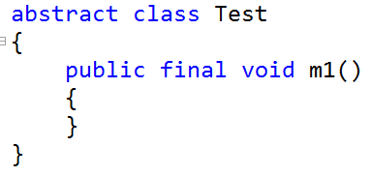
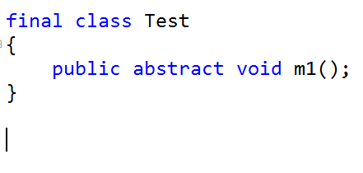
Question?
Notes:
Abstract class can contain final methods whereas final class can’t contain abstract methods

Slide 26
private modifier
private abstract combination ??
Notes:
Applicable for classes and methods
Visible in the class only

Slide 27
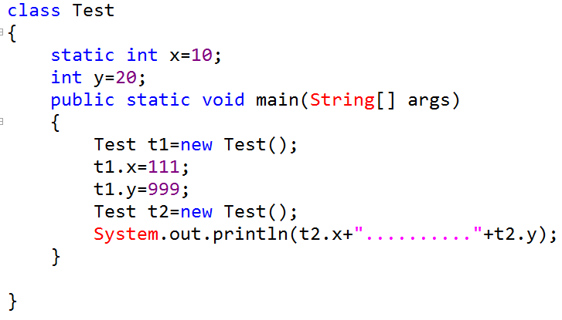
static modifier>static variable
Notes:
Applicable for methods, classes and variables

Slide 28
private members
private abstract combination is legal or illegal??
A method of super class with default access modifier can be overridden as protected or public but not as private. True or false?
Notes:
If a member is private then we can access that member only within the class.
2. Private abstract combination is illegal

