Slide 1
Module 4
Notes:
https://www.w3resource.com/c-programming-exercises/linked_list/index.php
http://www.ggu.ac.in/download/IT/Inf%20Tech%20Pankaj%20Chandra%20B%20Tech%20%20IV%20Data%20Structure%20-%20Model%20Answer.pdf

Slide 2
Topics( TOPICS HIGHLIGHTED IN Yellow COLOR ARE MADE ONLINE, STUDY THEM ON YOUR OWN FROM THE RESOURCE Available ON BLACKBOARD)
Module-4 Queue, Stack and Linked List
Representing Queues using Arrays
Representing Stacks using Arrays
Polish and Reverse polish Notations, Infix to Postfix conversion
Postfix expression evaluation
Linked lists: Operations (insert)
Linked lists: Operations (delete & search)
Stack & Queue implementation using Linked List
Circular Queues, Priority Queues, Circular Linked List
Doubly linked lists
Polynomial representation & operations using Linked List

Slide 3
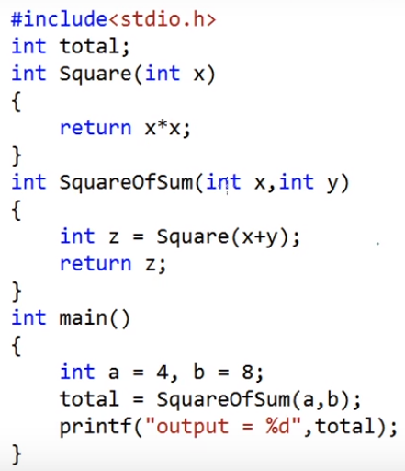
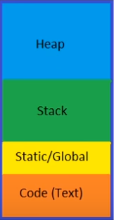
Dynamic memory allocation
STACK
Application’s memory
Function calls and local variables
Global and static data
Instructions
GLOBAL
Notes:
https://www.youtube.com/watch?v=_8-ht2AKyH4

Slide 4
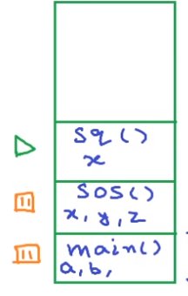
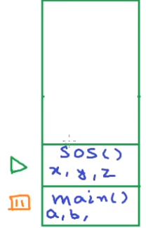
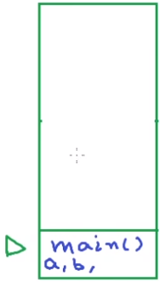
STACK FRAME
total
total
total
Global
Global
Global

Slide 5
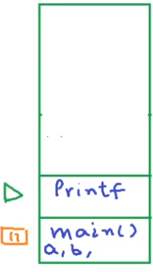

stack
stack
OS allocates some amount of space for stack at compile time but stack frames and local variables are allocated at run time
If stack grows beyond the reserved space (eg: bad recursion), stack overflow occurs because stack cannot grow at run time
total
Global
Global
Unlike stack, heap is not fixed. Its size can vary during the lifetime of the application. A programmer can totally control how much memory to use from heap.
Notes:
We should assign a variable global only if is needed at multiple places in multiple functions and needed for whole lifetime of the program otherwise it is just waste of memory

Slide 6
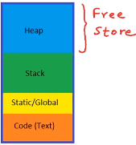

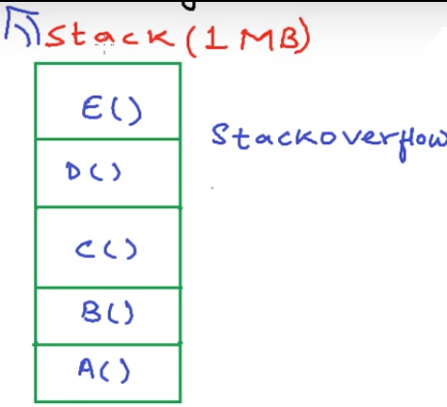
malloc
calloc
realloc
free
Heap is also called dynamic memory and using the heap is referred to as dynamic memory allocation

Slide 7
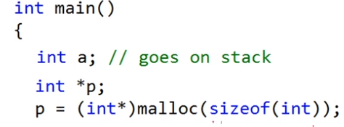

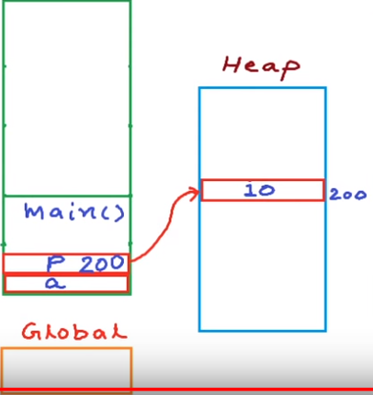

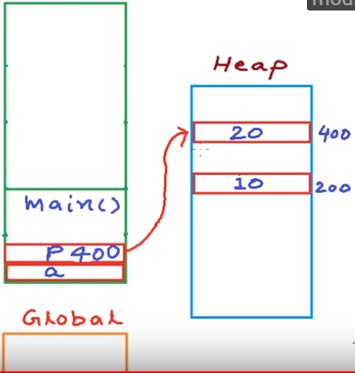
Clear the memory using free

Slide 8

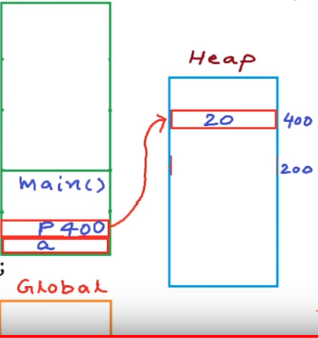
?

Slide 9
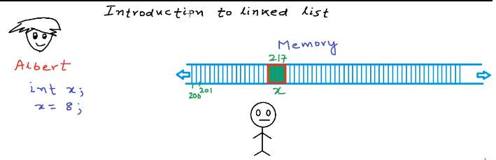
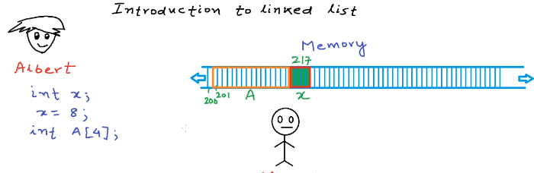
Storing an integer value in memory,
int x=8;
Memory Manager
Storing a list of numbers in memory: Using array we can store list of number of same type, array is always stored as one contiguous block of memory
Memory Manager

Slide 10
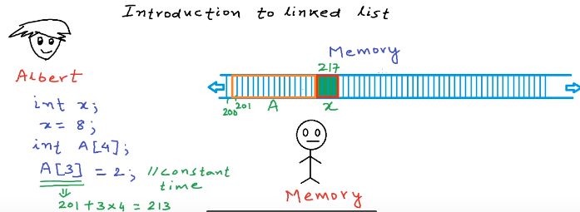
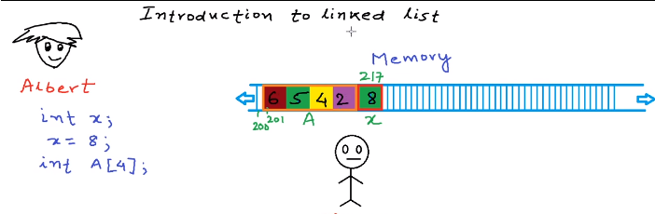
Irrespective of the size of arrays, an application can access any of the elements in array in constant time(Random access)
Memory Manager
Storing elements in array: a[0]=6; a[1]=5; a[2]=4; a[3]=2;
Memory Manager

Slide 11
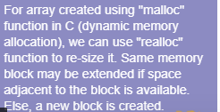
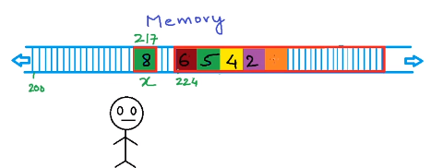
Now, adding one more element to the array won't be possible in the same location, therefore the array is copied to a different memory area where the sufficient space is available
Memory Manager
Memory Manager
Creation of entirely new array is costly. Solution to this problem is linked list data structure
Creation of entirely new array is costly. Solution to this problem is linked list data structure
Memory Manager

Slide 12
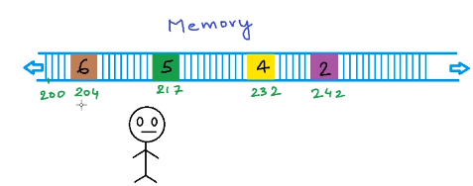
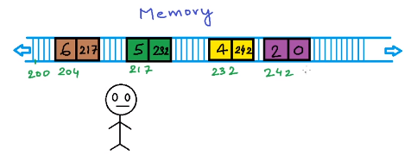
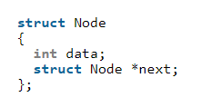
If we request for one element at a time, instead of getting one contiguous block of memory we get these disjoint, non-contiguous block of memory
Memory Manager
Now we need to link these newly created blocks. To link these blocks, we store some extra information with the block.
Memory Manager
Request MM for 2 blocks where 1st block stores the value and other variable stores the address of the next block in order to create a link

Slide 13

Linked List vs Array
Both Arrays and Linked List can be used to store linear data of similar types, but they both have some advantages and disadvantages over each other.
Following are the points in favor of Linked Lists.
(1) The size of the arrays is fixed: So we must know the upper limit on the number of elements in advance. Also, generally, the allocated memory is equal to the upper limit irrespective of the usage, and in practical uses, upper limit is rarely reached.
(2) Inserting a new element in an array (sorted) of elements is expensive, because room has to be created for the new elements and to create room existing elements have to shifted.
Linked lists have following drawbacks 1) Random access is not allowed. We have to access elements sequentially starting from the first node. So we cannot do binary search with linked lists. 2) Extra memory space for a pointer is required with each element of the list.
Logical representation of linked list. Each node stores the data and address to the next node. First node also called as head node and the only information about the list that we keep all the time is address of the first node. The address of the last node is null.

Slide 14
linked list vs array
Dynamically allocating an array of size 4 to this heap area will not be possible because contiguous block of 16 bytes is not available here.
Dynamically allocating an array of size 4 to this heap area will not be possible because contiguous block of 16 bytes is not available here.
HEAP MEMORY(every block represents 4 byte and white color block represents free space)
But, Allocating a linked list of size 4 to this heap area will be possible

Slide 15

Linked list operations
Linked list is a collection of data item, where each item is stored in a structure (node). The structure for node can be declared as follows:
Operations on Linked Lists (v imp)
Refer Program here

Slide 16
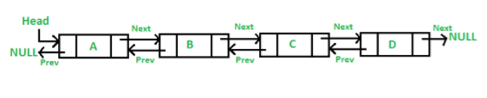
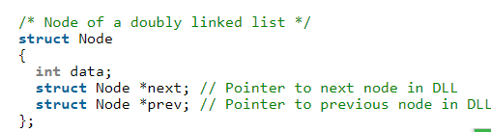
Doubly linked list
A Doubly Linked List (DLL) contains an extra pointer, typically called previous pointer, together with next pointer and data which are there in singly linked list.

Slide 17
Doubly linked list
Advantages over singly linked list 1) A DLL can be traversed in both forward and backward direction. 2) The delete operation in DLL is more efficient if pointer to the node to be deleted is given. In singly linked list, to delete a node, pointer to the previous node is needed. To get this previous node, sometimes the list is traversed. In DLL, we can get the previous node using previous pointer.
Disadvantages over singly linked list 1) Every node of DLL Require extra space for an previous pointer. It is possible to implement DLL with single pointer though. 2) All operations require an extra pointer previous to be maintained. For example, in insertion, we need to modify previous pointers together with next pointers. For example in following functions for insertions at different positions, we need 1 or 2 extra steps to set previous pointer.

Slide 18
Doubly linked list operations
Refer Program here
Note: Doubly linked list operations like insertion at begin, insertion at end and insertion at middle are present in the attached code. You need to complete deletion at beginning, deletion at end and deletion at a position on your own

Slide 19
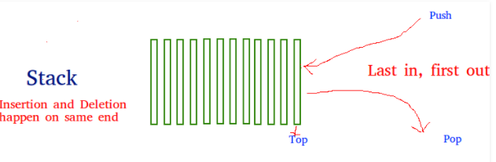
Stack Data Structure
Stack is a linear data structure which follows a particular order in which the operations are performed. The order may be LIFO(Last In First Out) or FILO(First In Last Out).
Mainly the following basic operations are performed in the stack:
Push: Adds an item in the stack. If the stack is full, then it is said to be an Overflow condition.
Pop: Removes an item from the stack. The items are popped in the reversed order in which they are pushed. If the stack is empty, then it is said to be an Underflow condition.
Peek or Top: Returns top element of stack.
isEmpty: Returns true if stack is empty, else fals.

Slide 20
Stack Data Structure
How to understand a stack practically? There are many real life examples of stack. Consider the simple example of plates stacked over one another in canteen. The plate which is at the top is the first one to be removed, i.e. the plate which has been placed at the bottommost position remains in the stack for the longest period of time. So, it can be simply seen to follow LIFO/FILO order.
Time Complexities of operations on stack:
push(), pop(), esEmpty() and peek() all take O(1) time. We do not run any loop in any of these operations.

Slide 21
Stack Data Structure
Real life examples of stack are:
To reverse a word. You push a given word to stack - letter by letter - and then pop letters from the stack.
An "undo" mechanism in text editors; this operation is accomplished by keeping all text changes in a stack.
Undo/Redo stacks in Excel or Word.
Language processing :
space for parameters and local variables is created internally using a stack.
compiler's syntax check for matching braces is implemented by using stack.
A stack of plates/books in a cupboard.
Wearing/Removing Bangles.
Support for recursion
Activation records of method calls.

Slide 22
Stack implementation using Array
Refer Program here

Slide 23
Stack implementation using linked list
Stack is an area of memory that holds all local variables and parameters used by any function, and remembers the order in which functions are called so that function returns occur correctly.
Each time a function is called, its local variables and parameters are “pushed onto” the stack. When the function returns these locals and parameters are “popped.” Because of this, the size of a program’s stack fluctuates constantly as the program is running, but it has some maximum size.
A list with the restriction that insertion and deletion can be performed only from one end.
stack is as a last in, first out (LIFO) abstract data type and linear data structure.
Linked list is a data structure consisting of a group of nodes which together represent a sequence.
Here we need to apply the application of linked list to perform basic operations of stack.
Refer Program here

Slide 24
queue data structure
Like Stack, Queue is a linear structure which follows a particular order in which the operations are performed. The order is First In First Out (FIFO).
A good example of queue is any queue of consumers for a resource where the consumer that came first is served first.
The difference between stacks and queues is in removing. In a stack we remove the item the most recently added; in a queue, we remove the item the least recently added.
Operations on Queue: Mainly the following four basic operations are performed on queue:
Enqueue: Adds an item to the queue. If the queue is full, then it is said to be an Overflow condition. Dequeue: Removes an item from the queue. The items are popped in the same order in which they are pushed. If the queue is empty, then it is said to be an Underflow condition. Front: Get the front item from queue. Rear: Get the last item from queue.

Slide 25
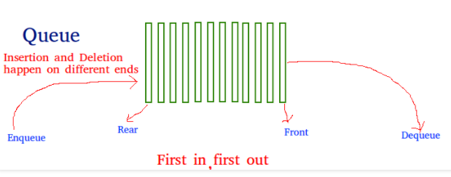
queue data structure
Applications of Queue: Queue is used when things don’t have to be processed immediately, but have to be processed in First In First Out order like Breadth First Search. This property of Queue makes it also useful in following kind of scenarios.
1) When a resource is shared among multiple consumers. Examples include CPU scheduling, Disk Scheduling. 2) When data is transferred asynchronously (data not necessarily received at same rate as sent) between two processes. Examples include IO Buffers, pipes, file IO, etc.

Slide 26
queue implementation using array and linked list
Refer Programs here

Slide 27
Infix to Postfix conversion
Infix expression: The expression of the form a op b. When an operator is in-between every pair of operands.
Postfix expression: The expression of the form a b op. When an operator is followed for every pair of operands.
Why postfix representation of the expression? The compiler scans the expression either from left to right or from right to left.
Consider the below expression: a + b * c + d If op1 = +, op2 = *, op3 = +
The compiler first scans the expression to evaluate the expression b * c, then again scan the expression to add a to it. The result is then added to d after another scan.
The repeated scanning makes it very in-efficient. It is better to convert the expression to postfix(or prefix) form before evaluation.
The corresponding expression in postfix form is: abc*+d+. The postfix expressions can be evaluated easily using a stack. We will cover postfix expression evaluation in a separate post.
Notes:
http://csis.pace.edu/~wolf/CS122/exexpans.html

Slide 28
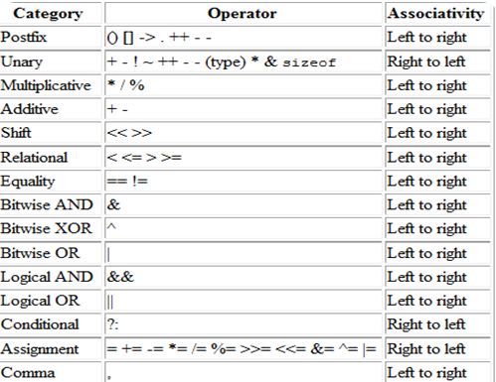
Operator precedence table
Notes:
http://csis.pace.edu/~wolf/CS122/exexpans.html

Slide 29
Infix to Postfix conversion and Postfix expression evaluation
1. infix: (A + B) * C + D / (E + F * G) - H
postfix: A B + C * D E F G * + / + H -
2. infix: A + ((B - C * D) / E ) + F - G / H
postfix: A B C D * - E / + F + G H / -
3. (A * B + C) / D - E / (F + G)
postfix: A B * C + D / E F G + / -
4. What is the value of the following postfix expression?
54 6 + 7 4 - * 9 / 35 15 + +
Notes:
http://csis.pace.edu/~wolf/CS122/exexpans.html

