Slide 1
Module-1
Basic C programming concepts

Slide 2
C was the programming language developed at AT & T's Bell Laboratories of USA in 1972. It was written by a man name Dennis Ritchie. When ever it comes to performance (speed of execution), C is unbeatable.
Device drivers of new devices are always written in C. The reason is that C provides you access to the basic elements of the computer. It gives you direct access to memory of your CPU through pointers. It allows you to manipulate and play with bits and bytes.
If you want to create your own OS, you have to learn C. Bcoz famous OS like windows, ios, linux and unix have thier major part written in C language .
Device Drivers of new devices are always written in C , because C provide direct access to memory of CPU by the help of pointers.

Slide 3

Notes:
Embedded systems: faster to execute

Slide 4
History of C Standards
1) K&R C
In 1978, Brian Kernighan and Dennis Ritchie published the first edition of The C Programming Language. This book, known to C programmers as "K&R", served for many years as an informal specification of the language.
2) ANSI C and ISO C (C89 or C90)
ANSI (American National Standards Institute) is the primary organization for encouraging the development of technology standards in the United States.
In 1983, the American National Standards Institute (ANSI) formed a committee, to establish a standard specification of C. In 1989, the C standard was ratified as ANSI X3.159-1989 "Programming Language C". This version of the language is often referred to as ANSI C, Standard C, or sometimes C89.
Notes:
The American National Standards Institute (ANSI, /ˈænsi/ an-see) is a private non-profit organization that oversees the development of voluntary consensus standards for products, services, processes, systems, and personnel in the United States.
The organization's headquarters are in Washington, DC. ANSI's operations office is located in New York City.
The International Organization for Standardization (ISO) is an international standard-setting body composed of representatives from various national standards organizations. Founded on 23 February 1947, the organization promotes worldwide proprietary, industrial and commercial standards. It is headquartered in Geneva, Switzerland and as of 2015 works in 163 countries.

Slide 5
History of C Standards
In 1990, the ANSI C standard (with formatting changes) was adopted by the International Organization for Standardization (ISO) as ISO/IEC 9899:1990, which is sometimes called C90. Therefore, the terms "C89" and "C90" refer to the same programming language.
3) C99
The C standard was further revised in the late 1990s, leading to the publication of ISO/IEC 9899:1999 in 1999, which is commonly referred to as C99
4) C11
The latest C standard is ISO/IEC 9899:2011, also known as C11 as the final draft was published in 2011.

Slide 6
Example
void main()
{
}
The above program fails in g++ compiler as the return type of main is void, but it compiles in Turbo C. How do we decide whether it is a legitimate C program or not?

Slide 7
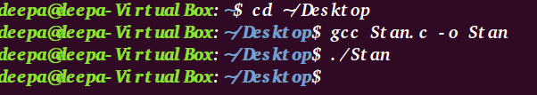
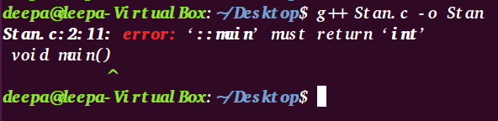
Example
On compiling the program with gcc compiler on Ubuntu
On compiling the program with g++ compiler on Ubuntu

Slide 8
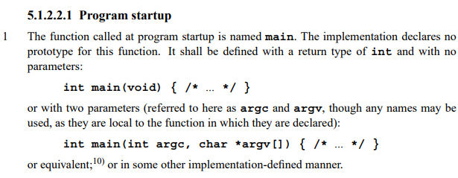
Example
“void main() {}”, the standard says following about prototype of main().

Slide 9

Number Systems
Computer uses a fixed number of bits to represent a piece of data, which could be a number, a character, or others. A n-bit storage location can represent up to 2^n distinct entities. For example, a 3-bit memory location can hold one of these eight binary patterns: 000, 001, 010, 011, 100, 101, 110, or 111. Hence, it can represent at most 8 distinct entities.
1. Decimal number system :It has ten symbols: 0, 1, 2, 3, 4, 5, 6, 7, 8, and 9, called digits. It uses positional notation. That is, the least-significant digit (right-most digit) is of the order of 10^0 (units or ones), the second right-most digit is of the order of 10^1 (tens), the third right-most digit is of the order of 10^2 (hundreds), and so on. For example,

Slide 10
Number Systems
2. Binary (Base 2) Number System: Binary number system has two symbols: 0 and 1, called bits. It is also a positional notation, for example,
10110B = 1×2^4 + 0×2^3 + 1×2^2 + 1×2^1 + 0×2^0
We shall denote a binary number with a suffix B.
A binary digit is called a bit. Eight bits is called a byte (why 8-bit unit? Probably because 8=2^3).
3. Hexadecimal (Base 16) Number System: Hexadecimal number system uses 16 symbols: 0, 1, 2, 3, 4, 5, 6, 7, 8, 9, A, B, C, D, E, and F, called hex digits. It is a positional notation, for example,
A3EH = 10×16^2 + 3×16^1 + 14×16^0
We shall denote a hexadecimal number (in short, hex) with a suffix H. Some programming languages denote hex numbers with prefix 0x (e.g., 0x1A3C5F), or prefix x with hex digit quoted (e.g., x'C3A4D98B').

Slide 11
Number Systems
Each hexadecimal digit is also called a hex digit. Most programming languages accept lowercase 'a' to 'f' as well as uppercase 'A' to 'F'.
Computers uses binary system in their internal operations, as they are built from binary digital electronic components. However, writing or reading a long sequence of binary bits is cumbersome and error-prone. Hexadecimal system is used as a compact form or shorthand for binary bits. Each hex digit is equivalent to 4 binary bits, i.e., shorthand for 4 bits, as follows:

Slide 12
Important Number Conversions
Conversion from Hexadecimal to Binary
Conversion from Binary to Hexadecimal
Replace each hex digit by the 4 equivalent bits, for examples,
A3C5H = 1010 0011 1100 0101B
102AH = 0001 0000 0010 1010B
Starting from the right-most bit (least-significant bit), replace each group of 4 bits by the equivalent hex digit (pad the left-most bits with zero if necessary), for examples,
1001001010B = 0010 0100 1010B = 24AH
10001011001011B = 0010 0010 1100 1011B = 22CBH
It is important to note that hexadecimal number provides a compact form or shorthand for representing binary bits.

Slide 13
Books
Yashwant Kanetkar, “Let Us C”.
Schaum Series, “Data Structure”.
Ellis Horowitz and Sartaz Sahni, “Data Structure using C”.
P.K. Sinha and P.K. Sinha, “Computer Fundamentals”
Reference Books
E Balaguruswamy, “Programming in ANSI C”.

Slide 14
Course Plan
Module 1: Basic C programming concepts | Module 4: Queue, Stack and Linked List
Module 2: Pointers and Functions | Module 5: Searching, Sorting and File Handling
Module 3: Array, Structure and Union

Slide 15
Module 1: Basic C programming concepts
Algorithm, Pseudo code and Flow-chart
Program Development steps, Use of translators, Linkers, Loaders, Editors and Locaters
Structure of C program, A Simple C program, Identifiers, Data types, Sizes of Data Types
Size-of operator, Modifiers, Use of values.h and limits.h
Variables, Declaration vs. Definition, Types of Variables, Global vs. Local Variable, Literals, Constants & Qualifiers
Arithmetic operators, Relational and Logical operators
Assignment operators, Increment and Decrement operators, Conditional operator, Bit-wise operators
Expressions, Precedence and Order of evaluation (Associativity), Type conversions
if statements, Conditional expressions, Input-output statements, statements and blocks
Loops: while, do-while, for statements
Switch statements, break, continue, goto and labels
Reflection & Discussion

Slide 16
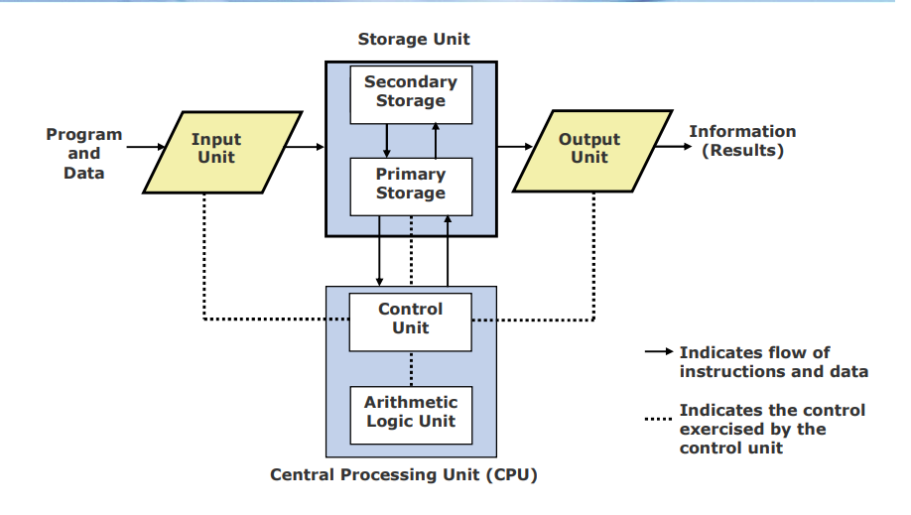
Basic Organization of a Computer System
Notes:
Explain >> sum= a+b
Byte: a unit of memory size
1GB= 2³⁰ bytes
A bit (short for binary digit) is the smallest unit of data in a computer. A bit has a single binary value, either 0 or 1. Although computers usually provide instructions that can test and manipulate bits, they generally are designed to store data and execute instructions in bit multiples called bytes

Slide 17
Algorithm
An algorithm is simply a solution to a problem. An algorithm presents the solution to a problem as a well defined set of steps or instructions.
Qualities of a good algorithm
Inputs and outputs should be defined precisely.
Each steps in algorithm should be clear and unambiguous.
Algorithm should be most effective among many different ways to solve a problem.
An algorithm shouldn't have computer code. Instead, the algorithm should be written in such a way that, it can be used in similar programming languages.
Features of an Algorithm:
As we know that an algorithm takes some inputs, execute some finite number of steps and gives an output. So, the certain step involved in the algorithm must be executable.
It must generate some result.
After a specific period, it must cease to run.
Notes:
When a computer is used for solving a particular problem, the steps to the solution should be communicated to the computer. This makes the study of algorithms a very important part in computer science. An algorithm is executed in a computer by combining lot of elementary operations such as additions and subtractions to perform more complex mathematical operations. But translating the idea of the algorithm in to computer code is not straight forward. Specially, converting an algorithm in to a low level language such as assembly language could be very tedious than using a high level language such as C or Java.

Slide 18
pseudocode
A set of specific instructions which are very similar to computer code, but not specific to any one computer.
Pseudocode allows to include control structures such as while, if,if then-else, repeat-until, for, case etc., which are present in many high level languages.
While algorithms can be written in natural language, pseudocode is written in a format that is closely related to high level programming language structures.
Additionally, transforming an algorithm presented in pseudocode to programming code could be much easier than converting an algorithm written in natural language.
Notes:
Pseudo-code is a general way of describing an algorithm. Pseudo-code does not use the syntax of a specific programming language, therefore cannot be executed on a computer. But it closely resembles the structure of a programming language and contains roughly the same level of detail.

Slide 19
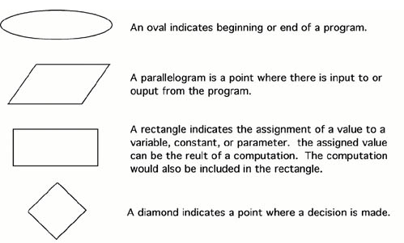
Flow chart
A flowchart is a pictorial representation of an algorithm in which the steps are drawn in the form of different shapes of boxes and the logical flow is indicated by interconnecting arrows.
The boxes represent operations and the arrows represent the sequence in which the operations are implemented.
Flowchart Symbols

Slide 20
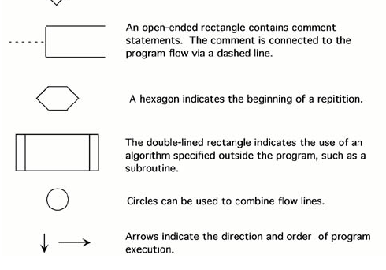
Flow chart

Slide 21
BASIS FOR COMPARISON | ALGORITHM | FLOW CHART
Basic | Includes sequence of steps which depicts the procedure of the solution. | An information diagram made up of different shapes shows the data flow.
Comprehensibility | Hard to understand | Easily interpreted
Uses | Text | Symbols
Implements | No rules are employed. | Predefined rules are implemented.
Debugging | Easier | Difficult
Ease of construction | Perplexing | Simple

Slide 22
Key Differences Between Algorithm and Flowchart
An algorithm involves a combination of sequential steps to interpret the logic of the solution. In contrast, a flowchart is the pictorial illustration of the algorithm.
A flow chart is more understandable as compared to the algorithm.
The algorithm is written in a language that can be perceived by humans. On the other hand, the flowchart is made up using different shapes and symbols.
There are no stringent rules are implemented in the algorithms while the flowchart is abode by predefined rules.
Errors and bugs are easily detected in the algorithm as compared to the flow charts.
Flow charts are simple to create. On the contrary, the construction of the algorithm is complex.

Slide 23
Activity
Let's say that you have a friend arriving at the airport, and your friend needs to get from the airport to your house. What are the algorithms that you might give your friend for getting to your home:

Slide 24
Possible Solutions?
The taxi algorithm:
Go to the taxi stand.
Get in a taxi.
Give the driver my address.
The call-me algorithm:
When your plane arrives, call me.
Meet me outside the airport.
The bus algorithm:
Outside baggage claim, catch bus for ISBT Dehradun
On reaching Dehradun ISBT catch bus for ballupur.
Get off on ballupur.
Walk two blocks north to my house.

Slide 25
Choosing the best Algorithm
All four of these algorithms accomplish exactly the same goal, but each algorithm does it in completely different way. Each algorithm also has a different cost and a different travel time. Taking a taxi, for example, is probably the fastest way, but also the most expensive. Taking the bus is definitely less expensive, but a whole lot slower. You choose the algorithm based on the circumstances.

Slide 26
Example-1
Ques: Write an algorithm, pseudocode and draw corresponding flow chart to determine a student’s final grade and indicate whether it is passing or failing. If final grade is less than 40, student is considered as fail. The final grade is calculated as the average of four marks.

Slide 27
Example-1
Ans: Algorithm:
1. Input set of marks
2. Find the average by adding the marks and dividing them by 4
3. if average is less than 40 then display fail otherwise pass
Pseudocode:
1. Input set of 4 marks a,b,c,d
2. Compute average as (a+b+c+d)/4
3. if (average<40) then
display fail
else display pass

Slide 28
Example-2
Q)Write an algorithm and pseudocode and draw a corresponding flow chart to print the sum of the digits of a given number
Ans: Algorithm:
Input a Number
Initialize Sum to zero
While Number is not zero
Get Remainder by Number Mod 10
Add Remainder to Sum
Divide Number by 10
Print sum

Slide 29
Example-2
pseudocode :
Step 1: Input N
Step 2: Sum = 0
Step 3: While (N != 0)
Rem = N % 10;
Sum = Sum + Rem;
N = N / 10;
Step 4: Print Sum

Slide 30
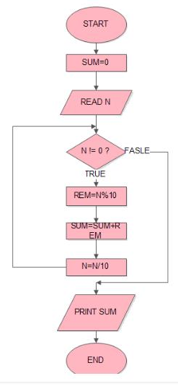
Example-2
Flow Chart

Slide 31
Questions?
Write an algorithm, pseudocode and draw corresponding flow chart for the Questions given below:
1)Find the sum of all the multiples of 3 or 5 below 1000.
2) find all the roots of a quadratic equation ax²+bx+c=0
3) find the largest among three different numbers entered by user.
4)Determine and Output Whether Number N is Even or Odd
5)Calculate the remainder, and the quotient of two given numbers.
6) Generate even numbers between 100and 200.

Slide 32
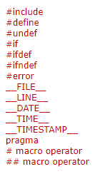
Compiling and executing a ‘C’ code
#include <stdio.h>
#define SOMETHING "Hello World"
int main()
{
/* Using a macro to print 'Hello World'*/
printf(“Hi”);
printf(SOMETHING);
return 0;
}
gcc Test.c -o Test.exe
gcc -E -o Test.i Test.c
Preprocessor directive
Notes:
The 'Hello World!' program is created with help of a text editor and saved as Test.c.
The Test.c program code is stored in a file as a sequence of bytes. Each byte has a value corresponding to some character. The first byte has the value 35 that corresponds to the character '#', for example. Likewise, the second byte has the integer value 105, which corresponds to the character 'i', and so on.

Slide 33
Compiling and executing a ‘C’ code
There are four main stages through which a source code passes in order to finally become an executable. The four stages for a C program to become an executable are the following:
Pre-processing
Compilation
Assembly
Linking
Notes:
https://www.geeksforgeeks.org/compiling-a-c-program-behind-the-scenes/

Slide 34
Compiling and executing a ‘C’ code
1) Preprocessing: This is the very first stage through which a source code passes. In this stage the following tasks are done:
Expansion of the included files
Macro substitution
Comments are stripped off
Analysis:
printf contains now “Hello World” rather than the macro SOMETHING that’s because macros have expanded.
Comments are stripped off.
#include<stdio.h> is missing instead we see lots of code. So header files has been expanded and included in our source file.
Notes:
During compilation of a C program the compilation is started off with preprocessing the directives (e.g., #include and #define). The preprocessor (cpp - c preprocessor) is a separate program in reality, but it is invoked automatically by the compiler. For example, the #include <stdio.h> command in line 1 of Test.c tells the preprocessor to read the contents of the system header file stdio.h and insert it directly into the program text. The result is another file typically with the .i suffix. In practice, the preprocessed file is not saved to disk unless the -save-temps option is used.
This is the first stage of compilation process where preprocessor directives (macros and header files are most common) are expanded. To perform this step gcc executes the following command internally.

Slide 35
Compiling and executing a ‘C’ code
2) Compilation:In this phase compilation proper takes place. The compiler (ccl) translates Test.i into Test.s. File Test.s contains assembly code. You can explicitly tell gcc to translate Test.i to Test.s by executing the following command.
gcc -S Test.i
The command line option -S tells the compiler to convert the preprocessed code to assembly language without creating an object file. After having created Test.s we can see the content of this file. While looking at assembly code we may note that the assembly code contains a call to the external function printf.
3) Assembly: Here, the assembler (as) translates Test.s into machine language instructions, and generates an object file Test.o. You can invoke the assembler at your own by executing the following command.
gcc Test.s -o Test.o

Slide 36
Compiling and executing a ‘C’ code
The above command will generate Test.o as it is specified with -o option. And, the resulting file contains the machine instructions for the classic "Hello World!" program, with an undefined reference to printf.
4) Linking: This is the final stage in compilation of "Hello World!" program. This phase links object files to produce final executable file. An executable file requires many external resources (system functions, C run-time libraries etc.). Regarding our "Hello World!" program you have noticed that it calls the printf function to print the 'Hello World!' message on console. This function is contained in a separate pre compiled object file printf.o, which must somehow be merged with our helloworld.o file. The linker (ld) performs this task for you. Eventually, the resulting file helloworld is produced, which is an executable. This is now ready to be loaded into memory and executed by the system.
Notes:
Note: stdio.h holds information about the I/O stuff, the actual code for it will be in the runtime library (though you rarely have to link that library specifically since the compiler will try to take care of it for you). Because you usually link with the compiler (i.e., the compiler invokes the linker for you), it knows that you're probably going to need the C run time library.
On a normal Unix system, if you do not instruct it otherwise, [GCC] will look for headers requested with #include <file> in: C:\Program Files (x86)\CodeBlocks\MinGW\include
Source: http://www.mingw.org/wiki/includepathhowto

Slide 37
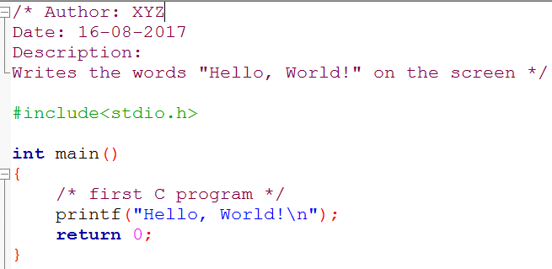
Sample Code of C “Hello World” Program

Slide 38
Structure of a C program
Documentations (Documentation Section): The Documentation section usually contains the collection of comment lines giving the name of the program, author’s or programmer’s name and few other details.
Preprocessor Statements (Link Section): It links predefined functions in library files into your program
Global Declarations : used to define those variables that are used globally within the entire program and is used in more than one function
The main() function
Local Declarations
Program Statements & Expressions
User Defined Functions

Slide 39
Structure of a C program
* Comments */ | This is a comment block, which is ignored by the compiler. Comment is used anywhere in program to add info about program or code block, which can be helpful for programmer to understand the code easily in feature.
#include<stdio.h> | This is a preprocessor command to include the header file stdio.h in the program before compiling the source-code.
main() | The main() is the main function where program execution begins. Every C program must contain only one main function.
Braces | The Curly braces which shows how much the main() function has its scope.
printf() | It is a predefined (already written and compiled) function in C, which prints text on the screen
return 0 | At the end of the main function returns value 0.

Slide 40
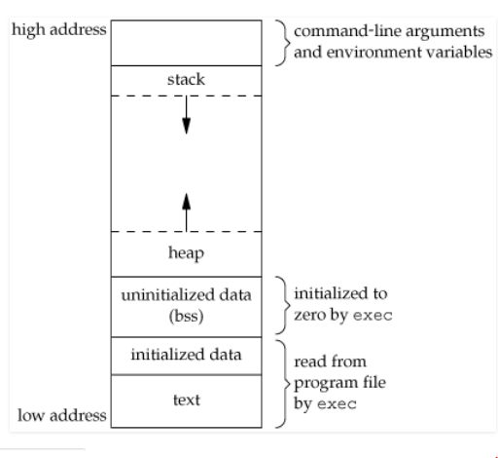
Memory Management in C

Slide 41
Memory Management in C
A typical memory layout of a running process
1. Text Segment: which contains executable instructions. the text segment is often read-only, to prevent a program from accidentally modifying its instructions.
2. Initialized Data Segment: contains the global variables and static variables that are initialized by the programmer.
Data segment is not read-only, since the values of the variables can be altered at run time.
This segment can be further classified into initialized read-only area and initialized read-write area.
Example: A global C statement int a=1 would be stored in initialized read-write area. And a global C statement like const char* a = “hello world” makes the string literal “hello world” to be stored in initialized read-only area and the character pointer variable string in initialized read-write area.
Notes:
Static : storage specifier and const is a type qualifier.

Slide 42
Memory Management in C
3. Uninitialized Data Segment: Uninitialized data segment, often called the “bss” segment, named after an ancient assembler operator that stood for “block started by symbol.
Data in this segment is initialized by the kernel to arithmetic 0 before the program starts executing.
4. Stack: The stack area traditionally adjoined the heap area and grew the opposite direction; when the stack pointer met the heap pointer, free memory was exhausted.
The stack grows and shrinks as functions push and pop local variables
There is no need to manage the memory yourself, variables are allocated and freed automatically
The stack has size limits
Stack variables only exist while the function that created them, is running
Notes:
What is the stack? It's a special region of your computer's memory that stores temporary variables created by each function (including the main() function). The stack is a "LIFO" (last in, first out) data structure, that is managed and optimized by the CPU quite closely. Every time a function declares a new variable, it is "pushed" onto the stack. Then every time a function exits, all of the variables pushed onto the stack by that function, are freed (that is to say, they are deleted). Once a stack variable is freed, that region of memory becomes available for other stack variables.
The advantage of using the stack to store variables, is that memory is managed for you. You don't have to allocate memory by hand, or free it once you don't need it any more. What's more, because the CPU organizes stack memory so efficiently, reading from and writing to stack variables is very fast.
A key to understanding the stack is the notion that when a function exits, all of its variables are popped off of the stack (and hence lost forever). Thus stack variables are local in nature. This is related to a concept we saw earlier known as variable scope, or local vs global variables. A common bug in C programming is attempting to access a variable that was created on the stack inside some function, from a place in your program outside of that function (i.e. after that function has exited).
Another feature of the stack to keep in mind, is that there is a limit (varies with OS) on the size of variables that can be store on the stack. This is not the case for variables allocated on the heap.
Heap: The heap is a region of your computer's memory that is not managed automatically for you, and is not as tightly managed by the CPU. It is a more free-floating region of memory (and is larger). To allocate memory on the heap, you must use malloc() or calloc(), which are built-in C functions. Once you have allocated memory on the heap, you are responsible for using free() to deallocate that memory once you don't need it any more. If you fail to do this, your program will have what is known as a memory leak. That is, memory on the heap will still be set aside (and won't be available to other processes). As we will see in the debugging section, there is a tool called valgrind that can help you detect memory leaks.
Unlike the stack, the heap does not have size restrictions on variable size (apart from the obvious physical limitations of your computer). Heap memory is slightly slower to be read from and written to, because one has to use pointers to access memory on the heap. We will talk about pointers shortly.
Unlike the stack, variables created on the heap are accessible by any function, anywhere in your program. Heap variables are essentially global in scope.

Slide 43
Memory Management in C
Variables created on the stack will go out of scope and are automatically deallocated.
Much faster to allocate in comparison to variables on the heap.
Implemented with an actual stack data structure.
Stores local data, return addresses, used for parameter passing.
Can have a stack overflow when too much of the stack is used (mostly from infinite or too deep recursion, very large allocations).
Data created on the stack can be used without pointers.
4. Heap: It is used on demand to allocate a block of data for use by the program.
Slower to allocate in comparison to variables on the stack.
Can have fragmentation when there are a lot of allocations and deallocations.

Slide 44
Memory Management in C
In C++ or C, data created on the heap will be pointed to by pointers and allocated with new or malloc respectively.
WE use the heap if we don't know exactly how much data we will need at run time.
Notes:
The idea behind int was that it was supposed to match the natural "word" size on the given platform: 16 bit on 16-bit platforms, 32 bit on 32-bit platforms, 64 bit on 64-bit platforms, you get the idea. However, for backward compatibility purposes some compilers prefer to stick to 32-bit inteven on 64-bit platforms.

Slide 45
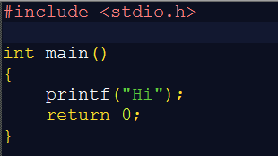


Example to compare the size of uninitialized data segment(bss)

Slide 46
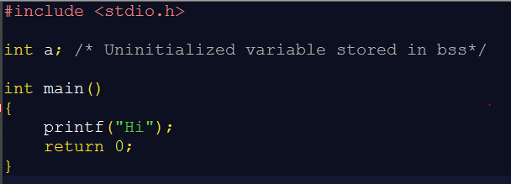
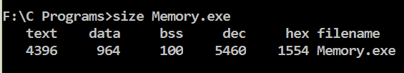
Example to compare the size of uninitialized data segment(bss)

Slide 47
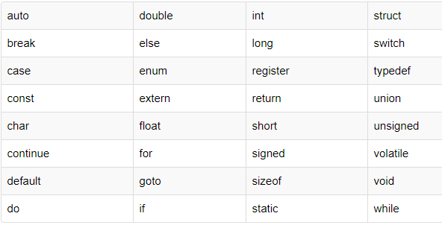
Keywords
Keywords are predefined, reserved words used in programming that have special meanings to the compiler. As C is a case sensitive language, all keywords must be written in lowercase. Here is a list of all keywords allowed in ANSI C.
Notes:
Note: In addition to these standard keywords, TIGCC recognizes some extended keywords which do not exist in ANSI C, like asm, typeof, inline, etc.,

Slide 48
Identifiers
In C language identifiers are the names given to variables, constants, functions and user-define data. These identifier are defined against a set of rules.
Rules for an Identifier
An Identifier can only have alphanumeric characters( a-z , A-Z , 0-9 ) and underscore( _ ).
The first character of an identifier can only contain alphabet( a-z , A-Z ) or underscore ( _ ).
Identifiers are also case sensitive in C. For example name and Name are two different identifier in C.
Keywords are not allowed to be used as Identifiers.
No special characters, such as semicolon, period, whitespaces, slash or comma are permitted to be used in or as Identifier.

Slide 49
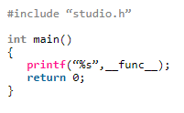
Identifiers (Note)
It won’t give any compile error and prints “main”
C language standard (i.e. C99 and C11) defines a predefined identifier therefore C compiler implicitly adds __func__ variable in every function so that it can be used in that function to get the function name.
Syntax: static const char __func__[] = “function-name”;

Slide 50
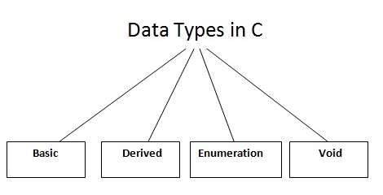
Data types
In C programming, variables or memory locations should be declared before it can be used.
Data types in c is used to declare variables or functions of different types. The type of a variable determines how much space it occupies in storage and how the bit pattern stored is interpreted.

Slide 51
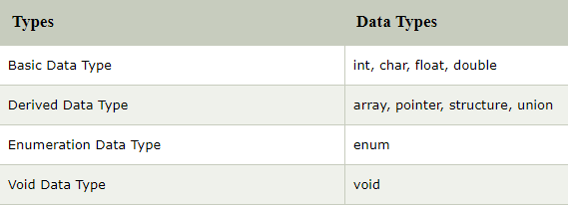
Data types
Basic Type:
1. Integer Type: Integers are whole numbers that can have both positive and negative values but no decimal values. Example: 0, -5, 10
In C programming, keyword int is used for declaring integer variable. For example: int a;
Here, a is a variable of type integer.

Slide 52
Data types
We can declare multiple variable at once in C programming. For example: int a, b;
2. float - Floating types: Floating type variables can hold real numbers such as: 2.34, -9.382, 5.0 etc. You can declare a floating point variable in C by using either float or double keyword. For example:
float a;
double b;
double: It is used to store decimal numbers (numbers with floating point value) with double precision.

Slide 53
Data types
3. char: The most basic data type in C. It stores a single character and requires a single byte of memory in almost all compilers.
Keyword char is used for declaring character type variables. For example:
char test = 'h';
Here, test is a character variable. The value of test is 'h'.
The size of character variable is 1 byte.

Slide 54
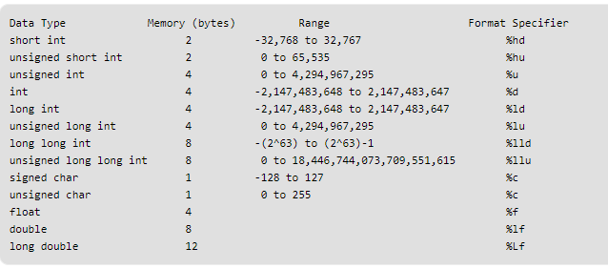
Data types and sizes of Data types
Different data types also have different ranges upto which they can store numbers. These ranges may vary from compiler to compiler. Below is list of ranges along with the memory requirement and format specifiers on 32 bit gcc compiler.

Slide 55
Online Lecture
Size-of operator, Modifiers, Use of values.h and limits.h

Slide 56
Variables
A variable is a name of memory location. It is used to store data. Its value can be changed and it can be reused many times.
It is a way to represent memory location through symbol so that it can be easily identified.
type variable_list;
int a;
float b;
char c;
Here, a, b, c are variables and int, float, char are data types.
Rules to define variable name
Variable name must not start with a digit.
Variable name can consist of alphabets, digits and special symbols like underscore _.

Slide 57
Variables
Blank or spaces are not allowed in variable name.
Keywords are not allowed as variable name.
Declaration and Definition of variable
Declaration of variables must be done before they are used in the program. Declaration does two things.
It tells the compiler what the variable name is.
It specifies what type of data the variable will hold.
Definition of variable means to assign a value to a variable.
Definition specify what code or data the variable describes. A variable must be declared before it can be defined.

Slide 58
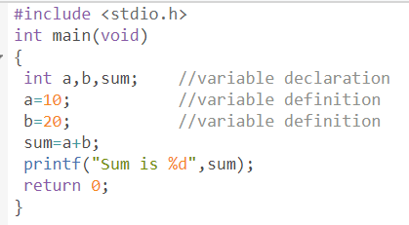
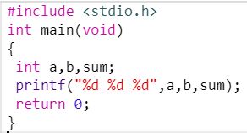
Example
Notes:
The value of an uninitialized local variable in C is indeterminate and reading it can invoke undefined behavior.
Now, repeatedly executing a particular program compiled with a particular compiler in a particular environment (as you are doing) is likely to yield the same (still undefined, of course) behavior. This could be because the OS will usually give your process the same range of logical memory every time you run it and thus the garbage that your program reads has a good chance of being the same every time (but it's still garbage, nonetheless).
Output: sum is 30
Output: unpredictable(garbage value) (right)

Slide 59
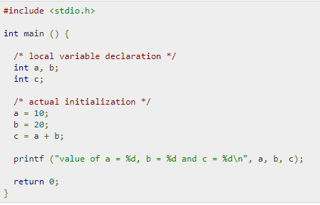
Local and Global variables
Local variables: Variables that are declared inside a function or block are called local variables. Local variables are not known to functions outside their own. Example: Here all the variables a, b, and c are local to main() function.

Slide 60
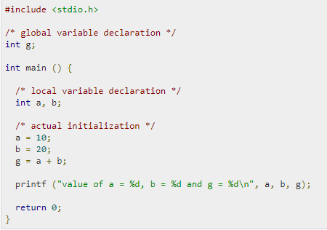
Local and Global variables
Global variables: They are defined outside a function, usually on top of the program. Global variables hold their values throughout the lifetime of your program and can be accessed inside any functions defined for the program.

Slide 61
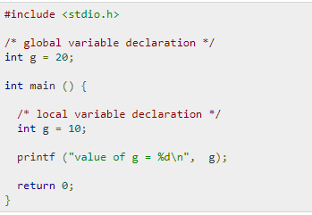
Local and Global variables
Note: A program can have same name for local and global variables but the value of local variable inside a function will take preference.
Example:
Notes:
Output: value of g= 10

Slide 62
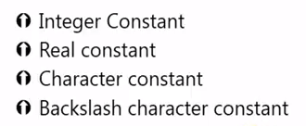
Constant in C
Constant is a value that never changes.
Constant in C means the content whose value doesnot change at the time of execution of the program.
It is considered as the best practice to define constants using only upper-case names.
Syntax: const type constant_name; or const data_type *variable_name;
We can define constants in C in two ways.
Using const keyword in variable declaration.
Using #define preprocessor directives.
Types:

Slide 63
Constant in C
Integer Constant:
An integer constant is a decimal(base 10), octal(base 8), or hexadecimal(base 16) number that represents an integer value.
Integer constants are used to represent integer value that cannot be changed.
Example: 10, -121, 0, 0256, +14, 0x6, 0xA
Rules for constructing integer constant:
1) An integer constant must have at least one digit. 2) It must not have a decimal point. 3) It can either be positive or negative. 4) No commas or blanks are allowed within an integer constant. 5) If no sign precedes an integer constant, it is assumed to be positive.

Slide 64
Constant in C
Decimal Integer constant: • 0 to 9 • E.g.: 49, 58, -62 …
Octal Integer constant: • 0 to 7 • Add “0” before the value. • E.g.: 045, 056, 067
Hexadecimal Integer constant: • 0 to 9 and A to F • Add 0x before the value • E.g.: 0x42, 0x56, 0x67
Notes:
Note: The hexadecimal system is commonly used by programmers to describe locations in memory because it can represent every byte (i.e., eight bits) as two consecutive hexadecimal digits instead of the eight digits that would be required by binary (i.e., base 2) numbers and the three digits that would be required with decimal numbers. In addition, it is much easier for humans to read hexadecimal numbers than binary numbers. Memory is often manipulated in terms of larger units, such as pages or segments, which tend to have sizes that are powers of 2. So if addresses are expressed in hex, it's much easier to read them as page+offset or similar constructs.

Slide 65
Constant in C
Backslash Character Constants In C:
There are some characters which have special meaning in C language.
They should be preceded by backslash symbol to make use of special function of them.

Slide 66
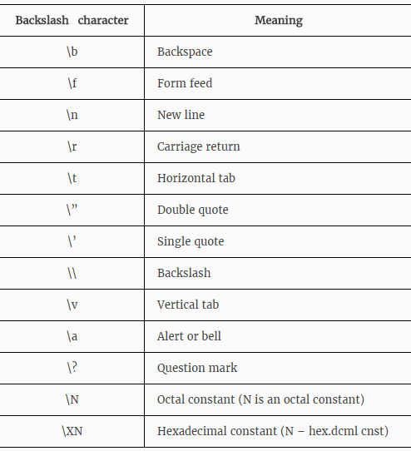
Constant in C

Slide 67
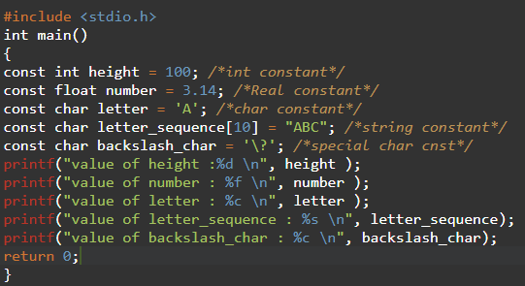
Example:1(using const keyword)
Notes:
value of height :100
value of number : 3.140000
value of number : 3.14
value of number : 3.1400
value of letter : A
value of letter_sequence : ABC
value of backslash_char : ?

Slide 68
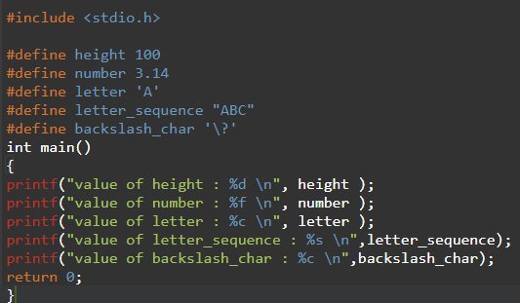
Example-2(using #preprocessor directive)
Notes:
value of height : 100
value of number : 3.140000
value of letter : A
value of letter_sequence : ABC
value of backslash_char : ?

Slide 69
Literal
A literal is a value that is expressed as itself. For example, the number 25 or the string "Hello World" are both literals.
A constant is a data type that substitutes a literal. Constants are useful in situations where a specific, unchanging value is to be used at various times during the software program
Notes:
If requirements dictate that the constant be changed (for example, if the voting age is lowered to 20 in the future), it is much easier to adapt the program. If we use literals throughout the program, the change will be hard to do and there is a good chance some instances will not be corrected.

Slide 70
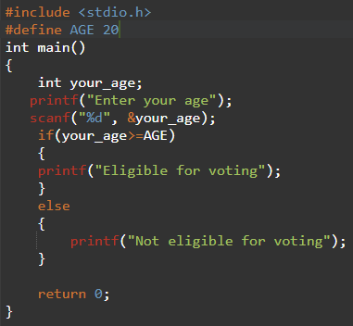
Example: literal vs constant
Notes:
Here,

Slide 71
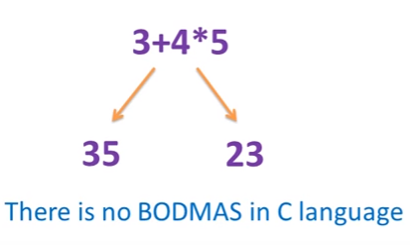
Operators in C
Operators in C Programming (all valid operators available in C), expressions (combination of operators, variables and constants) and precedence of operators (which operator has higher priority and which operator has lower priority).
Precedence and Associativity are two characteristics of operators that determine the evaluation order of subexpressions in absence of brackets.
Notes:
Operator precedence determines which operator is performed first in an expression with more than one operators with different precedence. For example 10 + 20 * 30 is calculated as 10 + (20 * 30) and not as (10 + 20) * 30.
Associativity is used when two operators of same precedence appear in an expression. Associativity can be either Left to Right or Right to Left. For example ‘*’ and ‘/’ have same precedence and their associativity is Left to Right, so the expression “100 / 10 * 10” is treated as “(100 / 10) * 10”.

Slide 72
Types
Operator Types:
Operators are the symbols which tell the computer to execute certain mathematical or logical operations.
Arithmetic operators
Relational operators
Logical operators
Assignment operators
Increment and Decrement operators
Conditional operators
Bitwise operators
Special operators
Notes:
Click the link to know more about undefined behavior :https://www.nayuki.io/page/undefined-behavior-in-c-and-cplusplus-programs

Slide 73
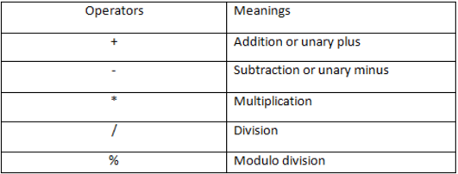
Arithmetic Operators
Note: ‘/’ is integer division which only gives integer part as result after division. ‘%’ is modulo division which gives the remainder of integer division as result.

Slide 74
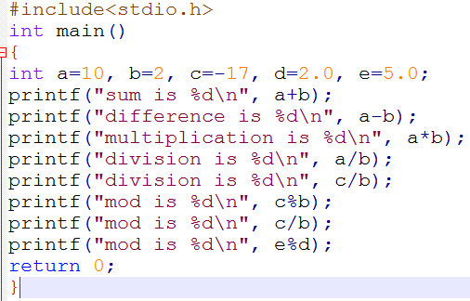
Operators
Notes:
sum is 12
difference is 8
multiplication is 20
division is 5
division is -8
mod is -1
mod is -8
mod is 1

Slide 75
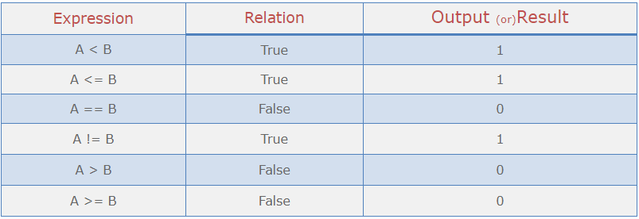
Relational Operators
Relational Operators
Relational operators are used when we have to make comparisons. C programming offers 6 relational operators.
Relational operators are most commonly used in decision statements like if, while, etc. Some simple relational expressions are:

Slide 76
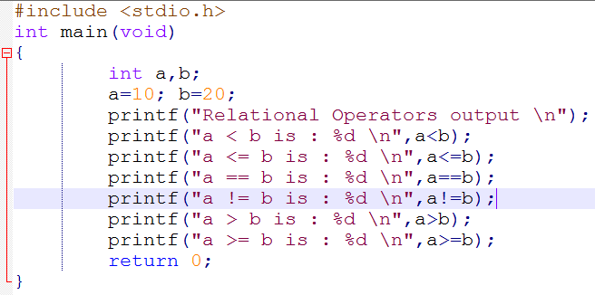
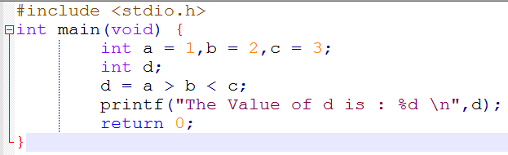
Example
Notes:
1.
a < b is : 1
a <= b is : 1
a == b is : 0
a != b is : 1
a > b is : 0
a >= b is : 0
2. The Value of d is : 1

Slide 77
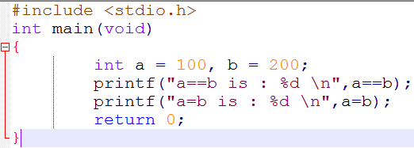
Note:
Assignment operator and Equality operator is entirely Different. Assignment operator(=) is used to Assign Values while Equality(==) operator is used to compare the Two Expressions.
Notes:
a==b is : 0
a=b is : 200

Slide 78
Logical Operators:
There are 3 logical operators in C language AND(&&), OR(||) and NOT(!)
Logical Operators in C programming language combines multiple boolean expressions. If we want to check more than one condition, then we need logical Operators.
Logical Operators always produces boolean results, either TRUE(non-zero value) or FALSE(zero value).
Example: If roll_no of a student is greater than 34 and less than 72 then student belongs to batch 2 We can implement above mentioned condition using logical operator as follows: if((roll_no >34) && (roll_no <72))
AND : Returns true, If both operands are true otherwise false.
OR : Returns false If both operands are false, otherwise true.
NOT : Returns true if operand is false and Returns false if operand is true.

Slide 79
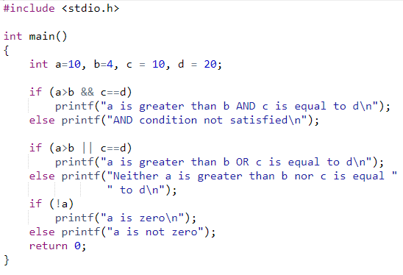
Example

Slide 80
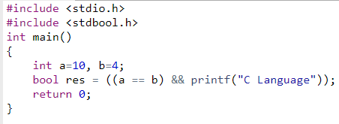
Short-Circuiting in Logical Operators:
In case of logical AND, the second operand is not evaluated if first operand is false. For example, program 1 below doesn’t print “C language” as the first operand of logical AND itself is false.
Notes:
No output

Slide 81
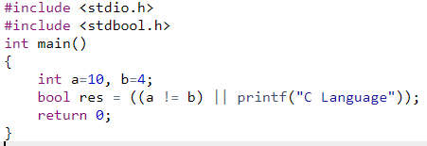
Short-Circuiting in Logical Operators:
In case of logical OR, the second operand is not evaluated if first operand is true. For example, program 1 below doesn’t print “C Language” as the first operand of logical OR itself is true.
Notes:
No output

Slide 82
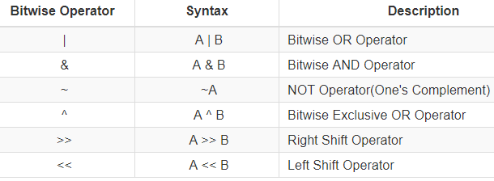
Bitwise Operators
C is a middle level language, it support many operations which can be performed in assembly language like operations on bits.
Bitwise operators performs bit-by-bit operations on operands. There are six bitwise operators supported in C programming language.
Notes:
Bitwise Operators can only be applied on char and integer operands. We cannot use bitwise operators with float, double, long double, void and other user define complex data types.

Slide 83
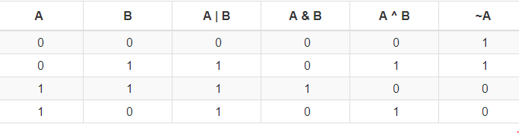
Bitwise Operators
Bitwise Operators can only be applied on char and integer operands. We cannot use bitwise operators with float, double, long double, void and other user define complex data types.

Slide 84
Bitwise Shift Operators
The shift operators shift their first operand left (<<) or right (>>) by the number of positions the second operand specifies.
Both operands must be integral values. These operators perform the usual arithmetic conversions; the type of the result is the type of the left operand after conversion.

Slide 85
Bitwise Shift Operators
The shift operators shift their first operand left (<<) or right (>>) by the number of positions the second operand specifies.
Left shift is useful in implementing multiplication with powers of 2 and Right shift is used to implement division with powers of 2. class Test { public static void main(String args[]) { int y = 4; System.out.println(y>>1); } }
We can also check whether a number is even or odd by AND ing operation with 1. Because if lowest order bit is set number is odd otherwise it is even.

Slide 86
Increment and decrement operators
Increment: The ‘++’ operator is used to increment the value of an integer. When placed before the variable name (also called pre-increment operator), its value is incremented instantly. For example, ++x. And when it is placed after the variable name (also called post-increment operator), its value is preserved temporarily until the execution of this statement and it gets updated before the execution of the next statement. For example, x++.
Decrement: The ‘–‘ operator is used to decrement the value of an integer. When placed before the variable name (also called pre-decrement operator), its value is decremented instantly. For example, –x. And when it is placed after the variable name (also called post-decrement operator), its value is preserved temporarily until the execution of this statement and it gets updated before the execution of the next statement. For example, x–.

Slide 87
Example2
How does printf("%d %d %d", i, ++i, i++) evaluate? Does it operate from left to right or from right to left?
The answer is undefined.
printf("%d %d %d", i, ++i, i++)
There are two modifications of i within a single sequence point, it called undefined behavior.

Slide 88
Decision control statements
There comes situations in real life when we need to make some decisions and based on these decisions, we decide what should we do next. Similar situations arises in programming also where we need to make some decisions and based on these decision we will execute the next block of code.
Decision making statements in programming languages decides the direction of flow of program execution. Decision making statements available in C:
if statement
if..else statements
nested if statements
if-else-if ladder
switch statements

Slide 89
if statement
if statement is the most simple decision making statement. It is used to decide whether a certain statement or block of statements will be executed or not i.e if a certain condition is true then a block of statement is executed otherwise not.
Syntax:
if(condition)
{
// Statements to execute if
// condition is true
}
if(condition)
statement1;
statement2;
.
Notes:
Here, condition after evaluation will be either true or false. if statement accepts boolean values – if the value is true then it will execute the block of statements below it otherwise not.
If we do not provide the curly braces ‘{‘ and ‘}’ after if( condition ) then by default if statement will consider the first immediately below statement to be inside its block.
Example:
// Here if the condition is true, if block
// will consider only statement1 to be inside
// its block

Slide 90
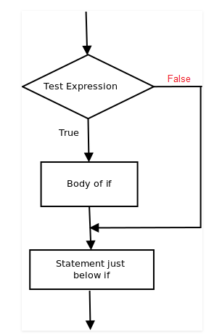
Flow chart

Slide 91
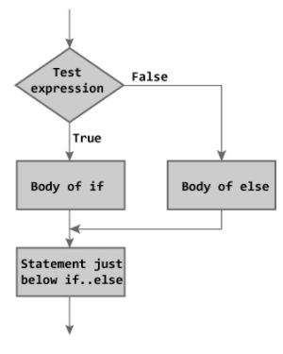
if-else
The if statement alone tells us that if a condition is true it will execute a block of statements and if the condition is false it won’t. But what if we want to do something else if the condition is false. Here comes the else statement. We can use the else statement with if statement to execute a block of code when the condition is false.
Syntax:
if (condition)
{
// Executes this block if
// condition is true
}
else
{
// Executes this block if
// condition is false
}

Slide 92
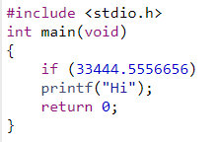
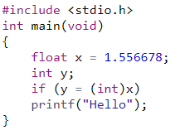
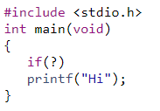
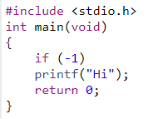
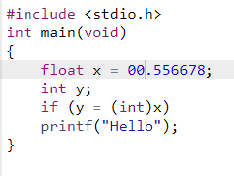
Example

Slide 93
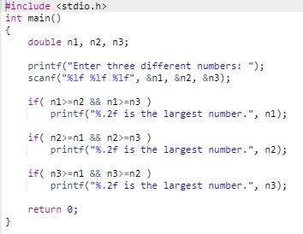
Example-1

Slide 94
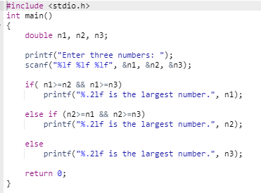
Example-2

Slide 95
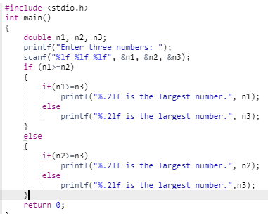
Example-2

Slide 96
switch case
Note:
1. expression in the switch must result in integer value. 2. Maximum one of the label values match the expression value in order for the corresponding statements to execute. Otherwise default statement executes if present in the switch statement. 3. break statement must be in the end in each case. 4. break causes the execution to jump out of the switch to the statement immediately following the switch.

Slide 97


Example1
In C switch statement, the expression of each case label must be an integer constant expression.
The expression used in switch must be integral type ( int, char and enum). Any other type of expression is not allowed.

Slide 98


Example2
All the statements following a matching case execute until a break statement is reached.

Slide 99


Example3
The statements written above cases are never executed
Two case labels cannot have same value

Slide 100
Ternary Statement
Ternary statement or Ternary operator is like if-else statement in its functioning. However, its syntax differs from if-else’s syntax.
Advantage of Ternary Operator
Using ?: reduce the number of line codes and improve the performance of application.
Syntax
expression-1 ? expression-2 : expression-3
In the above symbol expression-1 is condition and expression-2 and expression-3 will be either value or variable or statement or any mathematical expression. If condition will be true expression-2 will be execute otherwise expression-3 will be executed. Example
a<b ? printf("a is less") : printf("a is greater");

Slide 101
Example
# include <stdio.h>
int main()
{
int a, b, c, big ;
printf("Enter three numbers : ") ;
scanf("%d %d %d", &a, &b, &c) ;
big = a > b ? (a > c ? a : c) : (b > c ? b : c) ;
printf("\nThe biggest number is : %d", big) ;
}

Slide 102
Loops
3 type of Loops in C language
while loop
for loop
do-while loop
while loop
while loop can be addressed as an entry control loop. It is completed in 3 steps.
Variable initialization.( e.g int x=0; )
condition( e.g while( x<=10) )
Variable increment or decrement ( x++ or x-- or x=x+2 )

Slide 103
Loops
In for loop we have exactly two semicolons, one after initialization and second after condition. In this loop we can have more than one initialization or increment/decrement, separated using comma operator. for loop can have only one condition.
The for loop is executed as follows:
It first evaluates the initialization code.
Then it checks the condition expression.
If it is true, it executes the for-loop body.
Then it evaluate the increment/decrement condition and again follows from step 2.
When the condition expression becomes false, it exits the loop.

Slide 104
Loops
The for loop seems most appropriate when number of iteration are known in advance, for example, counting array elements. But, there could be many complex problems where number of iterations depend upon a certain condition and can't be predicated beforehand, in those situation programmers usually prefer to use while loop.

Slide 105
Loops
do while loop
In some situations it is necessary to execute body of the loop before testing the condition. Such situations can be handled with the help of do-while loop. do statement evaluates the body of the loop first and at the end, the condition is checked using while statement. It means that for at least one time ,the body of the loop will be executed, even though the starting condition inside while is initialized to false. General format of do-while loop is,

Slide 106
In for loop, initialization, condition and adjustment statements are all put together in one line which make loop easier to understand and implement. While in the while loop, initialization is done prior to the beginning of the loop. Conditional statement is always put at the start of the loop. While adjustment can be either combined with condition or embedded into the body of the loop. For example:

